Slide 1
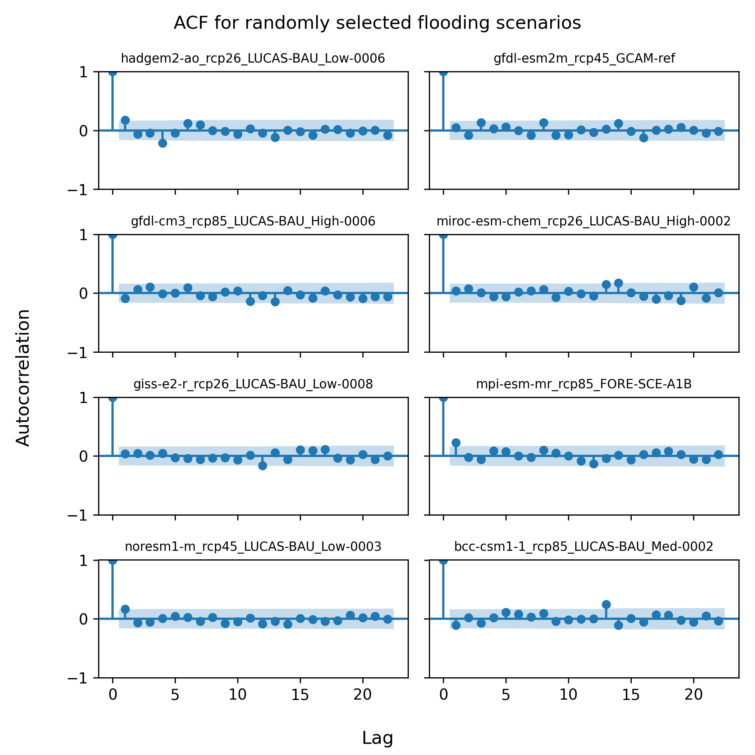
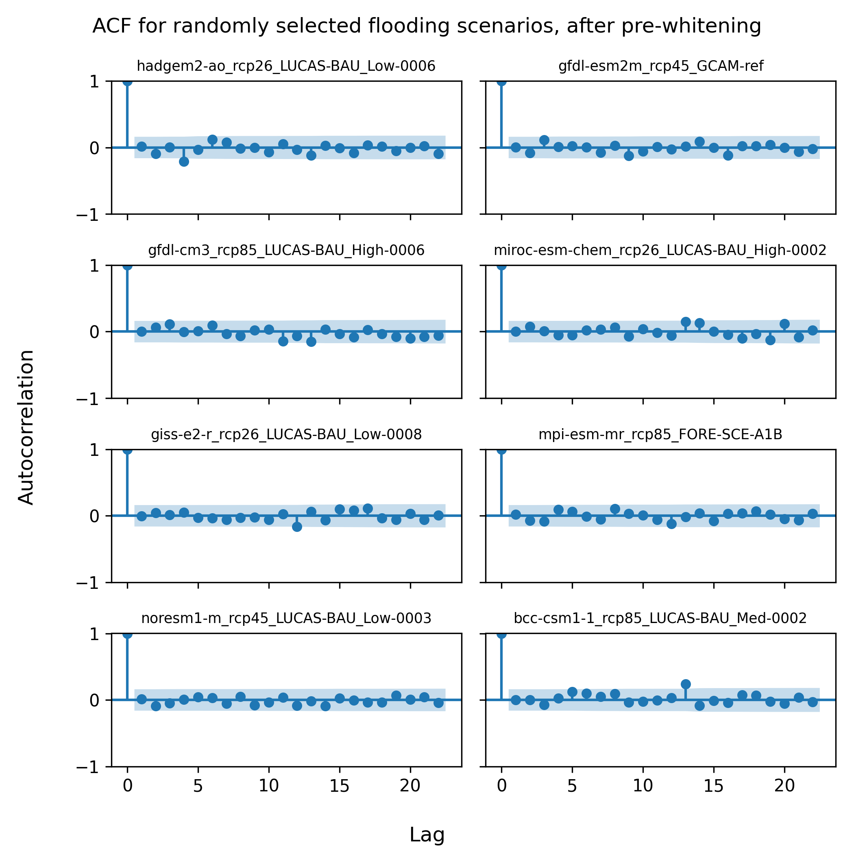
ACF for randomly selected flooding scenarios
No pre-whitening
With pre-whitening

