Slide 1
BIOL 6220: Practical Computing Final Project
Matthew Barnes
Bell Lab
MSB Student

Slide 2
Background Project Information
Consists of an 8 x 3 design of 150-gallon tanks with 18 plants each
Three species in total with treatments of 1,2,3 species per tank plus control
Juncus effusus, Pontederia cordata, and Panicum virgatum
Water source is treated wastewater amended with additional nitrogen and phosphorus
Project goal: Remediate N and P from FTW tanks
Project Objective: To observe whether remediation is additive, synergistic, or antagonistic

Slide 3
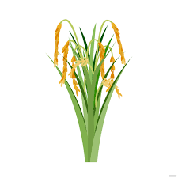




How We Got Here
Data Preparation
Data Collection
Data Modification
Data Analysis

Slide 4
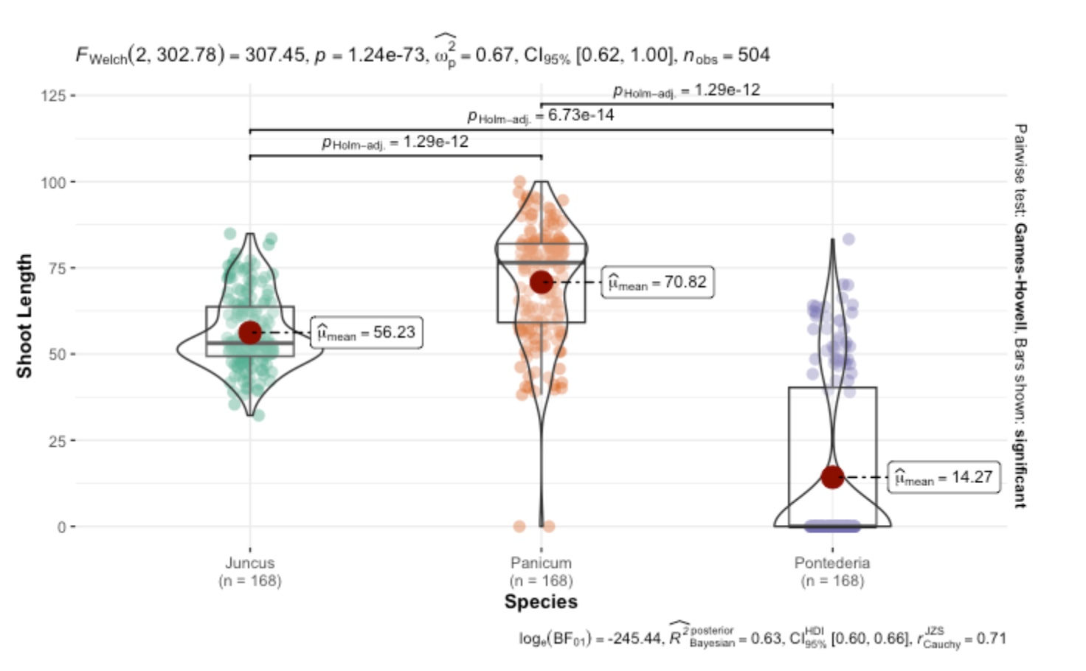
Pairwise Testing
```{r}
plt2 <- ggbetweenstats(
data = gucplant.Aseries,
x = Species,
y = ShootLength,
ylab="Shoot Length"
)
plt2
```

Slide 5
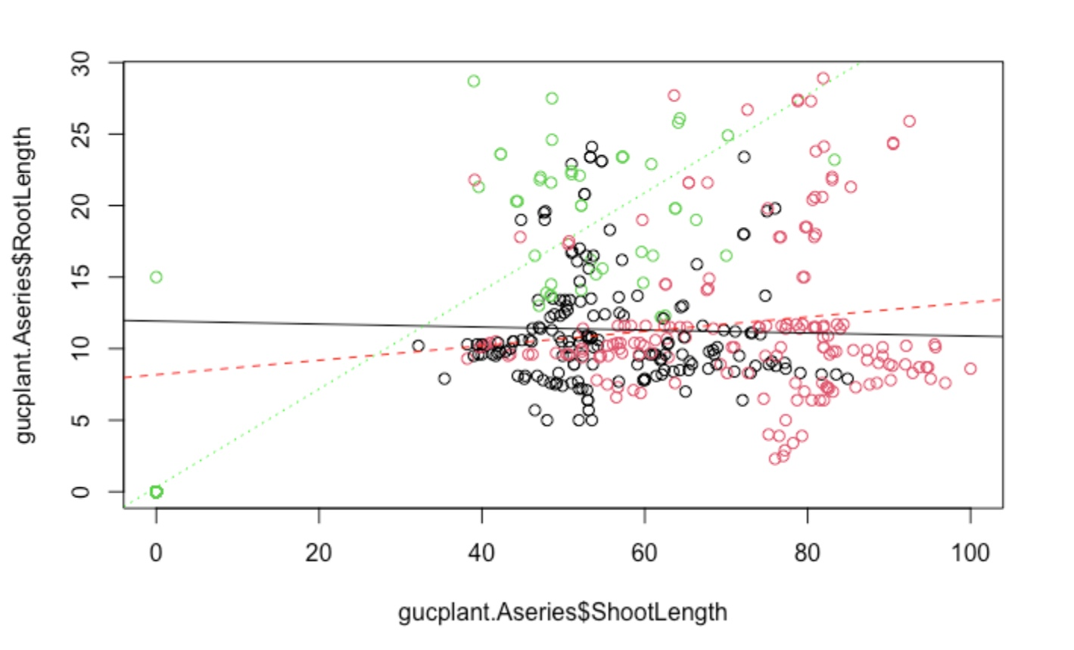
Correlation Plot
‘’’{r}
plot(gucplant.Aseries$RootLength ~ gucplant.Aseries$ShootLength, col=factor(gucplant.Aseries$Species))
Juncus <- gucplant.Aseries[ which(gucplant.Aseries$Species == "Juncus"), ]
Panicum <- gucplant.Aseries[ which(gucplant.Aseries$Species == "Panicum"), ]
Pontederia <- gucplant.Aseries[ which(gucplant.Aseries$Species == "Pontederia"), ]
Juncus.reg <- lm(Juncus$RootLength ~ Juncus$ShootLength)
Panicum.reg <- lm(Panicum$RootLength ~ Panicum$ShootLength)
Pontederia.reg <- lm(Pontederia$RootLength ~ Pontederia$ShootLength)
abline(Juncus.reg, col="black")
abline(Panicum.reg, col="red", lty=2)
abline(Pontederia.reg, col="green", lty=3)
‘’’

Slide 6
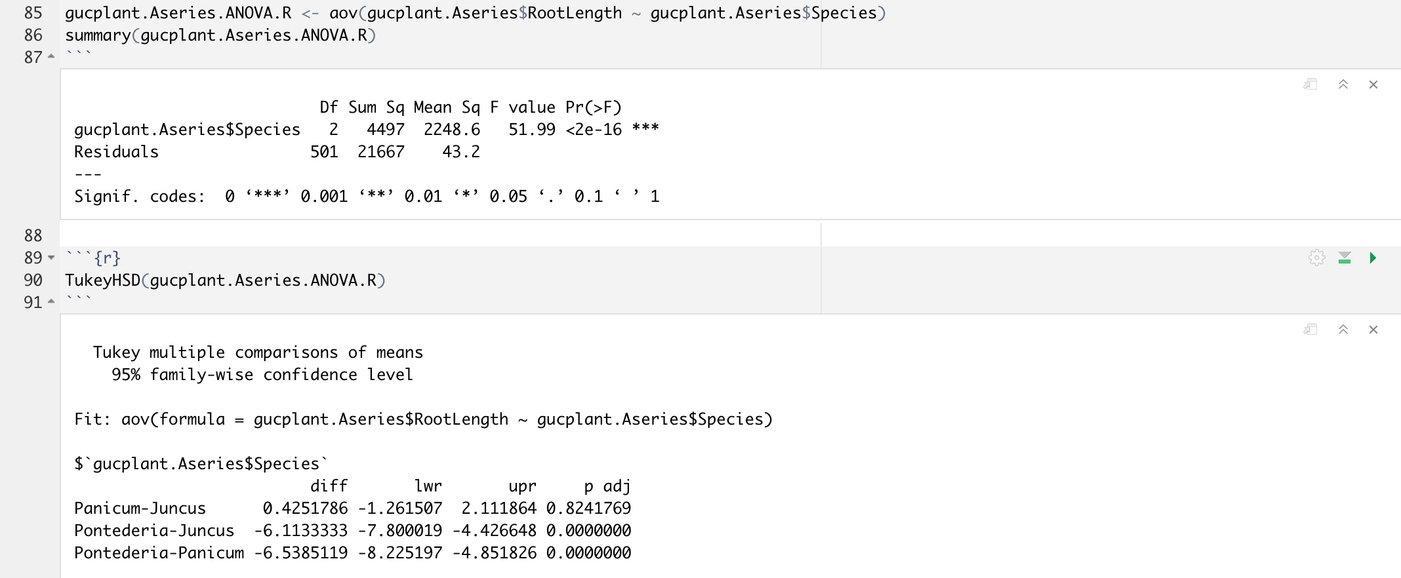
ANOVA and Tukey

Slide 7
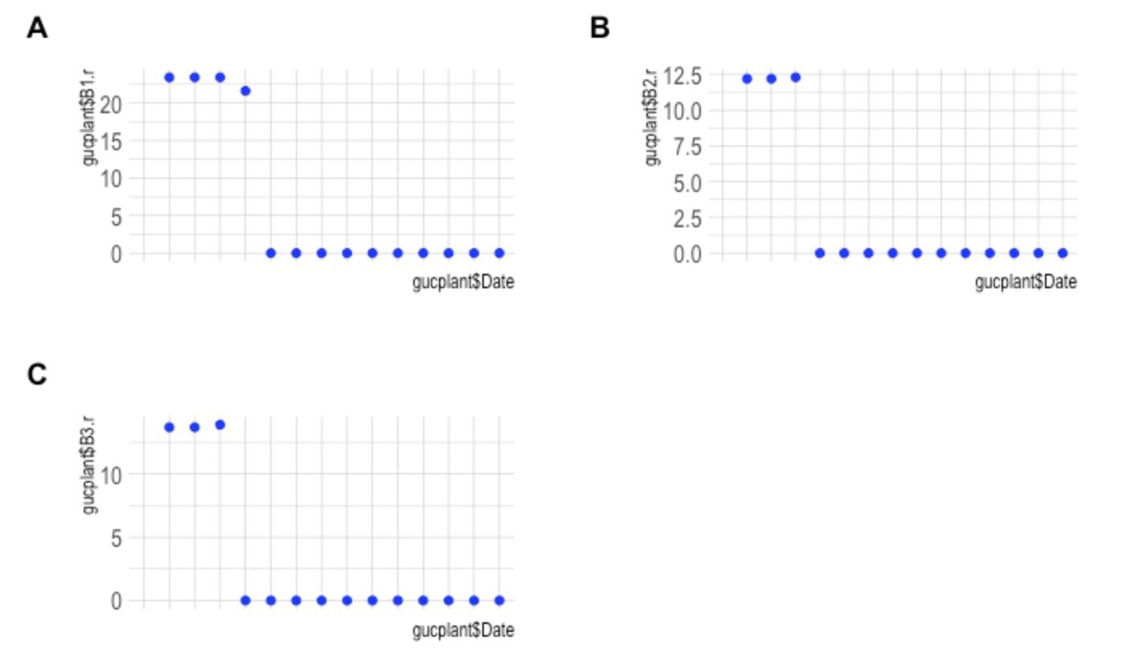
Plotting Growth
‘’’{r}
gucplantbytankB1r <- ggplot(data = gucplant, aes(x=gucplant$Date, y=gucplant$B1.r)) +
geom_point(color="Blue", linewidth=2, alpha=0.9) +
theme_ipsum() +
theme(axis.text.x = element_text(size = 8))
gucplantbytankB1r
ggarrange(gucplantbytankB1r + rremove("x.text"), gucplantbytankB2r + rremove("x.text"), gucplantbytankB3r + rremove("x.text"),
labels = c("A", "B", "C"),
ncol =2, nrow =2)
‘’’

Slide 8
Github
https://github.com/Matt9120/PracComp2022

