Slide 1
Nitrogen and Phosphorus Remediation in Mesocosm Floating Treatment Wetlands receiving Municipal and Aquacultural Wastewater
BIOL 6220: Final Project
Matthew Barnes
Bell Lab
MSB Student

Slide 2
Background Project Information
Consists of an 8 x 3 design of 150-gallon tanks with 18 plants each
Three species in total with treatments of 1,2,3 species per tank plus control
Juncus effusus, Pontederia cordata, and Panicum virgatum
Water source is treated wastewater amended with additional nitrogen and phosphorus
Project goal: Remediate N and P from FTW tanks
Project Objective: To observe whether remediation is additive, synergistic, or antagonistic

Slide 3

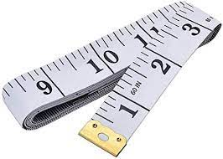



How We Got Here
Data Preparation
Data Collection
Data Modification
Data Analysis

Slide 4
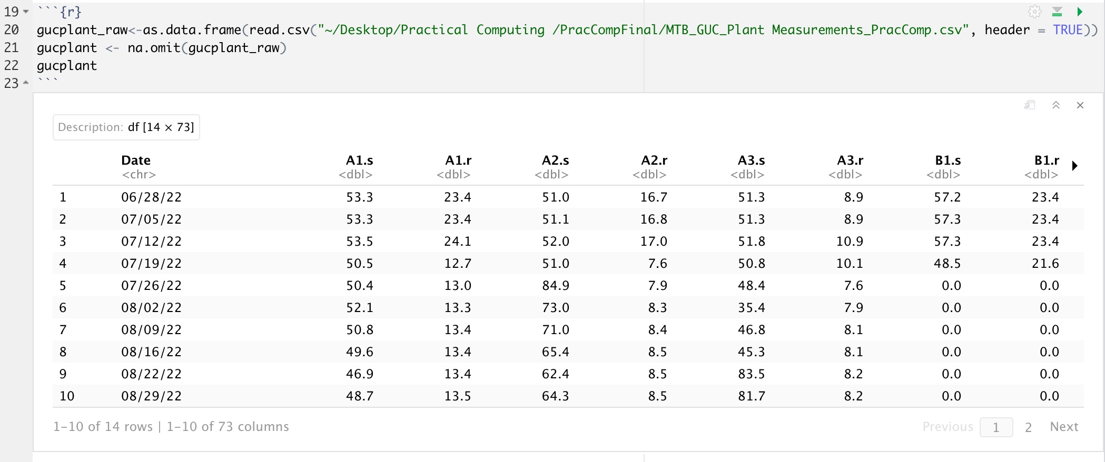
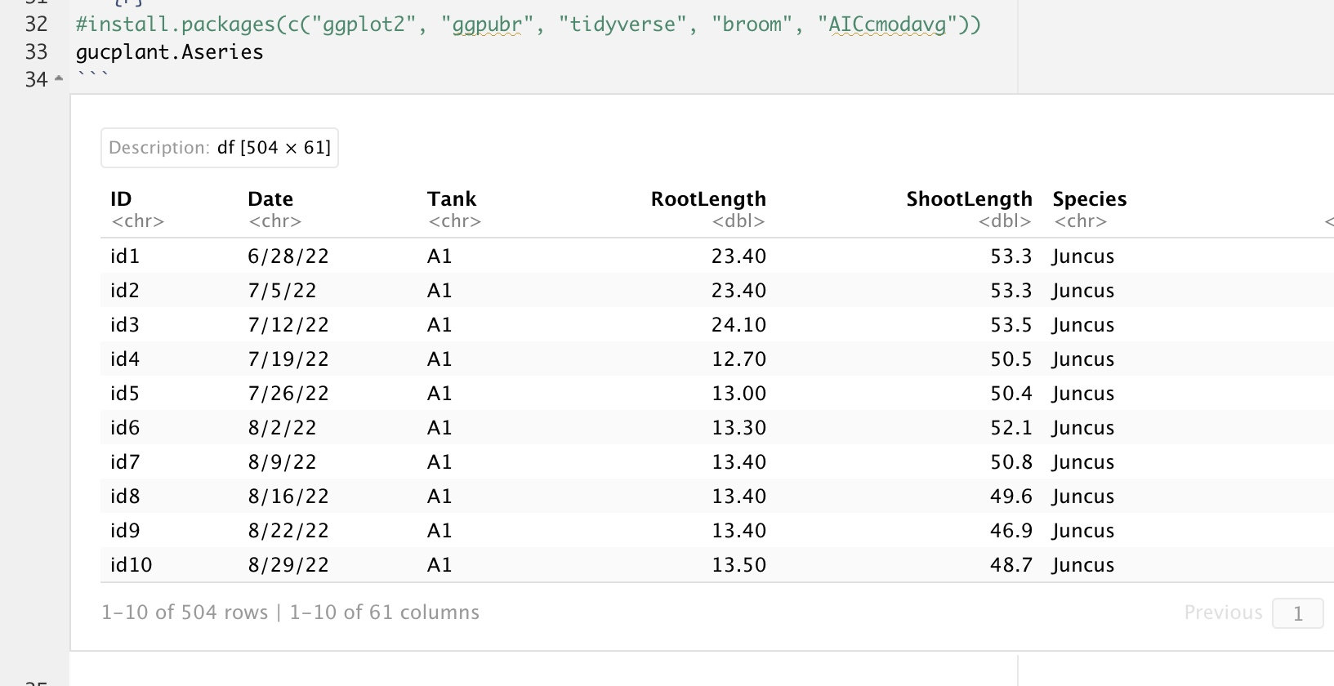
The Data

Slide 5
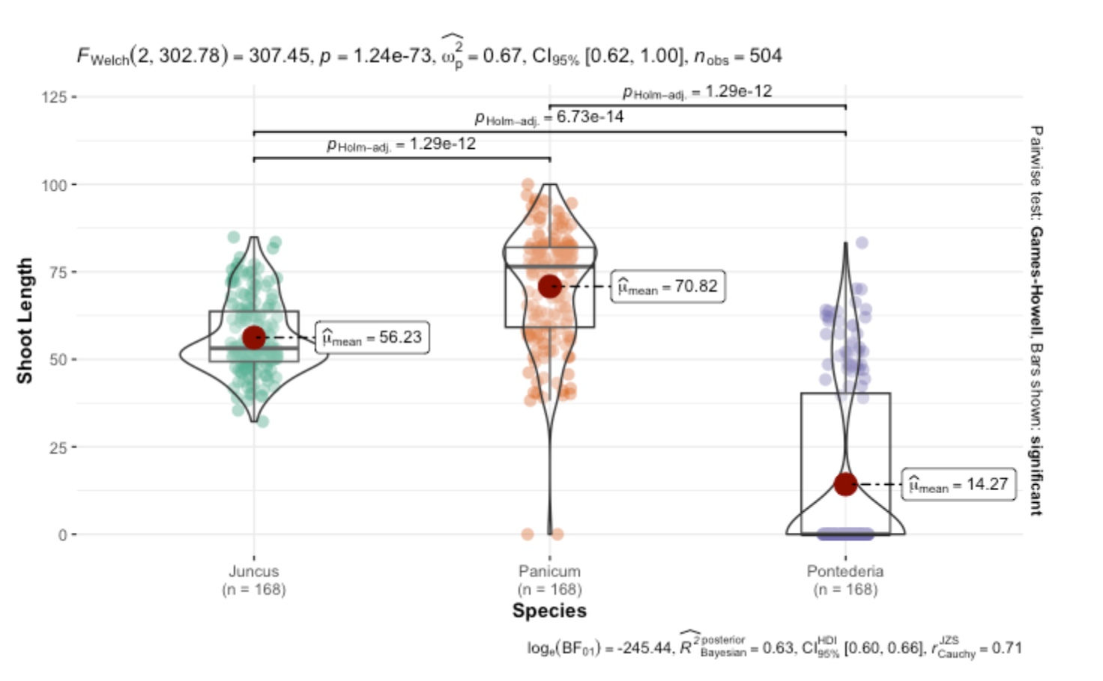
Pairwise Testing
```{r}
plt2 <- ggbetweenstats(
data = gucplant.Aseries,
x = Species,
y = ShootLength,
ylab="Shoot Length"
)
plt2
```
Notes:
The guc.Aseries was brought in again using a pairwise test to compare homogeneity amongst the species. The xlabel was the plant species with the y label being the shoot length for this graph and the root length for the graph below. The function ggbetweenstats() was used for its ability to create publication ready plots with relavent statistical analysis. In this case it was used to create a violin plot, which has the advantage over a traditional box plot by giving an more accurate accurate view on the distribution of the data points. From the graph we can see that each of the species is statistically significant from one another. From the confidence interval given we can say with 95% confidence that the mean of the data set is between 0.62 and 1.00 for this specific measure of plant species against shoot length. The r value can tell us that 71% of the points along the graph can be explained and that their is a positive correlation amongst the datapoints for the graph.

Slide 6
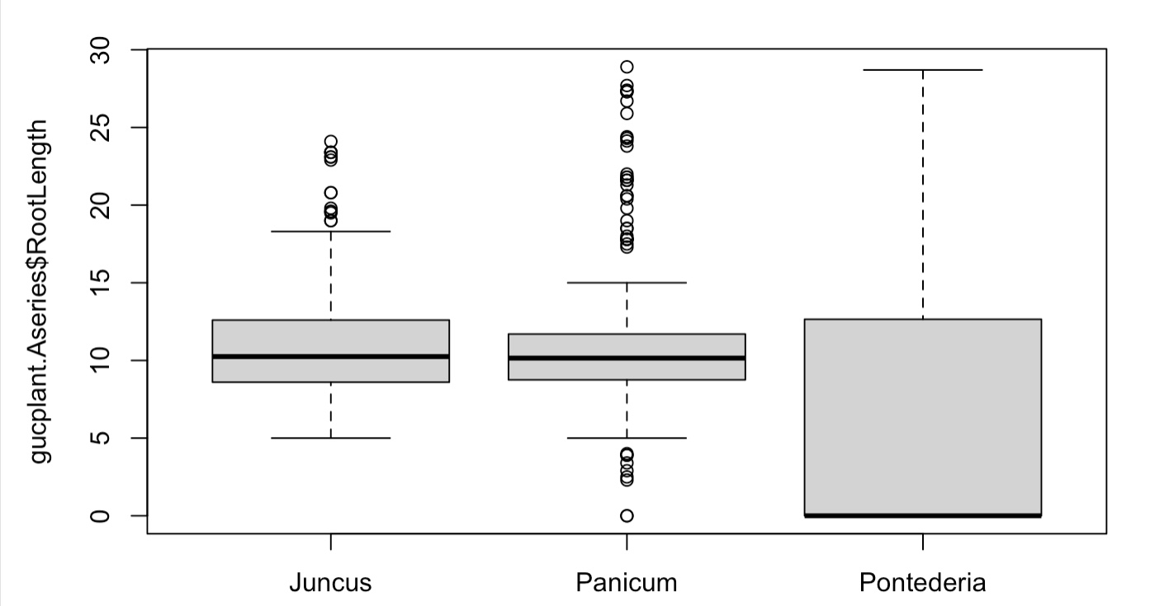
Boxplot
```{r}
boxplot(gucplant.Aseries$RootLength ~ gucplant.Aseries$Species)
```

Slide 7
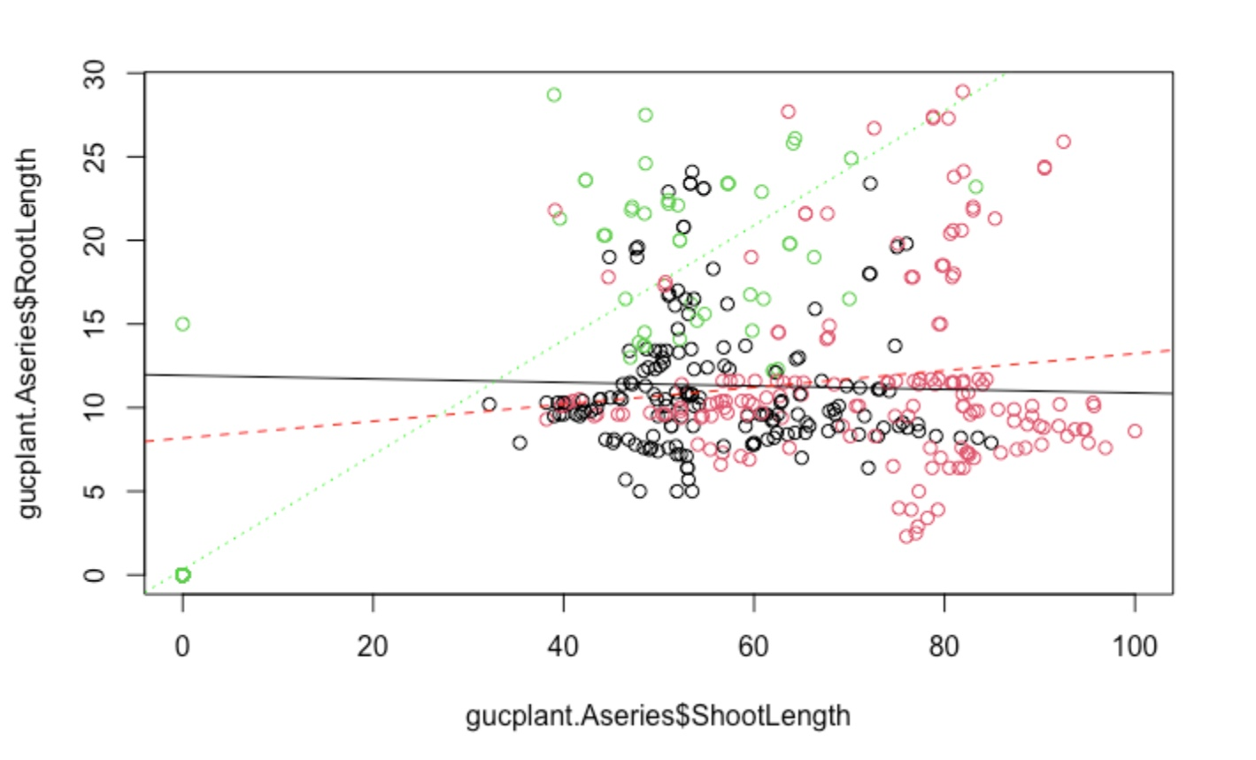
Correlation Plot
```{r}
plot(gucplant.Aseries$RootLength ~ gucplant.Aseries$ShootLength, col=factor(gucplant.Aseries$Species))
Juncus <- gucplant.Aseries[ which(gucplant.Aseries$Species == "Juncus"), ]
Panicum <- gucplant.Aseries[ which(gucplant.Aseries$Species == "Panicum"), ]
Pontederia <- gucplant.Aseries[ which(gucplant.Aseries$Species == "Pontederia"), ]
Juncus.reg <- lm(Juncus$RootLength ~ Juncus$ShootLength)
Panicum.reg <- lm(Panicum$RootLength ~ Panicum$ShootLength)
Pontederia.reg <- lm(Pontederia$RootLength ~ Pontederia$ShootLength)
abline(Juncus.reg, col="black")
abline(Panicum.reg, col="red", lty=2)
abline(Pontederia.reg, col="green", lty=3)
```
Notes:
Plot of roots by shoots to show association between them. One may expect the longer the roots the longer the shoots as that is an indicator of good plant growth and health. Initially where we name the different data was to associate the data based upon what shows up in the csv file. This is the point of the "which" command in where we are saying that everything that has this word or value associated, bring it over. The lm() command was used to create a linear regression of the grouped data. This way we can predict future data based on what we have currently. abline was used to give a line of best fit for the data. This line of best fit estimates the straight line through the data that minimized the distance between it and all the other points within the graph. col= was used ti associate the line with the color previously given to the data with lty= being used to maximize difference between the lines as to not confuse them.

Slide 8
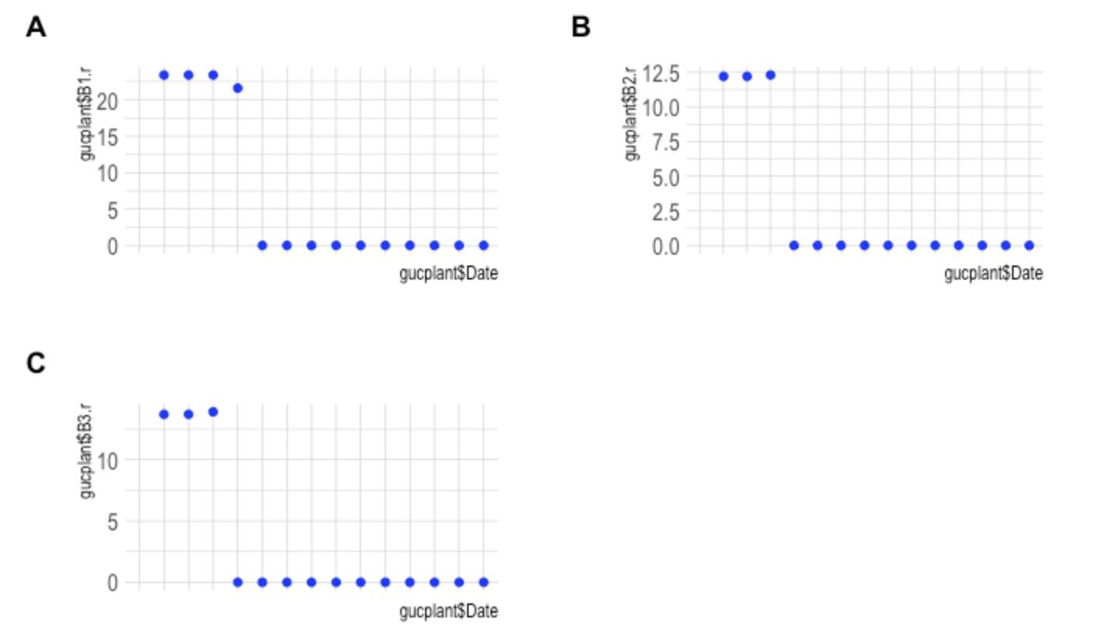
Plotting Growth
```{r}
gucplantbytankB1r <- ggplot(data = gucplant, aes(x=gucplant$Date, y=gucplant$B1.r)) +
geom_point(color="Blue", linewidth=2, alpha=0.9) +
theme_ipsum() +
theme(axis.text.x = element_text(size = 8))
gucplantbytankB1r
ggarrange(gucplantbytankB1r + rremove("x.text"), gucplantbytankB2r + rremove("x.text"), gucplantbytankB3r + rremove("x.text"),
labels = c("A", "B", "C"),
ncol =2, nrow =2)
```
Notes:
ggplot was ran again for a comparison of the overall growth of the roots and the shoots of all species within each tank. For the tanks with multiple plant species the plant species were singled out for individual analysis of their performance in the tanks. geom_point() draws the points defined by the x and y variables previously defined and can give them specifics on how they are presented on the graph. Within geom point we can give the points color (color=), tell it how big to make the points (linewidth=), annd the opacity of the points on a scale from 0-1 (alpha=). Within the ggpubr library we get the ggarrange function which allows for the graphs to be placed within a single page to be displayed at the same time. rremove allowed for the removal of the x labels that would have otheriwse been to jumbled to read. The label function gives a name to each graph (tank 1 is "a", tank 2 is "b" and tank 3 is "c") on the page while the ncola and nrow lays out the grid of how the graphs show up. In this case it is a 2x2 pattern.

Slide 9
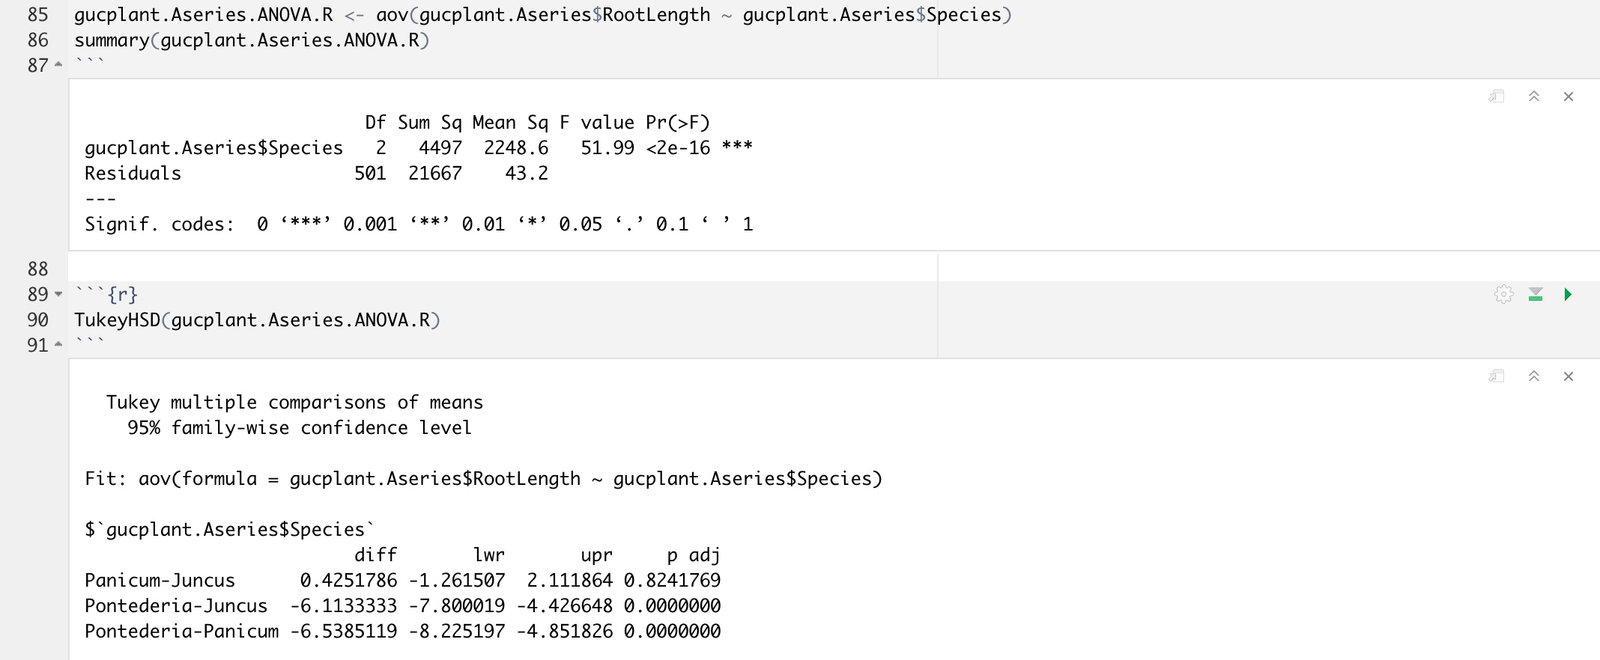
ANOVA and Tukey for Species x Species
Notes:
Anova was the next form of data to calculate. This is useful for testing three or more variables at a time, which in this case we have three plant species so this is perfect. This is similar to a two sample t-test, but with ANOVA we are likely to have fewer type 1 errors than the t-test. Within the anova shoot length was tested by species to see if the data is statistically significant from one another. Based on the p-value the data does come back as statistically significant but with ANOVA, it cannot give specifics as to which set of data it is, which is why a Tukey test was run next to compare datasets.

Slide 10
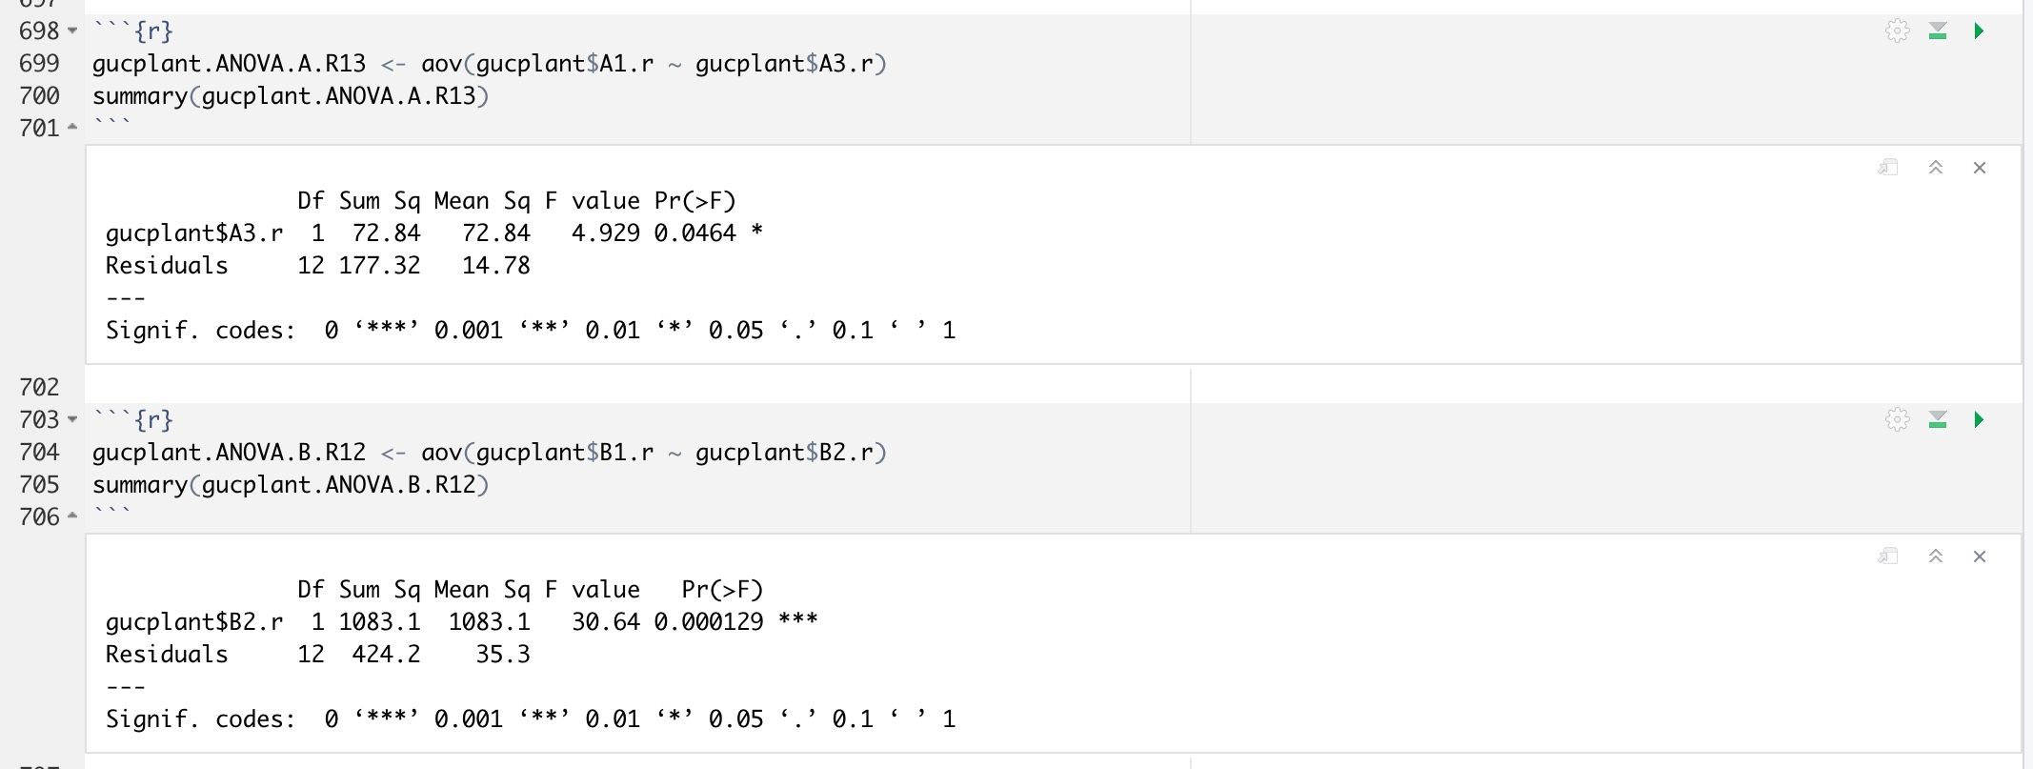
Anova for Tank x Tank
Notes:
ANOVA was used again to test the association between plants within the same treatment and eventually further down the file between tanks. Within the ANOVA function using aov() you can set up specfic columns within the dataframe as seen here by gucplant$A1.s ~ gucplantA2.s. Within these ANOVA tests, specifically this one here, the p-value is 0.533 but the f-value can be considered small at 0.412. This shows that the data within this specific ANOVA is not statistically different from one another.

Slide 11
Summary
Correlation plot I believe provided the best understanding visually of the data
The growth plots allowed for views on growth over the season
ANOVA allowed for ease of comparison amongst the species as well as between individual comparisons of the species within the tanks
What to change: organizing data differently initially, run more statistical tests to see what else is statistically significant amongst the data

Slide 12
Github
https://github.com/Matt9120/PracComp2022

