Slide 1
Adding I/O to the Raspberry Pi with a PIC32 Microcontroller and SPI
Matt Bennett

Slide 2
Who am I?

Slide 3
Who Am I?
Matt Bennett
FAE in Austin, Texas
I play with electronics
Not associated with the Raspberry Pi® Foundation

Slide 4
What is the Raspberry Pi®

Slide 5
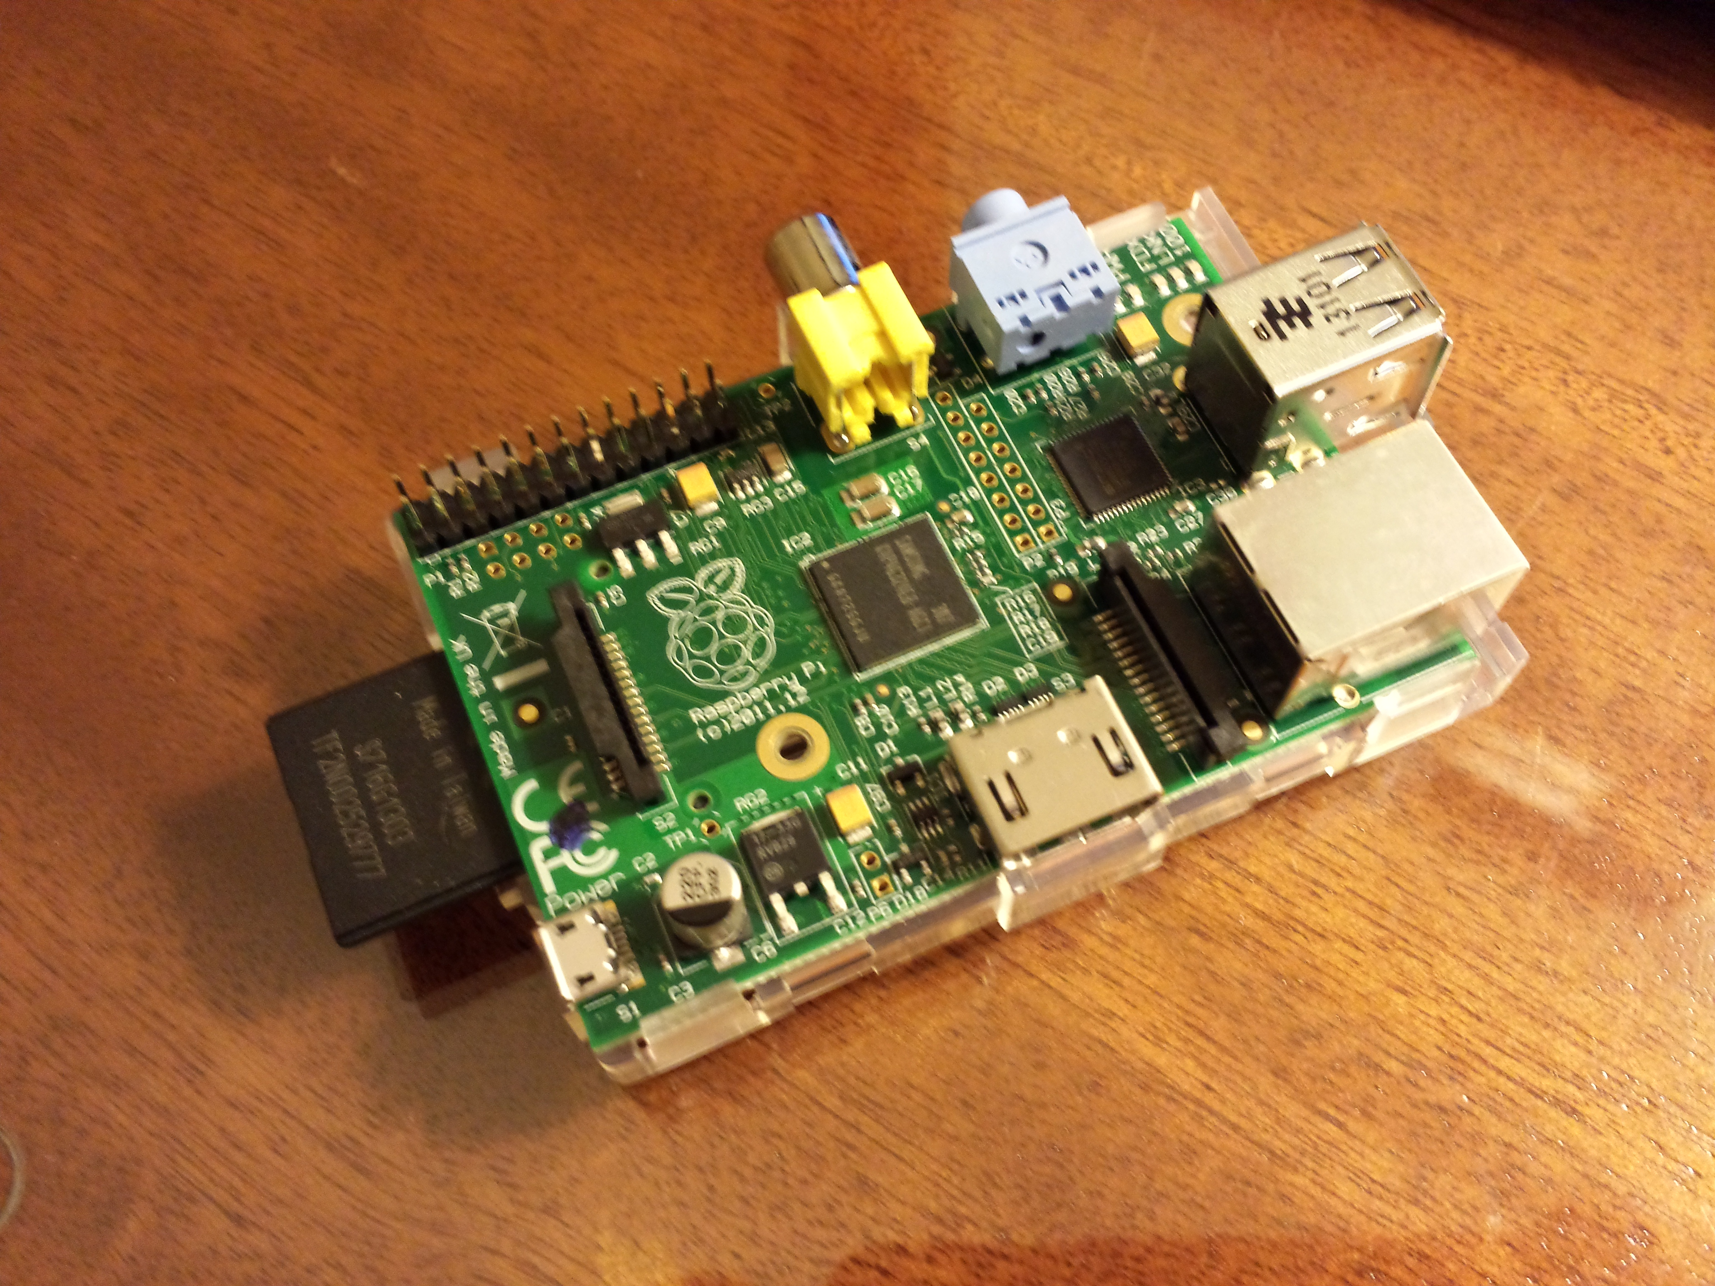
Raspberry Pi®
Raspberry Pi is a trademark of the Raspberry Pi Foundation

Slide 6
Raspberry Pi®
Credit card sized computer
Designed by Raspberry Pi Foundation
Teach basic computer science in schools
$35
Can run Linux
Programmed in Python, C

Slide 7
Raspberry Pi® Components
Processor
  Broadcom BCM2835 (ARM)
512K RAM (Current Model)
USB & Ethernet
  SMSC LAN9592 PHY

Slide 8
Raspberry Pi® Features
700 MHz Processor (overclockable)
GPU
SD Card filesystem
HDMI or Composite Video Output
Ethernet
I/O Header
  I2C
  SPI
  GPIO
LOW COST

Slide 9
Introducing
TRISThis

Slide 10
What is TRISThis
A goofy name from years ago
A Board that is designed to work with the Raspberry Pi®
Open Source Hardware
Open Source Software
NOT FOR SALE
Uses Microchip Parts, but not a Microchip Project

Slide 11
Why The TRISThis
No mounting holes
Not enough LEDs
No Analog inputs
Inputs not protected
Power supply mechanism is poor

Slide 12
What does TRISThis DO?
Powers the Raspberry Pi®
  Standard 9V supply works (can use higher or lower voltage)
^{Measures the input current}
^{Protected Digital I/O}
^{Analog Inputs}
  ^{Buffered}
  Digipots used in signal conditioning

Slide 13
Why?
I'm learning
I'm sharing
I'm learning how to do a open project in a collaborative manner
Giving back to the community

Slide 14
How?
Open source or low cost tools
  (as much as possible)
Linux
  MPLAB X
  Design in Eagle freeware version (goal)
    Single schematic sheet (2 sheets now)
    2 layer board
    4x3.2” max
Git revision control
  Free Project hosting for open source
  https://github.com/MattAtHazmat/TRISThis

Slide 15
TRISThis Hardware
Gerbers available
Used BatchPCB for original boards
  Unfortunately, no longer around, but there are alternatives
  Service would create non-rectangular boards

Slide 16
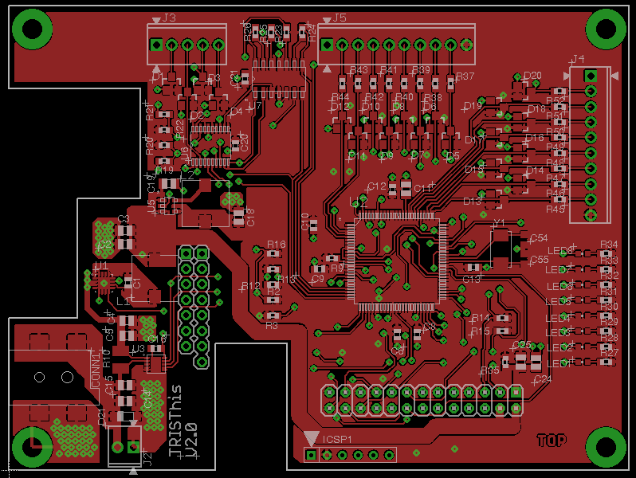
Latest Layout

Slide 17
What's TRISThis have?

Slide 18
Processor
PIC32MX795F512L
  Way overkill
  Large Memory
    128KB RAM
    512KB Program
    80 MIPs
  Peripherals

Slide 19
Input Current Measurement
PAC1710
  High-Side Current Sense Monitor with Power Calculation
  Measures input current across a shunt
  I2C

Slide 20
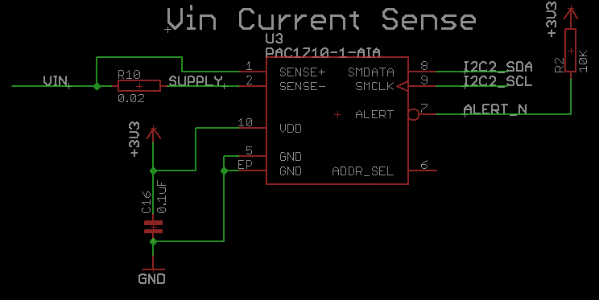
Input Current Measurement Schematic

Slide 21
Input Regulator
MCP16322
  24V Input, 1A/2A Output, High Efficiency Synchronous Buck Regulator
Input 6.0V to 24V
Fixed 5V output
Max 2A output

Slide 22
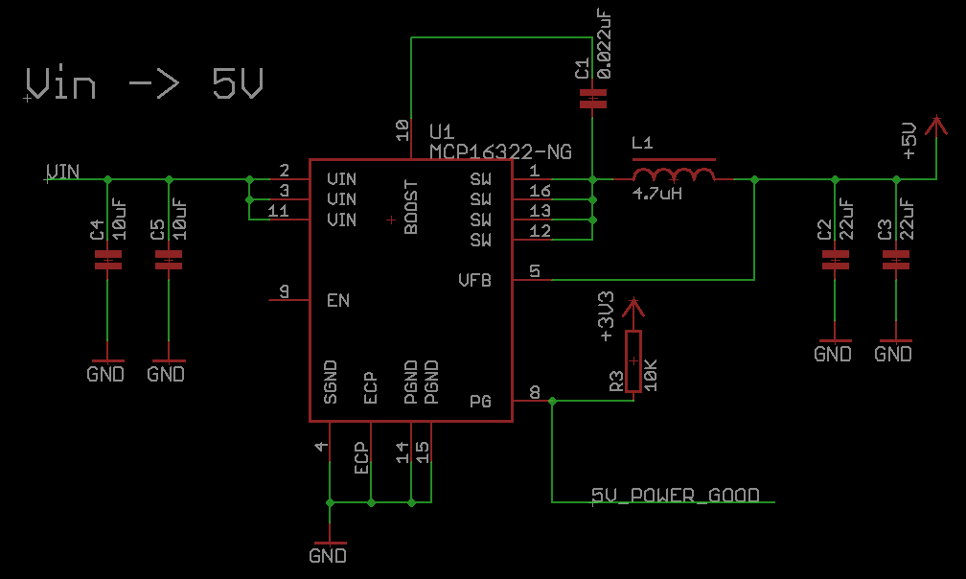
Input Regulator Schematic

Slide 23
5V to 3.3V Regulator
MCP1603
  500 mA 2.0 MHz synchronous buck regulator
Powers TRISThis board
Provision to replace 3.3V regulator on Raspberry Pi®

Slide 24
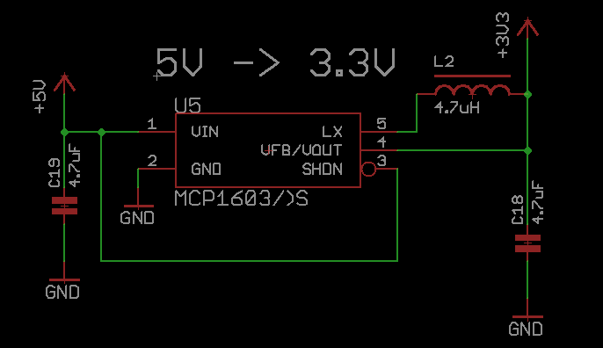
5V to 3.3V Regulator Schematic

Slide 25
Analog Input Conditioning
MCP6074
  Op Amp
MCP4461
  I2C Digipot

Slide 26
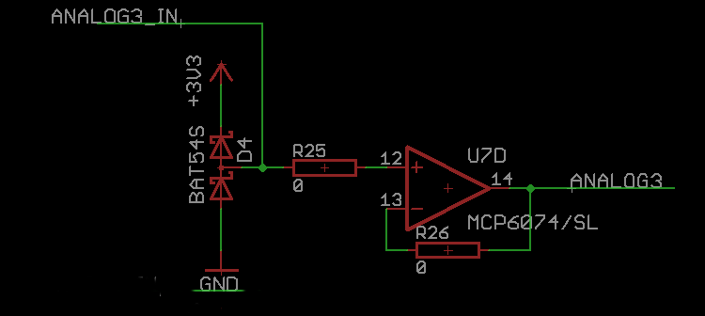
Input Follower Schematic

Slide 27
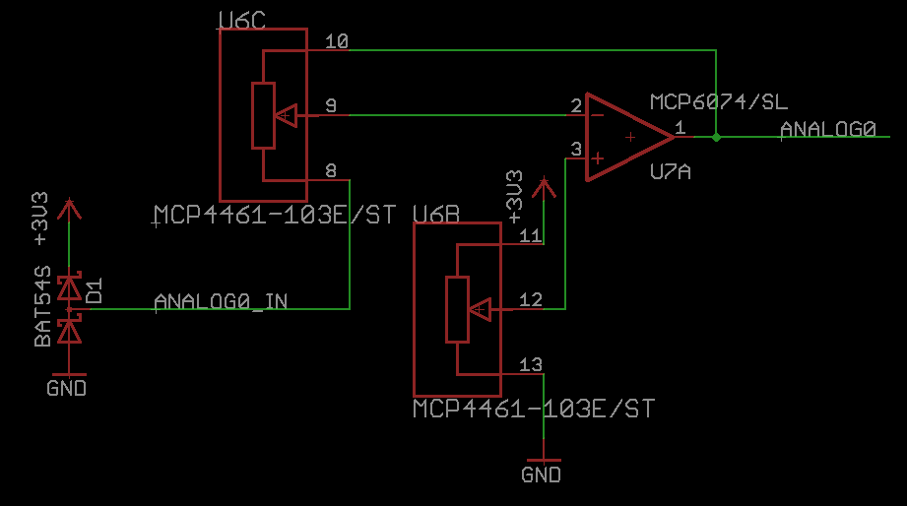
Adjustable Input Buffer Schematic

Slide 28
Interface to Raspberry Pi®
Power
  5V to Raspberry Pi®
SPI
I2C
JTAG
  Raspberry Pi® has capability of programming/debugging PIC32 over JTAG

Slide 29
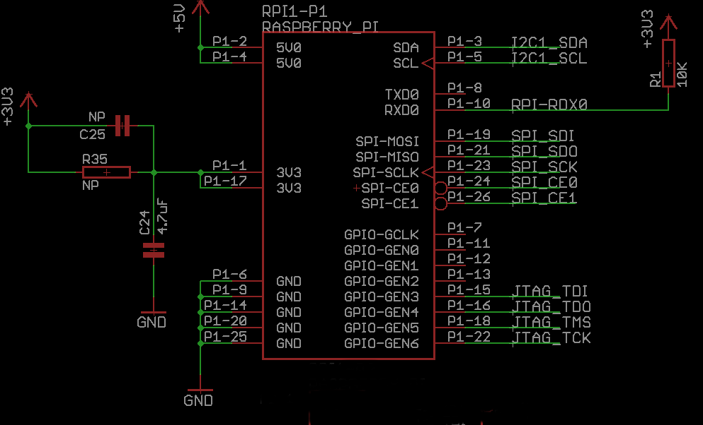
Interface to Raspberry Pi® Schematic

Slide 30
What's Working So Far?

Slide 31
Progress
Power supplies
LEDs
  Blinking under full control!
I2C
  PIC32 Master talking to PAC1710 Slave
SPI
  Raspberry Pi® Communication to PIC32 via SPI in development

Slide 32
How about on the Raspberry Pi®?

Slide 33
Raspberry Pi® Code?
Not much, so far
SPI communication to PIC32 used for testing interface
Hope to Implement FreeRTOS

Slide 34
Want to Help?

Slide 35
Join in!
Follow TRISThis project on Github
  https://github.com/MattAtHazmat/TRISThis
Build a board
  Build/Customize/Sell- do what you want it is a non-restrictive open license
Push contributions back to repository
  Share
  Learn
  Give

Slide 36
Not associated!
TRISThis is not an official Microchip Project
TRISThis is not associated with the Raspberry Pi Foundation
  Every effort is being made to work within trademarks and existing licenses. If there is anything overlooked, please inform Matt
As this is not a Microchip project, for questions related to TRISThis, please contact me via my personal email, matt.bennett@gmail.comI will reply evenings/weekends.

Slide 37
TRISThis for Raspberry Pi®
Power Supply
PIC32 I/O Processor
  16 I/O
  Analog Inputs
  LEDs
Mounting Holes!
Open Source

Slide 38
Thank you!

Slide 39
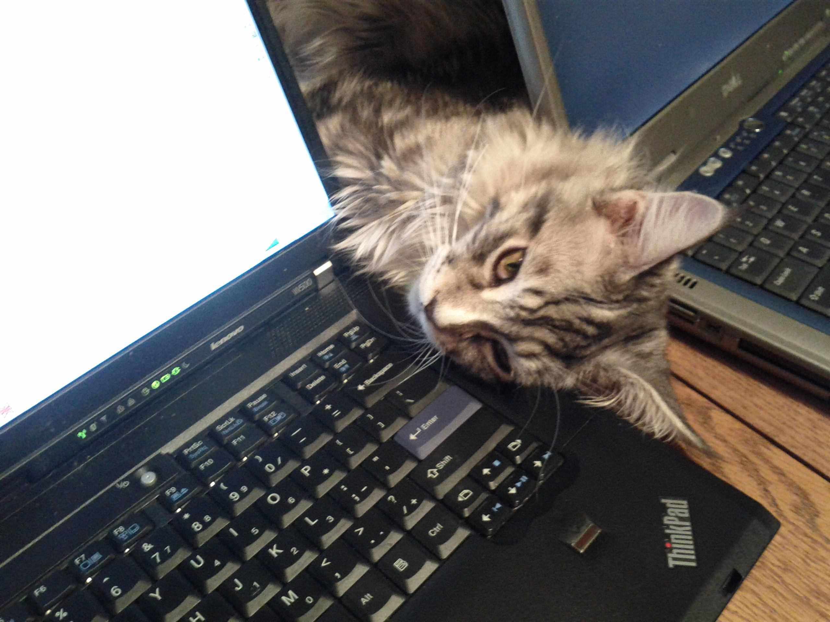
KITTY!

