Slide 1
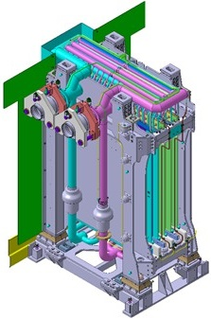
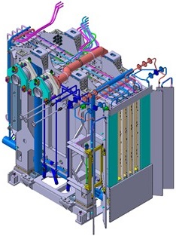
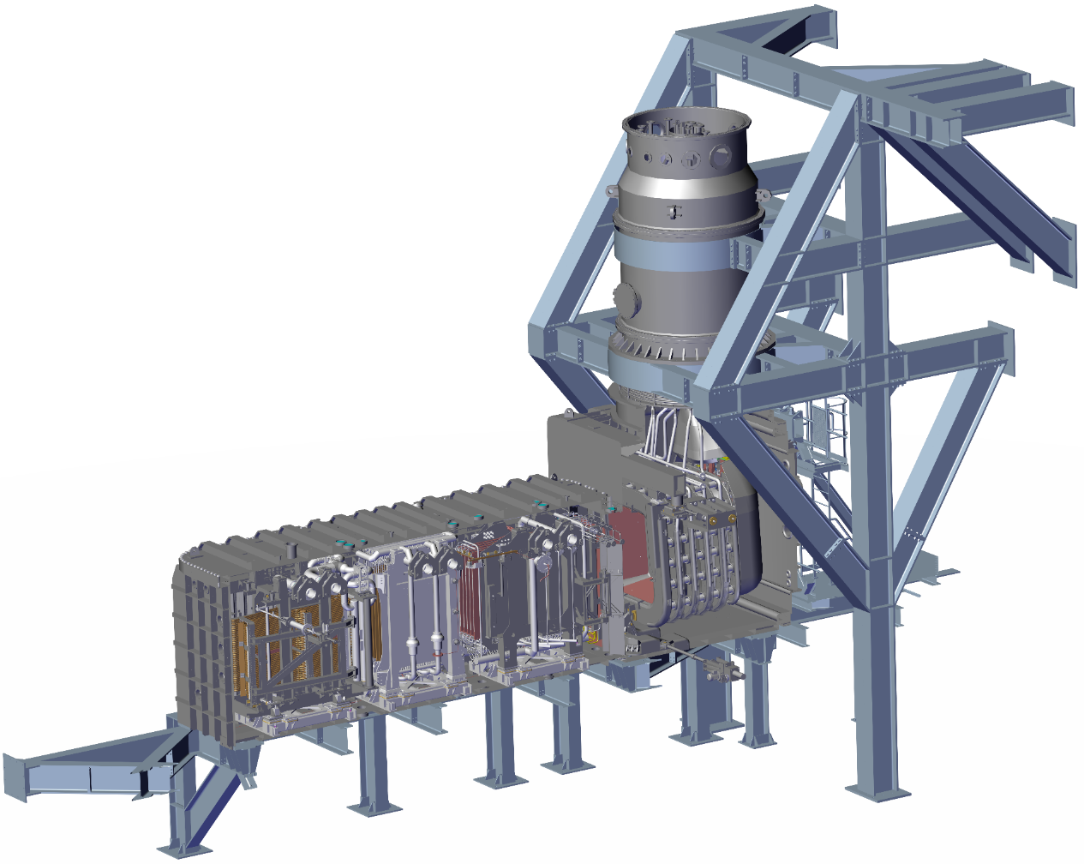
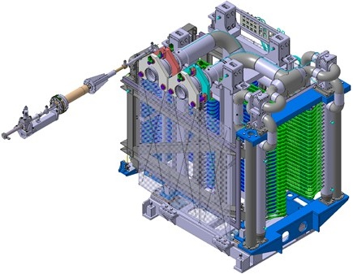
NEUTRALIZER
RESIDUAL ION DUMP
CALORIMETER

Slide 2
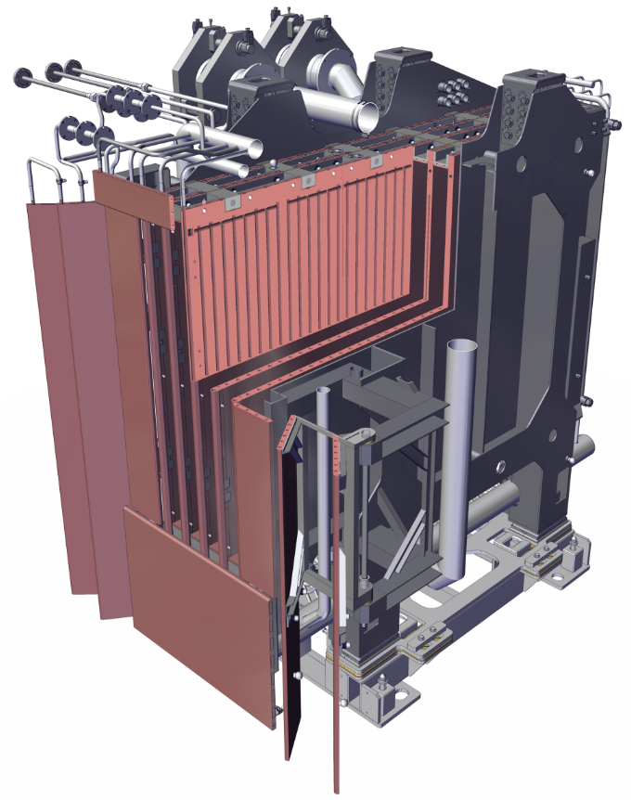
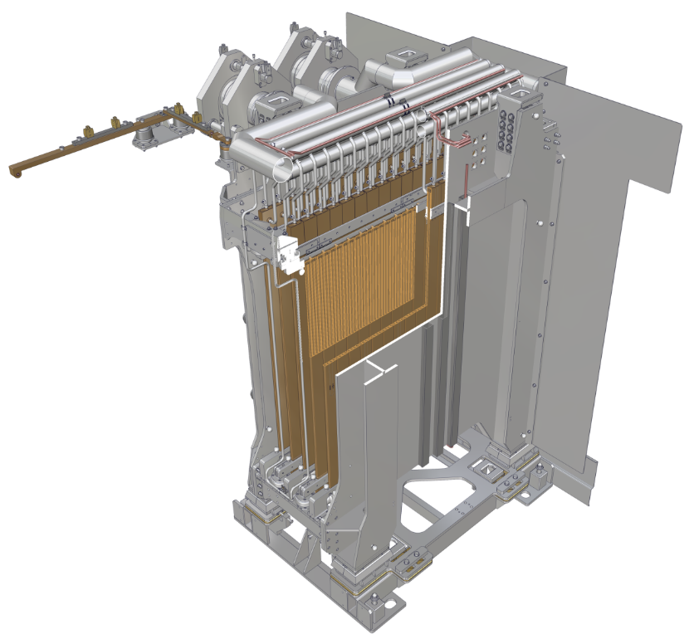
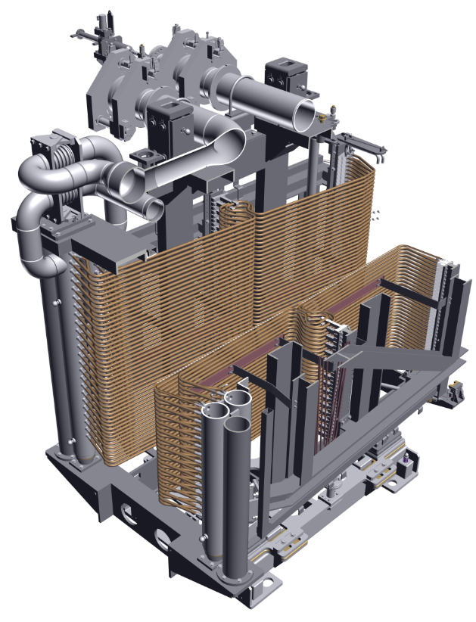
Descrizione sistema
1 m
Neutralizer
(NED)
massa: 13 t
3.4m (L) x 2.1m (W) x 3.2m (H)
Residual Ion Dump
(ERID)
massa: 7.5 t
2.2m (L) x 2.1m (W) x 3.2m (H)
Calorimeter
(CAL)
massa: 6.1 t
3.0m (L) x 2.1m (W) x 3.2m (H)

