Slide 1
NBA post season performers
Matthew Blackley
Advisors: Dr. Fellingham, Dr. Fisher, and Dr. Page

Slide 2


NBA season
Previous Playoff System
82 Regular Season Games
Top 8 teams from each conference
Best of 5 or 7 game series
Current Playoff System
82 Regular Season Games
4 Play-in teams for each conference
Top 6 of each conference and 2 winners of Play-in games
Best of 7 game series

Slide 3

Concept
Certain players perform better in the playoffs and others in the regular season

Slide 4
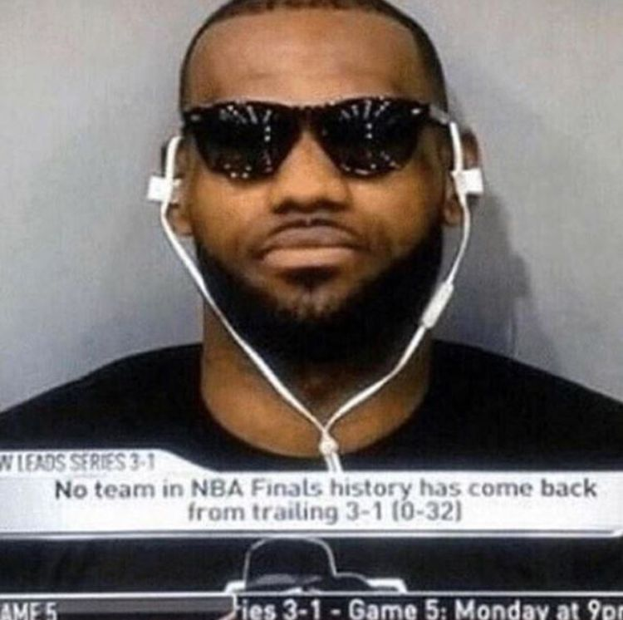

Examples
Steph Curry
Karl Malone
Chris Paul
Kobe Bryant
Michael Jordan
LeBron James

Slide 5
Web Scraping
Large amount of time spent web scraping
Basketball Reference
Scraped 3-4 major teams from every decade starting in the 80s
Adjusted Season VORP was calculated for each player every year

Slide 6
Metric
VORP (Value Over Replacement Player)
Box-score estimate of points scored during 100 team possessions compared to an “average” team
Box-score -- points scored and given while on court
Possession -- team has the ball and results in made shot or the other team with the ball
Season metric
Time played
Game by game metric
Adjusted Game VORP = Season VORP * (min played/ available min)

Slide 7

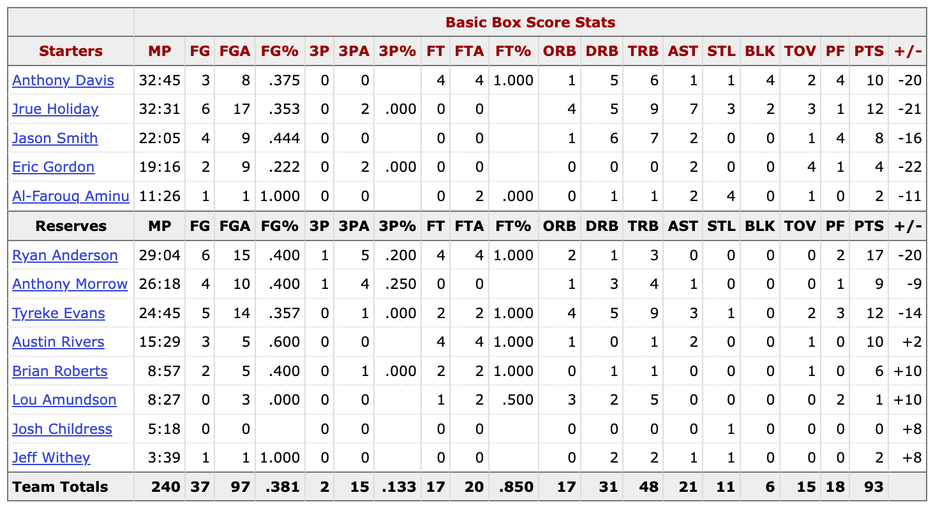

Slide 8
Metric
VORP (Value Over Replacement Player)
Box-score estimate of points scored during 100 team possessions compared to an “average” team
Box-score -- points scored and given while on court
Possession -- team has the ball and results in made shot or the other team with the ball
Season metric
Time played
Game by game metric
Adjusted Game VORP = Season VORP * (min played/ available min)

Slide 9

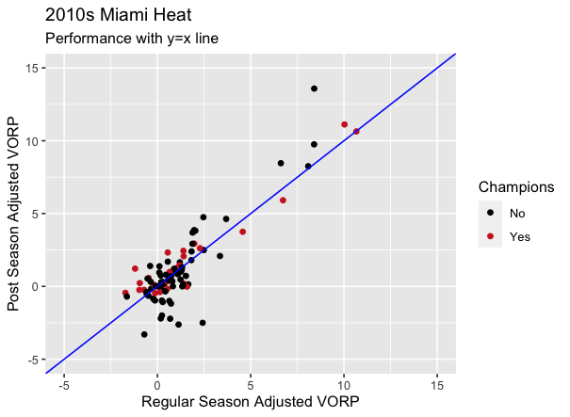
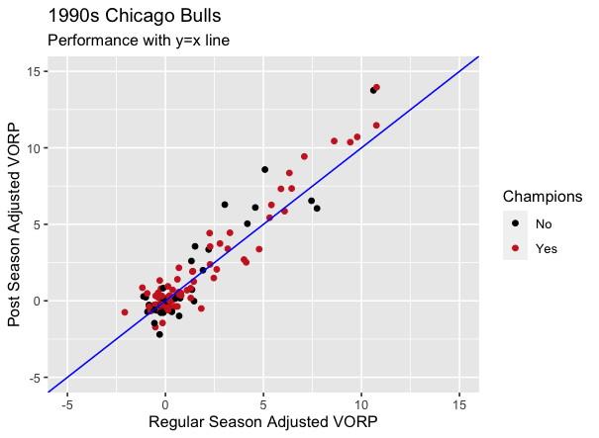
EDA

Slide 10
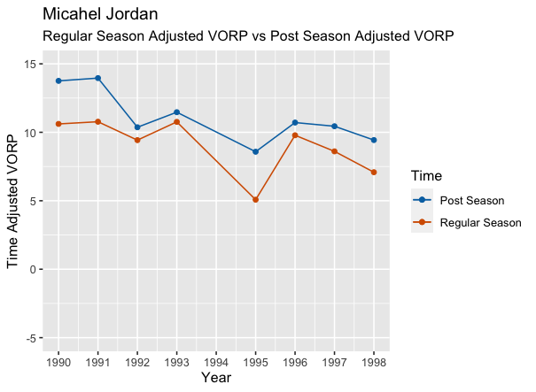
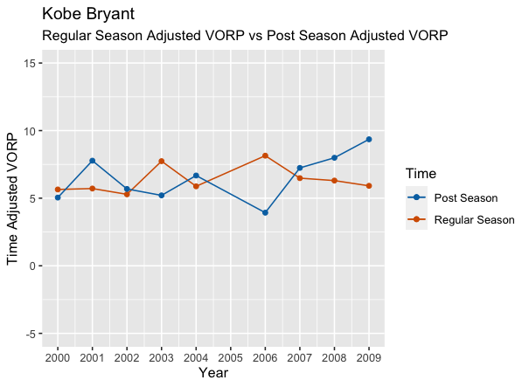
EDA

Slide 11
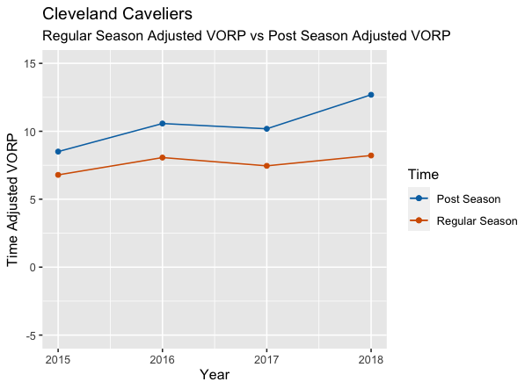
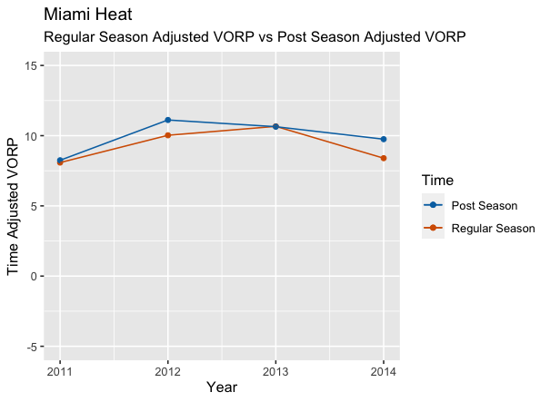
Lebron James

Slide 12
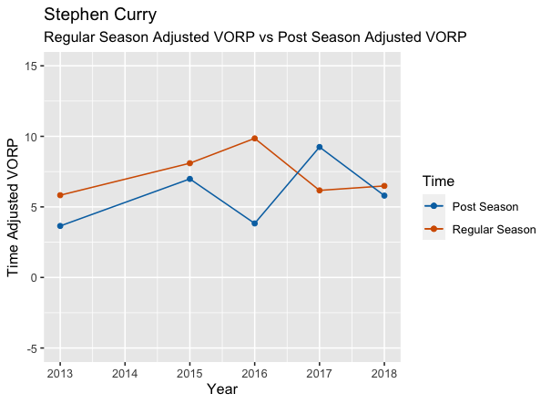
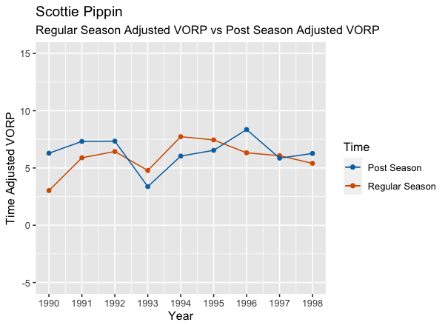
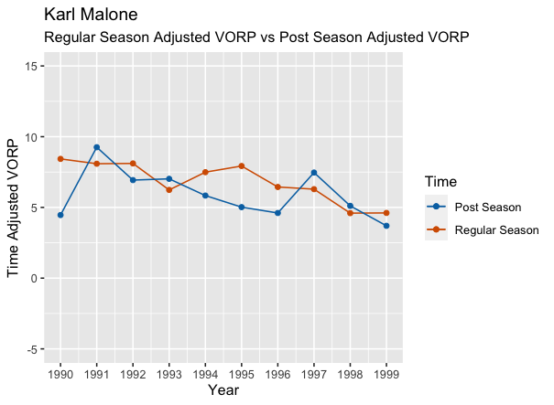
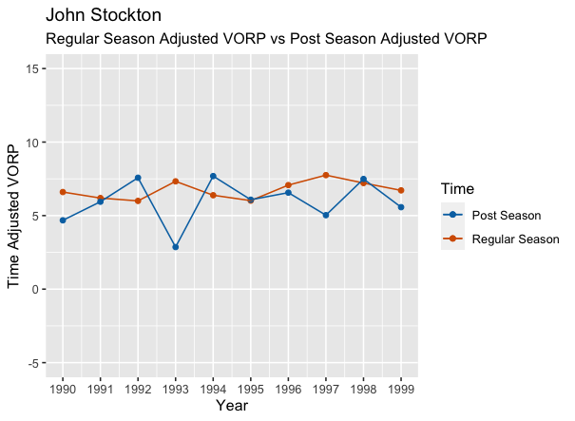
EDA

Slide 13
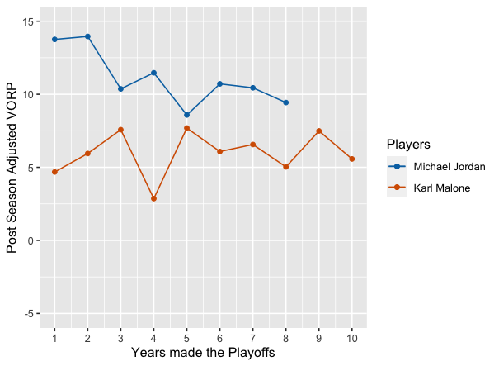
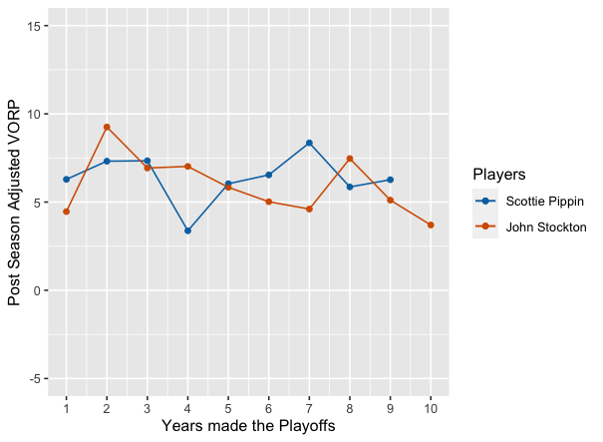
EDA

Slide 14
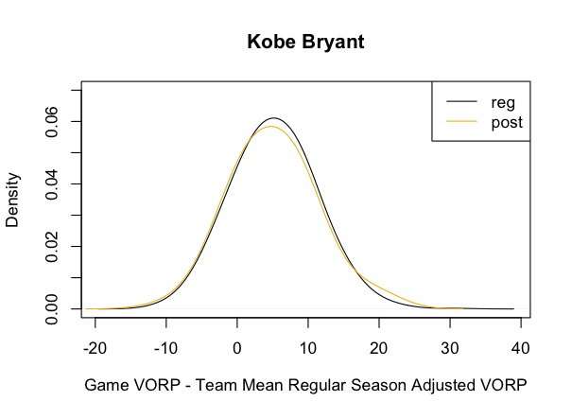
Eda

Slide 15
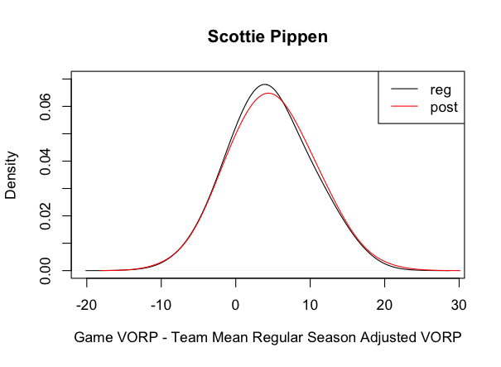
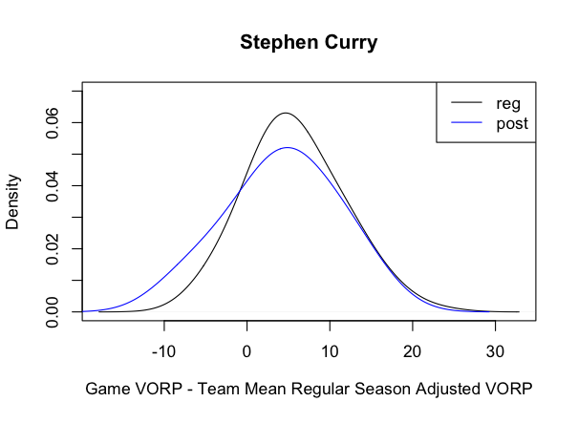
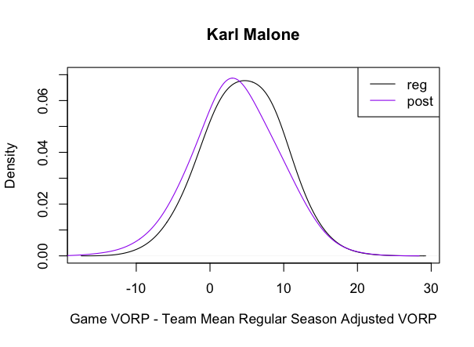
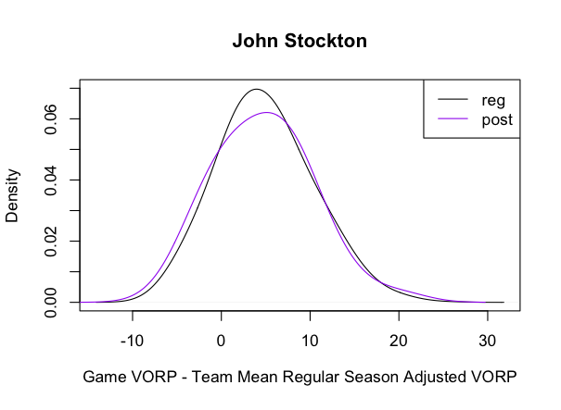
Eda

Slide 16
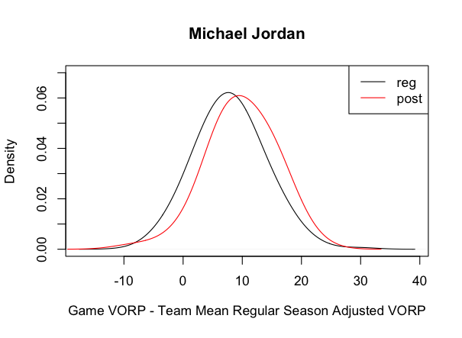
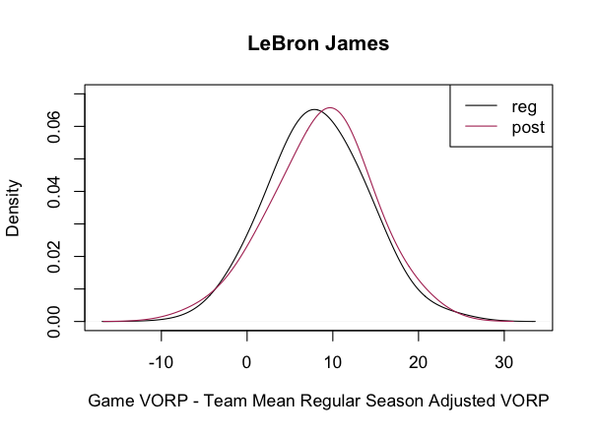
Eda

Slide 17
Future Research
See if Adjusted VORP can predicted playoff performance and winner
Scrape over specific player’s careers
Compare performance to league average adjusted VORP rather than team
Find and use variances on analyses

Slide 18
Questions?

