Slide 1



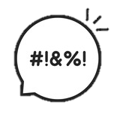
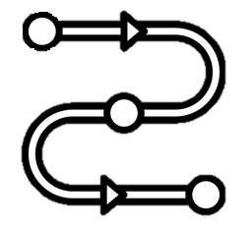
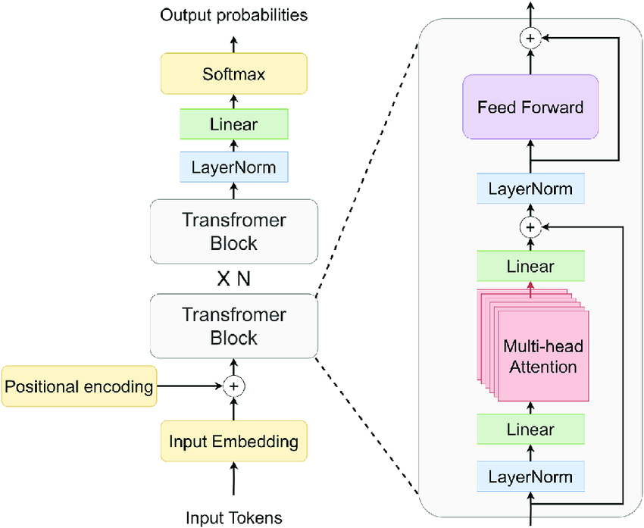
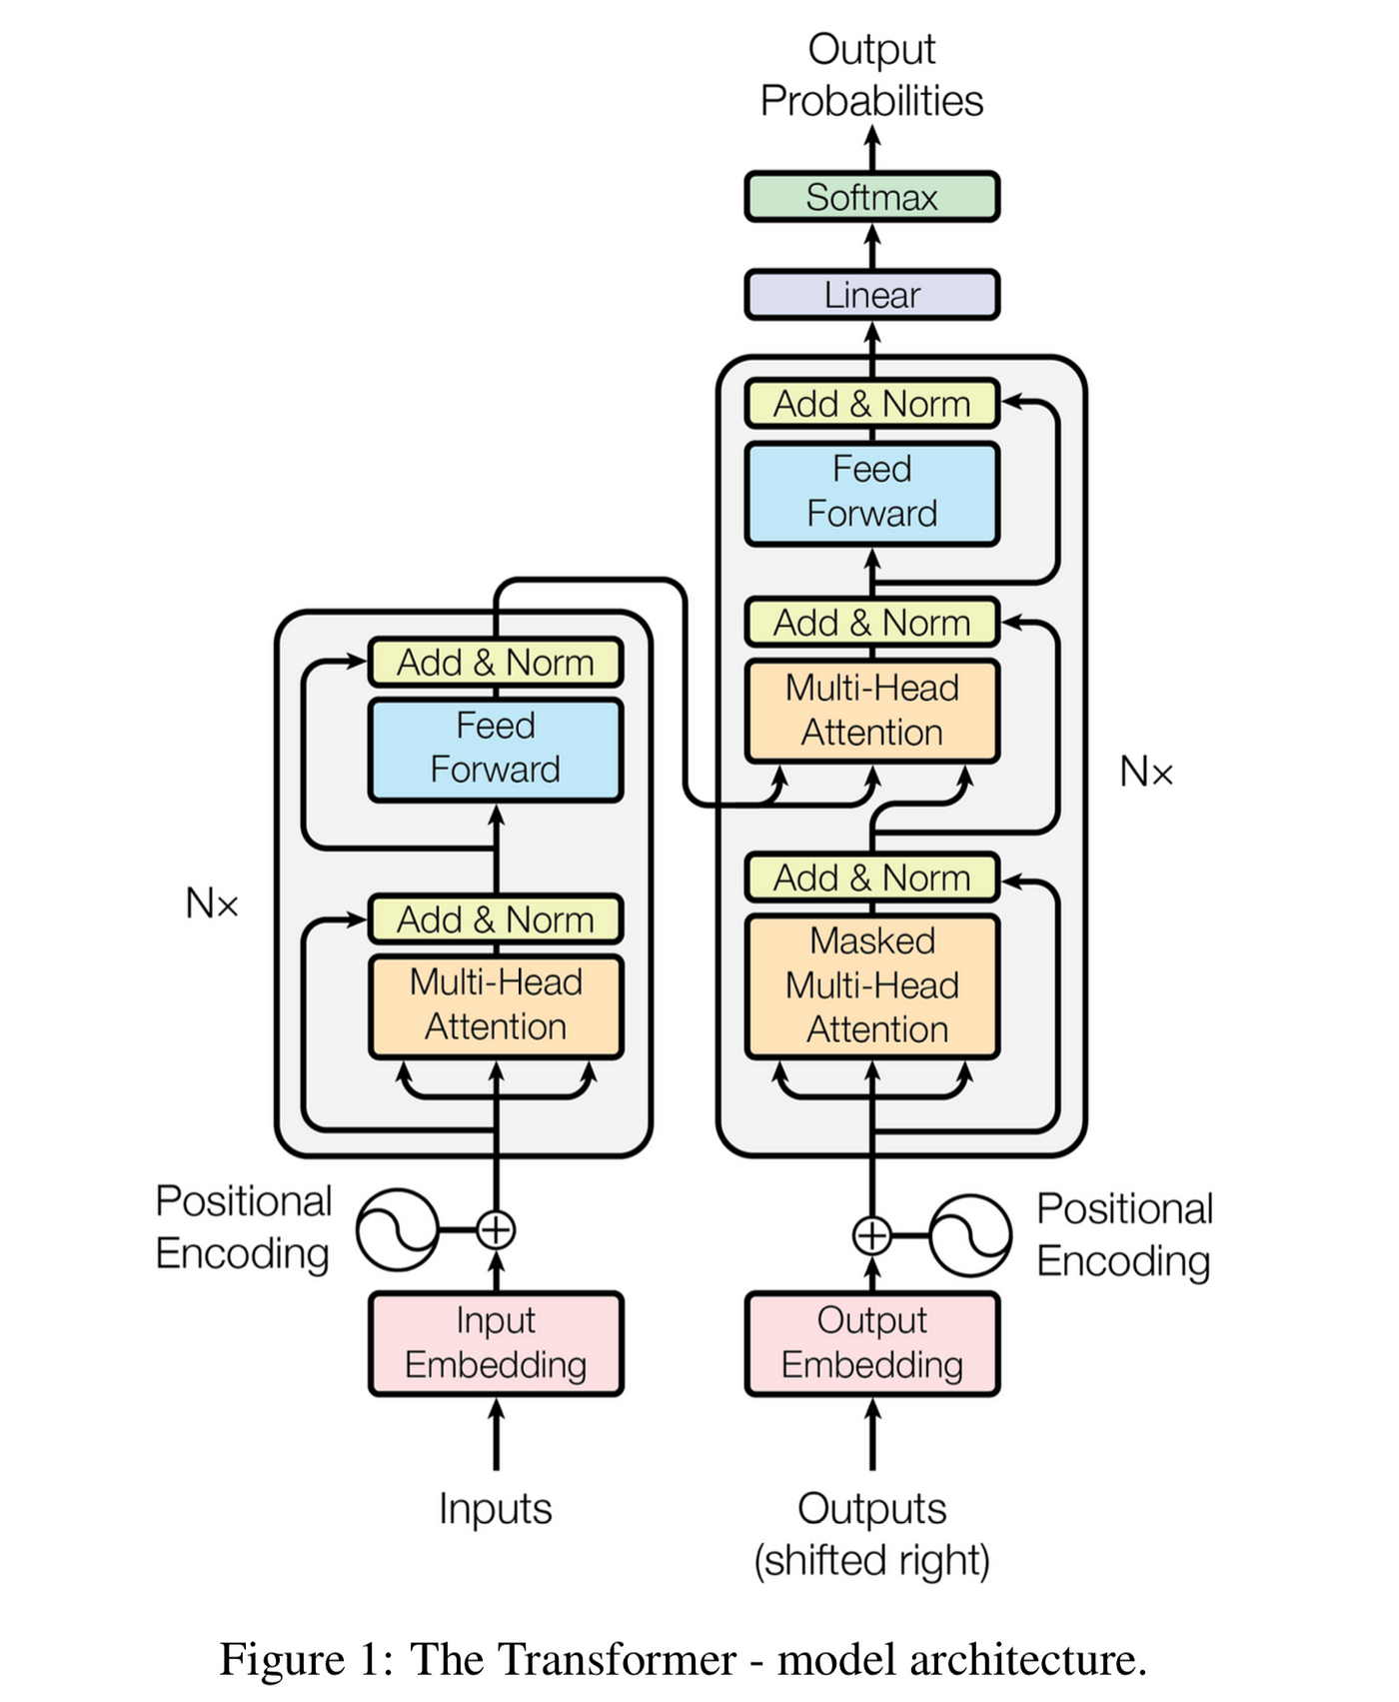
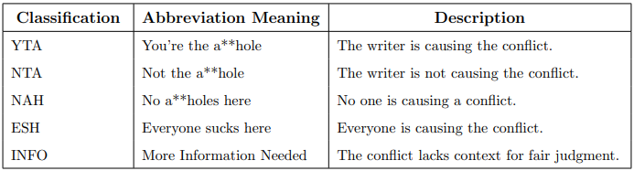

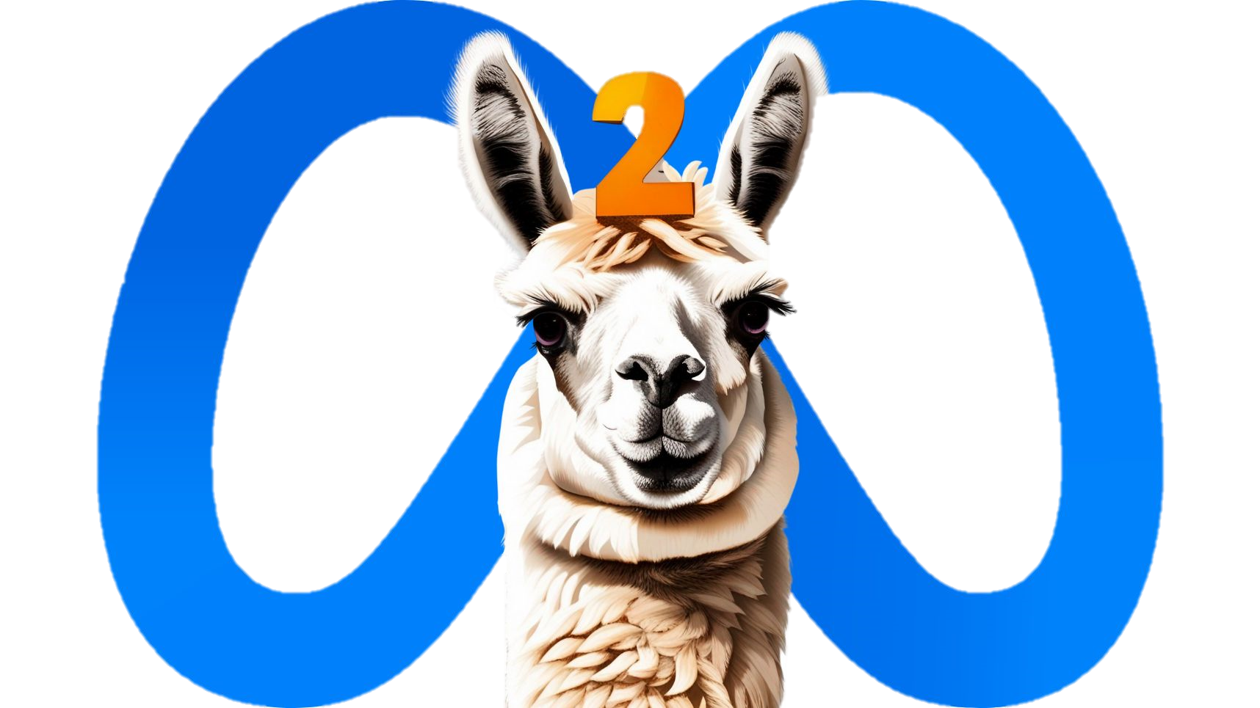
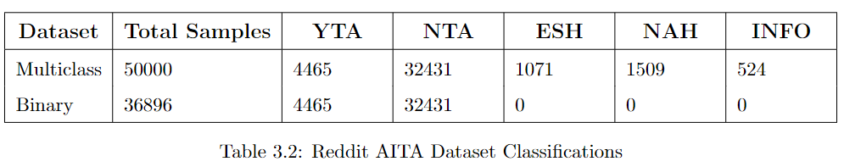
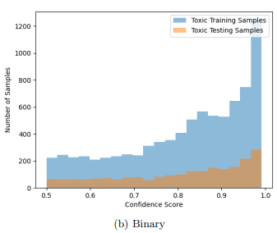
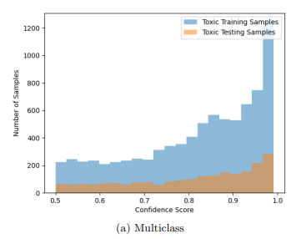

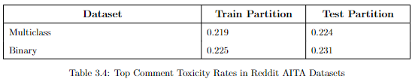
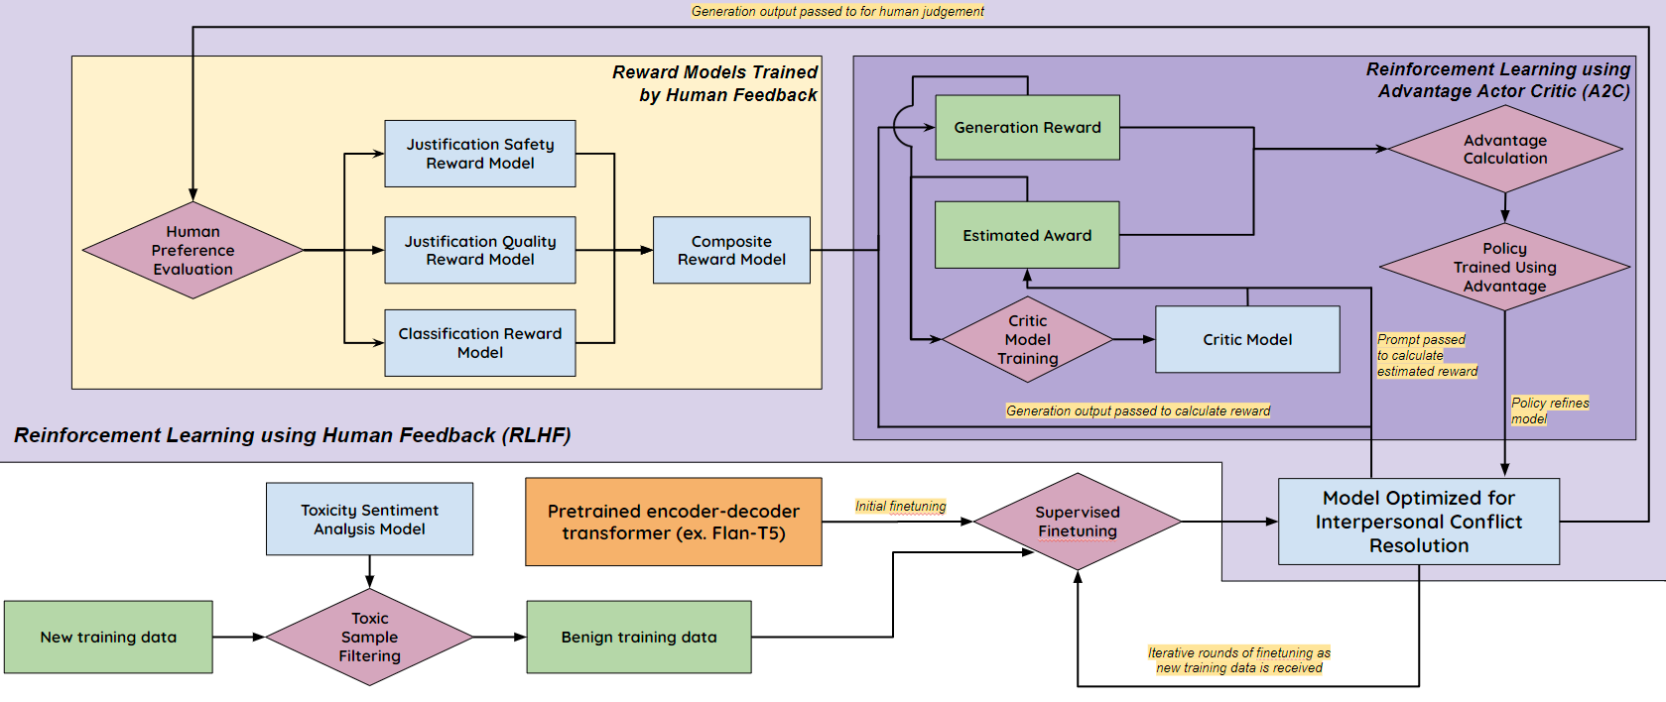
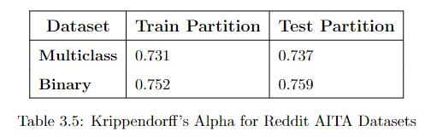
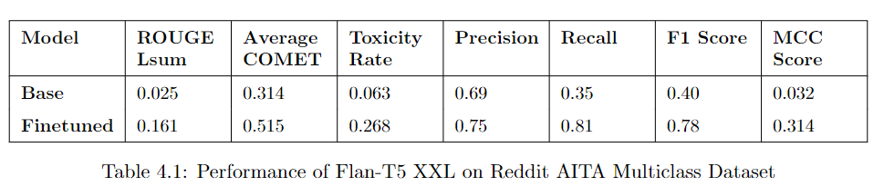
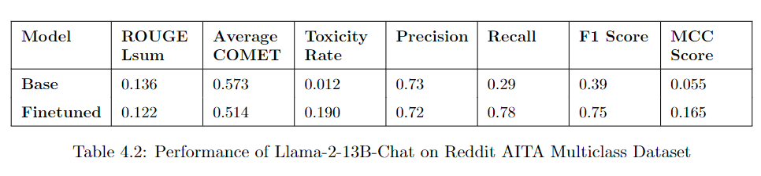
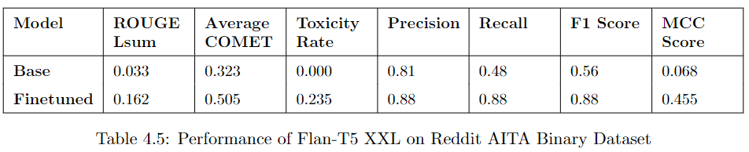
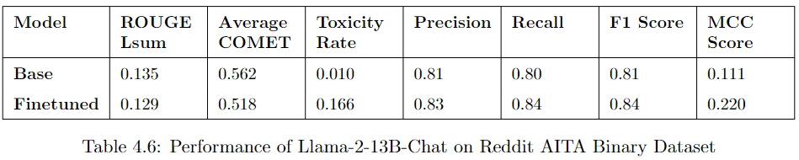
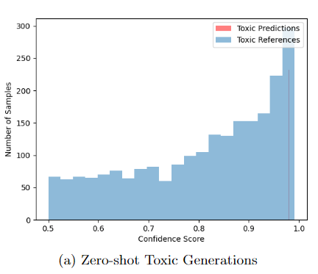
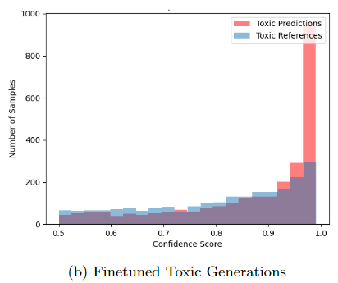
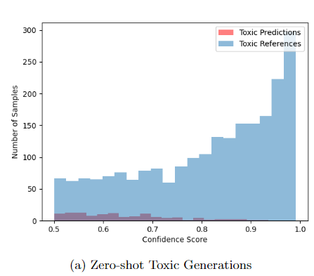
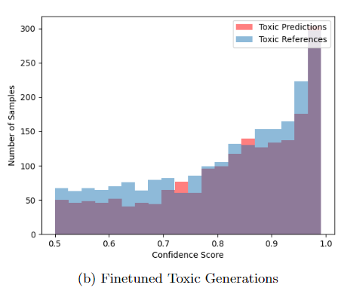
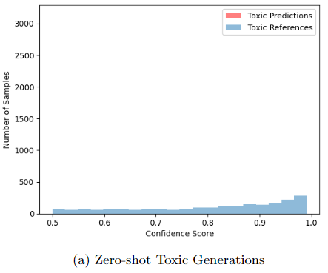
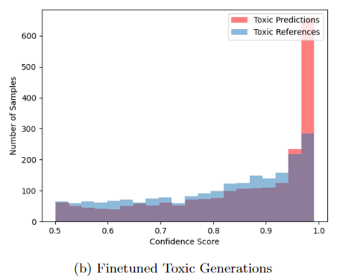
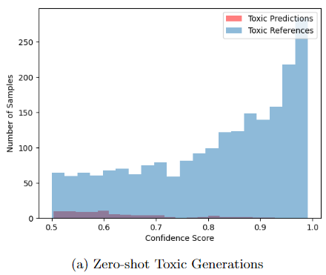
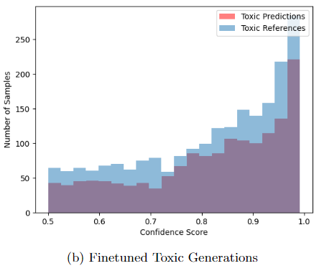
The Efficacy of Finetuning Large Language Models for Interpersonal Conflict Resolution
Matthew Boraske Advisor: Dr. Richard Burns
Large Language Models (LLMs) that leverage transformer architectures have become the predominant form of state-of-the-art artificial intelligence (AI).
Interpersonal conflict resolution
is a challenging task for LLMs
The Reddit “Am I the A**hole” (AITA) Subreddit
The Two Types of Transformers
An online forum with over fifteen million members where interpersonal conflicts are shared for judgement, which consists of choosing one of five AITA classifications and then writing a justification.
We created two datasets consisting of subreddit submissions and the classifications and justifications for the top ten comments by community score
- Multiclass dataset: Contains all five possible AITA classifiations.
- Binary dataset: Only includes the extreme classifications of NTA and YTA.
By finetuning Flan-T5-XXL and Llama-2-13B-Chat on these datasets, we evaluated their ability to learn to solve real-world interpersonal conflicts while also assessing their robustness against adopting the generation of toxic language.
Encoder-decoder
Decoder-only
AITA Classifications
Designed for sequence-to-sequence conversions tasks such as summarization and translation
Purpose of the encoder is to give the LLM an intricate understanding of the input context
Designed for open-ended generation tasks
Input is directly fed to decoder without any intermediate processing.
Reduced training requirements and improved generation speed by eliminating the encoder.
Solutions are inherently ambiguous
Tendency for humans to resort to toxic language
Task is two-fold:
classification and justification
Which LLM is superior at interpersonal conflict resolution when finetuned on these Reddit AITA datasets?
Toxicity Rates of Top Comments using ConfliBERT Finetuned on Toxigen dataset
State-of-the-art and open-source models that utilize each architecture
13 Billion
Parameters
11 Billion
Parameters
Meta Llama-2
A Proposed LLM Architecture and Training Process
for Learning to Safely Resolve interpersonal Conflicts
Metric | Description
ROUGE Lsum | A summarization evaluation metric that measures the longest common subsequence between a system-generated summary and a reference summary.
Average COMET | Evaluates the performance of machine translation systems by predicting how much a human would understand and appreciate the translation.
Toxicity Rate | The proportion of generated texts that contained toxic language
Precision | The proportion of true positive results out of all the positive results
Recall | The proportion of true positive cases that were correctly identified.
F1 Score | The harmonic mean of precision and recall.
Matthew’s Correlation Coefficient (MCC) | Accounts for both true and false positives and negatives and is regarded as a balanced measure that is particularly useful when the classes are of very different sizes.
Key Components
Usage of an encoder-decoder transformer like in Flan-T5 XXL, as the finetuned binary model achieved the greatest classification performance and justification quality.
Supervised finetuning only on samples validated to not contain toxic language.
Iteratively improving model alignment by implementing a Reinforcement Learning with Human Feedback loop that utilizes rewards models for safety, justification quality, and classification accuracy. This reinforces the idea that any AI tool that will be successfully used in sensitive contexts such as therapy will require close supervision by humans to ensure it doesn’t deviate towards dangerous behavior.
Comment Agreement Analysis
Using Krippendorff’s Alpha
A Krippendorff’s alpha of less than 0.8 indicates statistically significant disagreement between the AITA classifications by commenters [1]
By using a parameter efficient finetuning technique called QLoRA, all models were finetuned in less than 48 hours on a single, high-end Nvidia L40 GPU with 48 GB of VRAM
AITA Multiclass Results
Key Conclusions
AITA Binary Results
Flan-T5 XXL
Llama-2-13B-Chat
Flan-T5 XXL, with its encoder-decoder architecture, outperformed Llama-2-13B-Chat in both classification performance and justification quality after finetuning on both AITA datasets.
Flan-T5 XXL
Llama-2-13B-Chat
However, Llama-2-13B-Chat, thanks to its initial training including several rounds of RLHF, was considerably more resistant to learning to use toxic language.

