Slide 1
Git, Android Studio, and Beyond
How and open source tool integrates with an open source platform

Slide 2
A Brief History of Open Source
Linux
Git
The Cathedral and The Bazaar
The spread of open source
Android sits on Linux

Slide 3
Where did Linux come from
Unix
Linus Torvalds
Open Source development
Spread
Something else

Slide 4
The need for Git
Former VCS Bitkeeper, proprietary system
Need for a new VCS with better performance and right functionality
Developed in 2005
Many possible origins of the name Git
About a month to really get up and running and performing the way intended

Slide 5
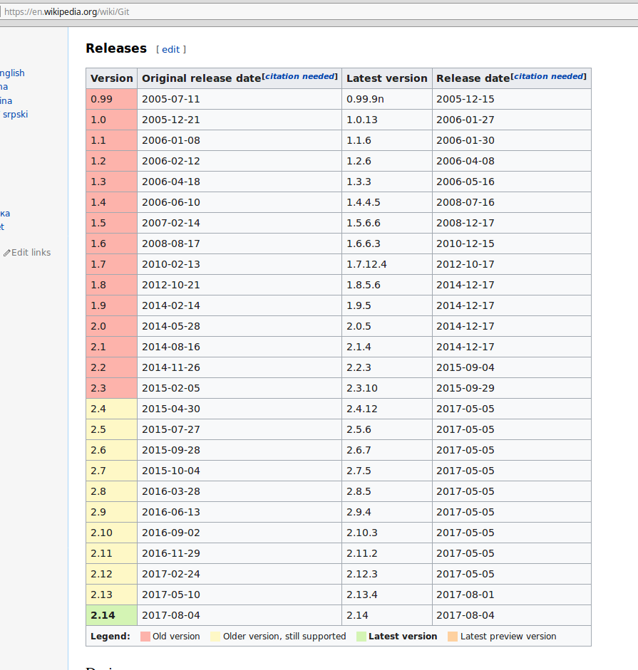

Slide 6
Basic Git commands
git add
git commit
git push
git pull
git log
git status

Slide 7
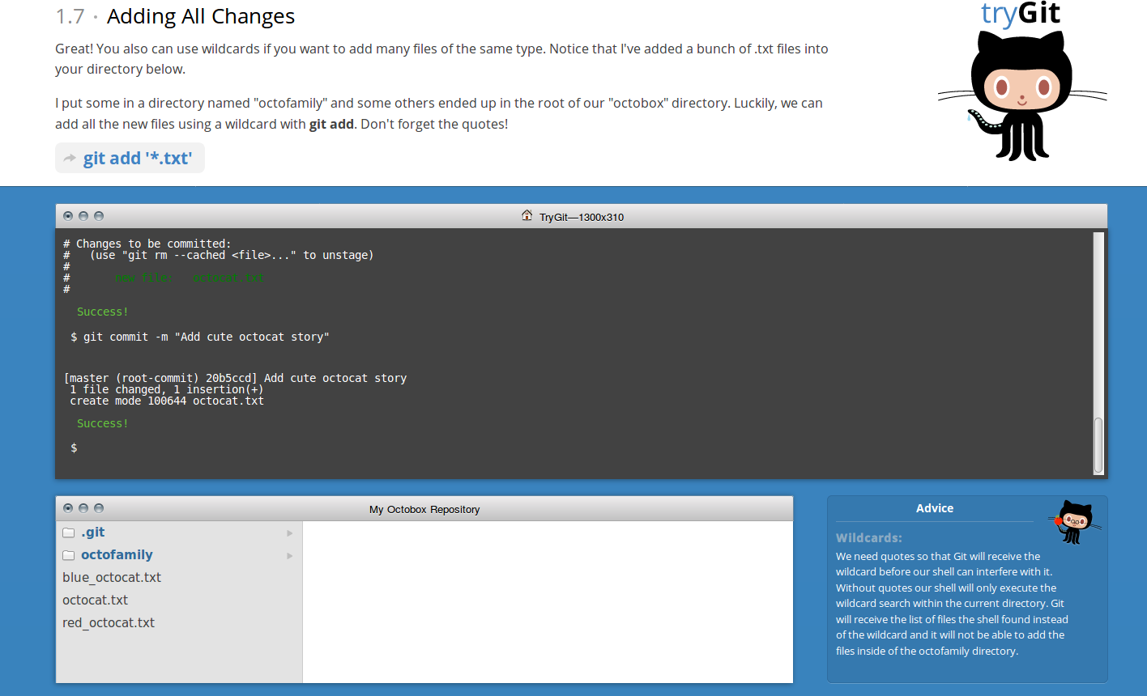
Git web site and demo
Home for git -- https://git-scm.com/
Tutorial to try git and learn basics -- https://try.github.io/levels/1/challenges/5

Slide 9
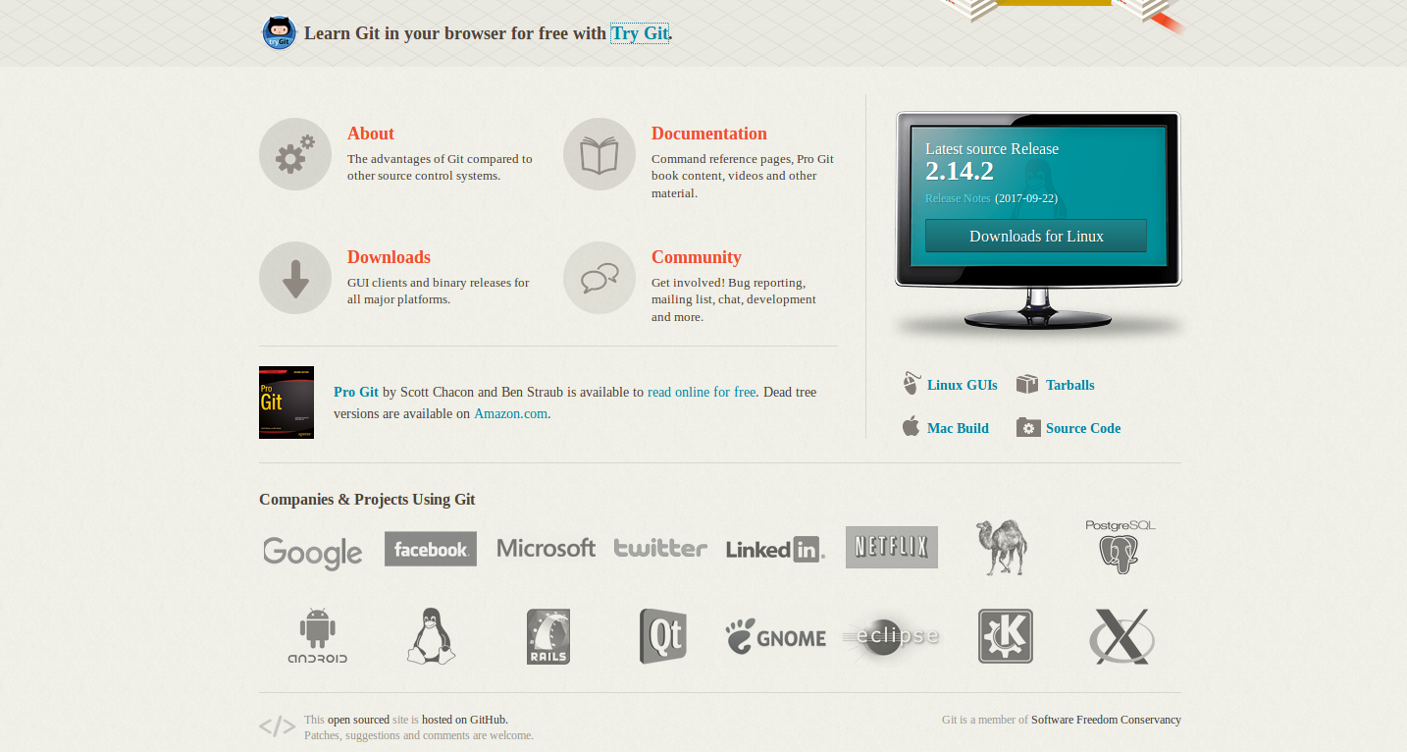

Slide 10
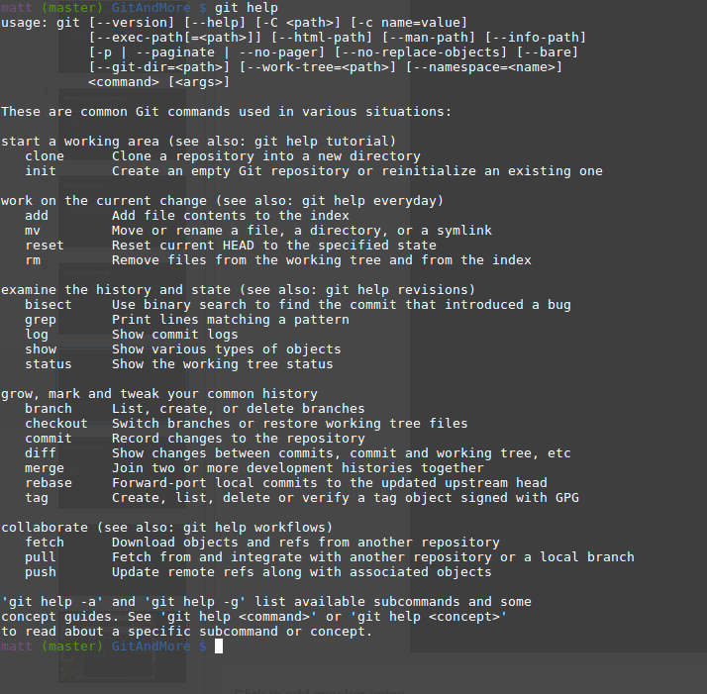

Slide 11
Basic Git concepts
Repository
Branch
Fork
Pull request
Merge

Slide 13
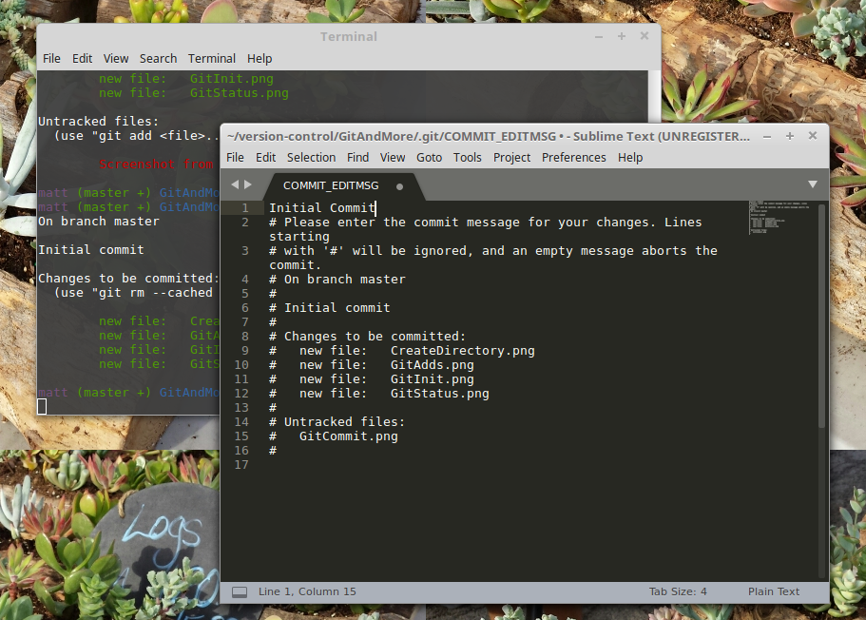

Slide 14
