Slide 1
Git, Android Studio, and Beyond
How and open source tool integrates with an open source platform

Slide 2
A Brief History of Open Source
Linux
Git
The Cathedral and The Bazaar
The spread of open source
Android sits on Linux

Slide 3
Where did Linux come from
Unix
Linus Torvalds
Open Source development
Spread
Something else

Slide 4
The need for Git
Former VCS Bitkeeper, proprietary system
Need for a new VCS with better performance and right functionality
Developed in 2005
Many possible origins of the name Git
About a month to really get up and running and performing the way intended

Slide 5
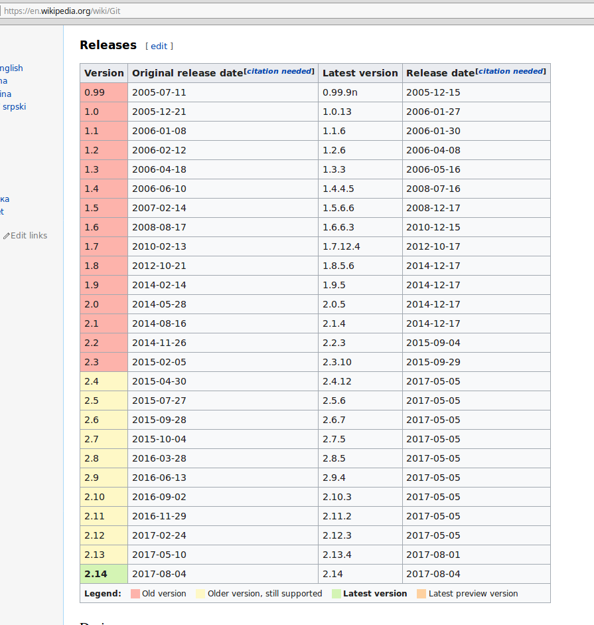

Slide 6
Basic Git commands
git add
git commit
git push
git pull
git log
git status

Slide 7
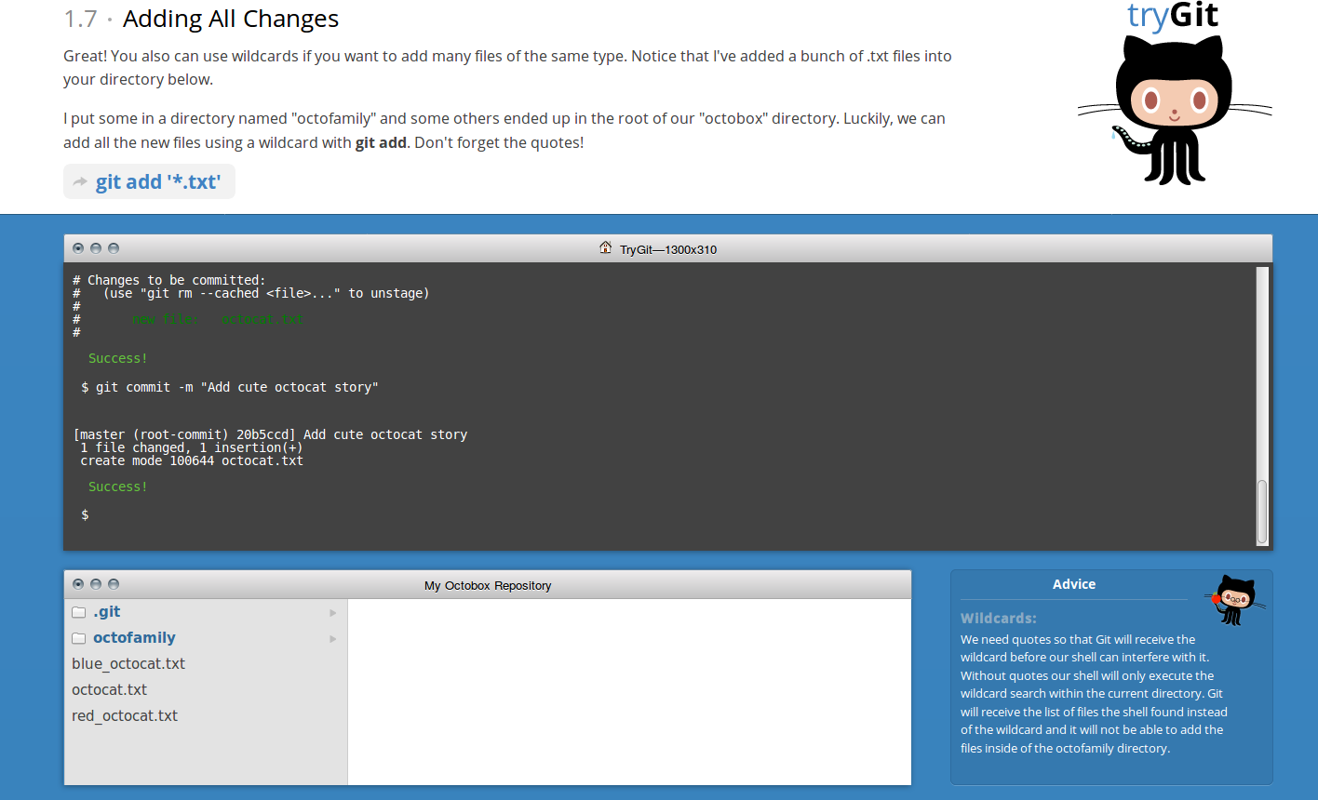
Git web site and demo
Home for git -- https://git-scm.com/
Tutorial to try git and learn basics -- https://try.github.io/levels/1/challenges/5

Slide 9
More git training resources
https://try.github.io/wrap_up
https://help.github.com/
https://services.github.com/customized-training
http://gitimmersion.com/
http://rogerdudler.github.io/git-guide/

Slide 10
Linus Torvalds talks about Linux and Git
Youtube TED talk -- https://www.youtube.com/watch?v=Vo9KPk-gqKk
20 minute talk where Linus Torvalds talks about his work, open source, Linux, git, and what makes him good at what he does

Slide 11
Some Linux numbers and facts
50 Core developers
Roughly 1,000 contributors to each release
Linux design tried initially to mimic Unix
Git much more of a design from scratch
Linux has a single kernel that runs on a multitude of processors -- from mobile devices to supercomputers

Slide 12
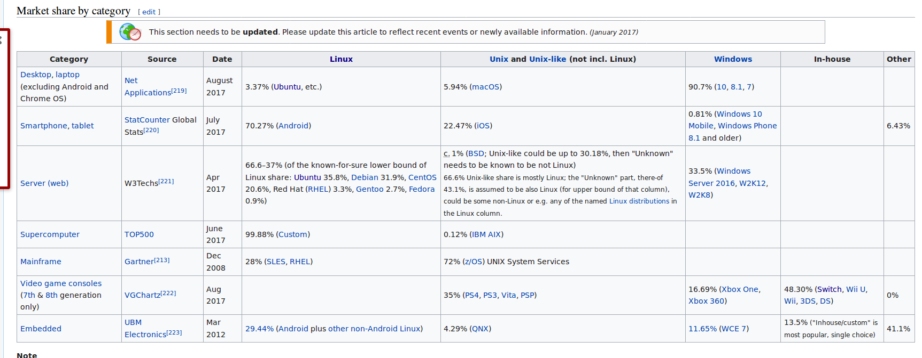

Slide 13
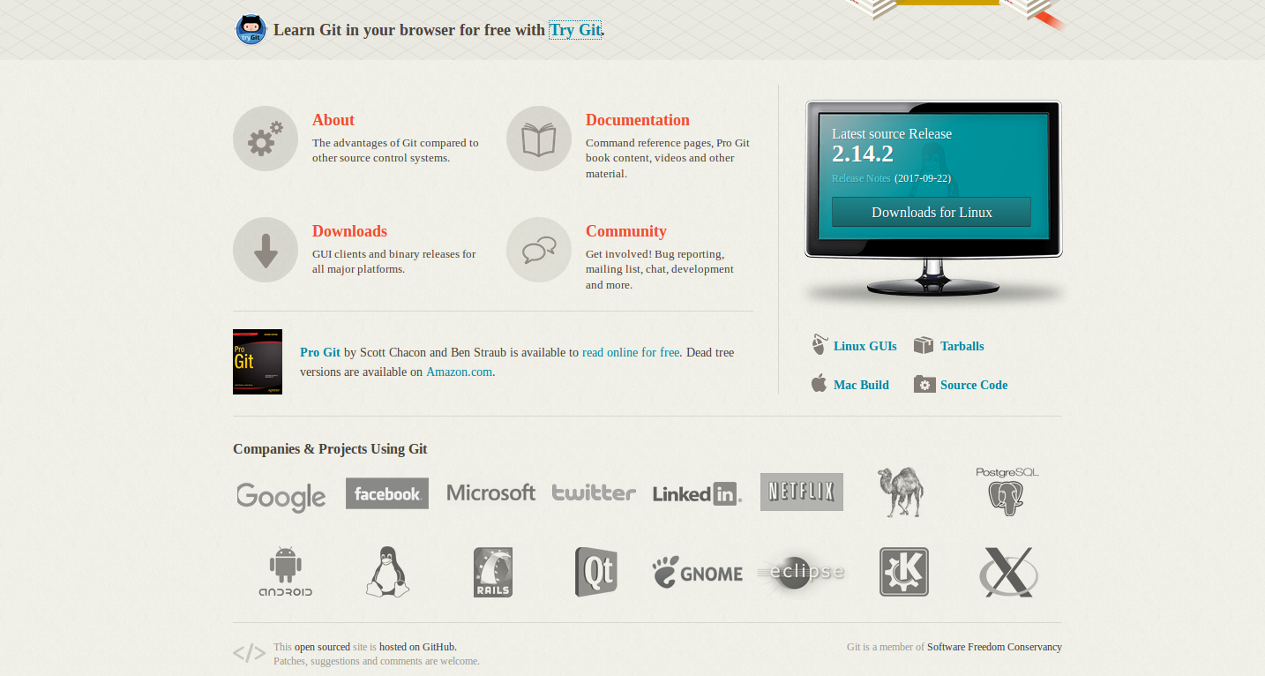

Slide 14
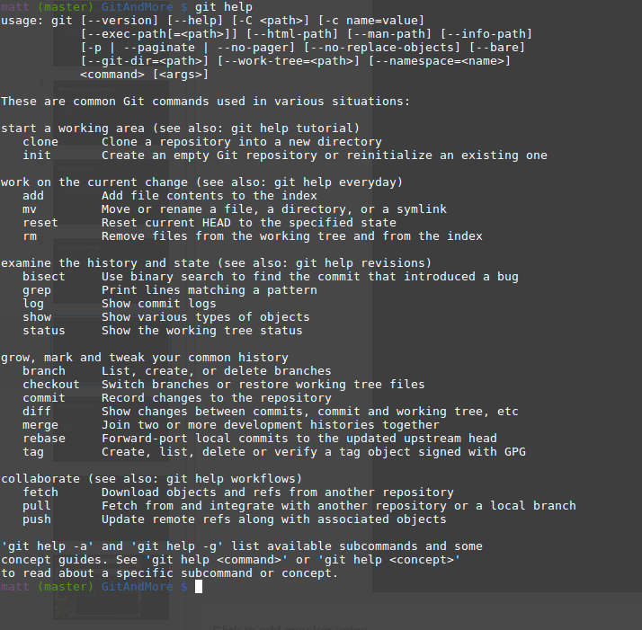

Slide 15
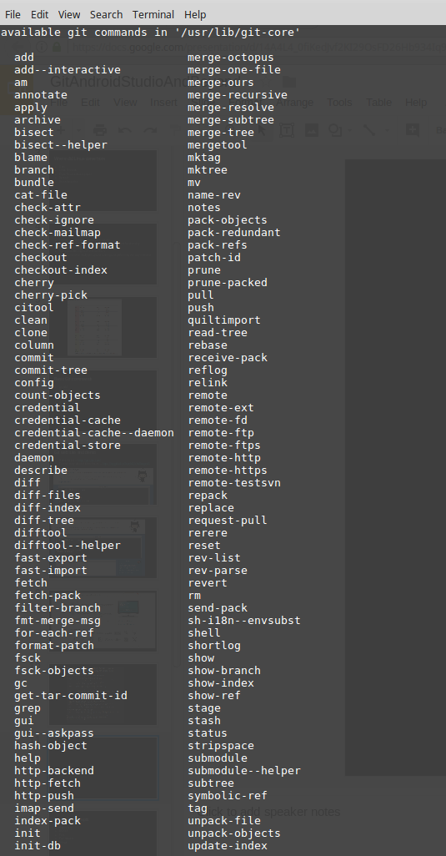

Slide 16
Basic Git concepts
Repository
Branch
Fork
Pull request
Merge

Slide 17
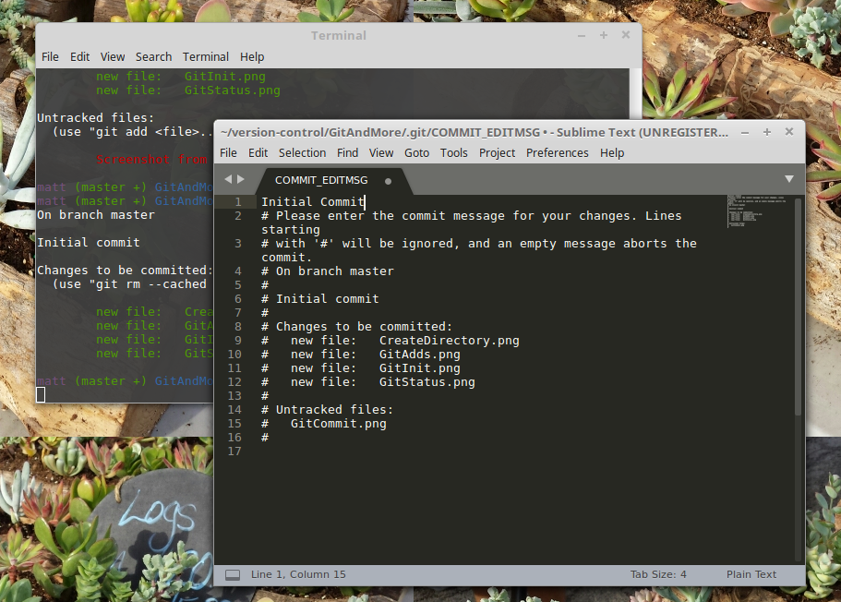

Slide 18
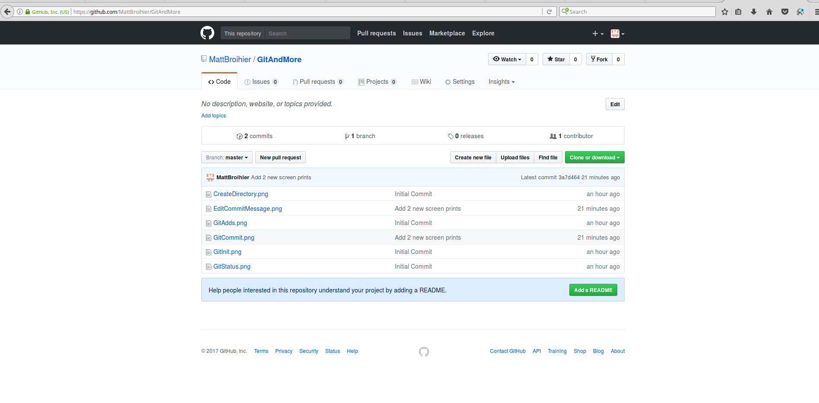

Slide 21
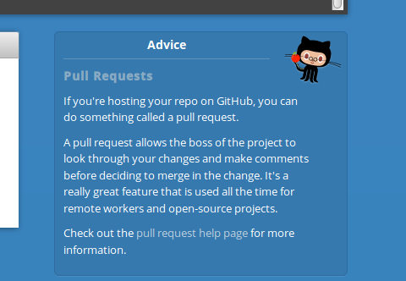
What is a pull request?

