Slide 1
Git, Android Studio, and Beyond
How an open source tool integrates with an open source platform

Slide 2
My original intention for this presentation
Android Studio app development
Too big of a topic
Started learning about Git, which I had never heard of
Learned about Git taking Udacity Android development class, which suggested I need to take their git/github class as a prerequisite
Found I enjoyed the git/github course a lot more than I expected
Fit in with my interest about Open Source
Much narrower topic, and still ties into Android Studio

Slide 3
My aims
A brief history of Linux, git, and open source
The basics of using git from the command line
Go over the git project itself
Git in Android
Other interfaces to Git

Slide 4
A Brief History of Open Source
Linux
Git
The Cathedral and The Bazaar
The spread of open source
Android sits on Linux

Slide 5
Where did Linux come from
Unix and Minix
Linus Torvalds
Open Source development
Took off
A multitude of versions
On a multitude of platforms

Slide 6
The Cathedral and the Bazaar
Differentiated Open Source from Free Software
Inspired Netscape to create Mozilla project, which eventually lead to Firefox
https://en.wikipedia.org/wiki/The_Cathedral_and_the_Bazaar
http://www.catb.org/~esr/writings/cathedral-bazaar/cathedral-bazaar/
Enough eyeballs tame complexity

Slide 7
The need for Git
Former VCS used for Linux development was Bitkeeper, proprietary system
Need for a new VCS with better performance and right functionality
Also Bitkeeper was starting to put restrictions on its free use
Developed in 2005
Many possible origins of the name Git
About a month to really get up and running and performing the way intended
But just 1 day to become self hosting

Slide 8
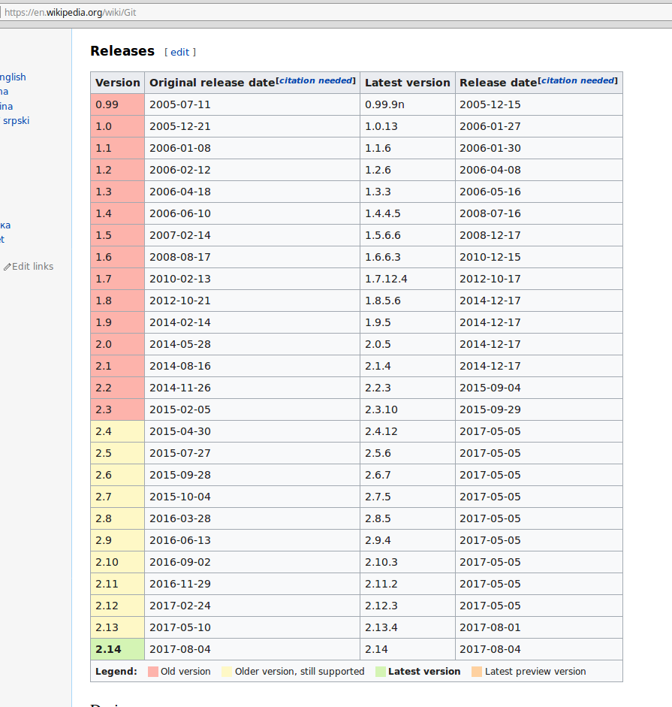

Slide 9
Key dates for Linux and Git
Linux 1991, developed on MINIX, announce August 25, 1991 on Usenet
1997 -- The Cathedral and the Bazaar first published
Git first commit on April 7th, 2005, 1 day after it was initially announced, 4 days after the beginning of development
Github originated October, 2007

Slide 10
Basic Git commands
git init
git add
git commit
git push
git pull
git log
git status
git diff

Slide 11
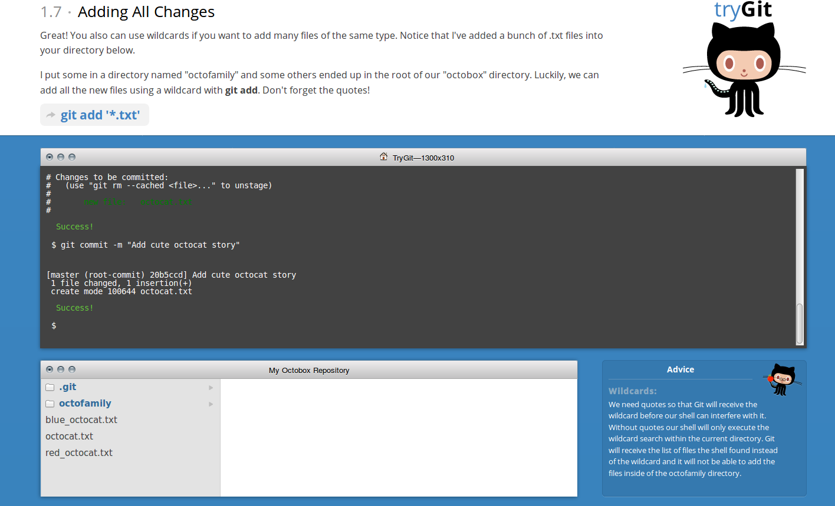
Git web site and demo
Home for git -- https://git-scm.com/
Tutorial to try git and learn basics -- https://try.github.io/levels/1/challenges/1

Slide 13
More git training resources
https://try.github.io/wrap_up
https://help.github.com/
https://services.github.com/customized-training
http://gitimmersion.com/
http://rogerdudler.github.io/git-guide/

Slide 14
Linus Torvalds talks about Linux and Git
Youtube TED talk -- https://www.youtube.com/watch?v=Vo9KPk-gqKk
20 minute talk where Linus Torvalds talks about his work, open source, Linux, git, and what makes him good at what he does

Slide 15
Some Linux numbers and facts
50 Core developers
Roughly 1,000 contributors to each release
Linux design tried initially to mimic Unix
Git much more of a design from scratch
Linux has a single kernel that runs on a multitude of processors -- from mobile devices to supercomputers

Slide 16
Mirror of Git project on Github
A mirror of Git project, can’t update it
Cool from a historical perspective
Very first commit (git doing a repository of it’s own development) -- https://github.com/git/git/commits/master?after=20fed7cad40ed0b96232feb828129e3a2ee9860d+48804
April 7, 2005
10 years of Git interview with Torvalds -- https://www.linuxfoundation.org/blog/10-years-of-git-an-interview-with-git-creator-linus-torvalds/

Slide 17
Linux irony
Linus Torvalds was trying to optimize Linux as a desktop operating system
Even with the huge number and variety of distributions, it’s never quite taken off in the desktop market
However, other than the gaming platform market and desktops, linux dominates on most other computer platforms

Slide 18
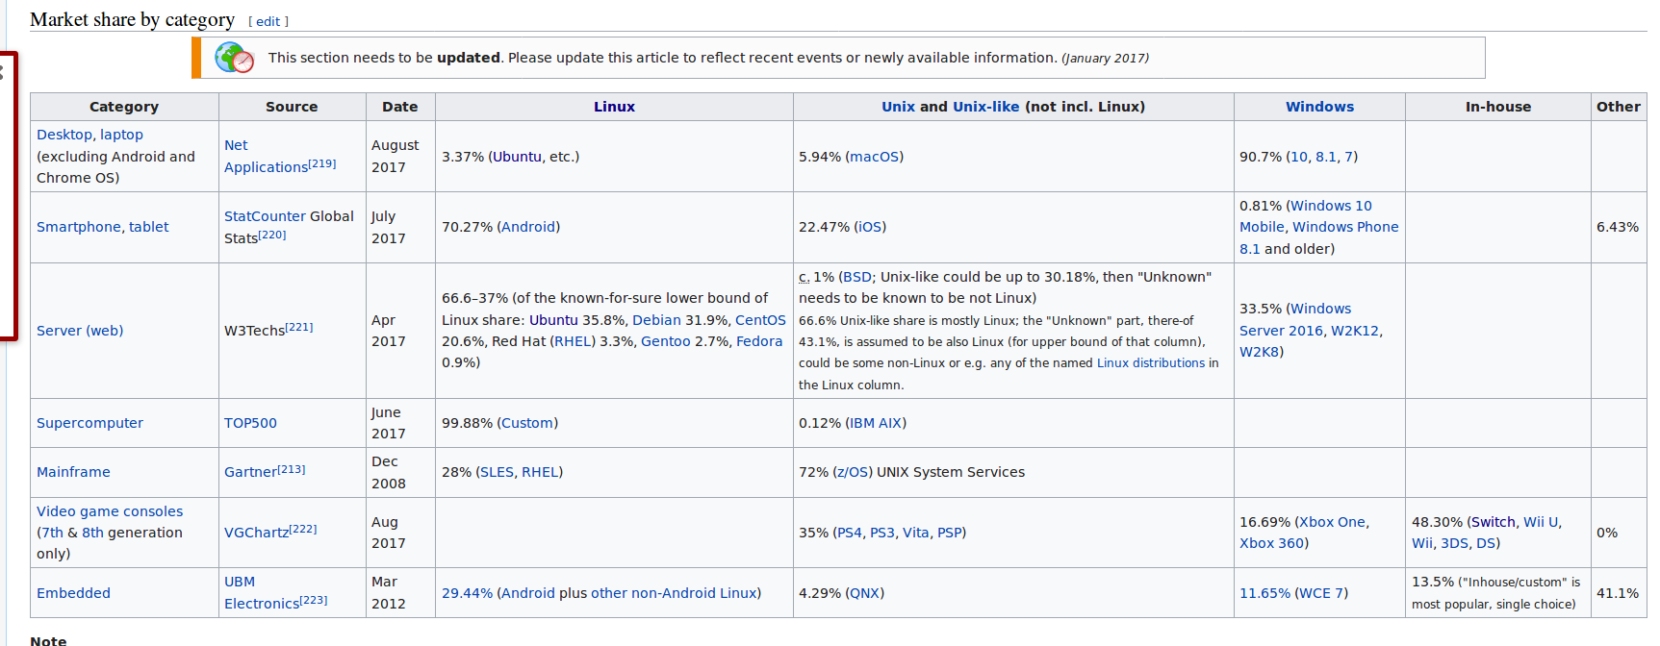

Slide 19
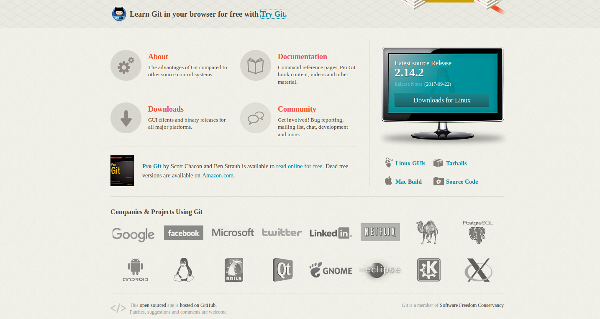

Slide 20
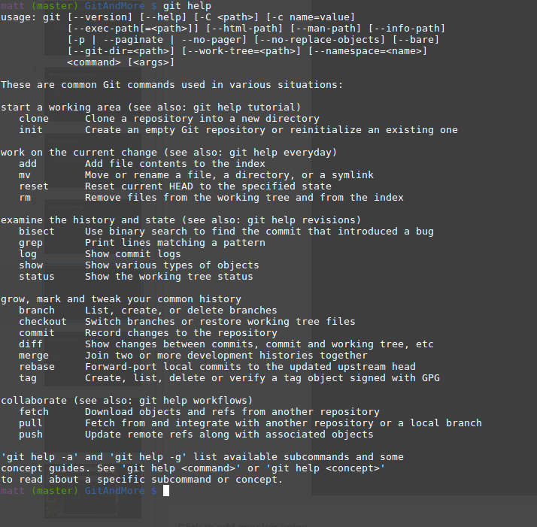

Slide 21
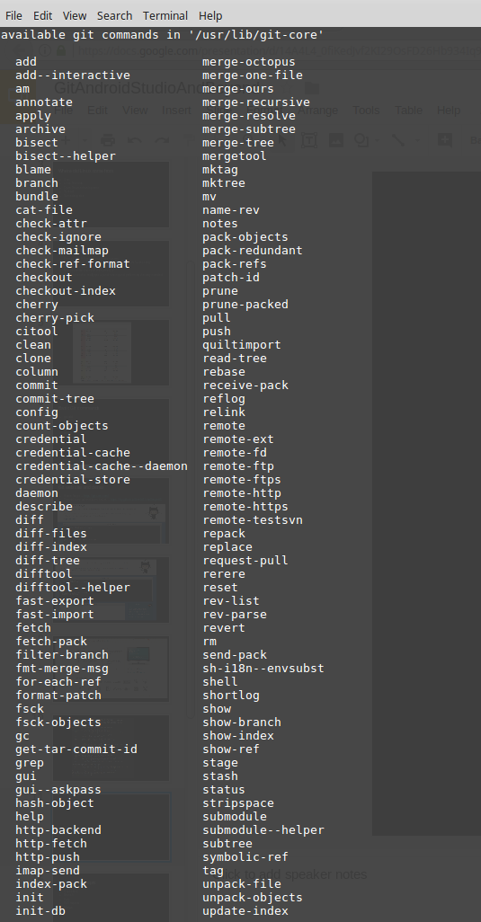

Slide 22
Basic Git concepts
Repository
Branch
Fork
Pull request
Merge

Slide 23
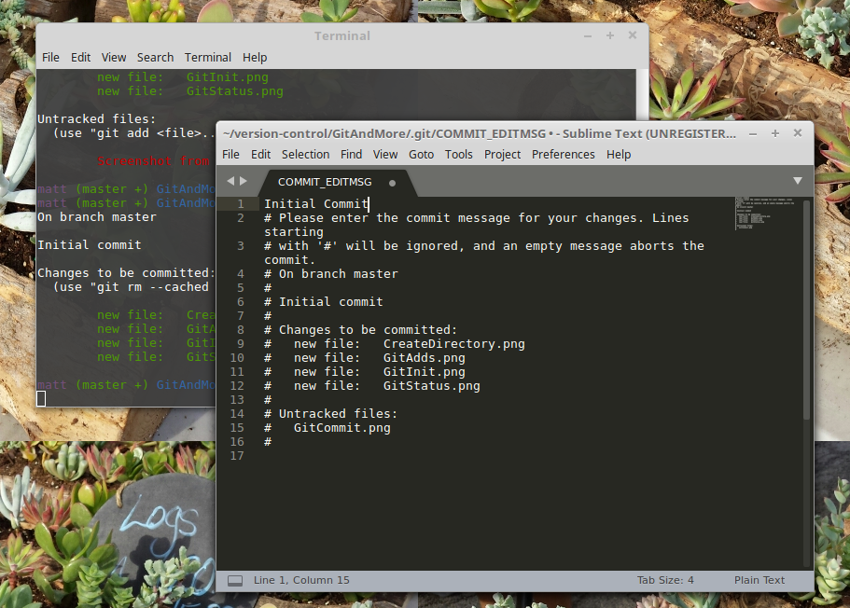

Slide 24
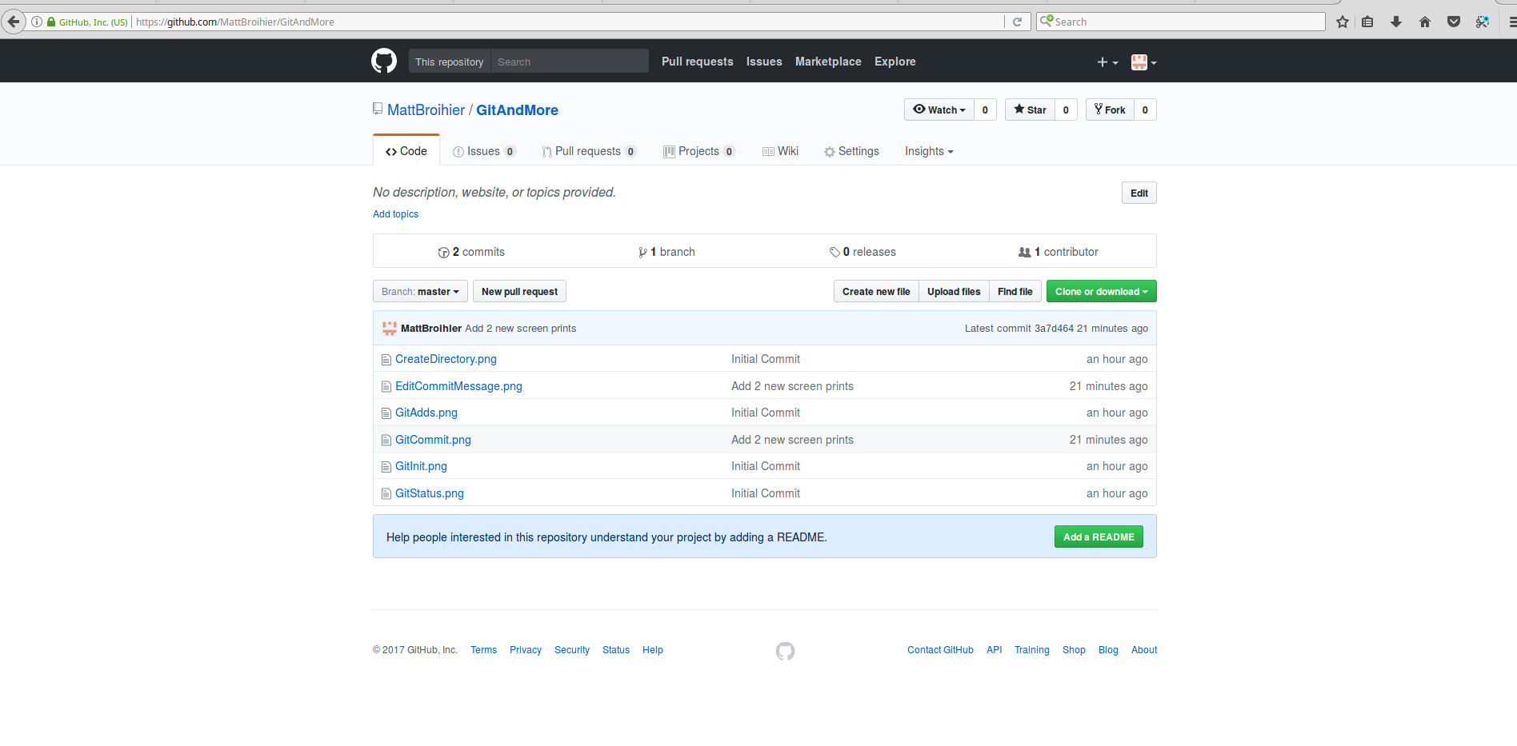

Slide 25
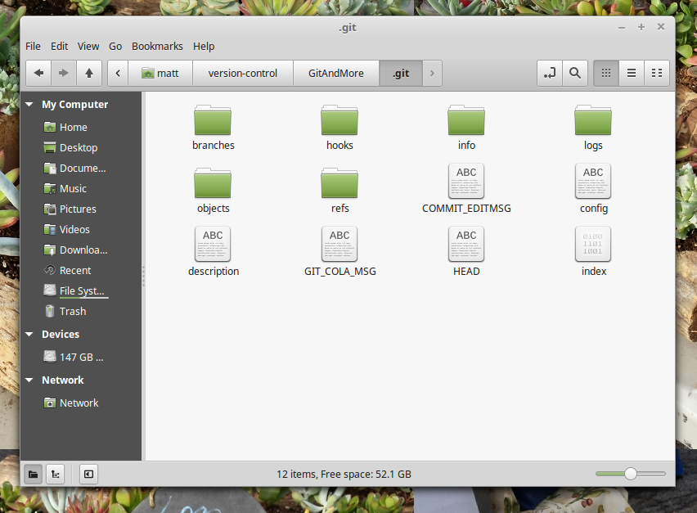

Slide 26
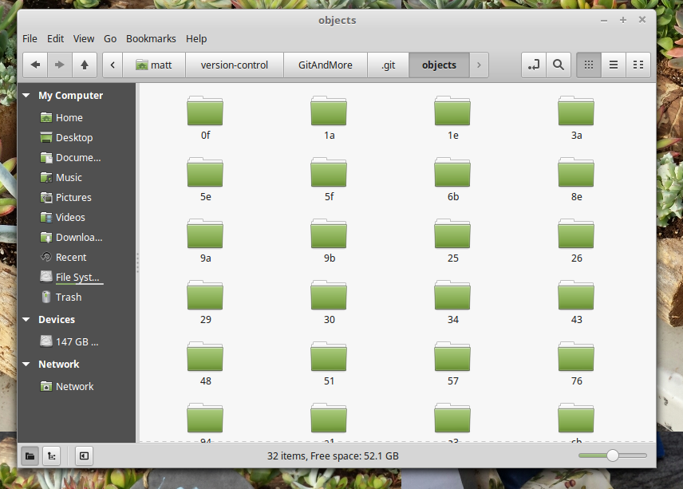

Slide 27
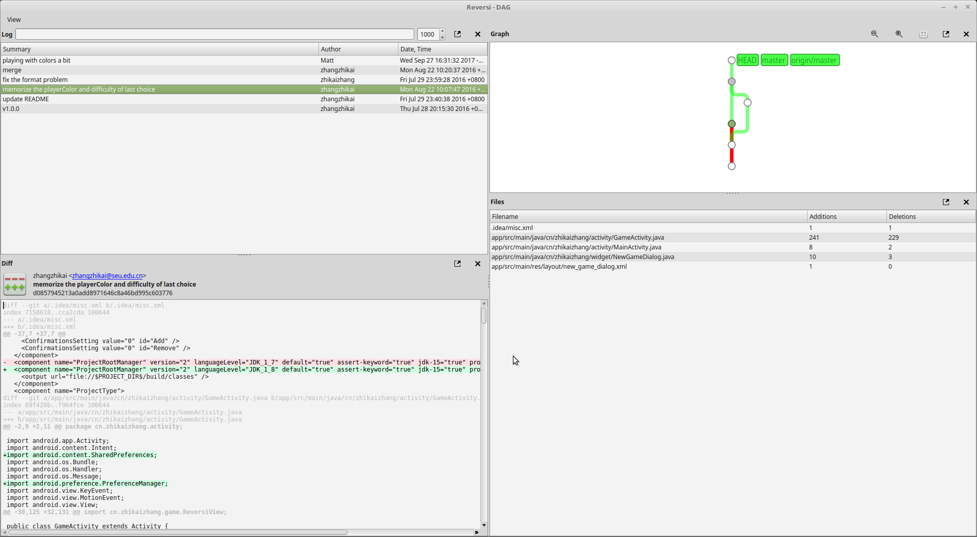

Slide 28
25 facts about Linux on it’s 25th birthday
https://medium.freecodecamp.org/linux-is-25-yay-lets-celebrate-with-25-rad-facts-about-linux-c8d8ac30076d

Slide 29
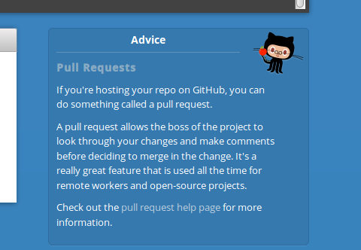
What is a pull request?

Slide 30
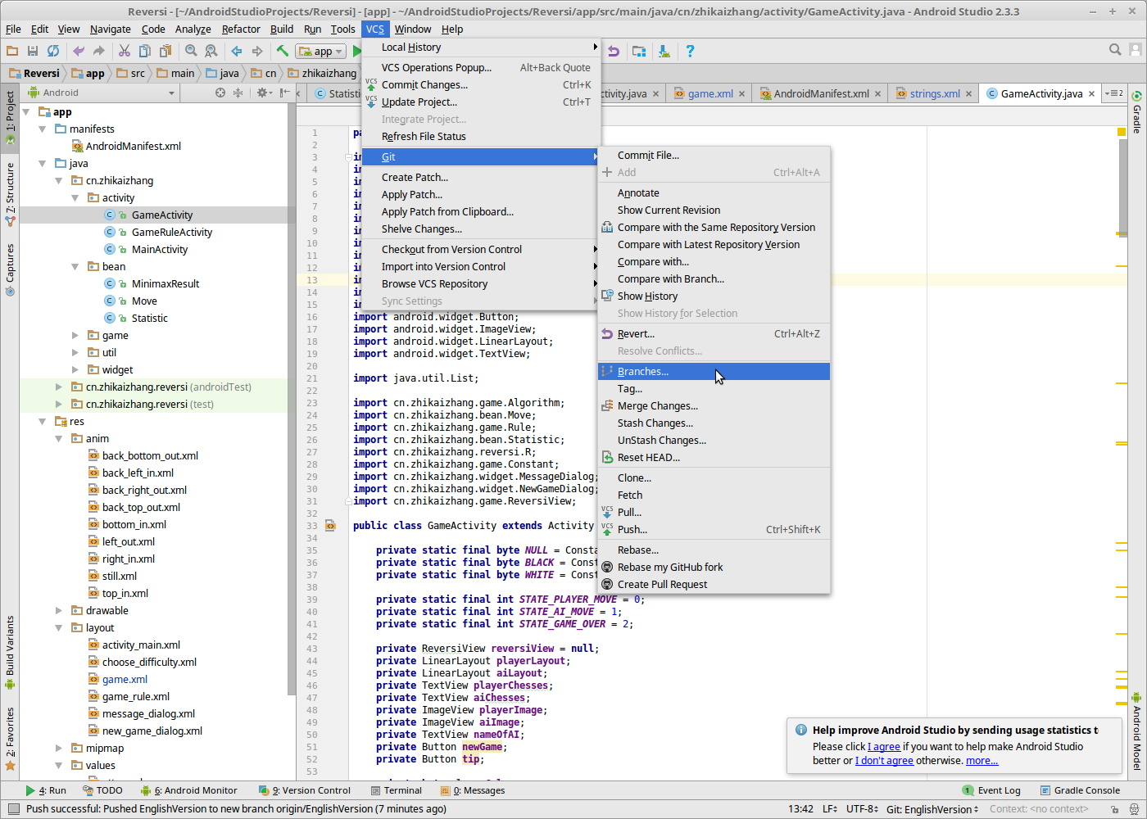

Slide 31
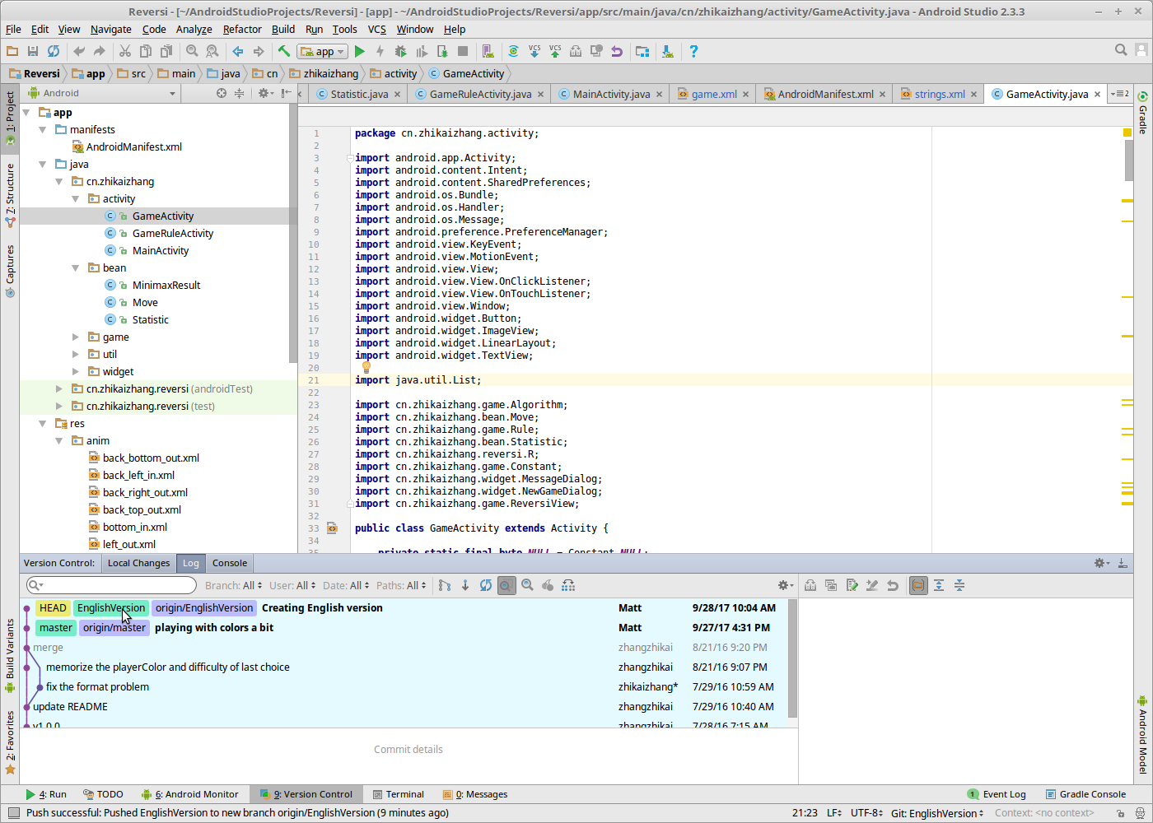

Slide 32
Git gui tools
A bunch out there, here are a couple
https://github.com/git-cola/git-cola/
Within Git Cola (DAG) -- https://git-cola.github.io/share/doc/git-cola/html/git-dag.html

Slide 33
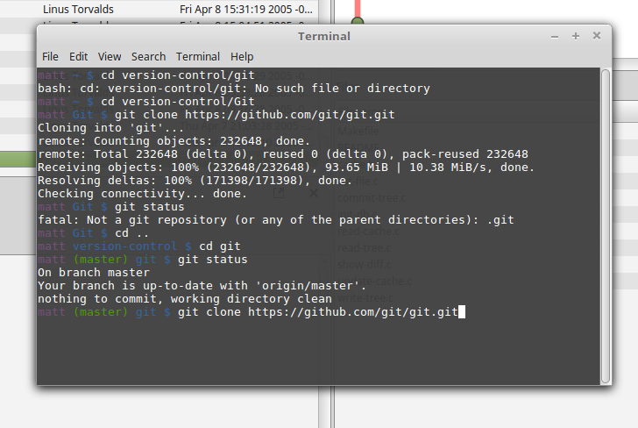

Slide 34
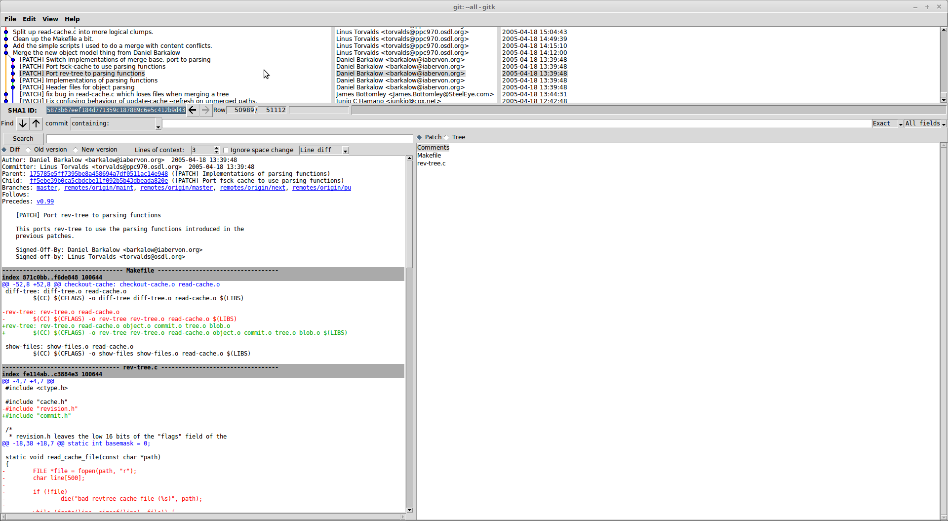

Slide 35
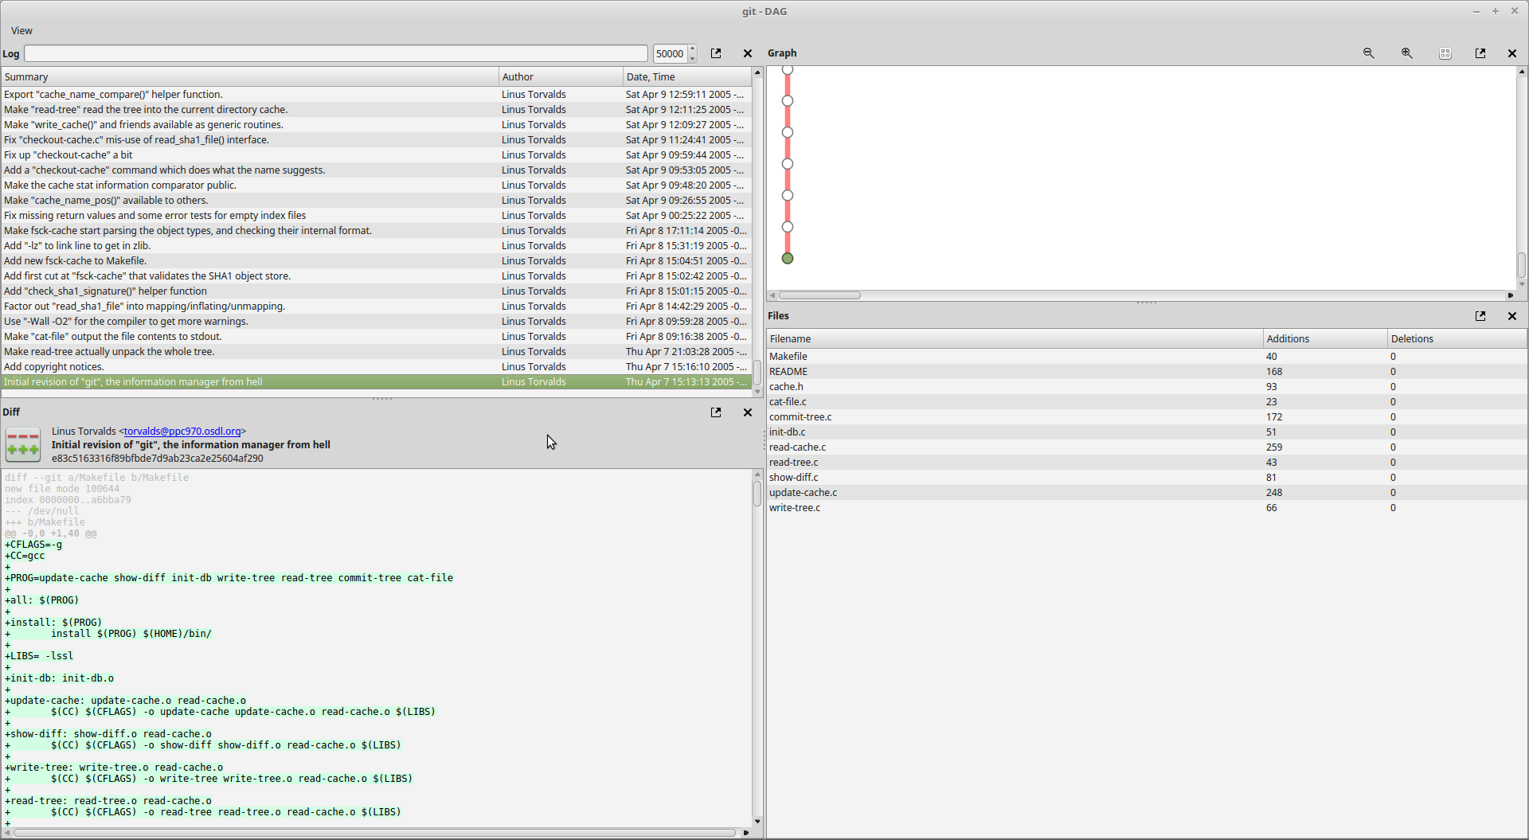

Slide 36
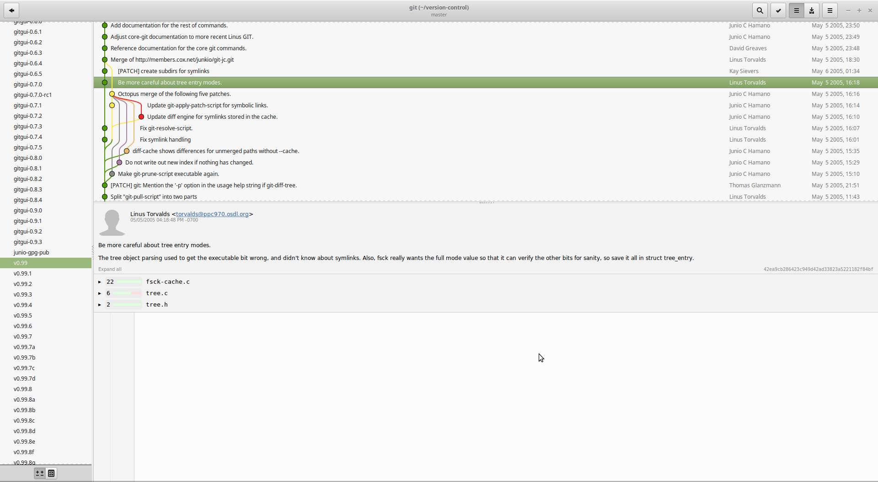

Slide 37
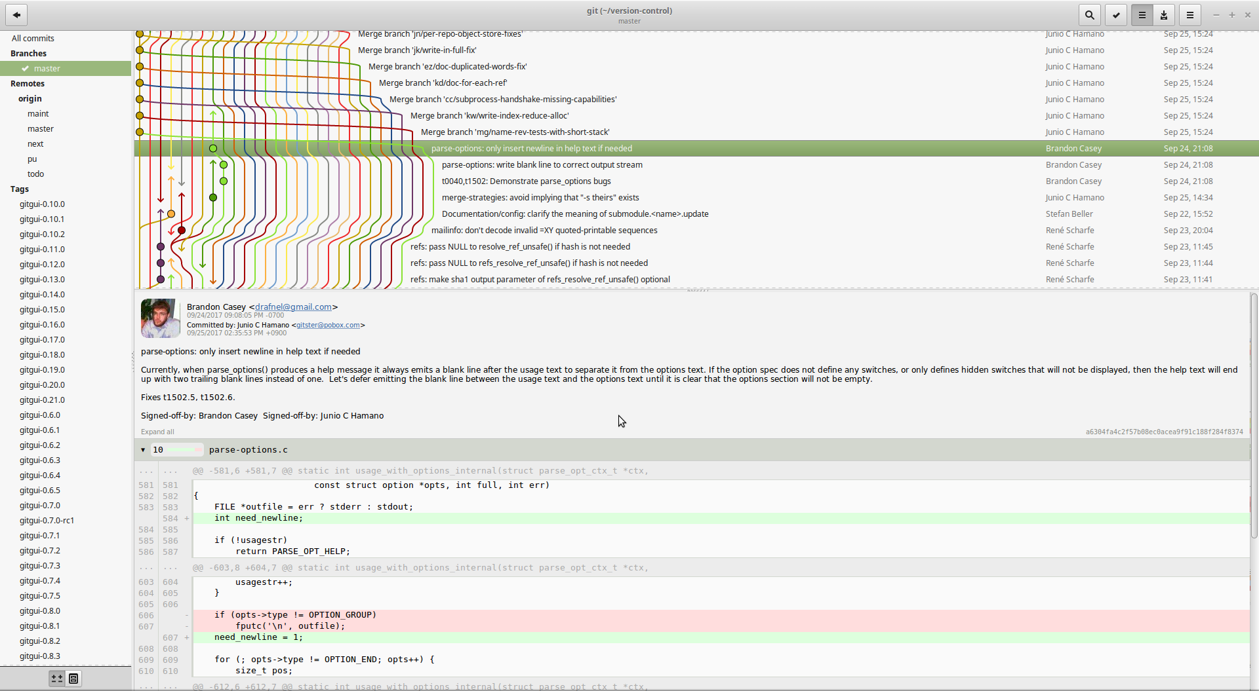

Slide 38
Visual Studio support for Git and Github
Starting with TFS 2013, Microsoft added native support for Git
Cloning an existing Git repository -- https://docs.microsoft.com/en-us/vsts/git/tutorial/clone?tabs=visual-studio
Github Extension for Visual Studio -- https://visualstudio.github.com/

