Slide 1
Campaign Name
11-07-2016

Slide 2
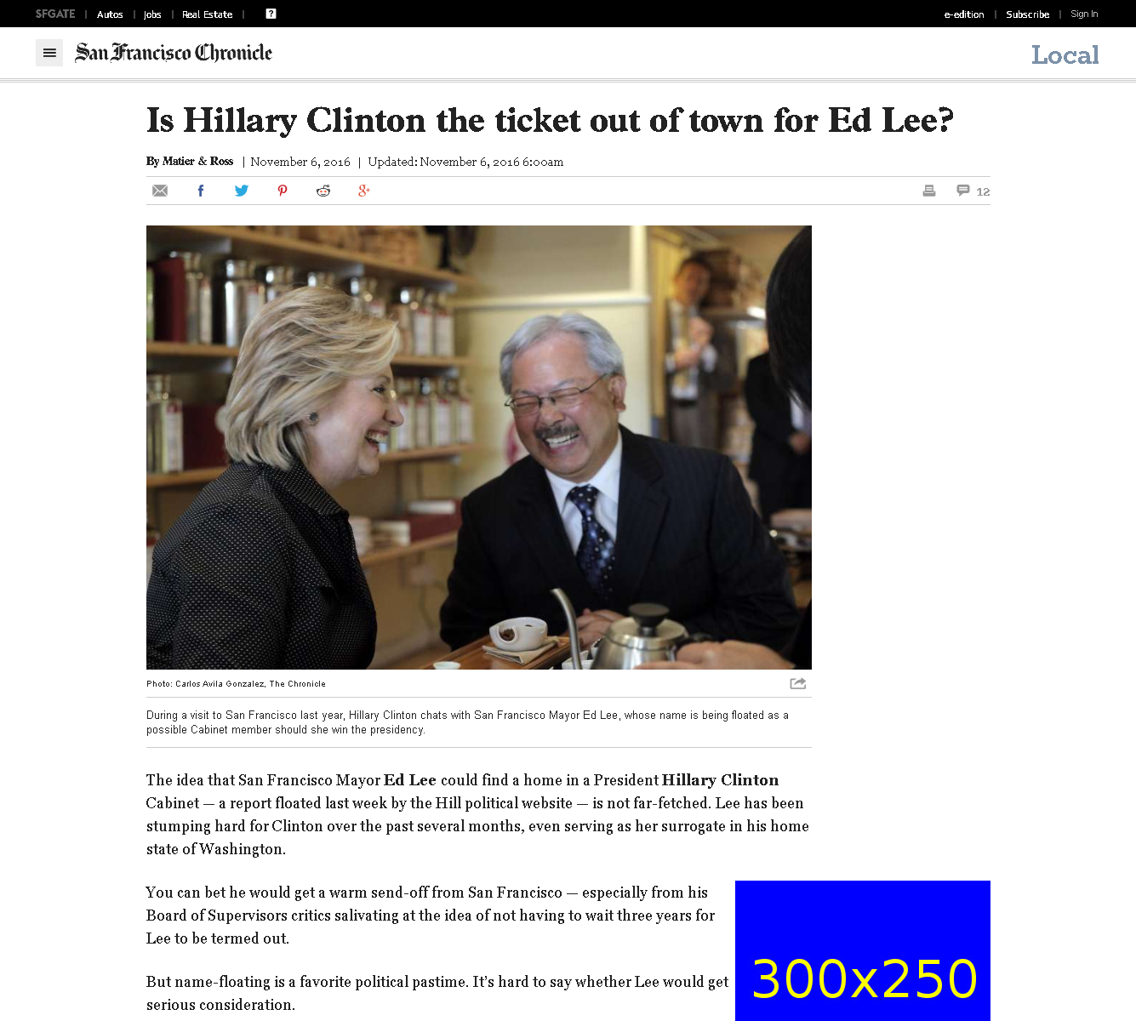
http://www.sfchronicle.com/bayarea/matier-ross/article/Is-Hillary-Clinton-the-ticket-out-of-town-for-Ed-10594705.php

Slide 3
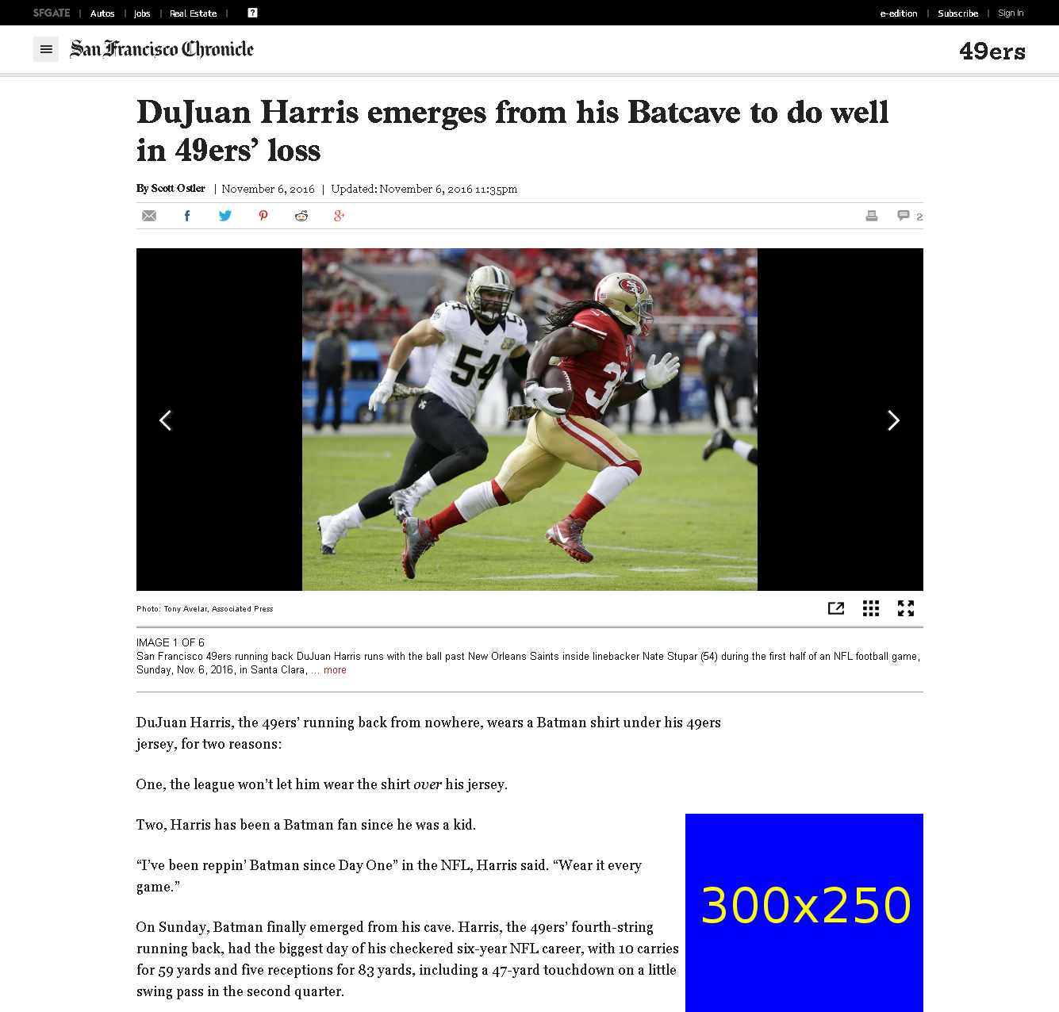
http://www.sfchronicle.com/49ers/article/DuJuan-Harris-emerges-from-his-Batcave-to-do-well-10597398.php

Slide 4
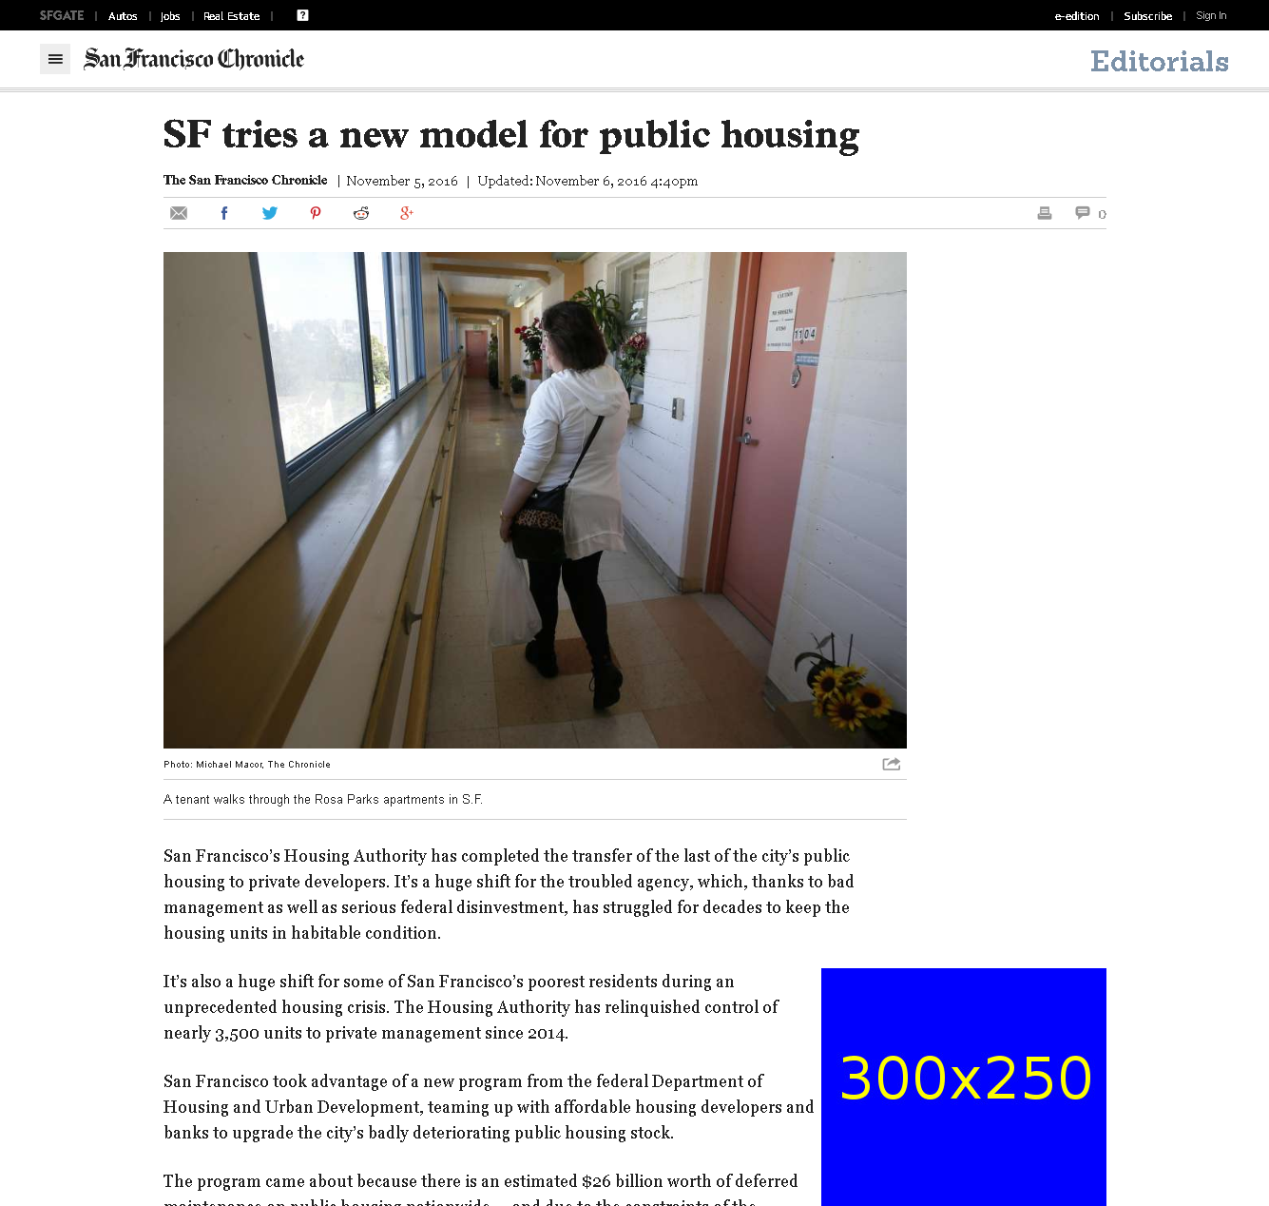
http://www.sfchronicle.com/opinion/editorials/article/SF-tries-a-new-model-for-public-housing-10596377.php

Slide 5
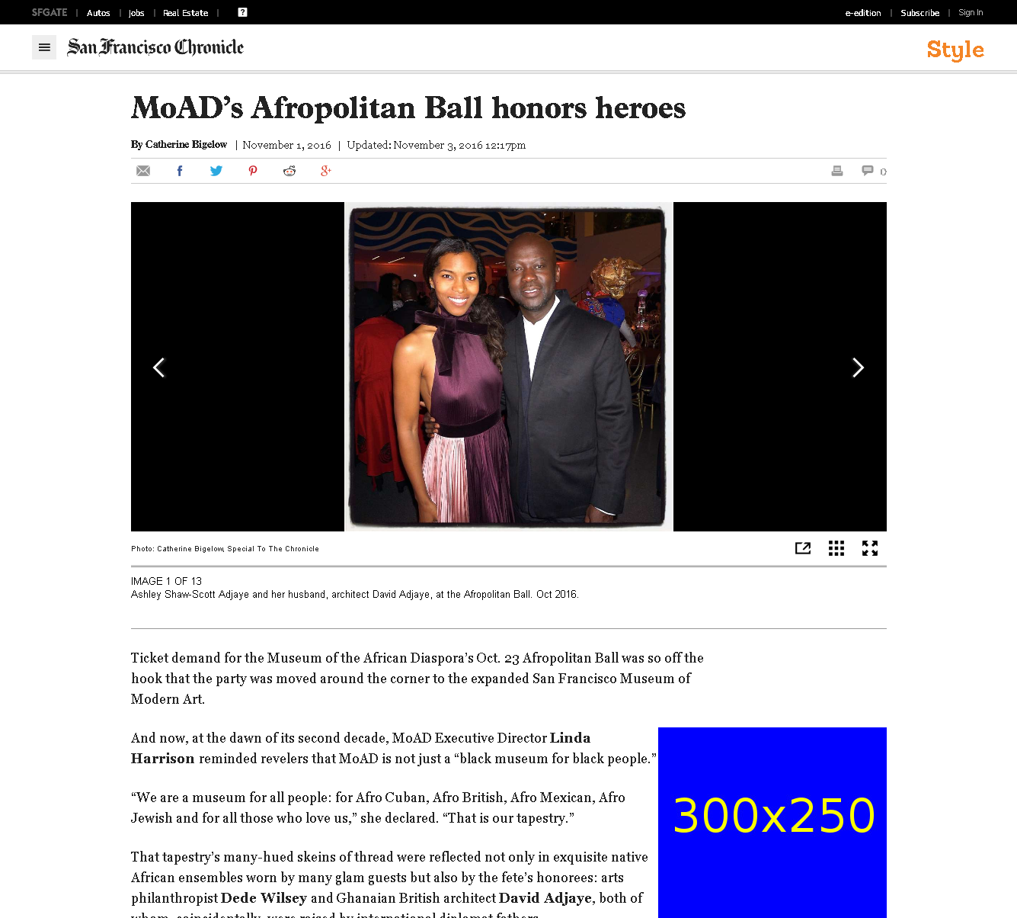
http://www.sfchronicle.com/style/article/MoAD-s-Afropolitan-Ball-honors-heroes-10448078.php

Slide 6
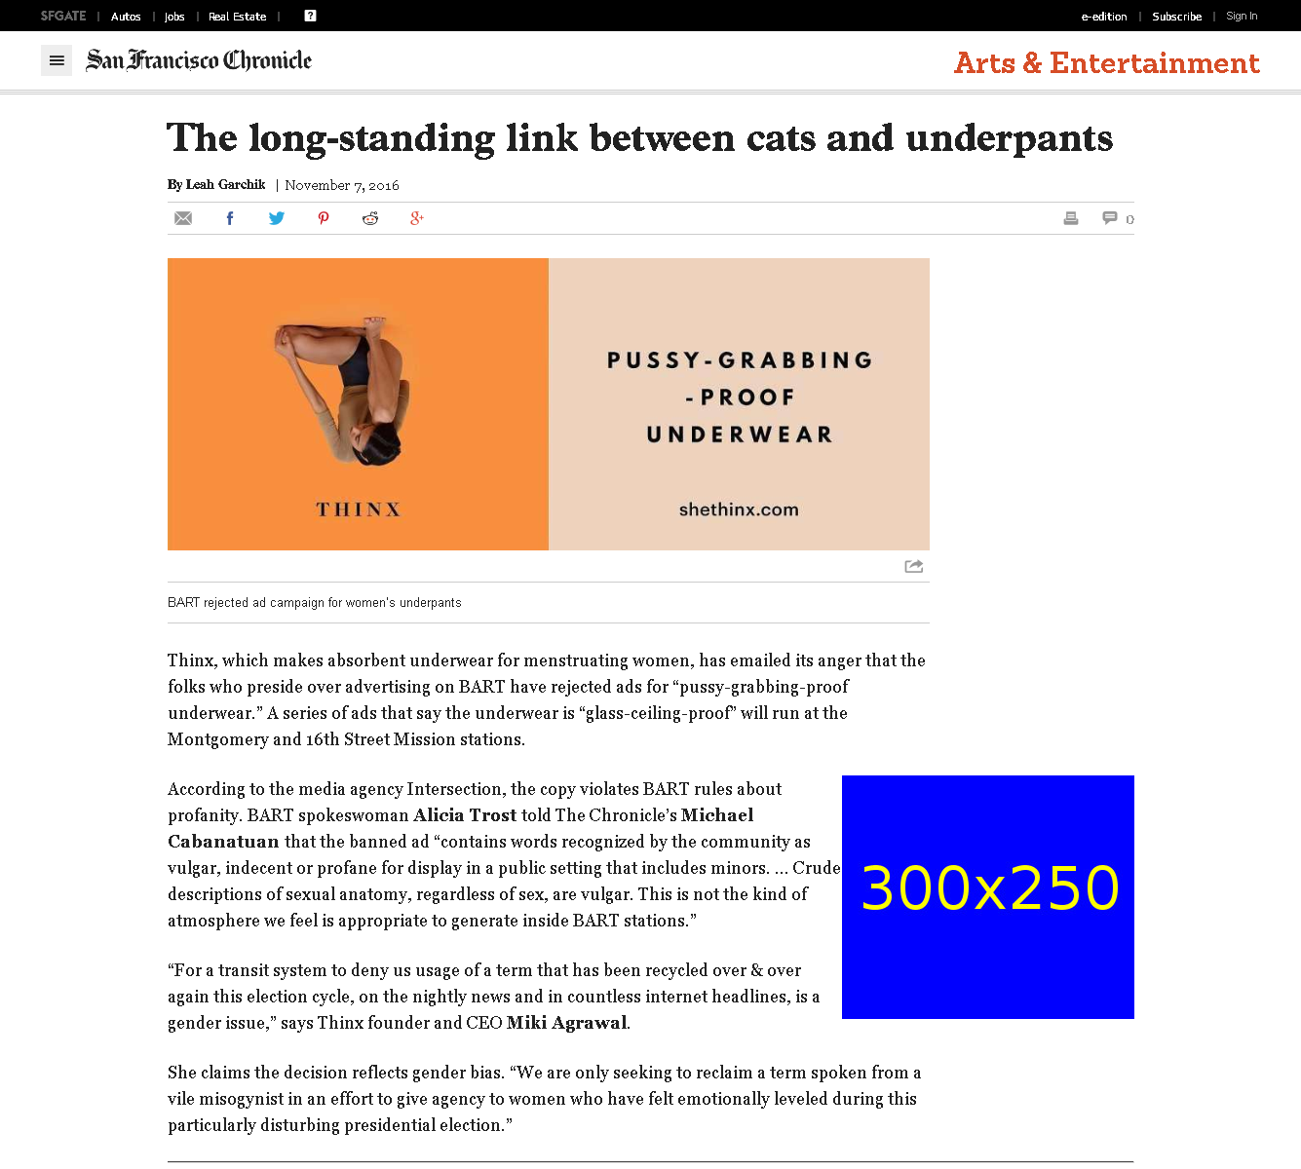
http://www.sfchronicle.com/entertainment/garchik/article/The-long-standing-link-between-cats-and-underpants-10594632.php

