Slide 1
Campaign Name
11-07-2016

Slide 2
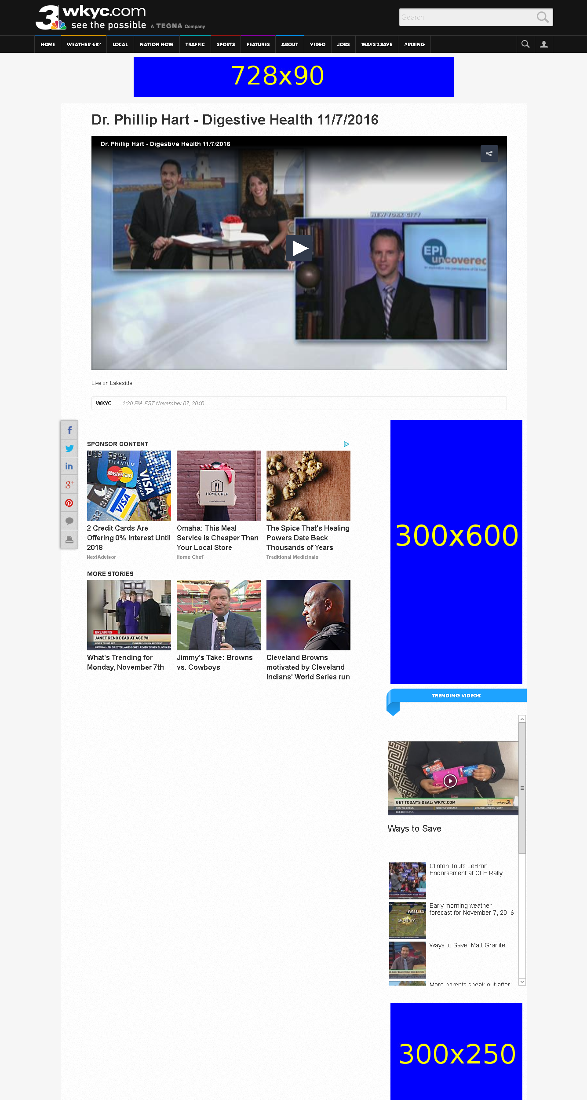
http://www.wkyc.com/home/dr-phillip-hart-digestive-health-11-7-2016/349348155

Slide 3
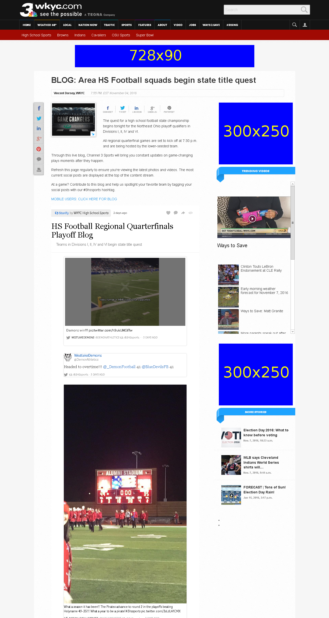
http://www.wkyc.com/sports/high-school/blog-area-hs-football-squads-begin-state-title-quest/348206721

