Slide 1
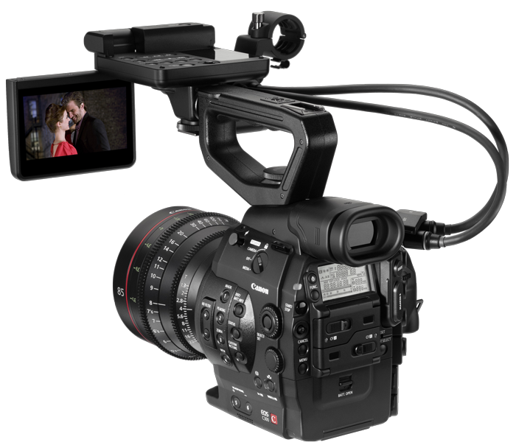

Slide 2

TextBoxTester1

Slide 3


