Slide 1
Campaign Name
10-20-2016

Slide 2
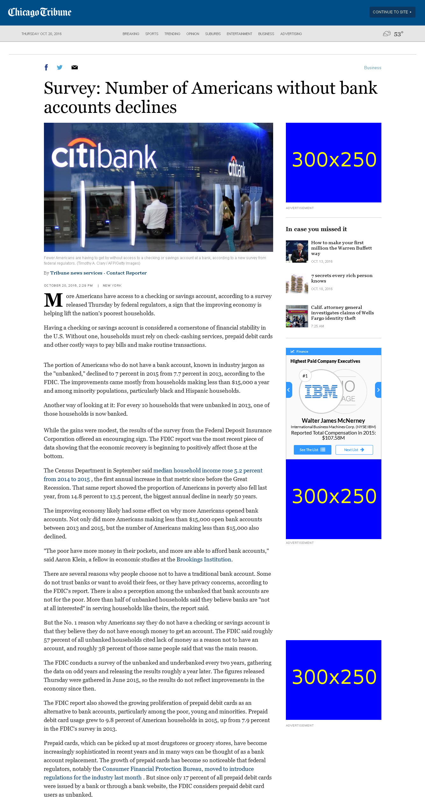
http://www.chicagotribune.com/business/ct-number-of-americans-without-bank-accounts-20161020-story.html

Slide 3
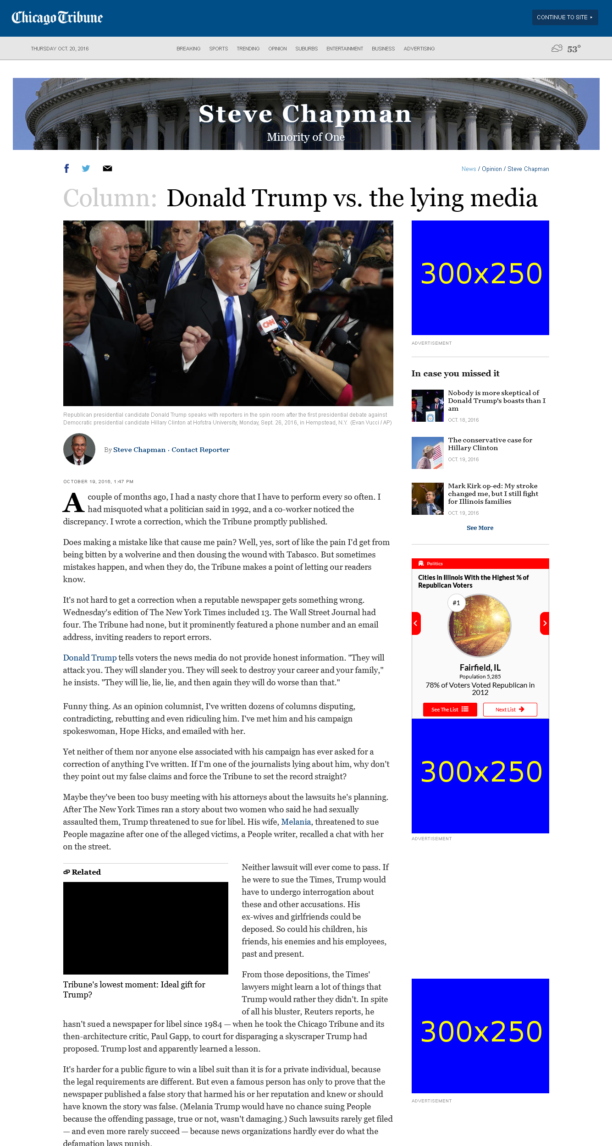
http://www.chicagotribune.com/news/opinion/chapman/ct-donald-trump-biased-media-lies-perspec-1020-jm-20161019-column.html

Slide 4
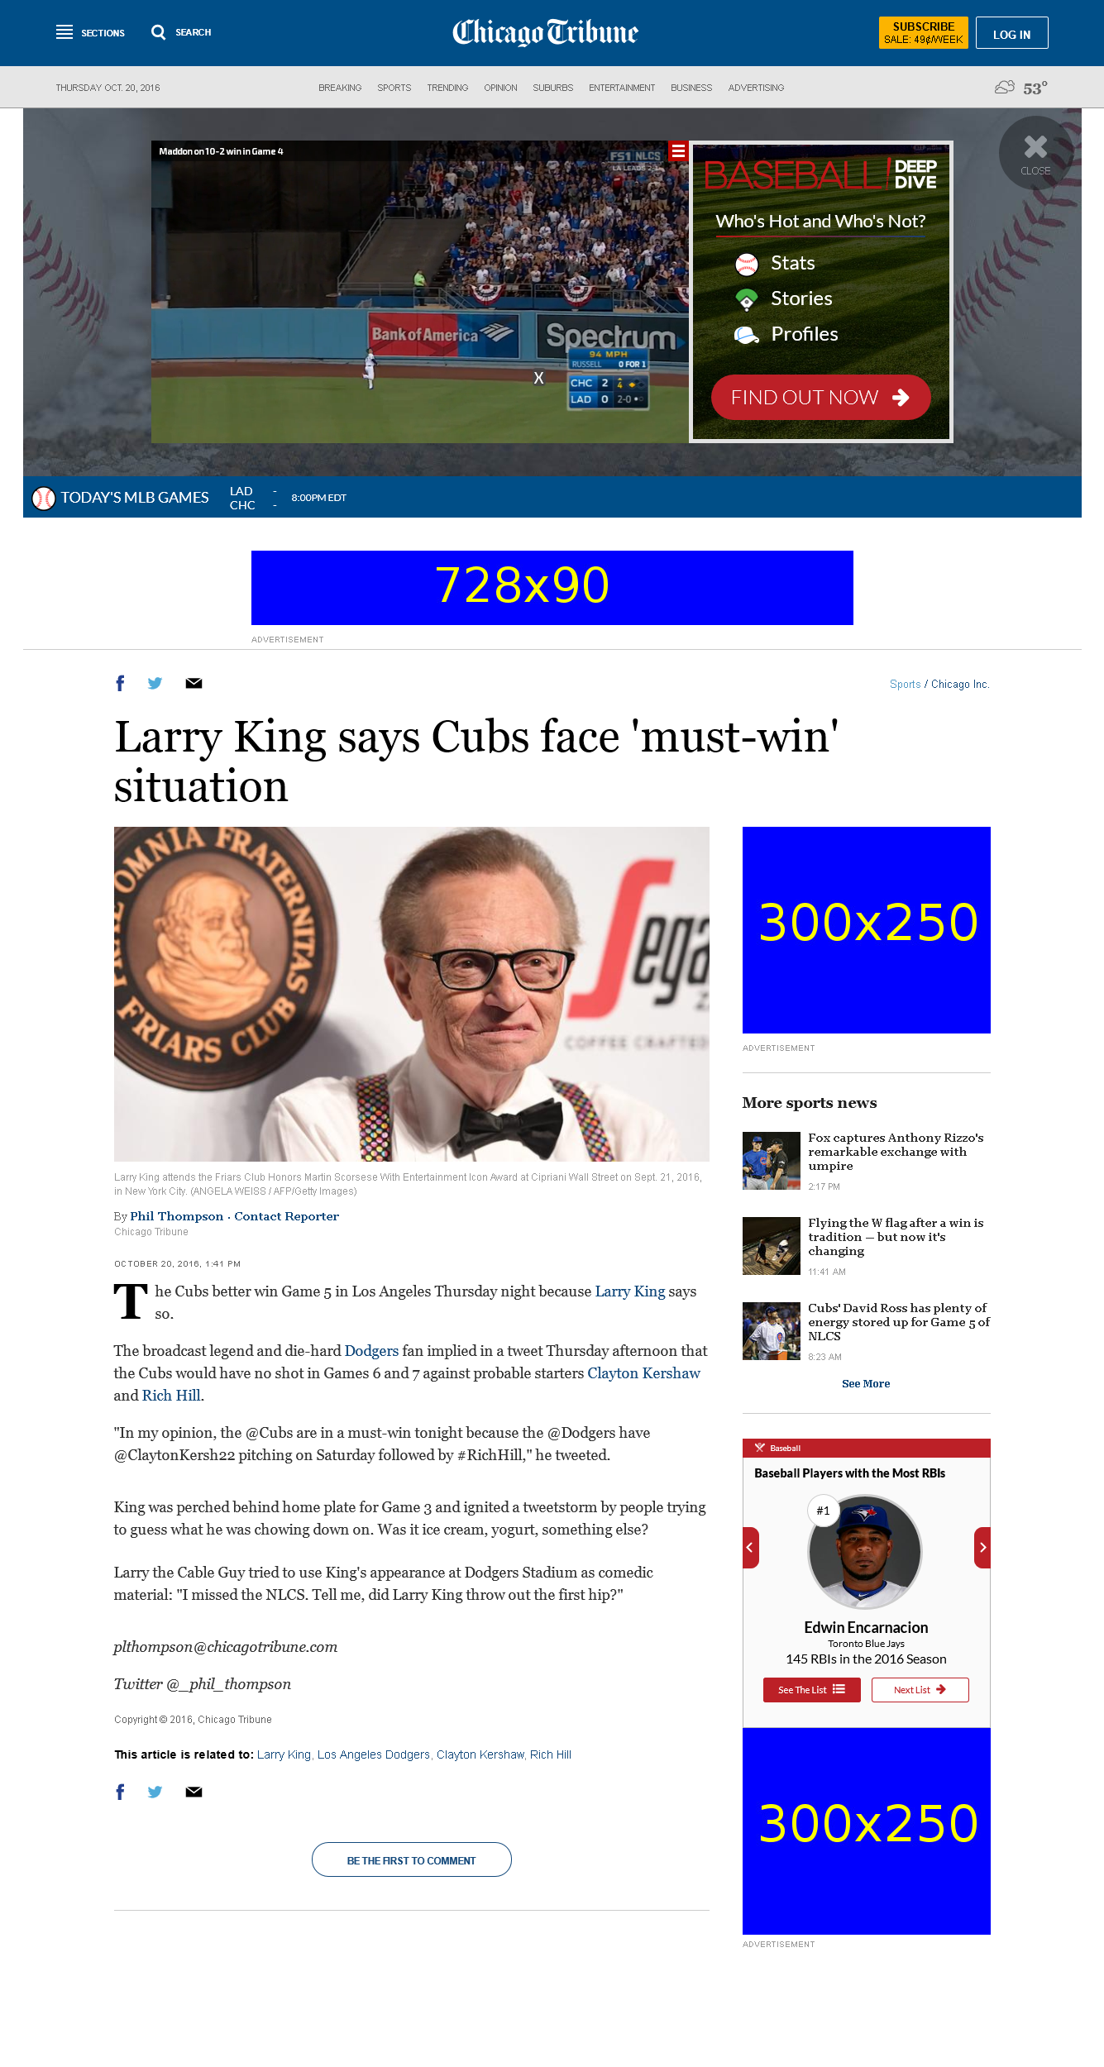
http://www.chicagotribune.com/sports/chicagoinc/ct-larry-king-cubs-must-win-0161020-story.html

