Slide 1
Campaign Name
09-28-2016

Slide 2
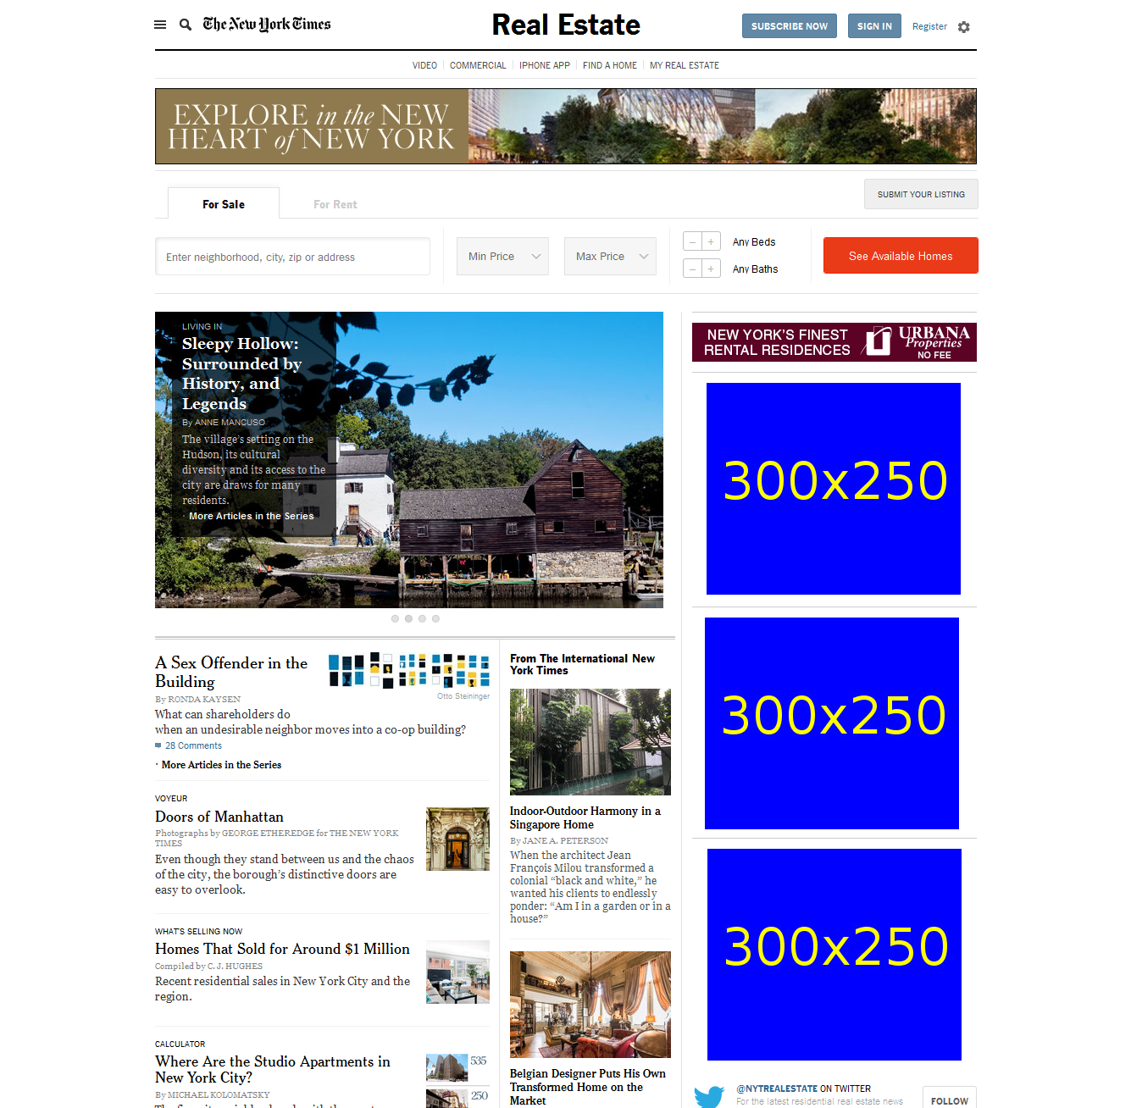
http://www.nytimes.com/pages/realestate/index.html

