Slide 1

Swensons
02/02/2017

Slide 2

Desktop: 300x50,300x600,728x90,300x250,320x50
Cleveland's Leading Local News: Weather, Traffic, Sports and more | Cleveland, Oh | WKYC.com

Slide 3

Desktop: 300x50,300x600,728x90,300x250,320x50
Cleveland Features: Feature Stories, Video and Photo Galleries | WKYC.com

Slide 4
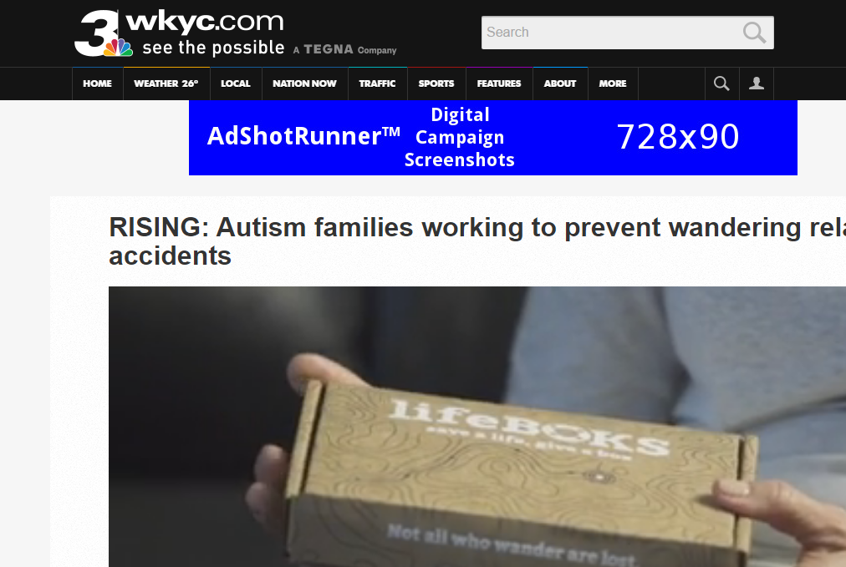
Desktop: 300x50,300x600,728x90,300x250,320x50
RISING: Autism families working to prevent wandering related accidents | WKYC.com

Slide 5

Mobile: 300x50,300x600,728x90,300x250,320x50
RISING: Autism families working to prevent wandering related accidents | WKYC.com

Slide 6
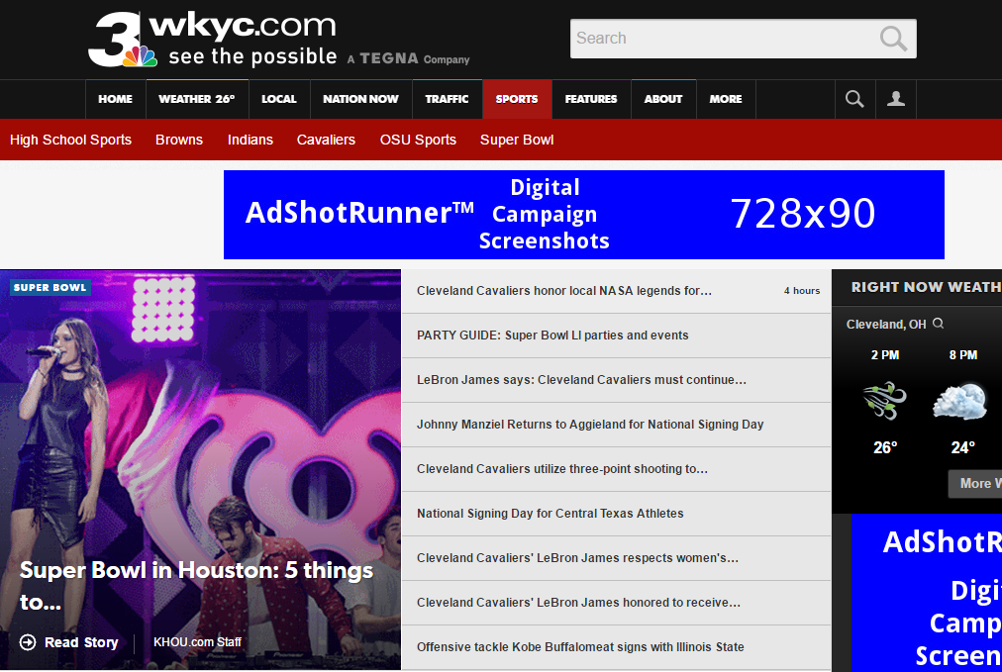
Desktop: 300x50,300x600,728x90,300x250,320x50
Cleveland Sports News: Browns, Indians, Cavaliers, OSU Sports, High School | WKYC.com

Slide 7
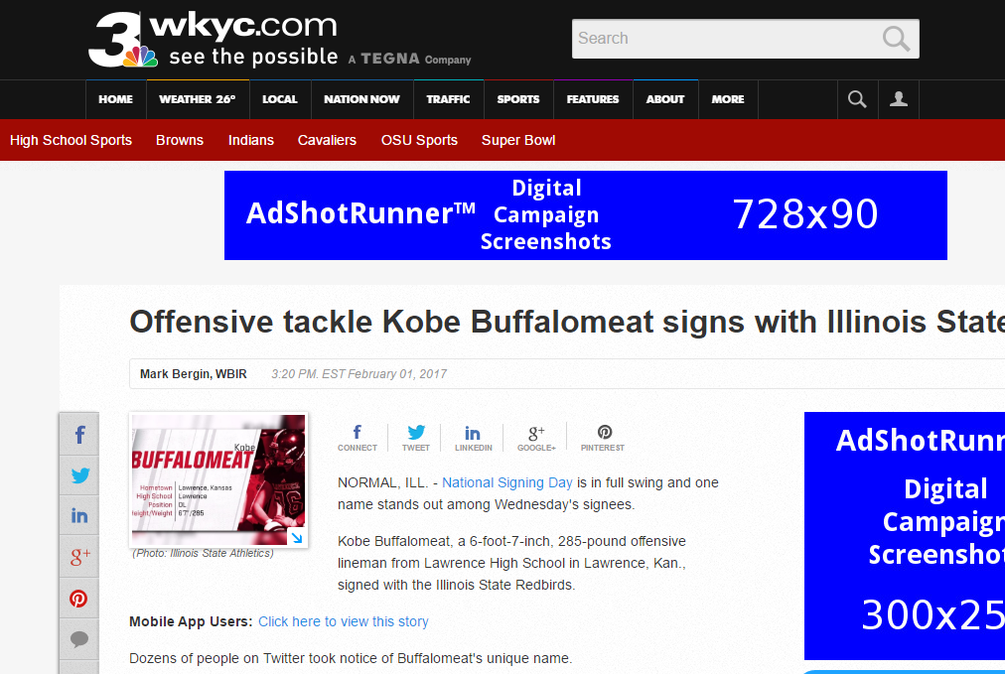
Desktop: 300x50,300x600,728x90,300x250,320x50
Offensive tackle Kobe Buffalomeat signs with Illinois State | WKYC.com

Slide 8
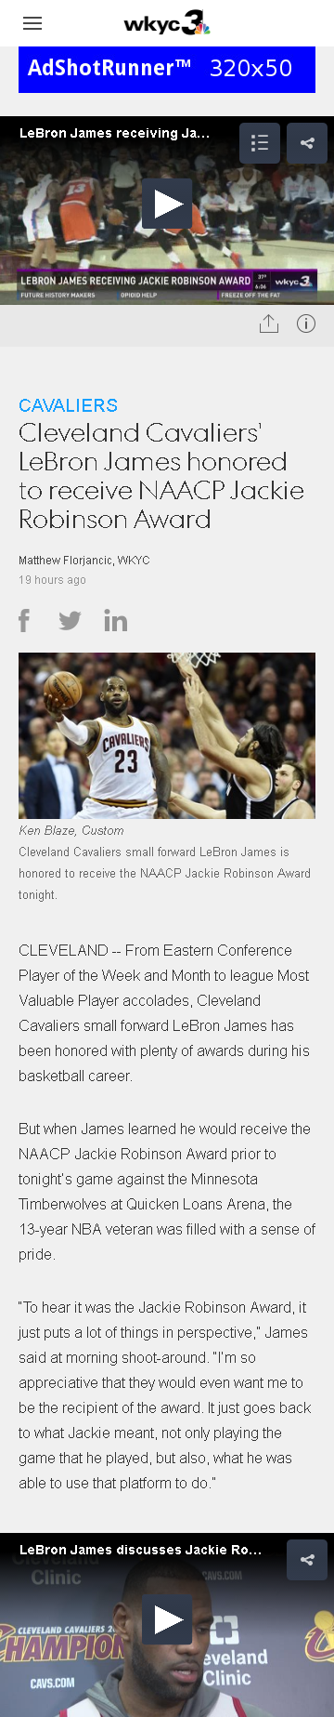
Mobile: 300x50,300x600,728x90,300x250,320x50
Cleveland Cavaliers' LeBron James honored to receive NAACP Jackie Robinson Award | WKYC.com

Slide 9
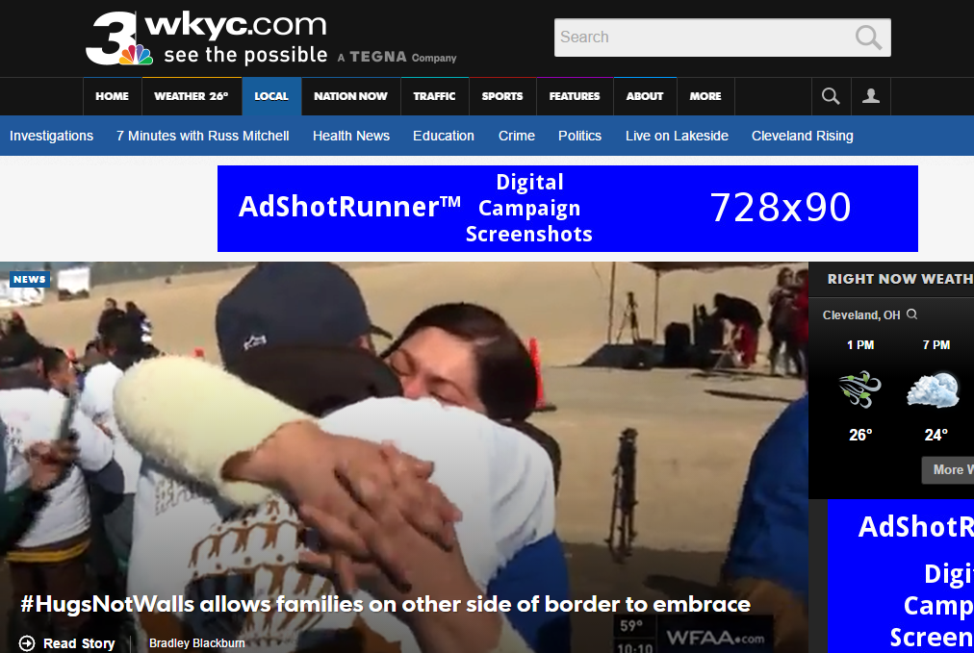
Desktop: 300x50,300x600,728x90,300x250,320x50
Cleveland Local News | Cleveland, Ohio | WKYC.com

Slide 10
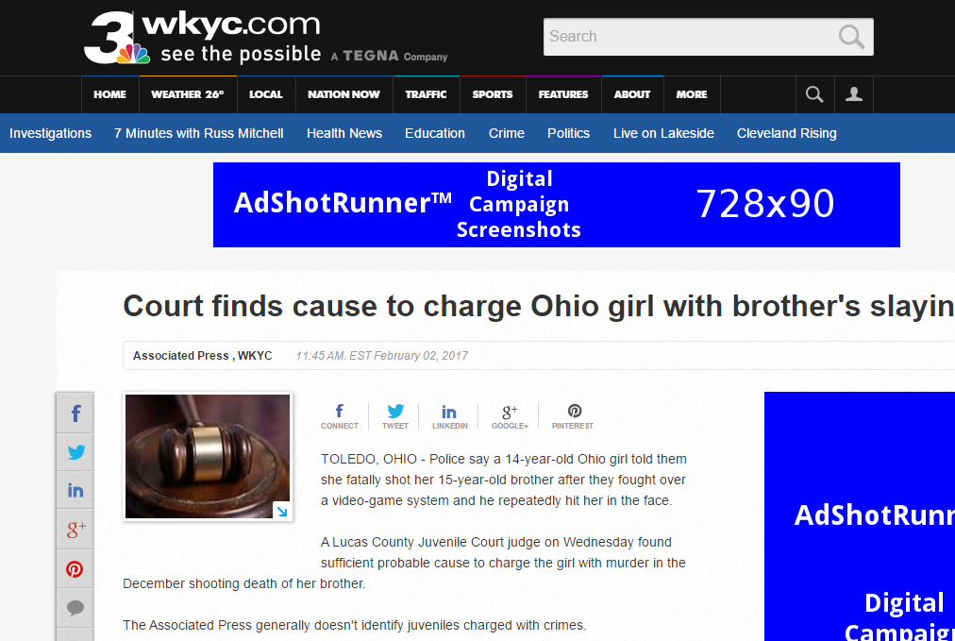
Desktop: 300x50,300x600,728x90,300x250,320x50
Court finds cause to charge Ohio girl with brother's slaying | WKYC.com

Slide 11
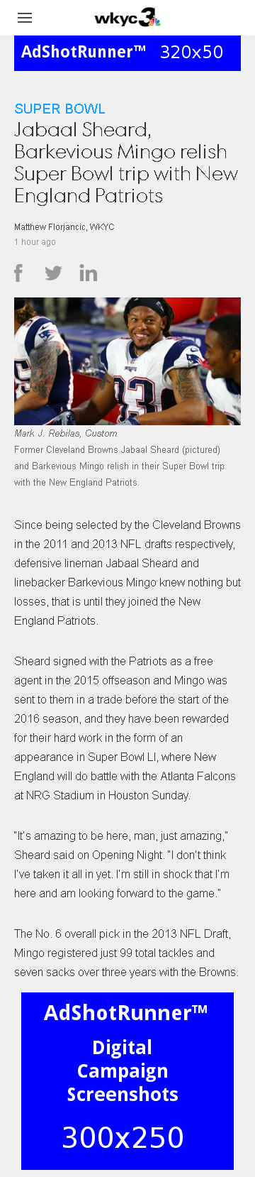
Mobile: 300x50,300x600,728x90,300x250,320x50
Jabaal Sheard, Barkevious Mingo relish Super Bowl trip with New England Patriots | WKYC.com

