Slide 1
Campaign Name
09-26-2016

Slide 2
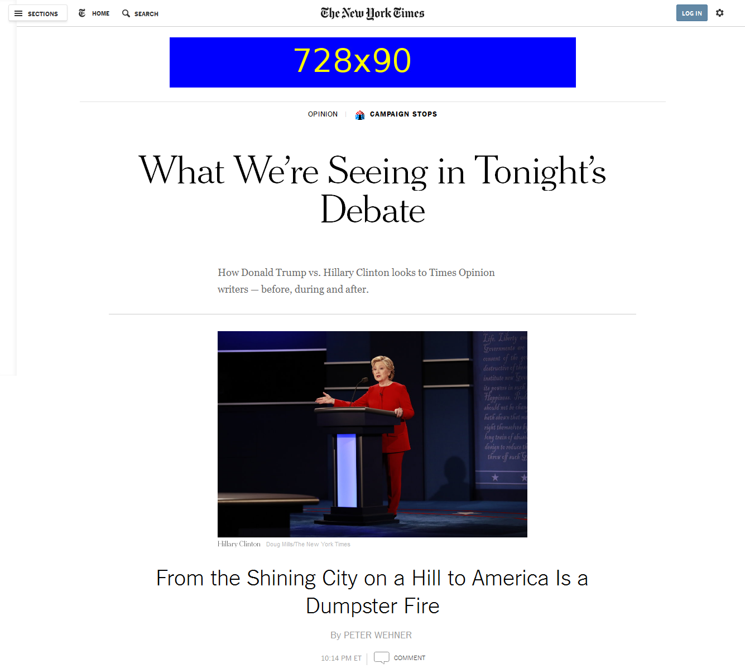
http://www.nytimes.com/interactive/projects/cp/opinion/clinton-trump-first-debate-election-2016/america-isa-dumpster-fire

Slide 3
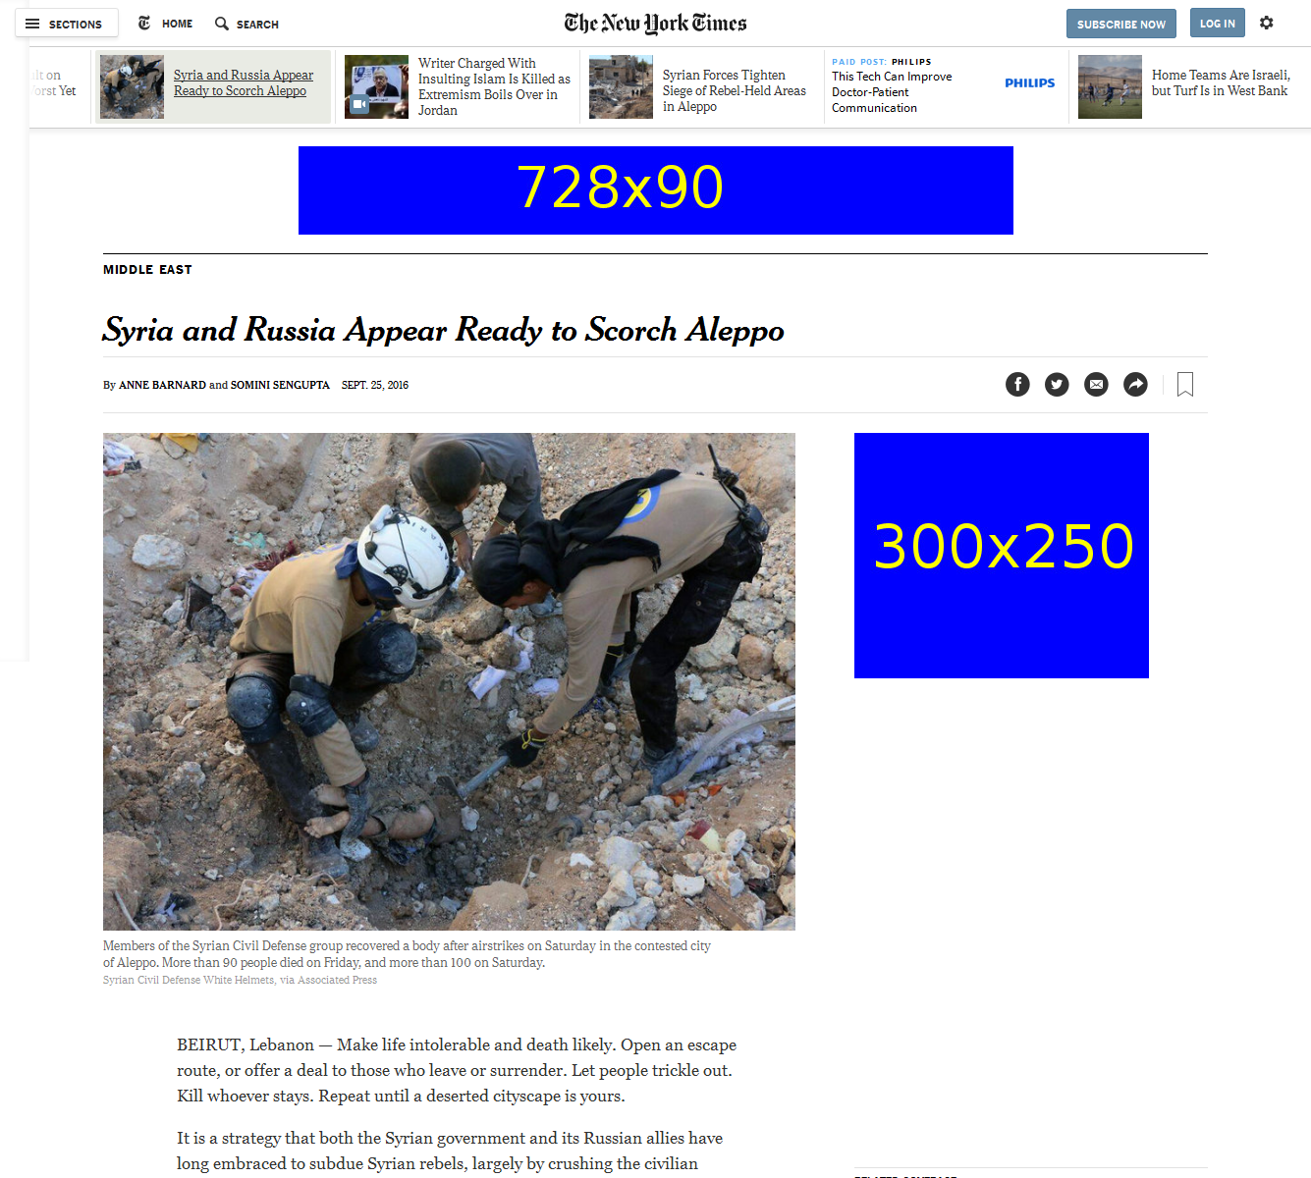

Slide 4
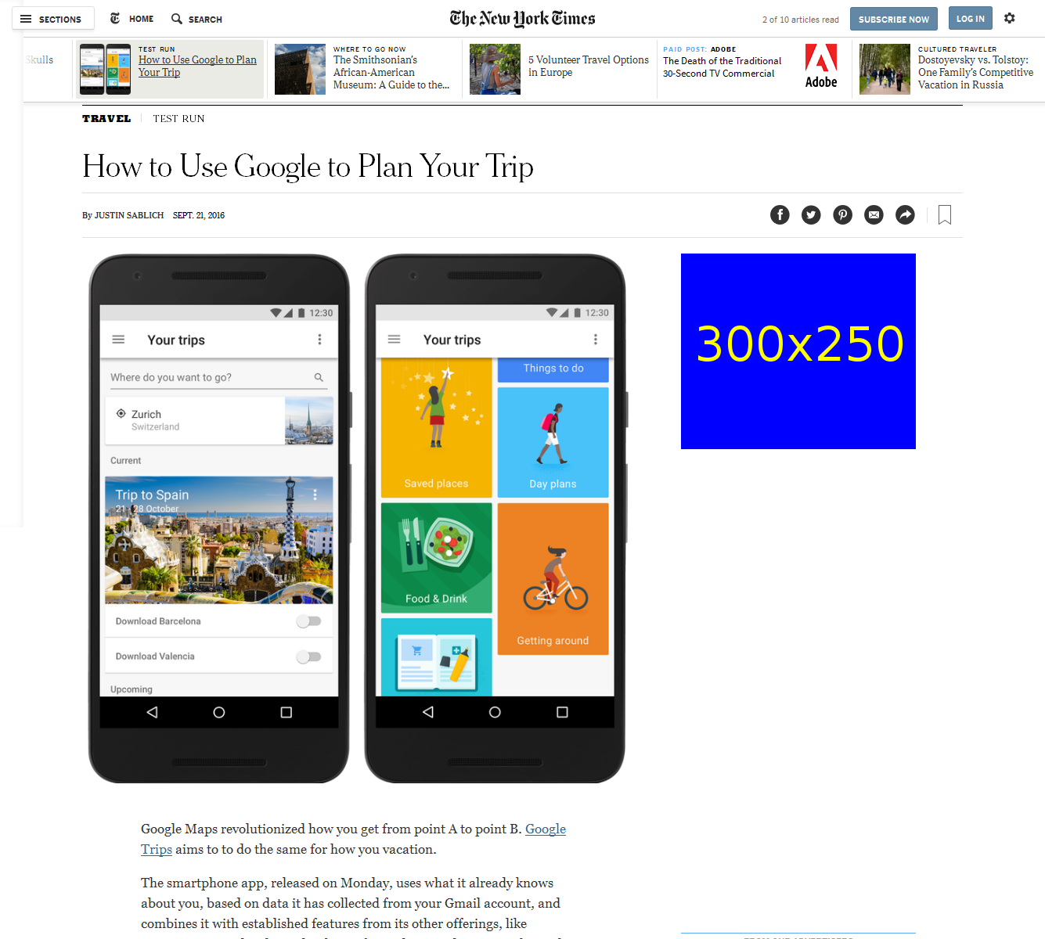
http://www.nytimes.com/2016/09/21/travel/how-to-use-google-trips-tour-guide-travel.html

