Slide 2
Some stuff
Quarto
Bullets
When you click the Render button a document will be generated that includes:
Content authored with markdown
Output from executable code
Code
When you click the Render button a presentation will be generated that includes both content and the output of embedded code. You can embed code like this:
[1] 2

Slide 3
Test
Slide Title
Slide with speaker notes
Slide content
Notes:
Speaker notes go here.

Slide 4
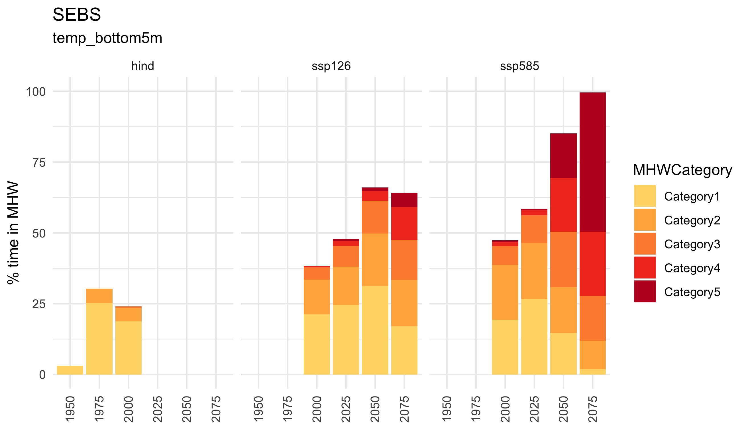
SEBS MHWs (bottom temp.)
presently, 20% of the time
with Carbon Mitigation (ssp126) –> 70% of the time
without Carbon Mitigation (ssp585) –> 95% of the time
much higher rate of Cat. 5 MHW

Slide 5
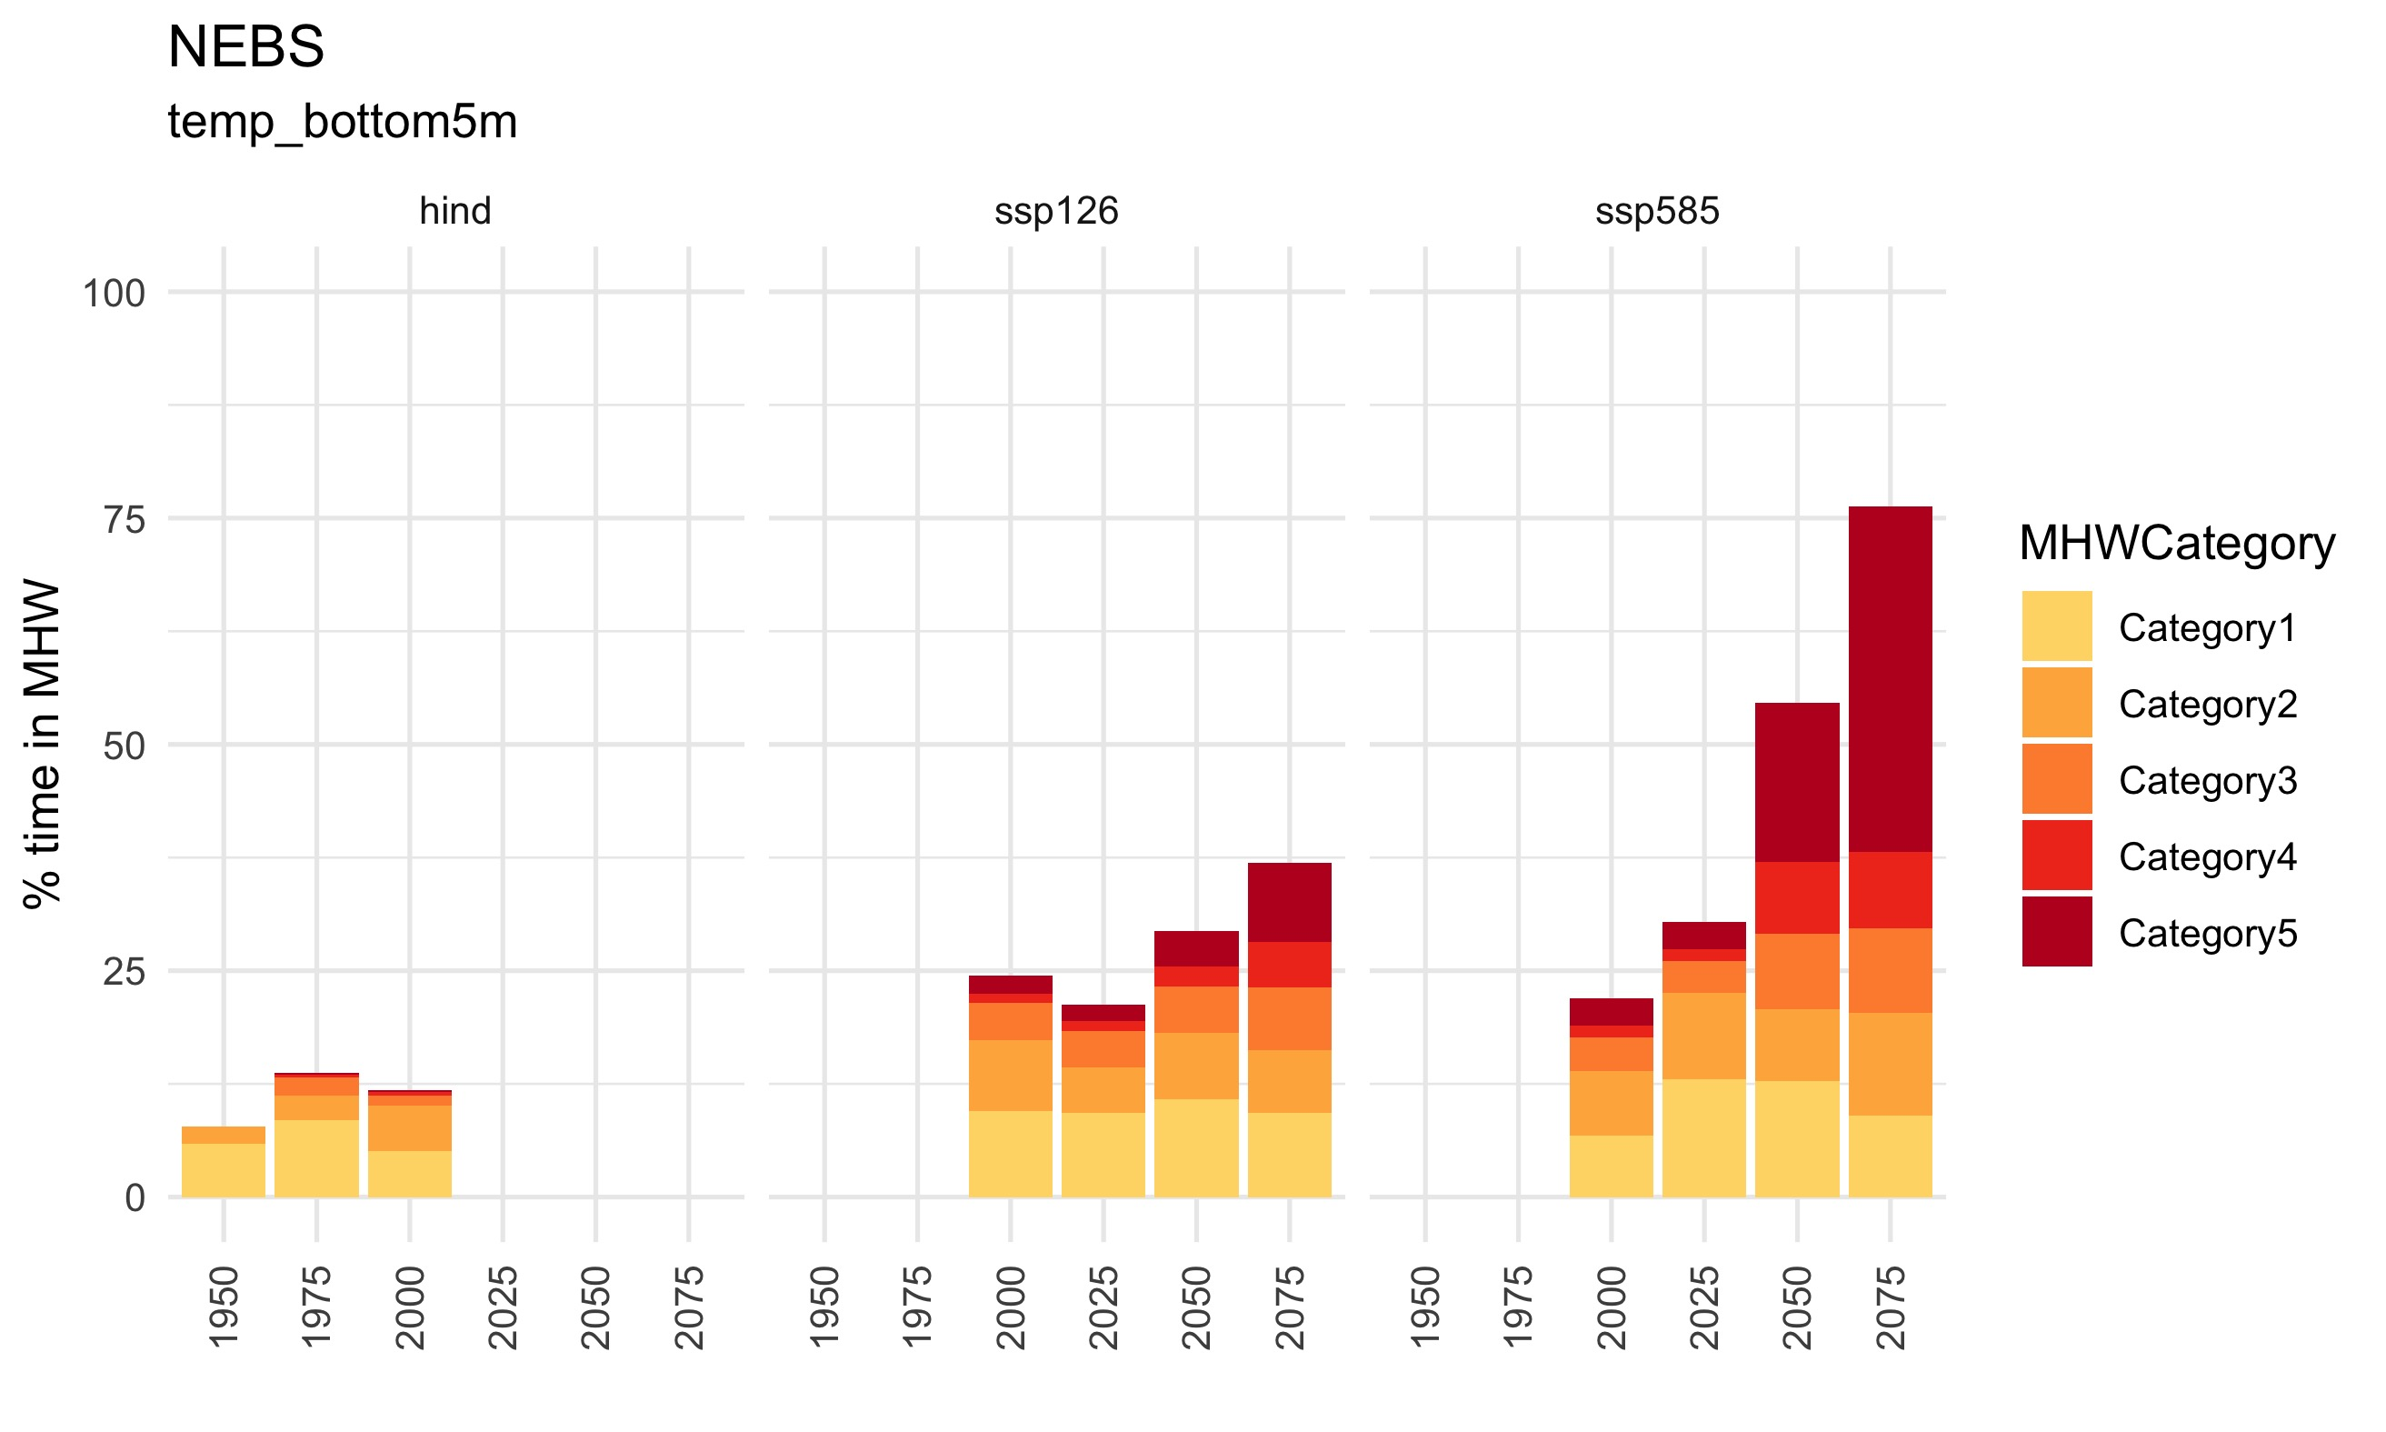
NEBS MHWs (bottom temp.)
presently, 20% of the time
with Carbon Mitigation (ssp126) –> 40% of the time
without Carbon Mitigation (ssp585) –> 70% of the time
much higher rate of Cat. 5 MHW

Slide 6
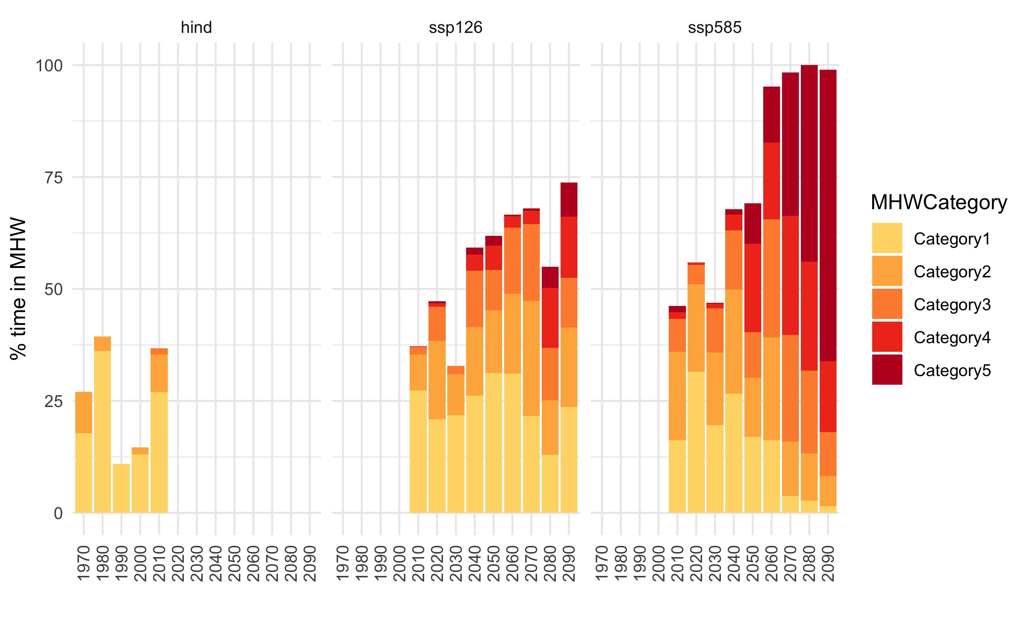
SEBS MHWs (bottom temp.)
presently, 20% of the time
with Carbon Mitigation (ssp126) –> 70% of the time
without Carbon Mitigation (ssp585) –> 95% of the time
much higher rate of Cat. 5 MHW

Slide 7
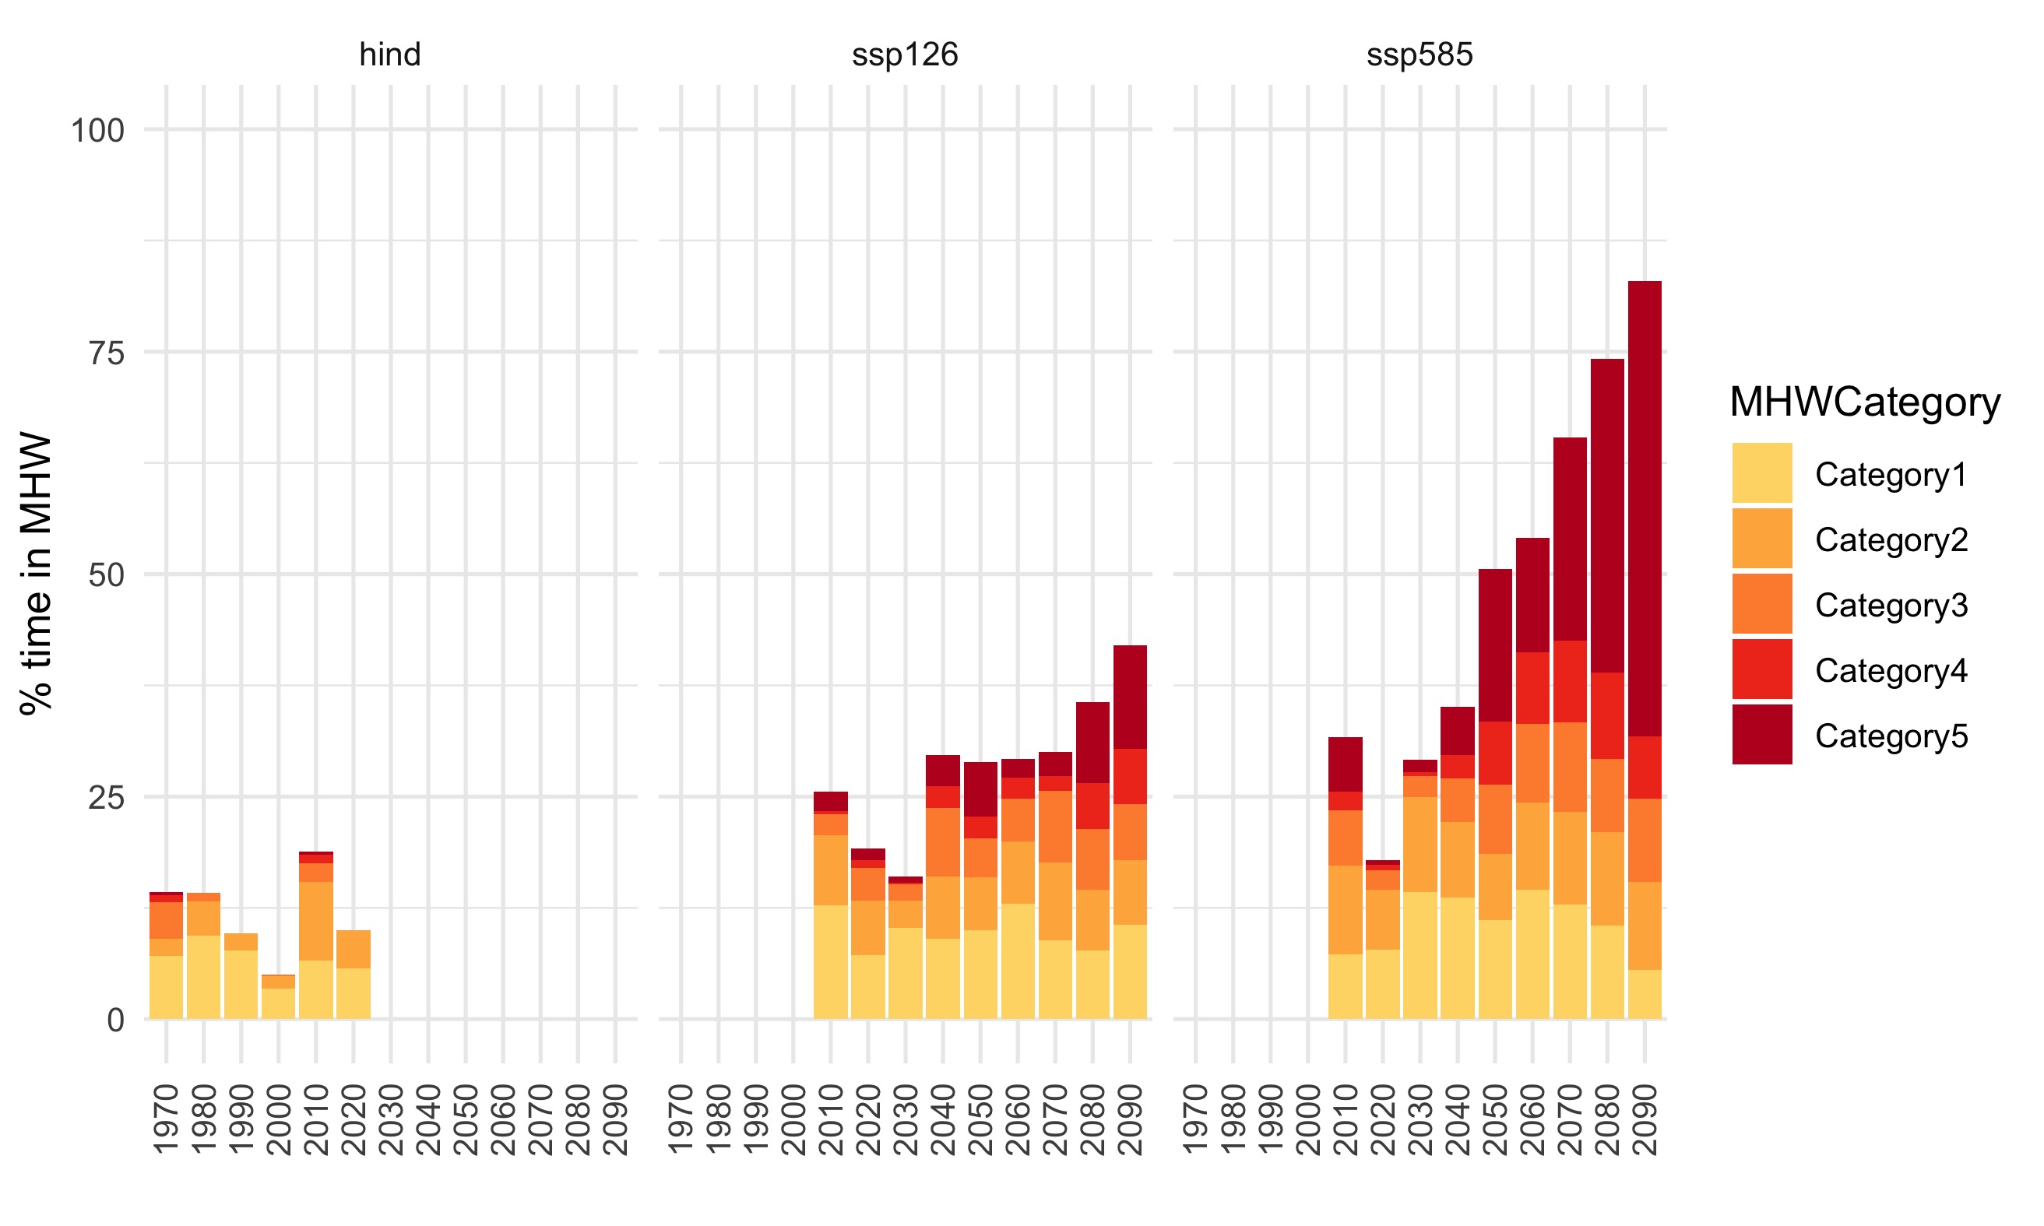
NEBS MHWs (bottom temp.)
presently, 20% of the time
with Carbon Mitigation (ssp126) –> 40% of the time
without Carbon Mitigation (ssp585) –> 70% of the time
much higher rate of Cat. 5 MHW

Slide 8
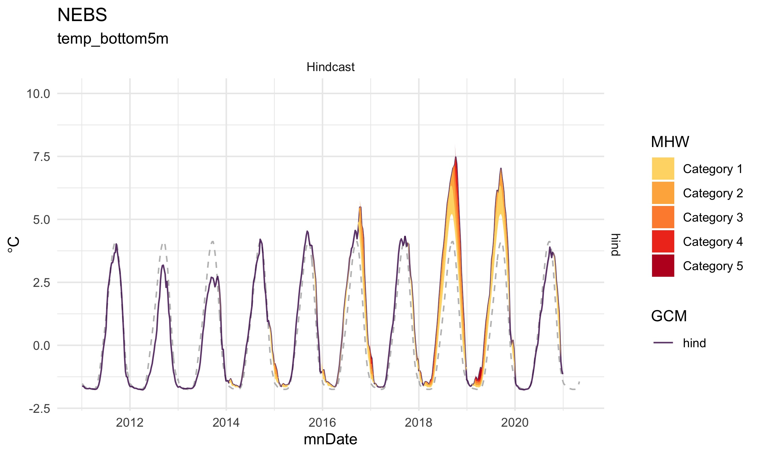
Historically (NEBS)
MHW uncommon winter in NEBS

Slide 9
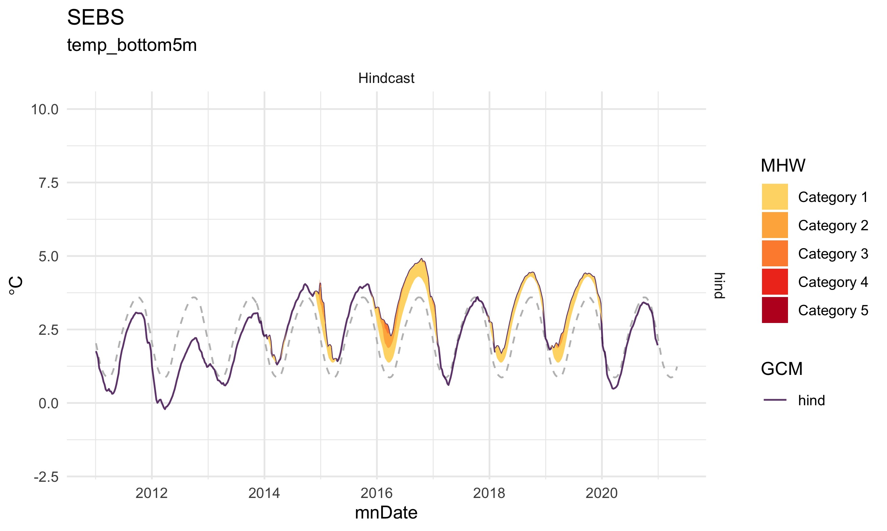
Historically (SEBS)
MHW uncommon winter in NEBS

Slide 10
longer look - NEBS

Slide 11
longer look - SEBS

