Slide 1
MHW_ACLIM3

Slide 2
Some stuff
Quarto
Quarto enables you to weave together content and executable code into a finished presentation. To learn more about Quarto presentations see https://quarto.org/docs/presentations/.
https://quarto.org/docs/presentations/powerpoint.html
Bullets
When you click the Render button a document will be generated that includes:
Content authored with markdown
Output from executable code
Code
When you click the Render button a presentation will be generated that includes both content and the output of embedded code. You can embed code like this:
[1] 2

Slide 3
Test
Slide Title
Slide with speaker notes
Slide content
Notes:
Speaker notes go here.

Slide 4
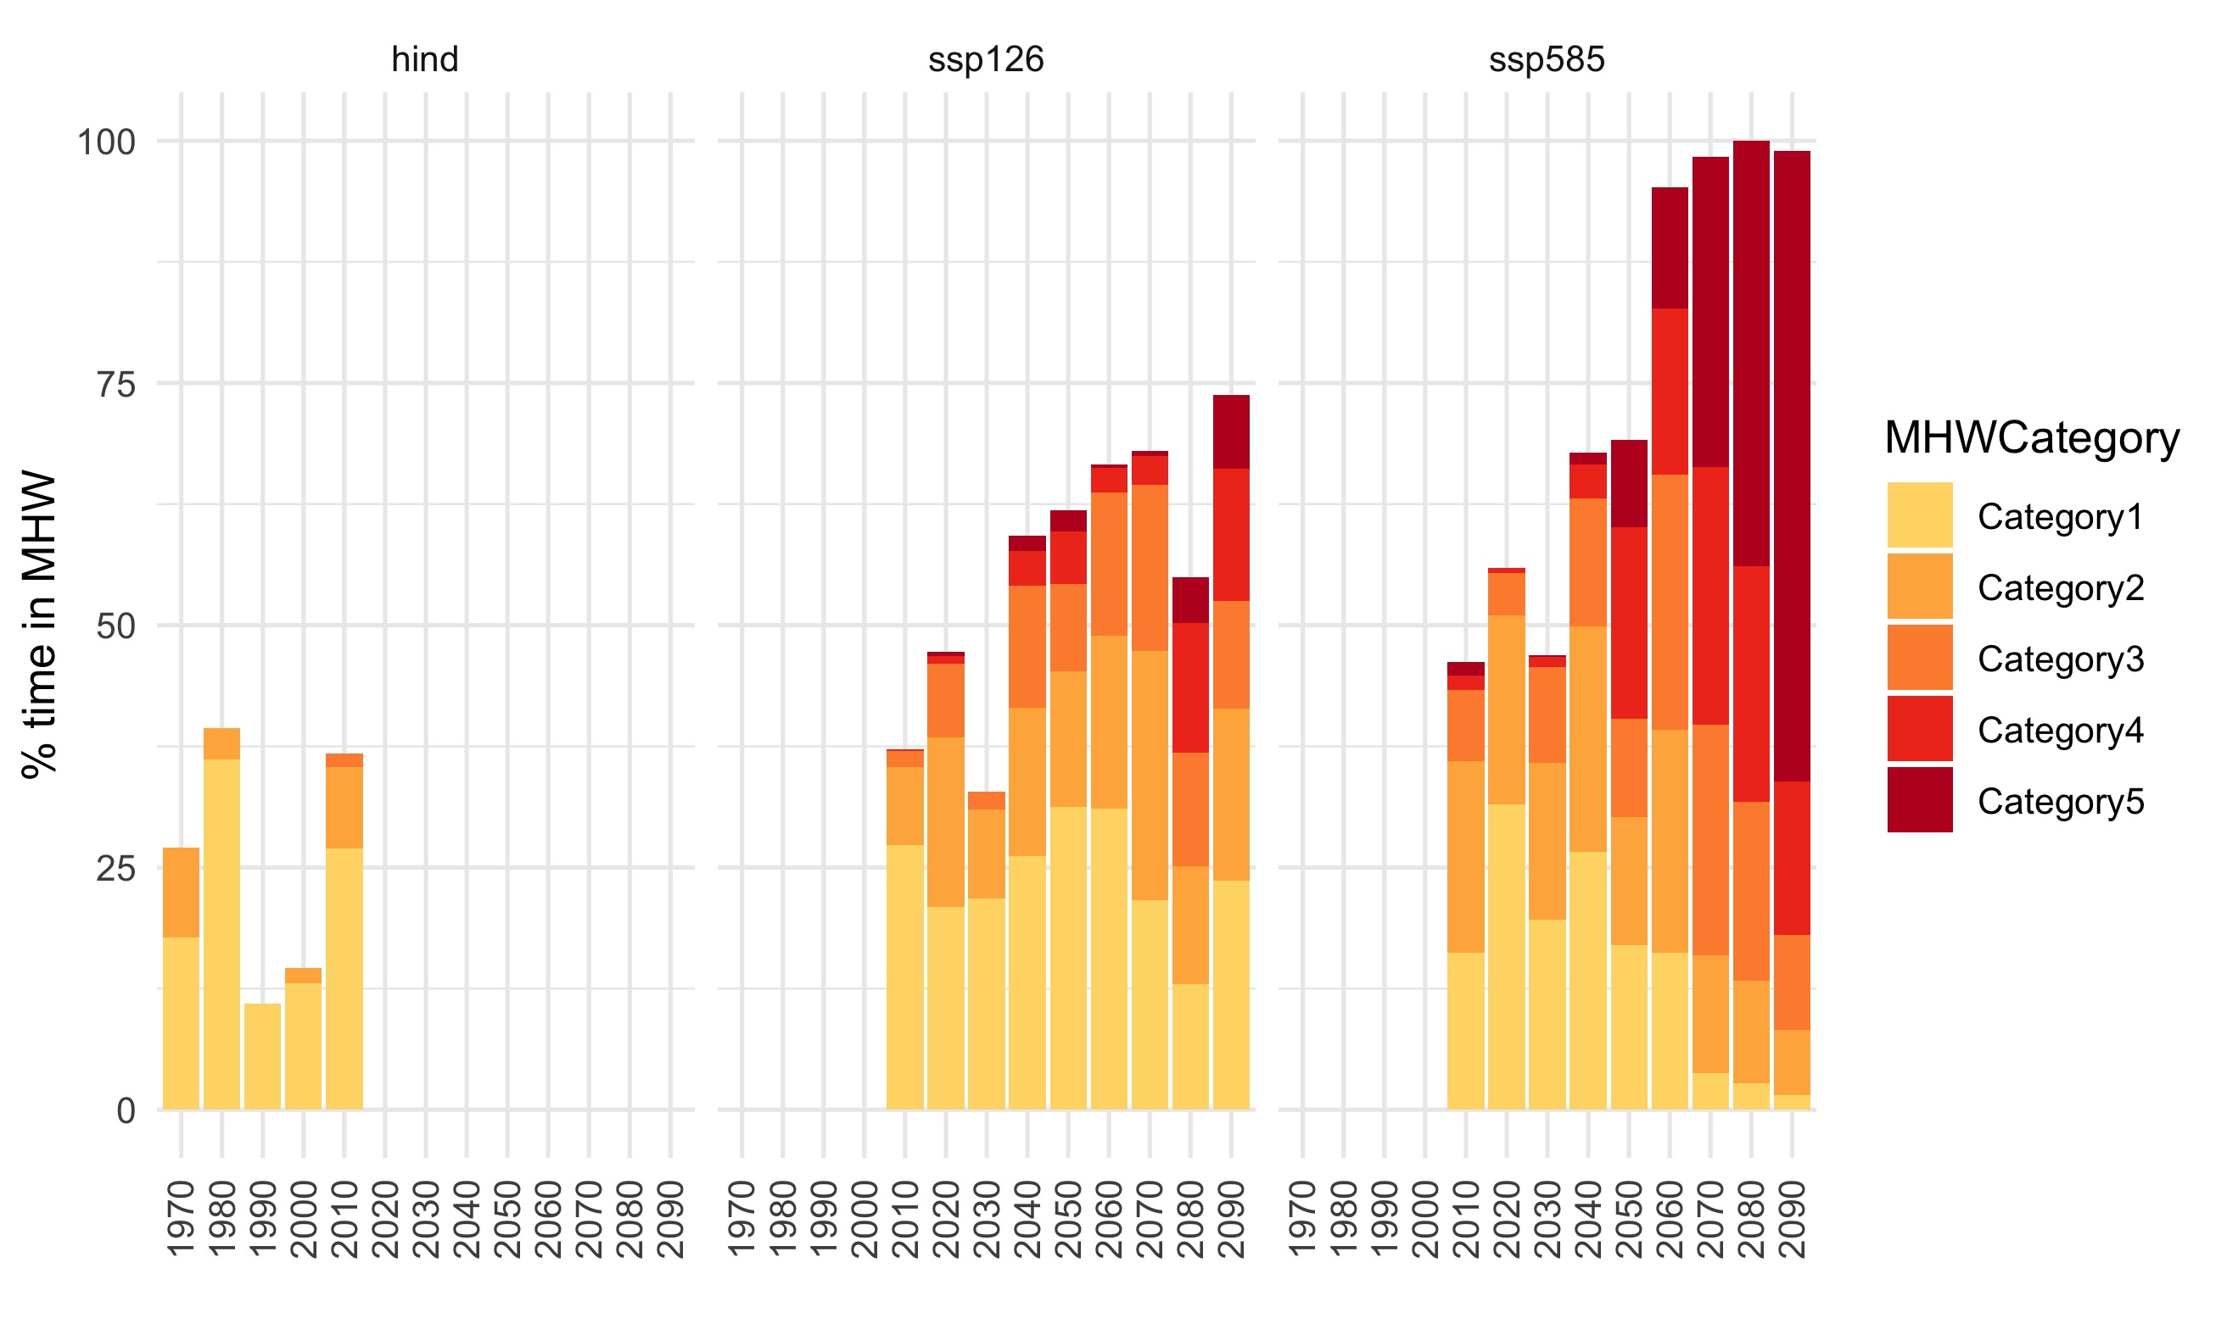
NEBS
contents…

