Slide 1


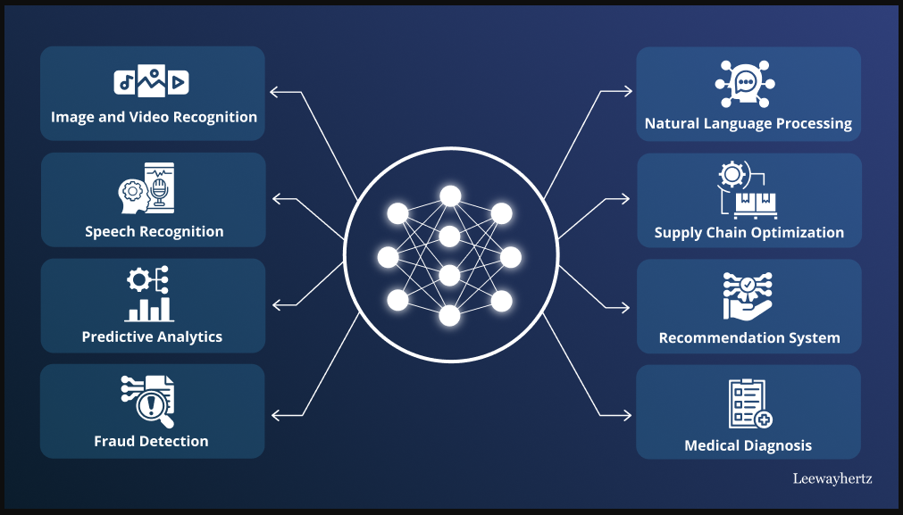
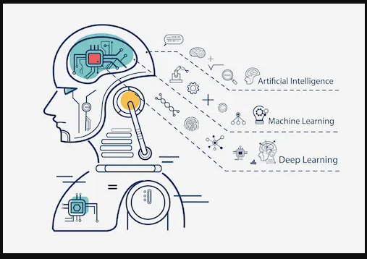
Course Portfolio
Matthew Choo - W206744145
Professor Patricia McManus
May 6, 2026

Slide 2
Introduction
My name is Matthew Choo (Call me Matt) I am taking Deep Learning AI. I am still new to AI. I am interested in AI because I want to try to use it for robotics and try to learn how to use AI correctly. The reason I took this class is to learn more about AI itself. This topic has been expanding a lot in the real world and I want to make sure I understand the concept and how to use it in the real world. Also I am interested in trying to make apps with AI in the near future.
Matthew-Choo-AI-Portfolio

Slide 3
Learning Journey
In this course, I worked with a good team on both the assignment and labs. The assignment and labs. From the labs, I have to do step by step while doing the Neural Networks from Scratch to Frameworks, CNN, RNN & Transformers, Diffusion Models and Teaching an Agent to balance a pole. Then in the assignment part is where me and my team have to create a neural network zoo, teaching a 11 year old kid about deep learning, and comparing computer science with the movie “Arrival”. What I learned from this class are neural network basics, convolutional neural network, sequence modeling and NLP, Transformers & Attention Mechanisms, variational autoencoders VAEs, GANS, generative AI with Diffusion Models, and reinforcement learning & AI Agents. It was a lot of work and practice and I feel like I need to improve more on my skills on programming. I feel like there is so much to learn about AI that my head is hurting.

Slide 4
Featured Projects: AI Agent Creation
The most recent project was with my teammates Chloe Tu and Franckeric Kolontchangtoheu in creating a phishing program called The Hunter. This program detects certain emails which can either be a virus or non-virus. It's a defense detection systems that helps the users check if the email is good or bad. This AI Agent is built on CrewAI and utilizes a three-agent sequential pipeline. There are three agents which are Email Ingest Specialist, Phishing Risk Analyst, and SOC Orchestrator . Email Ingest Specialist parses raw text and extracts five key phishing signal features (e.g., URL count, urgency keywords). Next, Phishing Risk Analyst where it runs a dual-model ensemble to score the email; it invokes deep regex analysis for ambiguous scores (0.35–0.75). Lastly, SOC Orchestrator where it consults a persistent SQLite Threat Memory to identify repeat offenders and applies a four-tier defense policy (Allow, Log, Quarantine, Block). There was also the classification backbone that combines the two models that provide a final risk score such as BiLSTM (65% weight), Logistic Regression (35% weight) and Backbone LLM.

Slide 5
Skills & Competencies
My technical skills is using google collab. The core AI competencies that I have developed are the variational autoencoders VAE, GANs, generative AI with Diffusion Models, reinforcement learning and AI agents, multi-agents systems and advanced agents patterns. The soft skills that are relevant to the field are critical thinking, emotional intelligence, adaptability, and complex communication. I have learned a little about Python and C++. I understand the concept of the frameworks & libraries such as TensorFlow and PyTorch. I should try to learn about Data & Cloud such as AWS (sagemaker) and Google Cloud Platform. Lastly the tools such as Github and MLflow.

Slide 6
Reflection & Next Steps
What I learn from this class are the concepts such as neural network basics, convolutional neural network, sequence modeling & NLP, Transformers & attention mechanisms, variational autoencoders VAEs, GANS, generative AI with diffusion models, reinforcement learning & AI Agents, agentic systems using tools, rag and reasoning, multi-agents systems and advanced agents patterns. Was able to work with a good team about phishing and creating a program that can detect emails that are threatening and non-threatening.
Matthew Choo
W206744145@student.hccs.edu
832 -353 - 5359

