Slide 1

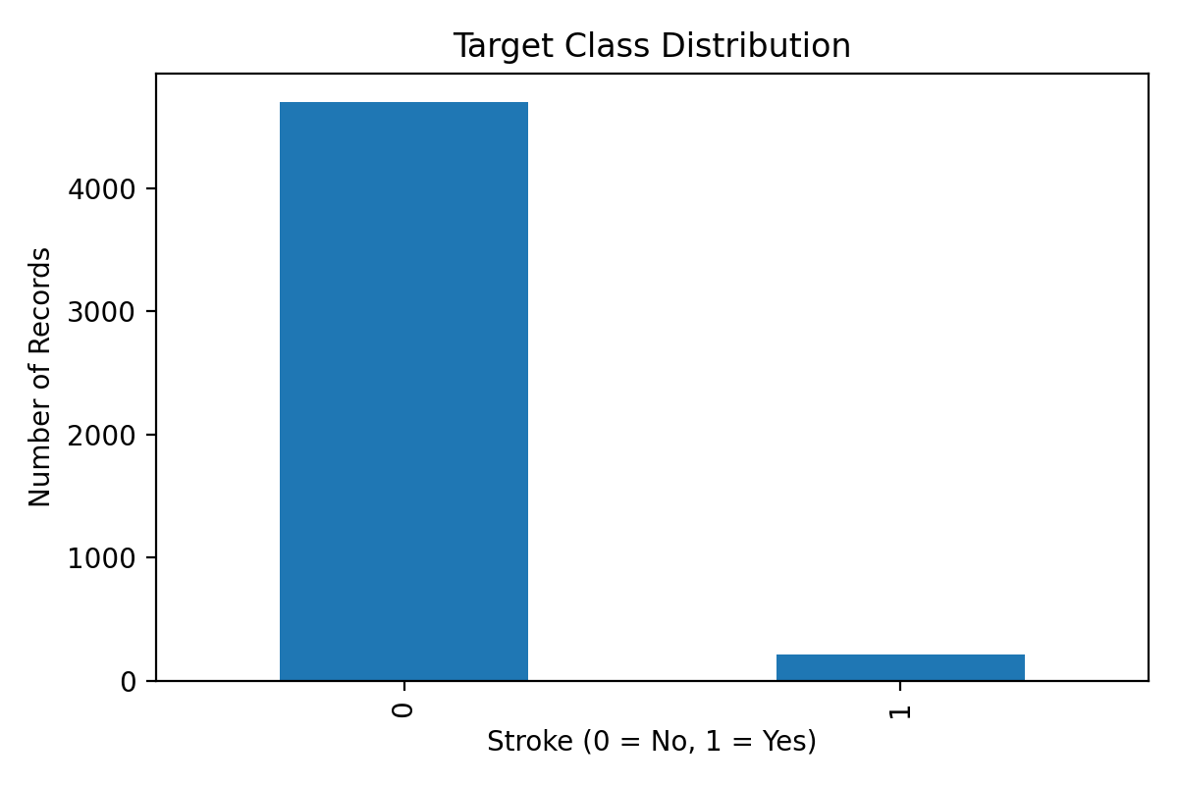
Stroke Prediction
Classification Project
Final ML Project - Classification | GitHub-ready deliverables
Mahdi Mohammadkhani
Target class is highly imbalanced: 4,700 no-stroke vs. 209 stroke records.
Final ML Project | Stroke Classification | Mahdi Mohammadkhani

Slide 2
Data Split and Modeling Workflow
Required Models
Project Setup
Logistic Regression
Decision Tree Classifier
Random Forest Classifier
Gradient Boosting Classifier
K-Nearest Neighbors Classifier
Support Vector Classifier
Target column: stroke
Split: 70% train, 15% validation, 15% test
Age group one-hot encoded
Numeric features scaled in pipeline
Metrics: Accuracy, Precision, Recall, F1, ROC-AUC
Final ML Project | Stroke Classification | Mahdi Mohammadkhani

Slide 3
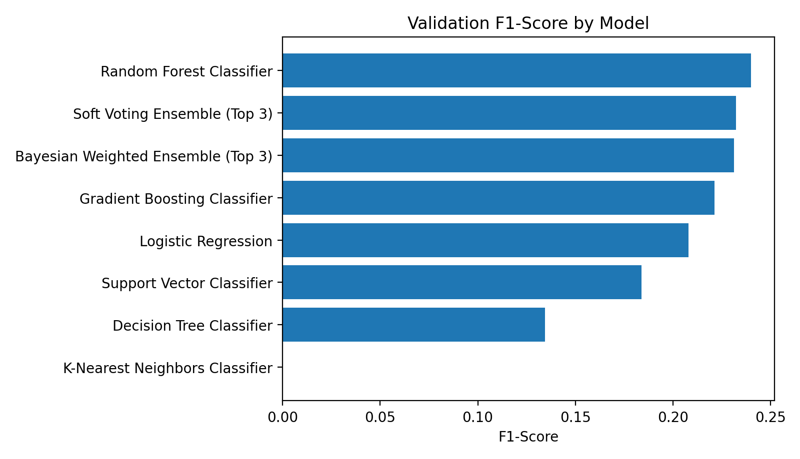
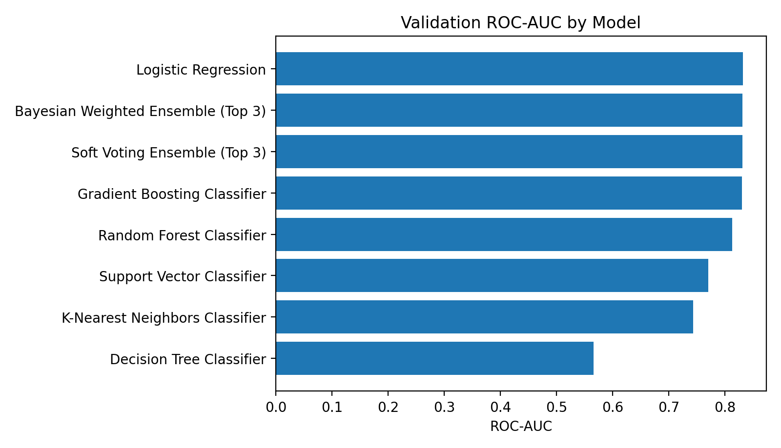
Validation Results: Choose Models Carefully
Accuracy alone can be misleading because the positive stroke class is small. F1 and ROC-AUC give a better comparison.
Final ML Project | Stroke Classification | Mahdi Mohammadkhani

Slide 4
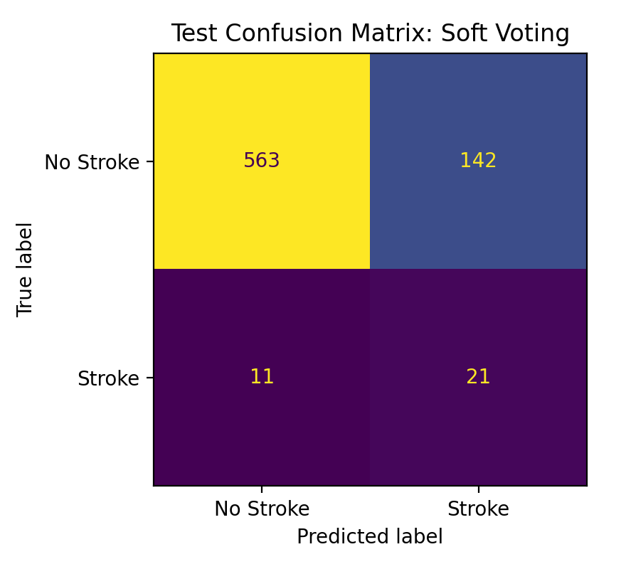
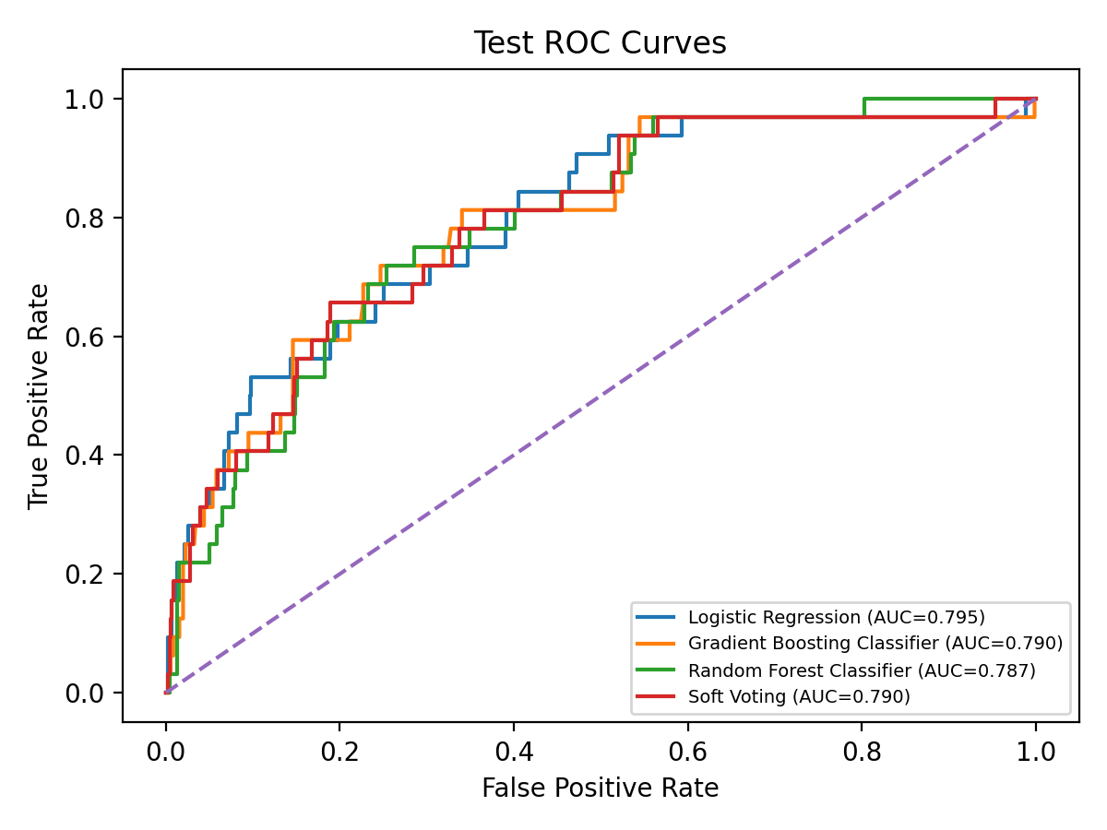
Final Recommendation: Ensemble Model
Best Test Result
Soft Voting Ensemble (Top 3)
Accuracy: 0.7924
Precision: 0.1288
Recall: 0.6562
F1-Score: 0.2154
ROC-AUC: 0.7901
Conclusion
Use the soft voting or Bayesian weighted ensemble. Future work: tune the probability threshold and test on a larger external healthcare dataset.
The ensemble combined the strongest probability models and produced the strongest F1 balance on the test set.
Final ML Project | Stroke Classification | Mahdi Mohammadkhani

