Slide 1
SOLID principles in PHP
→ Created by Robert C. Martin in 2000s
→ Quoted in the book Agile software development, principles, patterns and practice
→ Goal: create a structure easy to maintain and extend

Slide 2
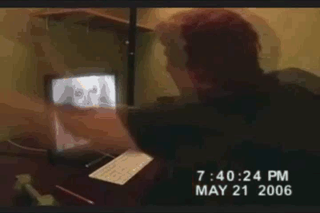
PHP OOP: reminder
In PHP OOP we can create:
- Classes
- Abstract classes
- Interfaces

Slide 3
Single responsibility principle
A class should have only a single responsibility
Example - printing different materials
Multiple responsibility:
- Display book/poster information
- Print book/poster
Problems:
→ code duplication between the two print method
→ not easy to extend

Slide 4
Possible solution
→ book and poster have only one responsibility
→ no duplicated code (common code is in the abstract class)

Slide 5
Open/Closed principle
Software entities (class, modules...) should be open for extension, but closed for modification.
Example - Render HTML
Problem:
→ Need to modify HTMLRenderer each time we add a new HTML element

Slide 6
Possible solution
→ create a new class for a new element without modifying anything (close to modification, open to extension)

Slide 7
Liskov substitution principle
Objects in a program should be replaceable with instances of their subtypes without altering the correctness of that program.
Example – The famous square/rectangle problem
→ In an application, if we replace the object Rectangle by the object Square, the behavior and result won't change

Slide 8

Following the principle, replacing Rectangle by Square should provide the same output
Implementation
class Rectangle {
public function setWidth($width){
$this->width = $width;
}
public function setHeight($height){
$this->height = $height;
}
public function calculateArea(){
return $this->width * $this->height;
}
}
class Square extends Rectangle {
public function setWidth($width){
$this->width = $width;
$this->height = $width;
}
public function setHeight($height){
$this->height = $height;
$this->width = $height;
}
}
$rectangle = new Rectangle();
$rectangle->setWidth(2);
$rectangle->setHeight(3);
var_dump($rectangle->area());
// Good Result: int(6)
$rectangle = new Square();
$rectangle->setWidth(2);
$rectangle->setHeight(3);
var_dump($rectangle->area());
// Bad Result: int(9) instead of int(6) !

Slide 9
Interface segregation principle
Many client-specific interfaces are better than one general-purpose interface.
Example – The worker
Problem:
→ Is the code() method necessary for an object manager?
What about the callClient() method for a developer?

Slide 10
Possible solution
→ Multiple interfaces for multiple behaviours

Slide 11
Dependency inversion principle
Classes depend upon Abstractions. Do not depend upon concretions.
Example – The lamp
→ Button depends directly on Lamp – changes to Lamp may require change to button
→ Button is not reusable (I can't control a new object Motor with it)

Slide 12
Possible solution
→ Buttons can control any device that implements SwitchableDevice interface (like a new Motor object)
→ Any object can implement SwitchableDevice and control the lamp and other SwitchableDevice

