Slide 1
CRUD App
Player List
Matt Coleman

Slide 2
Design Documents
Entity Relationship Diagrams
Continuous Integration Pipeline
Trello Board (MoSCoW)

Slide 3
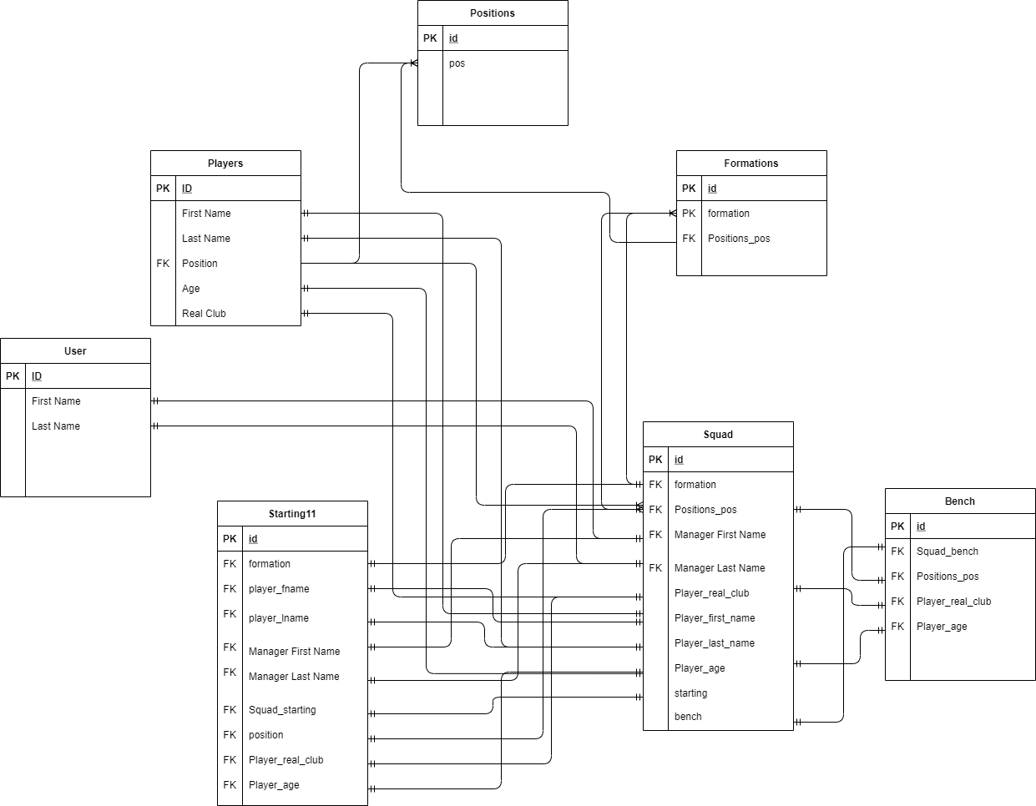
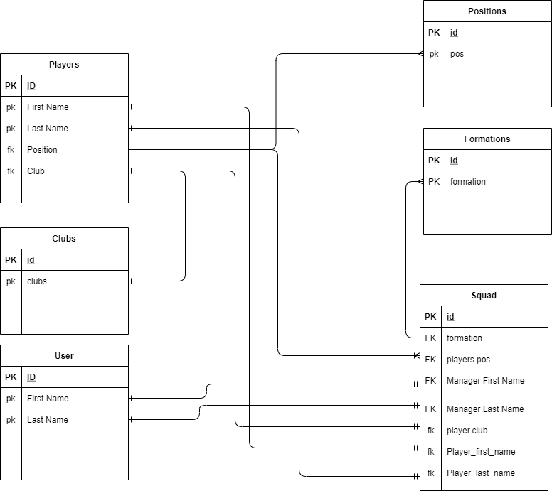
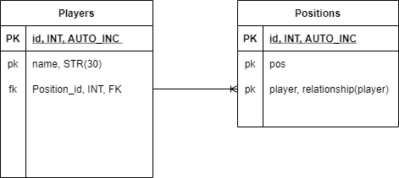

Slide 4
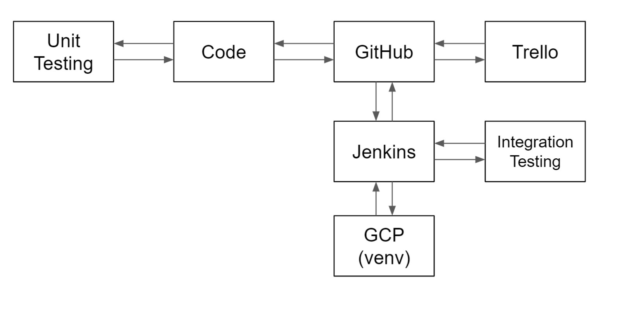

Slide 5
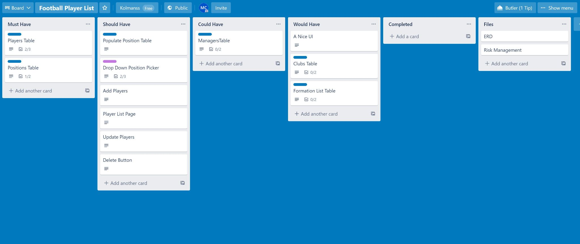
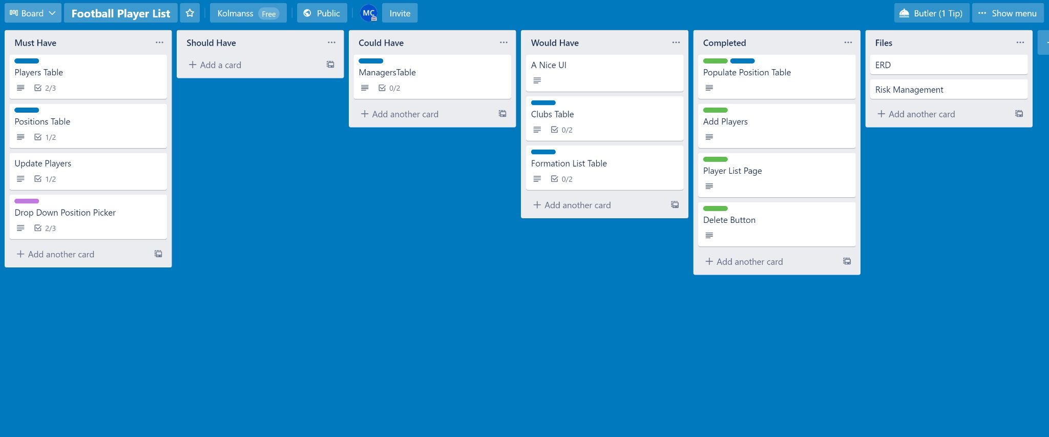

Slide 6
Risk Analysis
Risk Analysis Matrix
Finding more risks

Slide 7
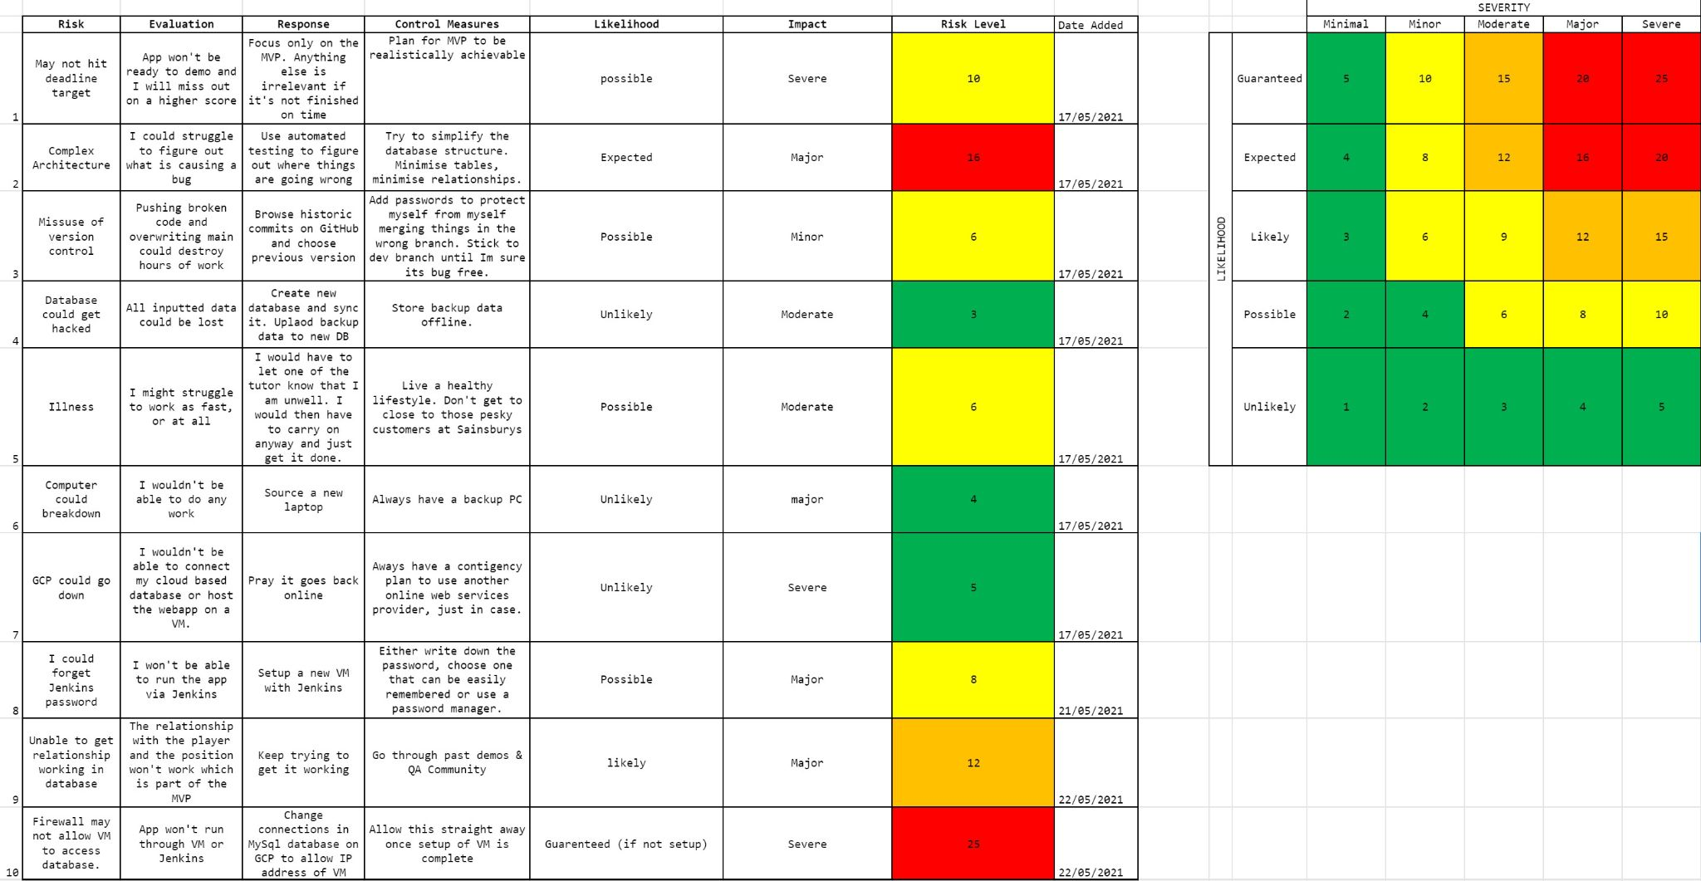

Slide 8
Software Development
Was this a success?
Any Issues
App Demo

Slide 9
Testing
Manual Testing
Unit Testing
Integration Testing

Slide 10
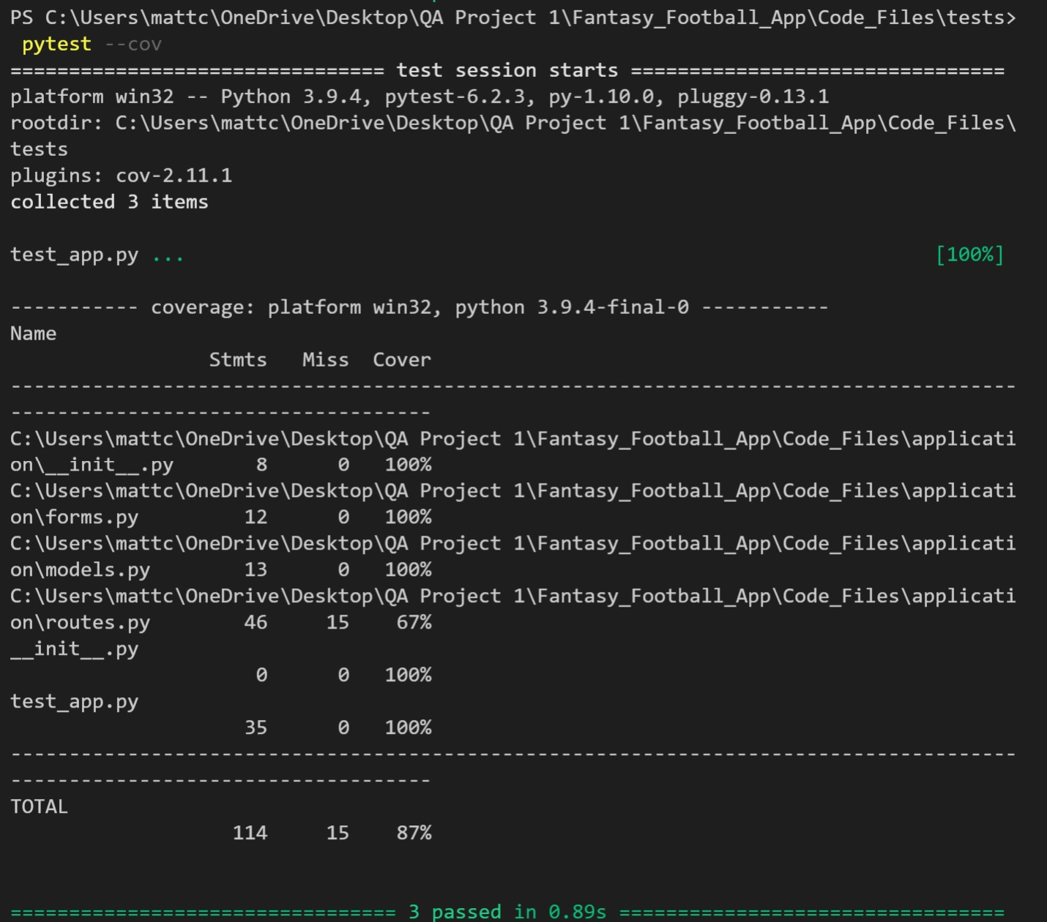
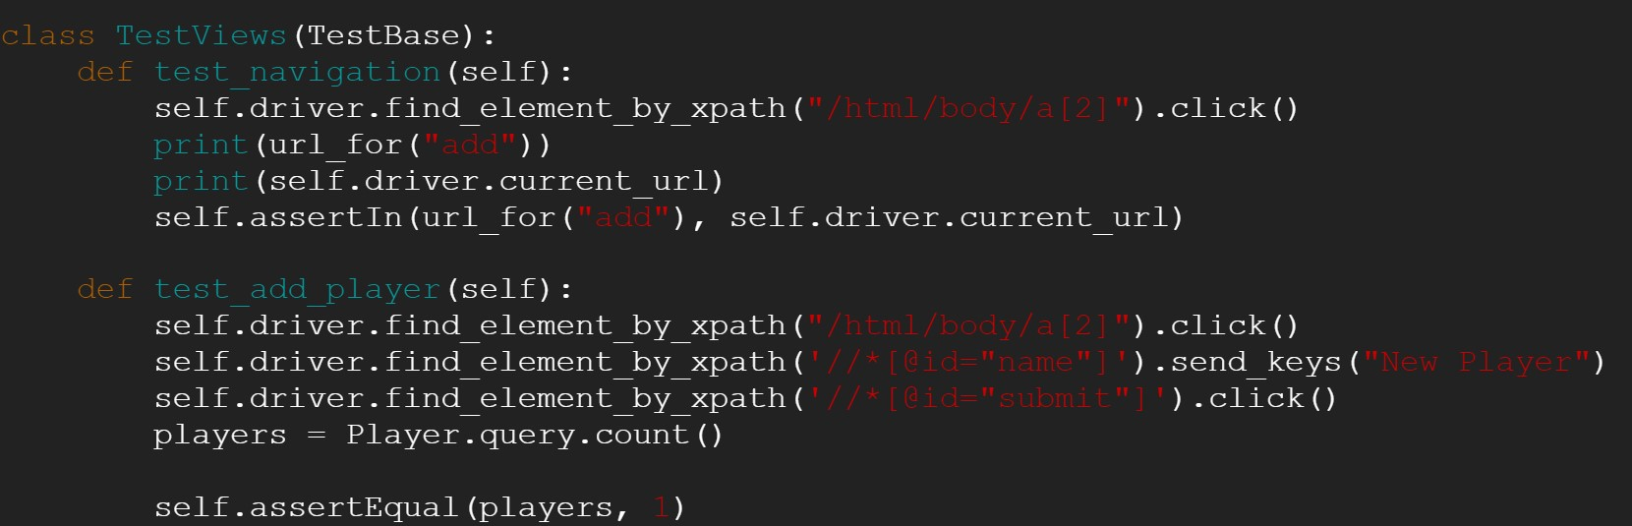
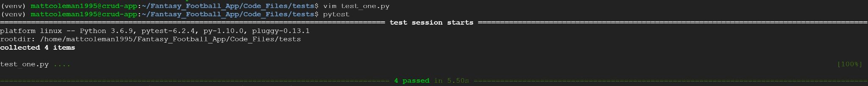

Slide 11
Readme
Find me on GitHub

