Slide 1
Objective
To learn the basic concept of data parallel computing
To learn the basic features of the CUDA C programming interface

Slide 2

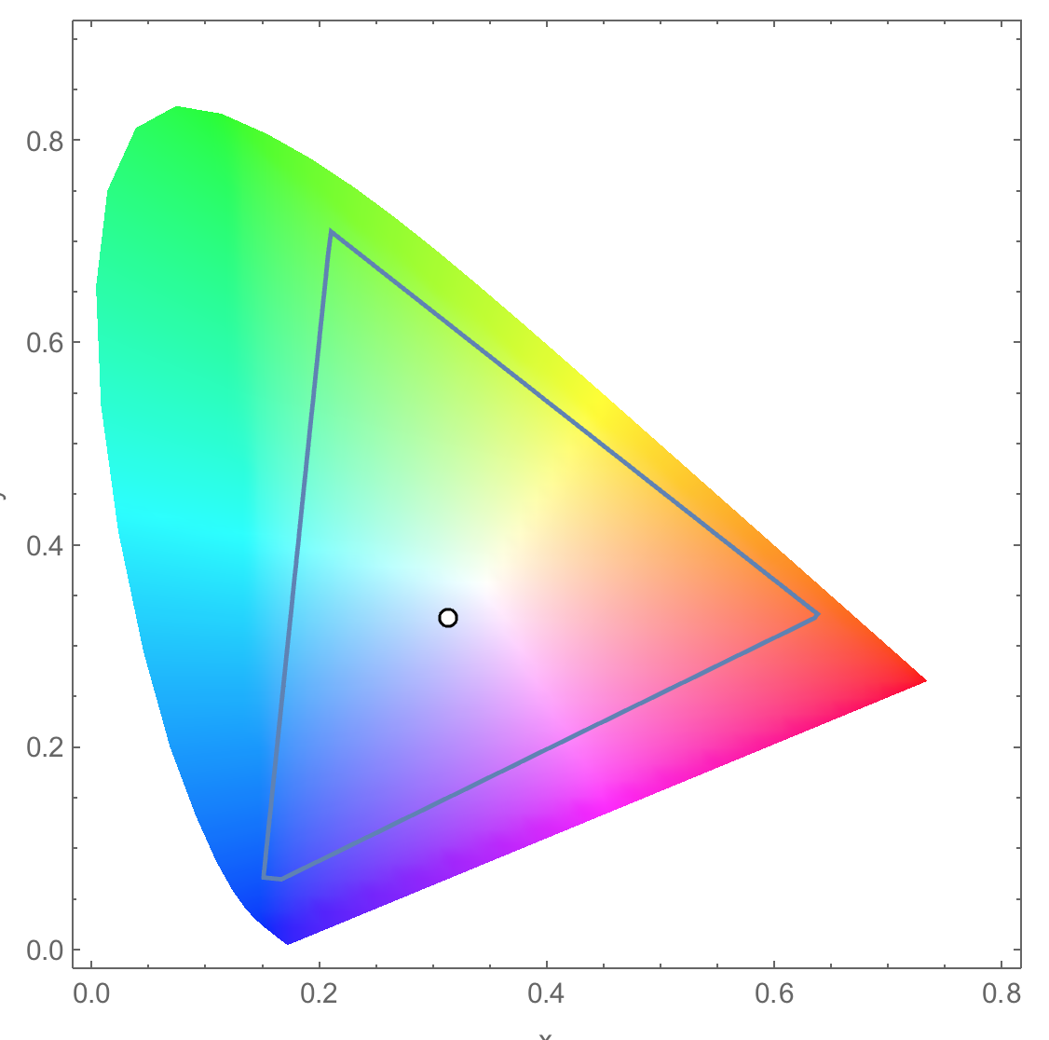
Conversion of a color image to grey–scale image

Slide 3
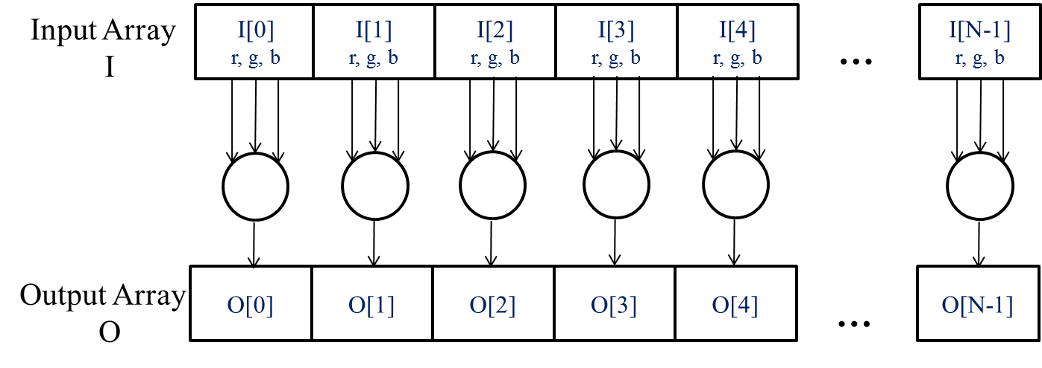
The pixels can be calculated independently of each other

Slide 4
CUDA/OpenCL – Execution Model
Integrated host+device app C program
Serial or modestly parallel parts in host C code
Highly parallel parts in device SPMD kernel C code
Serial Code (host)‏
Parallel Kernel (device)‏
KernelA<<< nBlk, nTid >>>(args);
. . .
Serial Code (host)‏
Parallel Kernel (device)‏
KernelB<<< nBlk, nTid >>>(args);
. . .

Slide 5
Arrays of Parallel Threads
A CUDA kernel is executed by a grid (array) of threads
All threads in a grid run the same kernel code (SPMD)‏
Each thread has an index that it uses to compute memory addresses and make control decisions
0
1
2
254
255
…
i = blockIdx.x * blockDim.x + threadIdx.x;
C[i] = A[i] + B[i];
…
5

Slide 6
Thread Blocks: Scalable Cooperation
Divide thread array into multiple blocks
Threads within a block cooperate via shared memory, atomic operations and barrier synchronization
Threads in different blocks cannot cooperate
Thread Block 0
Thread Block 1
Thread Block N-1
0
1
2
254
255
0
1
2
254
255
0
1
2
254
255
…
…
…
i = blockIdx.x * blockDim.x + threadIdx.x;
C[i] = A[i] + B[i];
i = blockIdx.x * blockDim.x + threadIdx.x;
C[i] = A[i] + B[i];
i = blockIdx.x * blockDim.x + threadIdx.x;
C[i] = A[i] + B[i];
…
…
…
…

Slide 7
blockIdx and threadIdx
Each thread uses indices to decide what data to work on
blockIdx: 1D, 2D, or 3D (CUDA 4.0)
threadIdx: 1D, 2D, or 3D
Simplifies memory addressing when processing multidimensional data
Image processing
Solving PDEs on volumes
…

Slide 8
Vector Addition – Conceptual View
vector A
A[0]
A[1]
A[2]
A[3]
A[4]
A[N-1]
…
vector B
B[0]
B[1]
B[2]
B[3]
B[4]
…
B[N-1]
+
+
+
+
+
+
vector C
C[0]
C[1]
C[2]
C[3]
C[4]
C[N-1]
…

Slide 9
Vector Addition – Traditional C Code
// Compute vector sum C = A+B
void vecAdd(float* A, float* B, float* C, int n)
{
for (i = 0, i < n, i++)
C[i] = A[i] + B[i];
}
int main()
{
// Memory allocation for A_h, B_h, and C_h
// I/O to read A_h and B_h, N elements
…
vecAdd(A_h, B_h, C_h, N);
}

Slide 10
Heterogeneous Computing vecAdd Host Code
#include <cuda.h>
void vecAdd(float* A, float* B, float* C, int n)‏
{
int size = n* sizeof(float);
float* A_d, B_d, C_d;
…
1. // Allocate device memory for A, B, and C
// copy A and B to device memory
2. // Kernel launch code – to have the device
// to perform the actual vector addition
3. // copy C from the device memory
// Free device vectors
}

Slide 11
Partial Overview of CUDA Memories
Device code can:
R/W per-thread registers
R/W per-grid global memory
Host code can
Transfer data to/from per grid global memory
(Device) Grid
Block (0, 0)
Block (1, 0)
Registers
Registers
Registers
Registers
Thread (0, 0)
Thread (1, 0)
Thread (0, 0)
Thread (1, 0)
We will cover more later.
Host
Global
Memory
Notes:
Global, constant, and texture memory spaces are persistent across kernels called by the same application.

Slide 12
CUDA Device Memory Management API functions
cudaMalloc()
Allocates object in the device global memory
Two parameters
Address of a pointer to the allocated object
Size of of allocated object in terms of bytes
cudaFree()
Frees object from device global memory
Pointer to freed object
Grid
Block (0, 0)
Block (1, 0)
Registers
Registers
Registers
Registers
Thread (0, 0)
Thread (1, 0)
Thread (0, 0)
Thread (1, 0)
Host
Global Memory

Slide 13
Host-Device Data Transfer API functions
cudaMemcpy()
memory data transfer
Requires four parameters
Pointer to destination
Pointer to source
Number of bytes copied
Type/Direction of transfer
Transfer to device is synchronous
(Device) Grid
Block (0, 0)
Block (1, 0)
Registers
Registers
Registers
Registers
Thread (0, 0)
Thread (1, 0)
Thread (0, 0)
Thread (1, 0)
Host
Global
Memory

Slide 14
void vecAdd(float* A, float* B, float* C, int n)
{
int size = n * sizeof(float);
float* A_d, B_d, C_d;
1. // Transfer A and B to device memory
cudaMalloc((void **) &A_d, size);
cudaMemcpy(A_d, A, size, cudaMemcpyHostToDevice);
cudaMalloc((void **) &B_d, size);
cudaMemcpy(B_d, B, size, cudaMemcpyHostToDevice);
// Allocate device memory for
cudaMalloc((void **) &C_d, size);
2. // Kernel invocation code – to be shown later
…
3. // Transfer C from device to host
cudaMemcpy(C, C_d, size, cudaMemcpyDeviceToHost);
// Free device memory for A, B, C
cudaFree(A_d); cudaFree(B_d); cudaFree (C_d);
}

Slide 15
Example: Vector Addition Kernel
Device Code
// Compute vector sum C = A+B
// Each thread performs one pair-wise addition
__global__
void vecAddKernel(float* A_d, float* B_d, float* C_d, int n)
{
int i = threadIdx.x + blockDim.x * blockIdx.x;
if(i<n) C_d[i] = A_d[i] + B_d[i];
}
int vectAdd(float* A, float* B, float* C, int n)
{
// A_d, B_d, C_d allocations and copies omitted
// Run ceil(n/256) blocks of 256 threads each
vecAddKernel<<<ceil(n/256.0), 256>>>(A_d, B_d, C_d, n);
}

Slide 16
Example: Vector Addition Kernel
// Compute vector sum C = A+B
// Each thread performs one pair-wise addition
__global__
void vecAddkernel(float* A_d, float* B_d, float* C_d, int n)
{
int i = threadIdx.x + blockDim.x * blockIdx.x;
if(i<n) C_d[i] = A_d[i] + B_d[i];
}
int vecAdd(float* A, float* B, float* C, int n)
{
// A_d, B_d, C_d allocations and copies omitted
// Run ceil(n/256) blocks of 256 threads each
vecAddKernnel<<<ceil(n/256.0),256>>>(A_d, B_d, C_d, n);
}
Host Code

Slide 17
More on Kernel Launch
int vecAdd(float* A, float* B, float* C, int n)
{
// A_d, B_d, C_d allocations and copies omitted
// Run ceil(n/256) blocks of 256 threads each
dim3 DimGrid(n/256, 1, 1);
if (n%256) DimGrid.x++;
dim3 DimBlock(256, 1, 1);
vecAddKernel<<<DimGrid,DimBlock>>>(A_d, B_d, C_d, n);
}
Any call to a kernel function is asynchronous from CUDA 1.0 on, explicit synch needed for blocking
Host Code

Slide 18
Kernel execution in a nutshell
__host__
Void vecAdd()
{
dim3 DimGrid(ceil(n/256.0),1,1);
dim3 DimBlock(256,1,1);
vecAddKernel<<<DimGrid,DimBlock>>>(A_d,B_d,C_d,n);
}
__global__
void vecAddKernel(float *A_d,
float *B_d, float *C_d, int n)
{
int i = blockIdx.x * blockDim.x
+ threadIdx.x;
if( i<n ) C_d[i] = A_d[i]+B_d[i];
}
Blk 0
Kernel
Blk N-1
• • •
Schedule onto multiprocessors
GPU
M0
Mk
• • •
RAM

Slide 19
More on CUDA Function Declarations
Executed on the:
Only callable from the:
__device__ float DeviceFunc()‏
device
device
__global__ void KernelFunc()‏
device
host
__host__ float HostFunc()‏
host
host
__global__ defines a kernel function
Each “__” consists of two underscore characters
A kernel function must return void
__device__ and __host__ can be used together

Slide 20
Compiling A CUDA Program
Integrated C programs with CUDA extensions
NVCC Compiler
Host Code
Device Code (PTX)
Host C Compiler/ Linker
Device Just-in-Time Compiler
Heterogeneous Computing Platform with
CPUs, GPUs

