Slide 1
Camera Calibration: Real-Time tracking of Control Points
Alumnos:
Choqueluque Roman David
Javier Quispe Diego

Slide 2
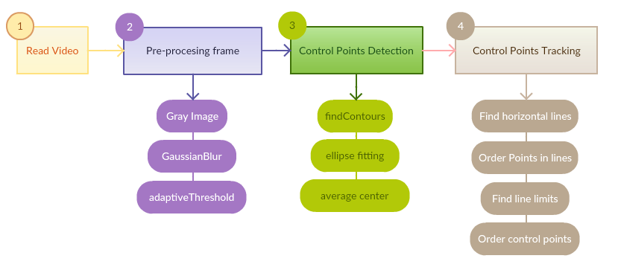
Pipeline

Slide 3
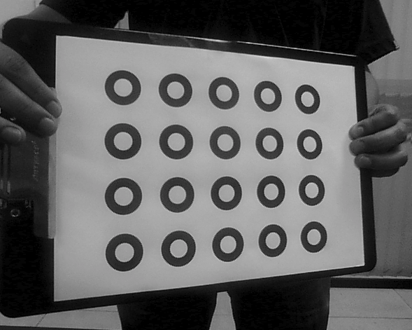
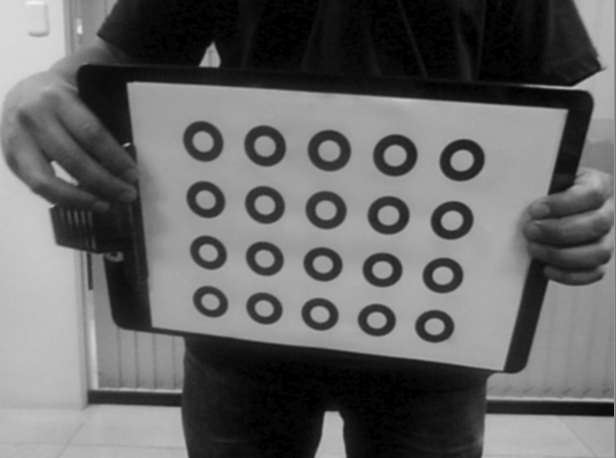

Pre-processing

Slide 4
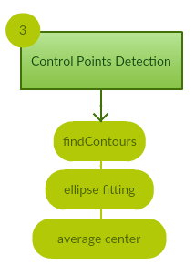
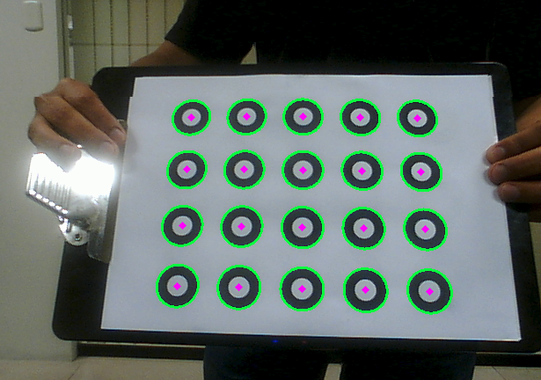
Control Point Detection

Slide 5
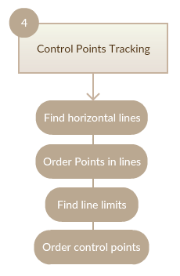
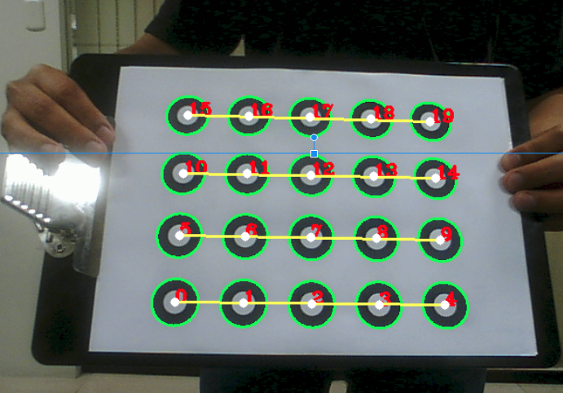
Control Point Tracking

Slide 6
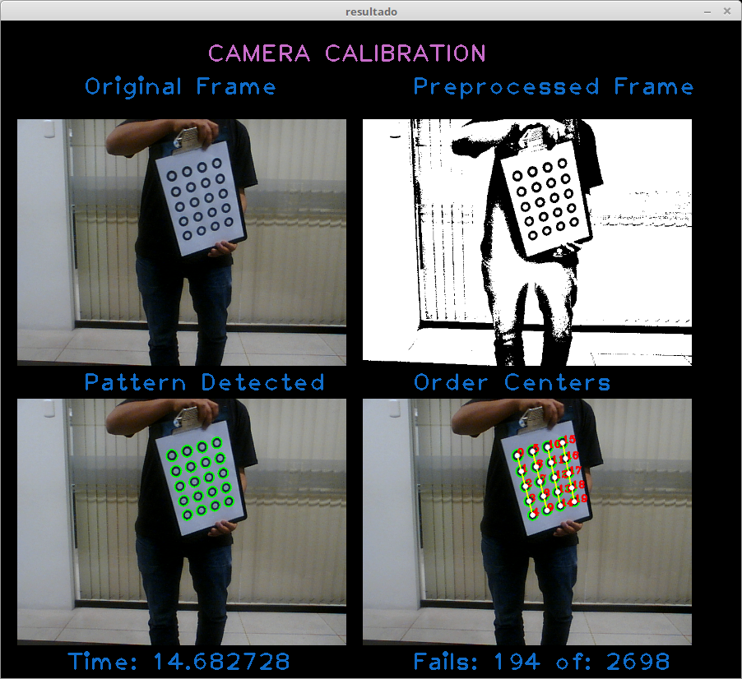
General View

Slide 7
Results
We obtained the following results:
Time to process a frame: 14.52 ms.
Accuracy: 86.59%.

Slide 8
THANKS

