Slide 1
Kinetic Data Structures
Matěj Bartoš

Slide 2
Motivation
Moving data (change with time)
Collision detection
Kinetic convex hull

Slide 3
Kinetic × Dynamic
Dynamic
  Addition/Removal of elements (points)
Kinetic
  Continuous movement of elements (smooth)
  Each point has a flight plan (directional vector, function, speed)

Slide 4
Dynamic Convex Hull
Demo: Dynamic graham-scan

Slide 5
Kinetic Convex Hull
How to deal with kinetic data?
  Dynamic Convex Hull (given timestamps, intervals, sampling)
  Kinetic Structure that somehow computes precise time of events

Slide 6
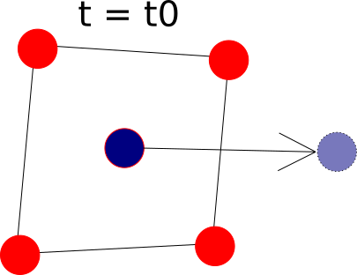
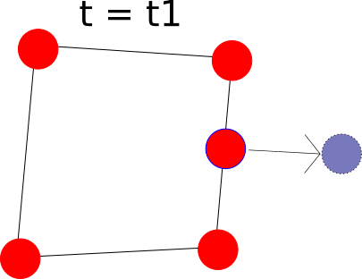
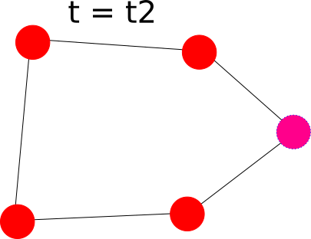
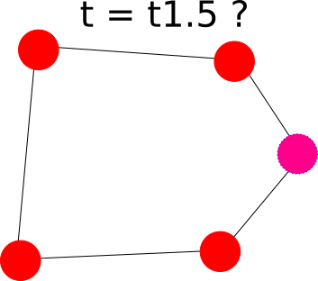
Timestamps/Sampling
Treat as static snapshots on given interval

Slide 7
Timestamps/Sampling cont.
How fast should we sample:
  Oversampling (Complexity overhead – no processing)
  Undersampling (Missing/Lost events – not correct)

Slide 8
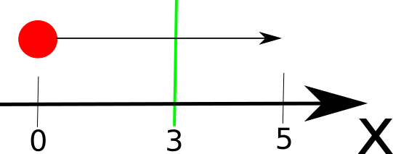
Certificate
Given initial proof of correctness
Property which proves that small part of structure is still correct

Slide 9
Configuration function
Eventhough problem is continuous, structure changes at discrete times
Find such discrete steps t₁,t₂, … t_{n}
  Minimize N

Slide 10
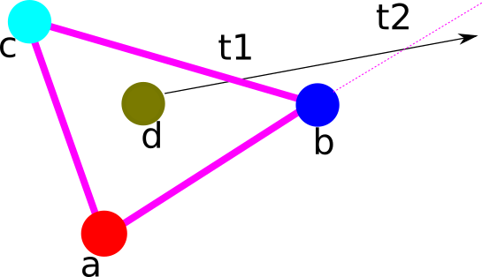
Certificates Example
Certificate | Failure Time
a left of bc | never
d left of bc | t1
b right of ad | t2
c left of ad | never

Slide 11
Kinetic Data Structure (KDS)
Data structure with certificates
Event Queue
  When certificate is violated, then event is created
  Event has it‘s time of violation
  Events in queue are sorted by violation time
“Time sweep”

Slide 12
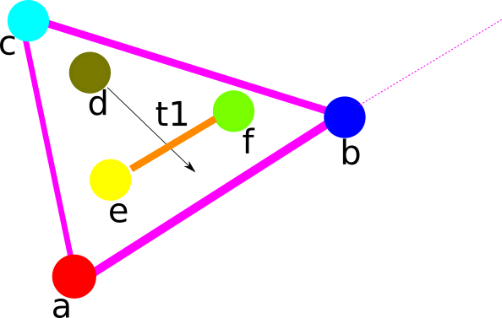

Inner event × Outer event
Inner event
  Local change in structure
Outer event
  Global change in structure
  We want outer events only

Slide 13
2D Kinetic Convex Hull
Preliminaries
  Each point has a flight plan
  Points can cross each other inside convex hull
  Kinetic data structure

Slide 14
Nested Convex Hulls (NCHs)
Kinetic data structure
Sequence of points in Convex Hull is CLOCKWISE
Each point has prior and next pointers

Slide 15
Construction of NCHs
Create convex hull
Erase points, that make convex hull
Take the rest and continue recursivelly, until there is no point left
  Even one point makes Convex hull

Slide 16
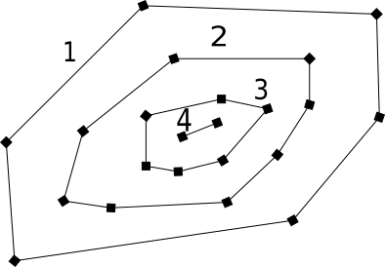
Construction of NCHs cont.

Slide 17
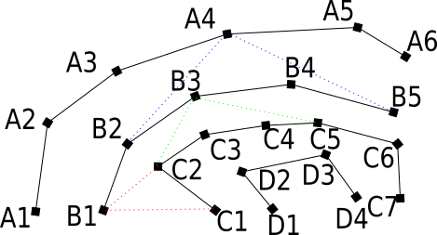
First child, Last child
First child
  point P, on immediate inner layer of X (IL(X)) which is not visible from X. Moving clockwise from p on IL(X), the first point visible from X is called firstChild(X).
Last child
  Same as firstChild, the last point visible from X is called lastChild(X).

Slide 18
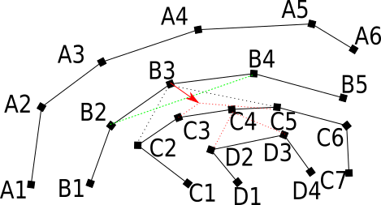
Event 1
Event: goIn(B3)
  Certificate: Crossing B3 with line segment B2B4
  Changes: B3 will be inserted in the inner convex hull that may result in goIn(Xi) for some X and i (X ∈ layers C, D, ...) recursively

Slide 19
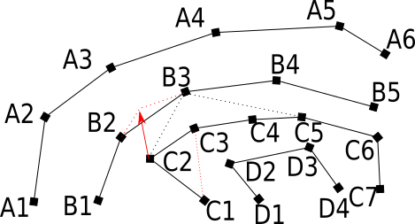
Event 2
Event: goOut(B3.firstChild)
  Certificate: Crossing B3.firstChild (e.g. C2) with the line segment B3B3.prior
  Changes: B3.firstChild (e.g. C2) will be deleted from inner convex hull and will be inserted between B3 and B3.prior (e.g. B2) that may result in goOut(Xi) for some i and X (X ∈ layers C, D, ...) recursively

Slide 20
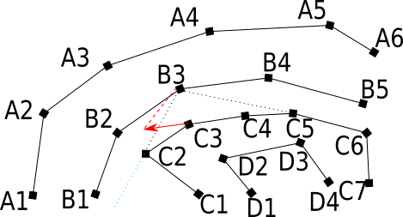
Event 3
Event: notFirstChild(B3)
  Certificate: Crossing the point B3.firstChild.next (e.g. C3) with line segment B3B3.firstChild (e.g. B3C2)
  Changes: B3.firstChild.next (e.g. C3) will become the new B3.firstChild

Slide 21
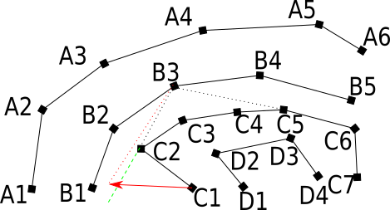
Event 4
Event: beFirstChild(B3)
  Certificate: Crossing the point B3.firstChild.prior (e.g. C1) with extension of line segment B3B3.firstChild (e.g. B3C2)
  Changes: B3.firstChild.prior (e.g. C1) will become the new B3.firstChild

Slide 22
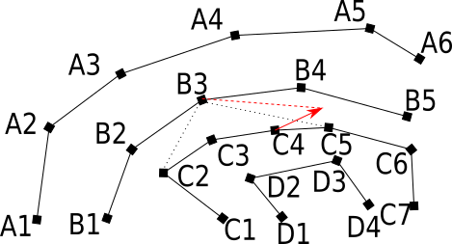
Event 5
Event: notLastChild(B3)
  Certificate: Crossing the point B3.lastChild.prior (e.g. C4) with line segment B3B3.lastChild (e.g. B3C5)
  Changes: B3.lastChild.prior (e.g. C4) will become the new B3.lastChild

Slide 23
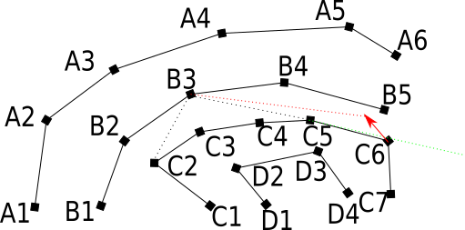
Event 6
Event: beLastChild(B3)
  Certificate: Crossing point B3.lastChild.next (e.g. C6) with extension of line segment B3B3.lastChild (e.g. B3C5)
  Changes: B3.lastChild.next (e.g. C6)will become the new B3.lastChild

Slide 24
(Event 7)
Event: changeDir(B3)
  Certificate: Crossing B3 with the border of the region
  Changes: A reflected direction of B3 with respect to the border will be applied
  When flightplan can change (e.g. after collision)

Slide 25
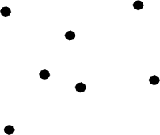
Algorithm - input
Input of algorithm points, with flight plan (function)

Slide 26
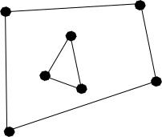
Algorithm - step 1
Create Nested Convex Hulls

Slide 27
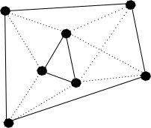
Algorithm - step 2
Link childs (first child, last child) for every point

Slide 28
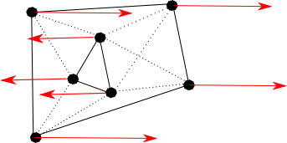
Algorithm – step 3
Schedule all events based on flight plan functions

Slide 29
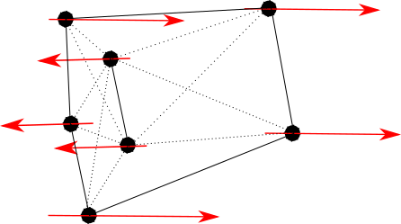
Algorithm – steps i
Pick event with minimal time from queue – related events rescheduled Queue
t = t_event

Slide 30
Summary
Certificates failure times make Events in EventQueue
Pick event from queue, change time to failure time and adjust structure according to type of event

Slide 31
Thank you for your attention

Slide 32
References
Basch, J., Guibas, L. J., Hershberger, J.: Data structures for mobile data. SoDA. 1997, http://www.graphics.stanford.edu/courses/cs268-11-spring/notes/kinetic.pdf
Mohammad Reza Razzazi, Ali Sajedi: Kinetic Convex Hull Maintenance Using Nested Convex Hull, EuroCG 2003,https://cw.fel.cvut.cz/wiki/_media/courses/ae4m39vg/presentations/rs-kchmu-03.pdf
Bo Gotthardt: Literature Study in Kinetic Data Structures, 2008, https://ai2-s2-pdfs.s3.amazonaws.com/1965/839a6ae7ba6f01143d8ba1891cab4e1d3ae9.pdf

