Slide 1
AMP, PWA, Reduced JS
Enhancing Teleflora
Mobile Presence
with
By: Ed Sarkisov, Matthew Eastman, Neal Bapat,

Slide 2
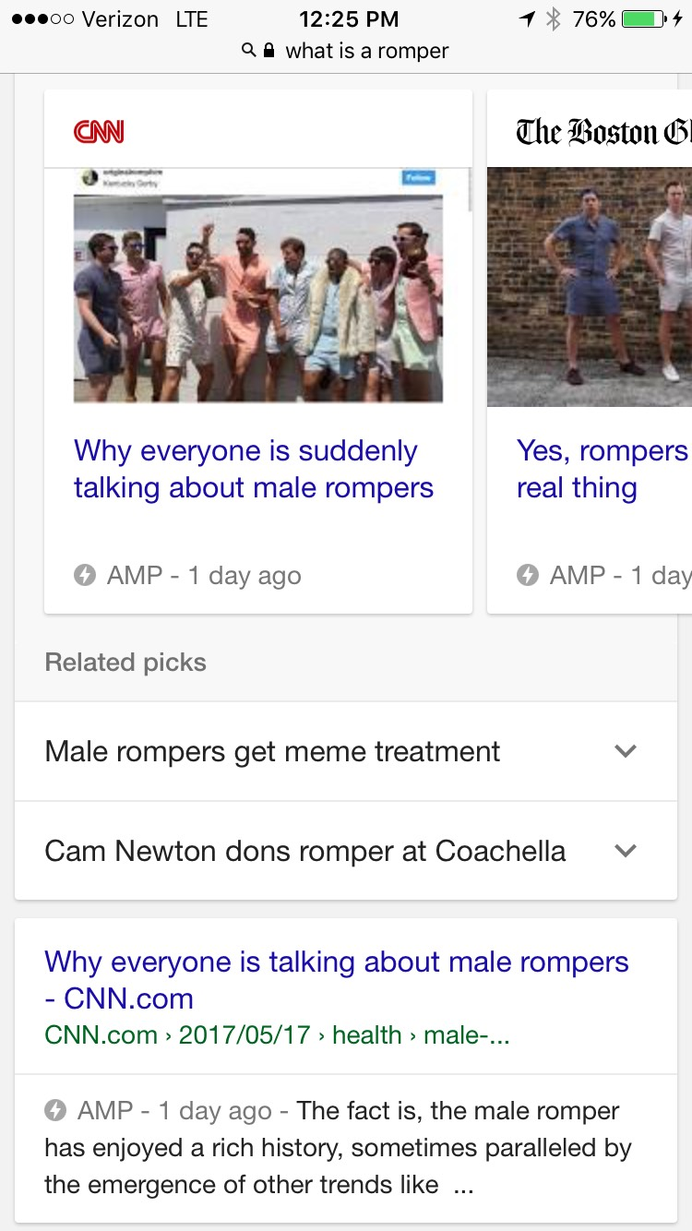
Mobile Improvements – AMP, PWA, Reduced JS
Problem to Solve
Speed up desktop and mobile load time
Decrease Bounce Rate
Improve customer experience on mobile
Improve Google ranking
Solution
Implement AMP markup to Content heavy pages (ex. Gift Guide Pages)
Leverage Progressive Web App Browser Caching
Organize and reduce JavaScript load per page

Slide 3


To many abbreviations..
AMP = Amplified Mobile Pages
AMP is a lightweight, open source framework (by google*) that is designed to increase mobile website speed by:
1. Implementing AMP specific HTML
2. Forcing Inline CSS
3. Accessing Google’s (free) CDN network
4. Eliminating external scripts and third party JavaScript
PWA = Progressive Web App
A Progressive Web App (PWA) is a ”web app” that uses modern web capabilities to deliver an app-like experience to users by leveraging browser and device capabilities.

Slide 4







Is AMP even a thing?
First Adopters
5.16.17 Hackathon participants

Slide 5
http://www.teleflora.com/gift-giving-ideas/valentines
Results
Current Valentines Gift Giving Page
AMP Valentines Gift Giving Page
http://webproducer.telefloramarketing.com/amp/demo/valentines.html
Metric | Current Version | AMP Version
Load Time (3G) | 14.2 sec. | 4.8 sec.
Frist Byte | 1.2 sec. | 0.9 sec.
# of Requests | 125 | 16
Bytes In (fully loaded) | 1,713 | 265
Speed Index | 6690 | 3870

Slide 6
AMP Wins and Limitations
AMP Wins
Speed, Speed, Speed.
Works with Google Analytics and Tag Manager
Improves Google Ranking.
Integrating this technology now puts us way ahead and sets Teleflora up to fully implement across entire site as the technology evolves.
Also, Speed.
AMP Limitations
New Technology with limited features and documentation.
Doesn’t support https, so no checkout pages.
No 3rd party JavaScript to Olapic and maximizer are not easy implemented.
Not compatible with Google Optimize, but we expect it will be soon.

Slide 7
JS Redesign
Lots of Unnecessary Javascript is loaded onto the Page
On average about 2 to 3 MB of JS & CSS are loaded.
Currently about 63% of JS is unused.
Much of our JS is in large files. Meaning all the Javascript we use throughout the site is locate in a few very large JS files.
Similarly with CSS as well.
Solution:
Reorganize the Javascript & CSS files into smaller with content on related to that page.
Each page will be broken down to one HTML (includes all responsive classes/ tags/ etc. added as well as inline Javascript). Desktop and Mobile will each have their own JS and CSS.
Consider switching our CSS to a CSS preprocessor like SASS/ LESS/ SCSS for further load reduction.
Locate and identify Javascript based on its use. Then break it down to smaller files where only what is used is loaded on the page.
Possible Problems:
Increasing number of files to manage. (Version Control software)
Inheritance issues.
Learning a new Syntax (CSS preprocessor)

Slide 8
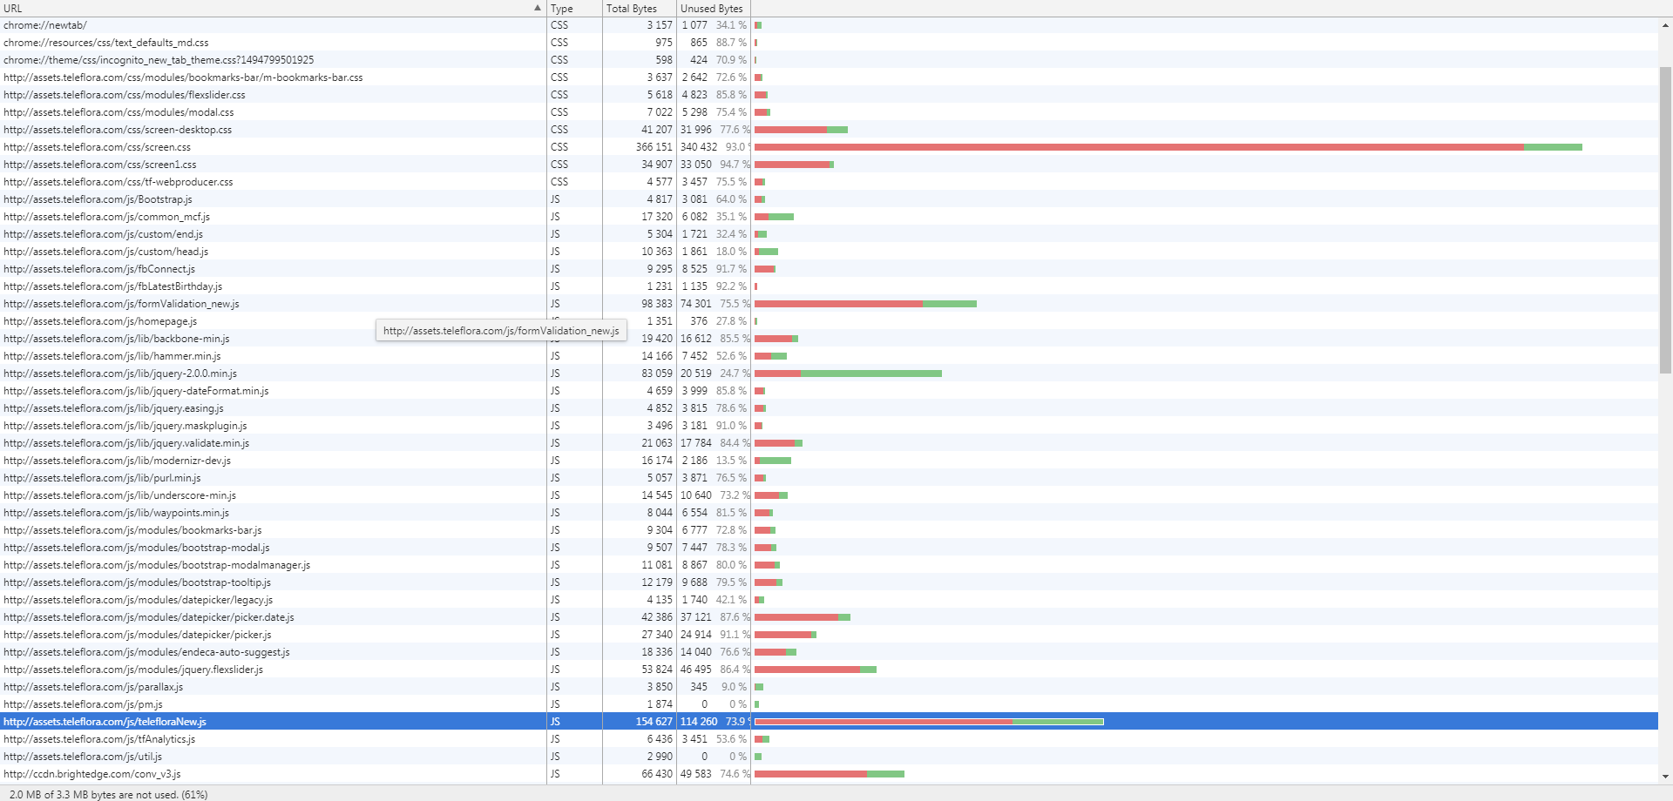
JS Redesign

Slide 9
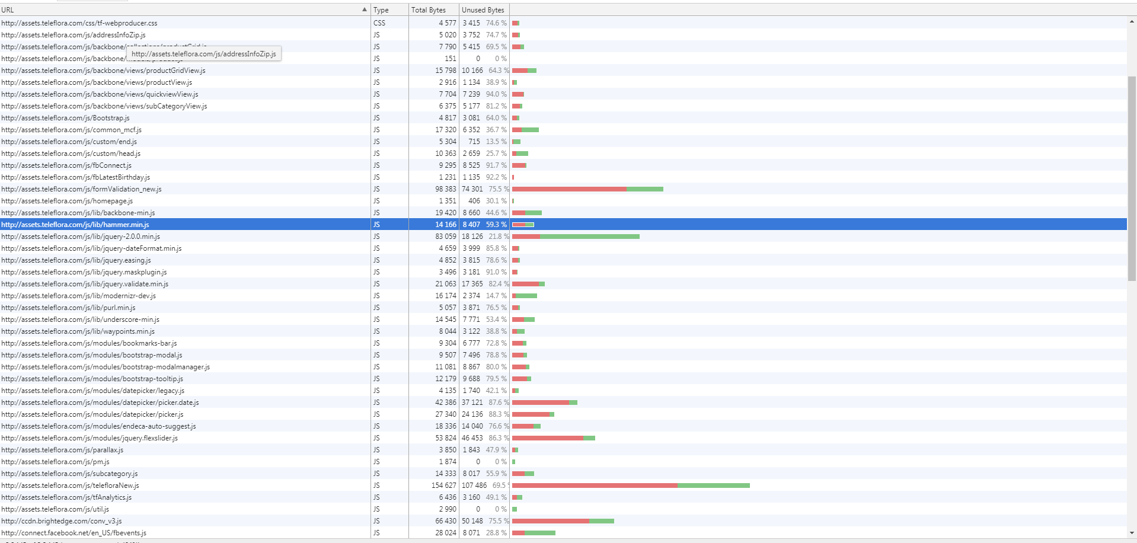
JS Redesign

