Slide 1
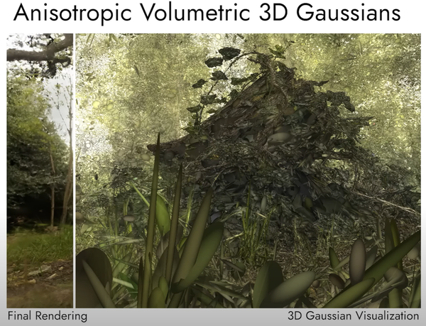
3D Gaussian Splatting
for Real-Time Radiance Field Rendering
Focus: method, training, and real-time rendering.
By REDACTED

Slide 2
Why it matters
High quality used to mean slow rendering.
3D Gaussian Splatting tries to keep both.
The whole method is built around one idea:
keep the scene explicit enough to render fast, but flexible enough to stay accurate.
Real surfaces are rarely round.
Long, thin splats fit edges, poles, rails, and flat areas much better.
A few well-shaped Gaussians can cover more of the scene without making it blurry.

Slide 3
Roadmap
1. Background
NeRF, radiance fields, and the main quality vs speed trade-off
2. Representation
What a 3D Gaussian stores, how it is optimized, and why anisotropy matters
3. Rendering
Density control, tile-based rasterization, and the final results

Slide 4
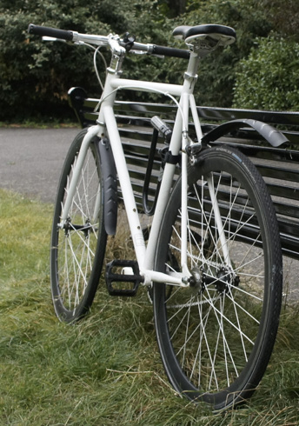
Why this topic matters
Novel view synthesis is useful only if the viewer can move freely.
Image quality matters, but so does latency.
A practical system needs to work at real-time frame rates, not just offline.
Typical captured scene

Slide 5

NeRF in one minute
A scene is represented as a continuous field.
A neural network predicts color and density for each point and view direction.
Rendering samples many points along each camera ray.
This is flexible, but expensive to evaluate.

Slide 6
Where NeRF slows down
Every pixel requires many samples along the ray, so most of the work is spent before a visible color is even produced.
Empty space still consumes computation, which is wasted effort in large scenes.
Fast variants often trade away some quality to gain speed.
That trade-off is exactly what Gaussian Splatting tries to improve.
Main weakness
A lot of computation is spent in places that do not contribute much to the final image.
That is wasted time.

Slide 7
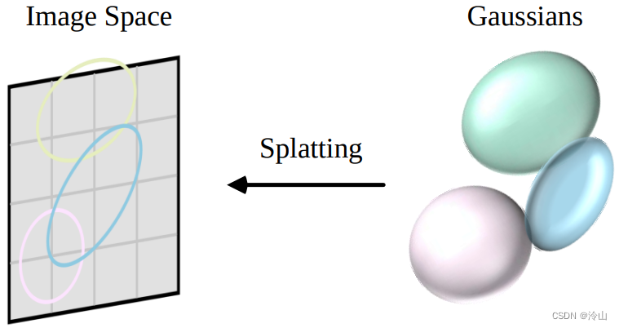
The core idea
Start from sparse Structure-from-Motion points.
Replace the implicit field with explicit 3D Gaussians.
Keep the model differentiable and easy to rasterize on the GPU.
The representation stays continuous, but the rendering becomes much simpler.

Slide 8
What one Gaussian stores
Position tells you where the primitive lives in 3D space.
Covariance controls its size, shape, and orientation.
Opacity decides how strongly it contributes after alpha blending.
Spherical harmonics store view-dependent color, so appearance can change with the camera angle.
position
covariance
opacity
Spherical harmonics capture how the color changes when the camera moves.

Slide 9
Why anisotropic shapes matter
Real surfaces are rarely round.
Long, thin splats fit edges and flat areas better.
A few well-shaped Gaussians can cover more of the scene.
This is one reason the method stays compact without looking blurry.

Slide 10
From 3D to the image plane
Each Gaussian is projected through the camera, so its footprint changes in image space.
The visible splats are blended front-to-back in depth order.
View direction still matters because the SH coefficients encode appearance changes across viewpoints.

Slide 11
Pipeline at a glance
SfM points
Initial Gaussians
Render view
Update params
And repeat
The loop is short and practical.
Each step keeps the scene representation explicit, which makes training and rendering easier to control.

Slide 12
Why SfM is a practical start
The method begins with sparse points from calibrated images.
No manual mesh is required, and normals are not needed to get started.
That gives the optimizer a real geometric hint instead of a random volume.
Practical advantage
The sparse cloud already gives a geometric hint, so the model can begin from real captured data instead of random volume.

Slide 13
How the parameters are stored
Each Gaussian stores position, scale, rotation, opacity, and SH color coefficients.
Scale and rotation describe the covariance in a way that is easy to optimize and always valid after normalization.
The result is compact: each primitive stays explicit, but still flexible enough to adapt during training.
Compact parameter set
μ, Σ, α, and color coefficients
The important part is that each Gaussian can change shape without becoming a neural network.

Slide 14
The optimization loop
Compare
Render
Backprop
Update
And the cycle repeats...
Render a training image from the current Gaussian set.
Compare it with the target view using the loss function.
Backpropagate through the differentiable rasterizer.
Update the parameters and repeat until the scene stabilizes.

Slide 15
The loss function
L1 keeps individual pixels close to the reference image.
D-SSIM preserves local structure, edges, and contrast.
The mix, L = 0.8L1 + 0.2LD-SSIM, balances fine detail with stable geometry.
L = 0.8L1 + 0.2LD-SSIM
A simple mix, but good enough to keep both texture and geometry under control.

Slide 16
Densification: clone
o
This helps fill missing geometry and adds detail where the model still struggles.
It is especially useful for thin structures and weak initial coverage.
o
o
Small Gaussians in under-reconstructed areas are duplicated and nudged along the gradient.

Slide 17
Densification: split and prune
Large splats in crowded or uncertain regions are split into smaller ones, so one primitive does not cover too much at once.
Transparent Gaussians are removed during pruning, which keeps the model compact and avoids wasted computation.
Splitting and pruning work together to keep detail high without letting the representation bloat.
Split when one primitive covers too much.
Prune when a Gaussian contributes almost nothing.

Slide 18
Fast rasterization
Tiles
Cull
Sort
Draw
Stop
The screen is divided into 16×16 tiles, which limits the work to the pixels that matter.
Gaussians are culled against the frustum and each tile, then a single GPU radix sort prepares the depth order.
That organization makes the renderer fast enough for dense scenes without per-pixel sorting.

Slide 19
Front-to-back blending
Each tile accumulates splats in depth order using standard alpha blending.
Once a pixel is nearly saturated, the renderer can stop early instead of processing every remaining splat.
That is a big part of the real-time gain, especially in busy scenes with many overlapping Gaussians.
Splat 1
Splat 2
Splat 3
Splat 4

Slide 20
Backward pass
Why this matters
The same sorted tile lists are reused during gradient computation, so the backward pass does not need a huge per-pixel buffer.
This keeps memory overhead low and avoids storing every blended primitive explicitly.
As a result, the renderer stays practical in both directions: forward synthesis and optimization.
The renderer can stay fast in both directions: forward synthesis and gradient computation.

Slide 21
What the results show
The paper reports quality that matches or exceeds strong NeRF baselines on standard datasets.
It also reaches real-time frame rates, with examples around 135 fps and 93 fps depending on the training budget.
Training stays competitive as well, with examples of 6 min and 51 min runs in the paper.

Slide 22
Why it is fast in practice
There is no neural network to evaluate at render time, so the renderer avoids a major bottleneck from NeRF-style methods.
Most work is concentrated on visible tiles instead of empty space.
Speed comes from three choices: explicit splats, tile-based culling, and GPU-friendly sorting.
Speed comes from three choices: explicit splats, tile-based culling, and GPU-friendly sorting.

Slide 23
Strengths of the approach
High visual quality
Real-time rendering
Flexible geometry
GPU-friendly design
It is a rare combination: the scene is still expressive, but the renderer is no longer the bottleneck.

Slide 24
What it does not solve
The method is designed for static scenes, so it is not a full solution for dynamic content.
Poor captures still produce poor reconstructions, and very complex lighting or transparency can remain difficult.
So the speed problem is largely solved, but the capture problem is not magically gone.
Bottom line
The method fixes the speed problem very well, but it does not remove every capture and scene-complexity limitation.

Slide 25
Takeaway
3D Gaussian Splatting
bridges the gap between quality and speed.
It keeps the radiance-field idea, but makes the scene explicit enough to optimize
and render in real time.
Sources here, any questions?
[1] Kerbl, B., Kopanas, G., Leimkühler, T., Drettakis, G. “3D Gaussian Splatting for Real-Time Radiance Field Rendering”
https://cseweb.ucsd.edu/~viscomp/classes/cse274/wi26/papers/3d_gaussian_splatting_low.pdf
[2] Mildenhall, B. et al. (2020) “NeRF: Representing Scenes as Neural Radiance Fields for View Synthesis”
https://arxiv.org/pdf/2003.08934
[3] Zwicker, M. et al. (2001) “EWA Volume Splatting”
https://www.cs.umd.edu/~zwicker/publications/EWAVolumeSplatting-VIS01.pdf
[4] Fridovich-Keil, S., Yu, A. et al. (2022) “Plenoxels”
https://arxiv.org/pdf/2112.05131
[5] Noah Snavely, Steven M. Seitz and Richard Szeliski “Photo Tourism: Exploring Photo Collections in 3D”
https://dl.acm.org/doi/epdf/10.1145/1141911.1141964
[6] Gaussian splatting principles
https://blog.csdn.net/qq_28087491/article/details/135629371
[7] Gaussian splatting showcase
https://velog.io/@cjkangme/3D-Gaussian-Splattingfor-Real-Time-Radiance-Field-Rendering
[8] Peer review
https://medium.com/@AriaLeeNotAriel/numbynum-3d-gaussian-splatting-for-real-time-radiance-field-rendering-kerbl-et-al-60c0b25e5544
By REDACTED

