Slide 1
ASP.NET MVC in the Cloud with AppHarbor
Matt Honeycutt
@matthoneycutt
http://trycatchfail.com

Slide 2
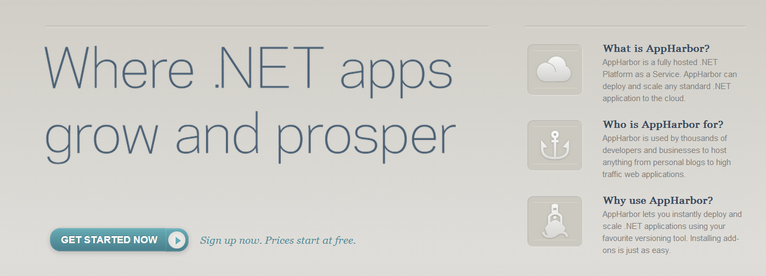
AppHarbor… What is it?

Slide 3
Demo: Your first AppHarbor application

Slide 4
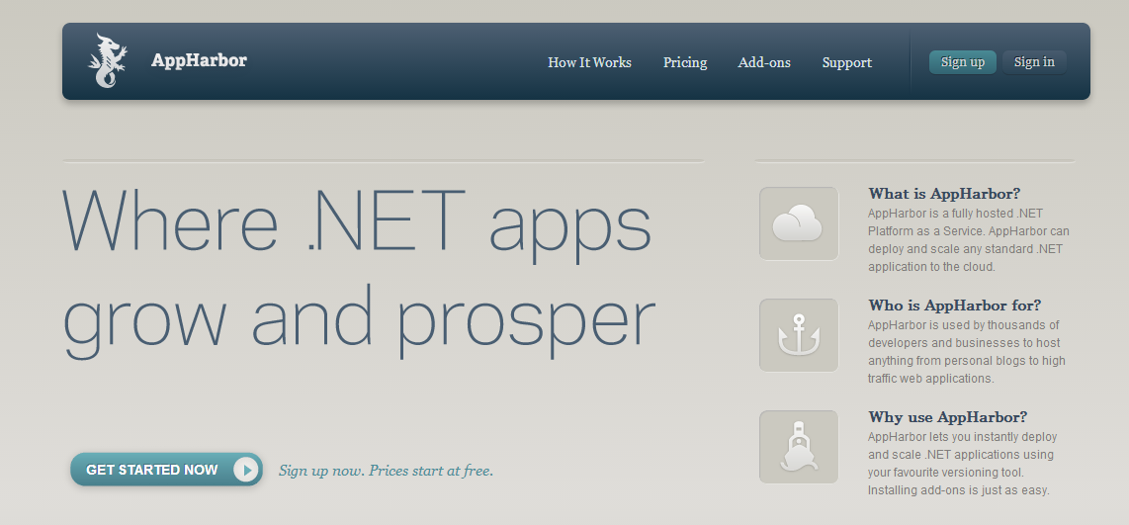

Slide 5
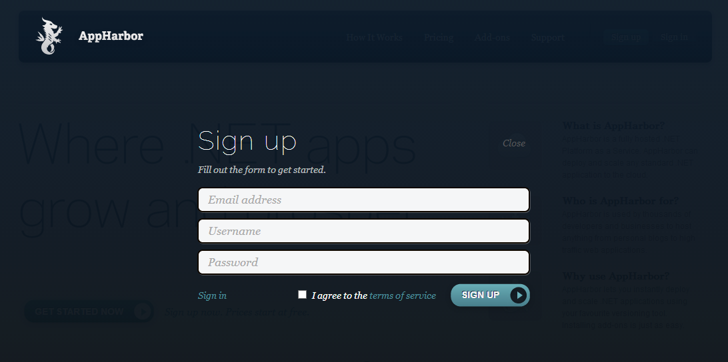

Slide 6
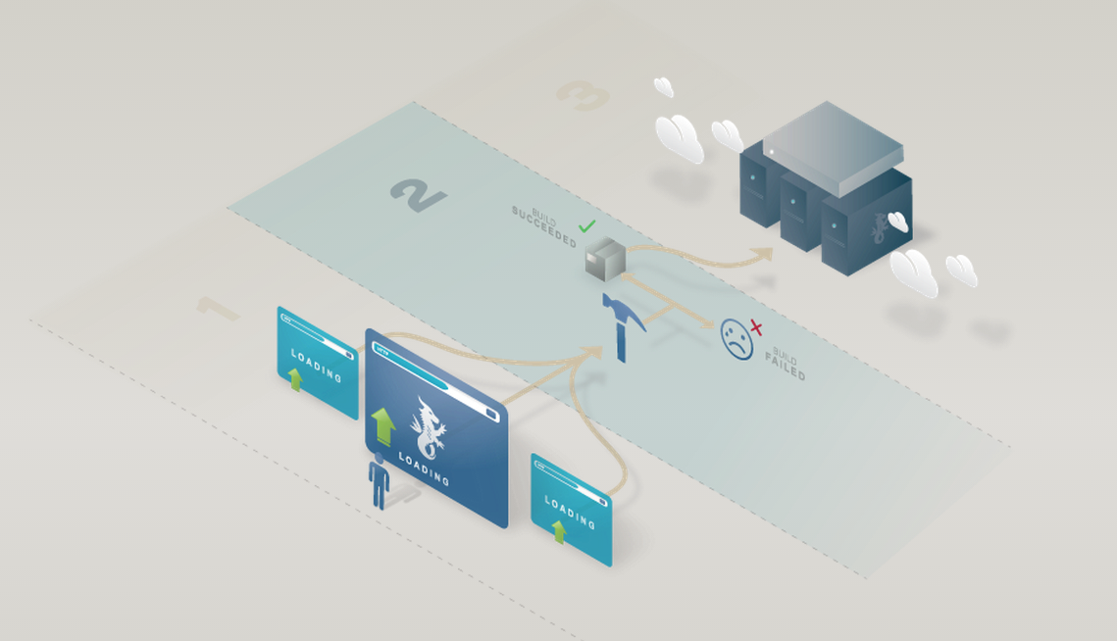
How does it work?

Slide 7

How does it work?

Slide 8
PaaS? IaaS? Saas??
Software as a Service (what end–users use)
Platform as a Service (AppHarbor, Azure web apps)
Infrastructure as a Service (Amazon EC2 instances,
Azure VMs)

Slide 9

We built “Hello, World” …so what??

Slide 10
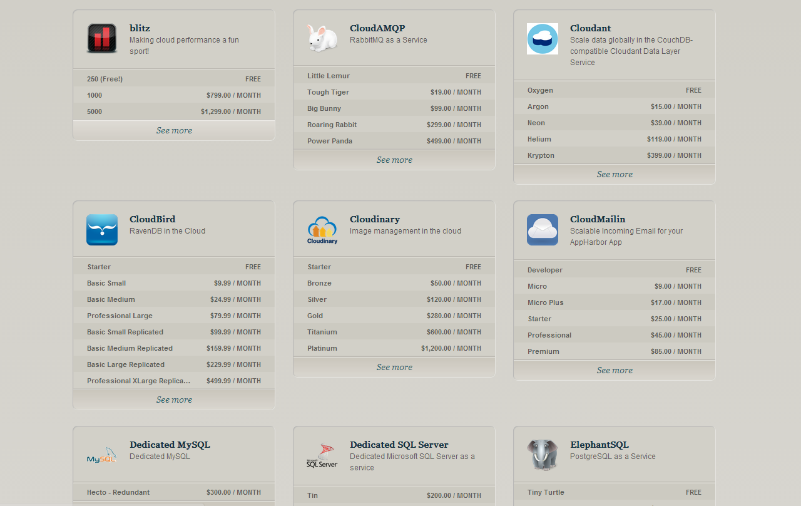
Add-ons

Slide 11
Add-ons
Storage
CouchDB
SQL Server
Monitoring
Airbrake
StillAlive
Email
CloudMailin’
Mailgun
MySQL
RavenDB
Postgres
loader.io
SendGrid

Slide 12

Let’s build something cool already!

Slide 13
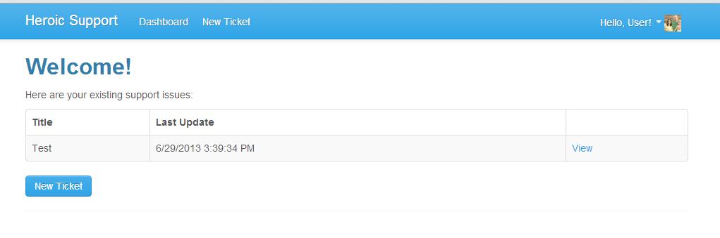
Heroic Support
Support Request
Tracking
Response
E-mail
Website
Reply via E-mail
See what’s waiting
See conversations
Tag and categorize

Slide 14
Heroic Support
1) Basic Structure
2) Storage
3) Receiving Mail
4) Sending Mail
5) Error Handling
Standard MVC app
MS SQL Server
Cloud Mailin’
Send Grid
Airbrake

Slide 15
Let’s code!

Slide 16
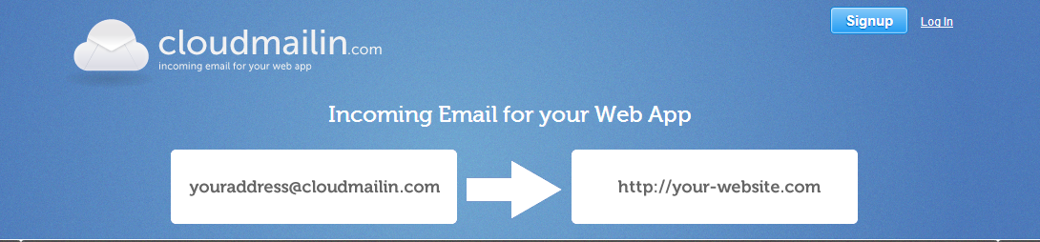

Slide 17

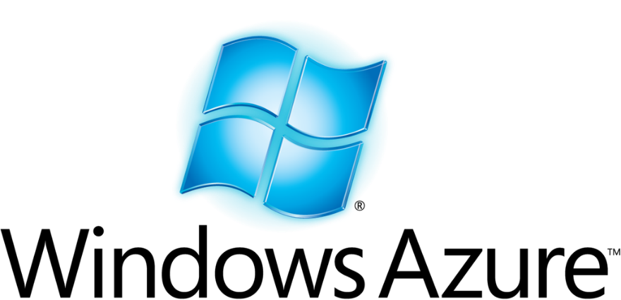
Which should I choose?
vs.

Slide 18
Get Started Today!
Sign-up for an account!
http://appharbor.com
Ping me online:
@matthoneycutt
Follow my blog:
http://trycatchfail.com

