Slide 1
Testing Everything for ASP.NET MVC Applications
Matt Honeycutt
@matthoneycutt
http://trycatchfail.com

Slide 2
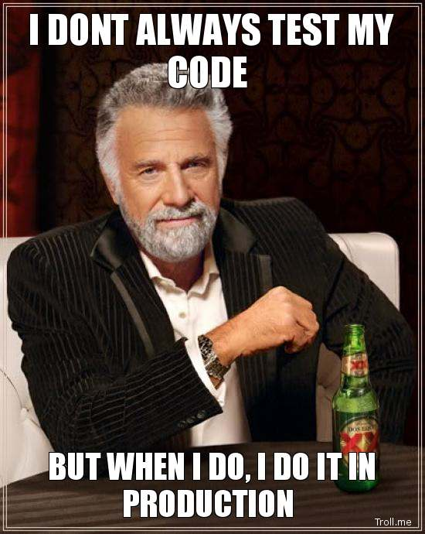
Not this kind of testing…

Slide 3
What we’ll cover:
1) Unit Testing C#
2) Unit Testing JavaScript
3) End-to-End Testing
Required Tools
Required Tools
Intro to SpecsFor.Mvc
Testing an ASP.NET MVC controller
Testing a Knockout view model
Testing jQuery and DOM manipulation
Implementing a new feature TDD-style

Slide 4
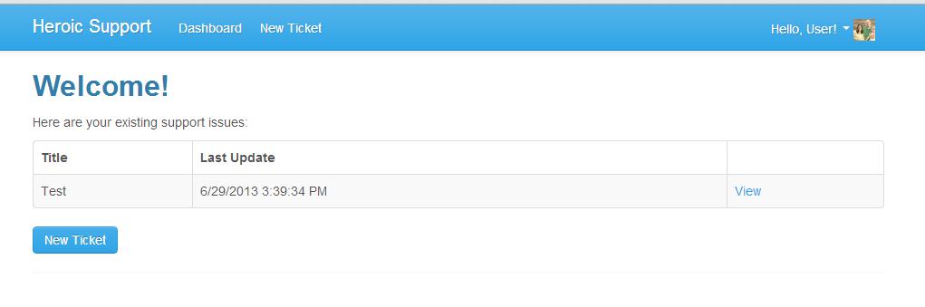
Heroic Support
Support Request
Tracking
Response
E-mail
Website
Reply via E-mail
See what’s waiting
See conversations
Tag and categorize

Slide 5
Given-When-Then
Given a ticket exists, when a user views the ticket, then it displays the ticket title, it displays the ticket body, and it displays the submitter’s name.
Given…
a ticket exists
When…
a user views the ticket
Then…
It displays the ticket title
It displays the ticket body
It displays the submitter’s name

Slide 6
Unit-Testing with C# in ASP.NET MVC

Slide 7


Base Class for Specs
Built on NUnit
Additional Helpers
Includes Solutions to Common Problems
Moq – Mocking framework
Auto-mocking container
Supports DRY testing with Spec-style tests
Should – Assertion extension methods
ExpectedObjects – Compare objects cleanly
Use as little or as much as you want
Extensions simplify to Moq and ExpectedObjects
Additional assertion extension methods

Slide 8
Demo: Testing an MVC Action
When someone submits a new ticket, it displays a success message, it saves the ticket, and it redirects back to the dashboard
When…
Then…
Someone submits a new ticket
It displays a success message
Given…
No state
It saves the ticket
It redirects back to the dashboard

Slide 9
Another example
Given a ticket exists, when a user views the ticket, it displays the ticket title, it displays the ticket body, and it displays the submitter’s E-mail.
Given…
a ticket exists
When…
a user views the ticket
Then…
It displays the ticket title
It displays the ticket body
It displays the submitter’s E-mail

Slide 10

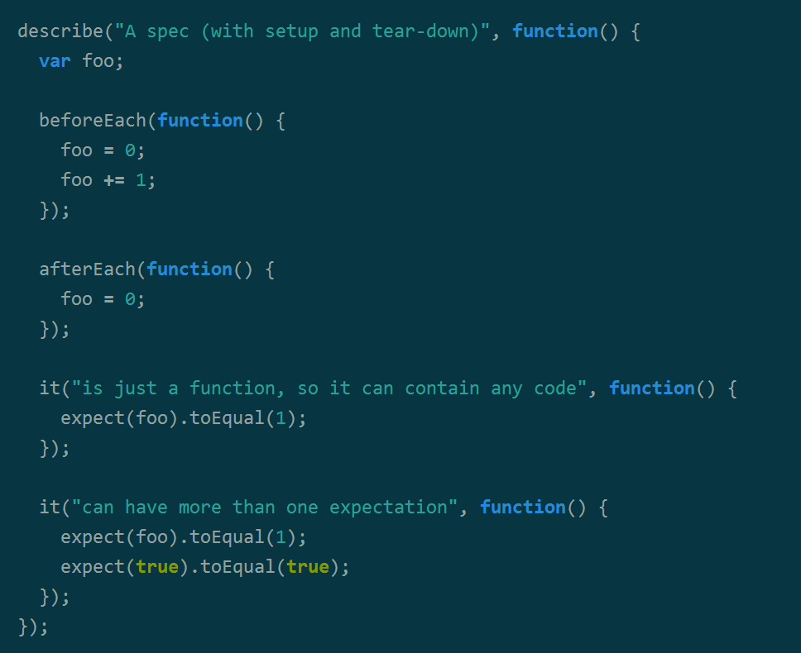
Testing JavaScript with

Slide 11
Given-When-Then
Given a ticket view model, when saving tags, it saves tags to the server, and it displays a success message.
Given…
a ticket view model
When…
saving tags
Then…
it saves tags to the server
it displays a success message

Slide 12
Jasmine Specifications
Given a ticket view model, when saving tags, it saves tags to the server, and it displays a success message.
Describe…
a ticket view model
Describe…
when saving tags
It…
saves tags to the server
displays a success message

Slide 13
Unit-Testing a Knockout View Model

Slide 14

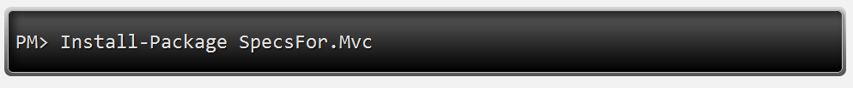
End-to-End Tests with…
ASP.NET Application Host
Built on IIS Express
Deploy and host your app when you run your tests
Strongly-Typed API for Browser Automation
Unit-test like syntax
Navigation and page manipulation based on lambda expressions
Abstraction Over Selenium Web Driver
Handles browser driver management
Provides simplified API for common operations
Includes a “stub” SMTP server

Slide 15
Authentication
Given a user exists, when logging in with valid credentials, it redirects to the dashboard.
Given…
a user exists
When…
logging in with valid credentials
Then…
it redirects to the dashboard

Slide 16
End-to-End Tests for ASP.NET MVC

Slide 17
Replying to a Ticket
Given there is an existing ticket, when replying to a ticket, then it sends the response to the submitter and displays the response on the ticket.
Given…
there is an existing ticket
When…
when replying to the ticket
Then…
it sends the response to the submitter
it displays the response on the ticket

Slide 18
Test your client-side JavaScript
Test your server-side C#
Test your app end-to-end

Slide 19
Want More?
Install SpecsFor and SpecsFor.Mvc
Ping me online:
@matthoneycutt
Follow my blog:
http://trycatchfail.com
Come see me tomorrow!
Last session of the day, learn about cloud-enabling this app!

