Slide 1
How to Build Beautiful ASP.NET MVC Apps for Non-Designers
4:05 pm / Ballroom A

Slide 2
How to Build Beautiful ASP.NET MVC Apps for Non-Designers
Matt Honeycutt |@matthoneycutt http://heroicapplications.com/beautiful-apps

Slide 3
Who am I?
Software developer for the past 16 years
Hideous designer for the past 16 years
Freelance developer, consultant, & problem-solver
Author for Pluralsight
Blogger (trycatchfail.com)
Father (of three!)

Slide 4
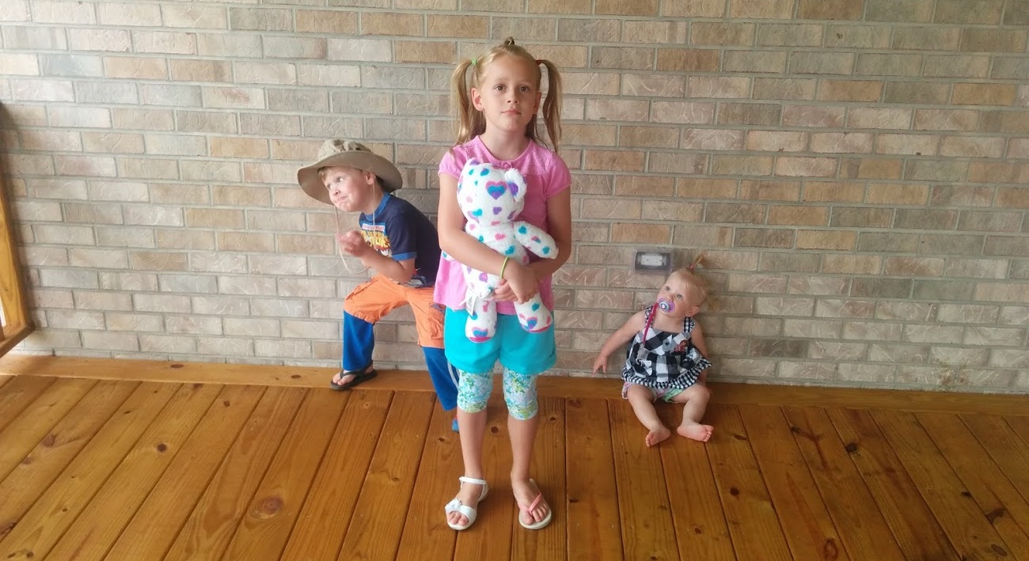
Why me?

Slide 5
This talk…
WON’T…
…help you be a better designer
…delve in to design theory
WILL
…help you create apps that look like you had some design sense
…cover resources to help you
…use simple techniques and tools

Slide 6
The importance of design
Good design!
Bad design!



Slide 7



The importance of design
Apple

Slide 8
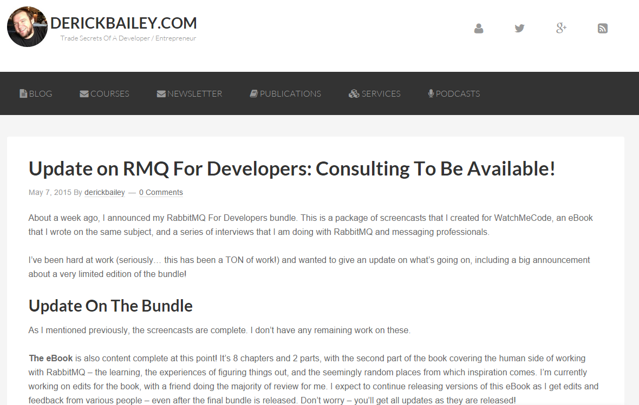
Where would you spend your time?

Slide 9
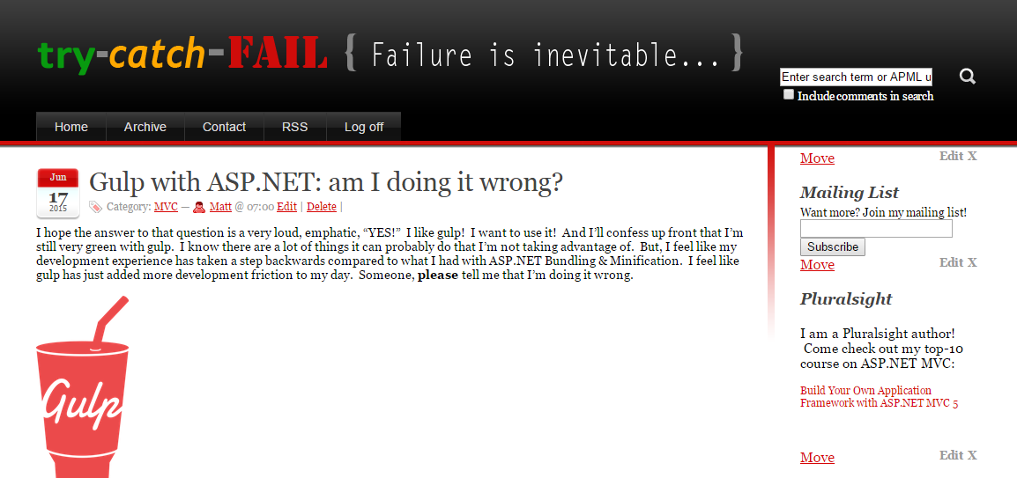
Where would you spend your time?

Slide 10
vs.

Slide 11
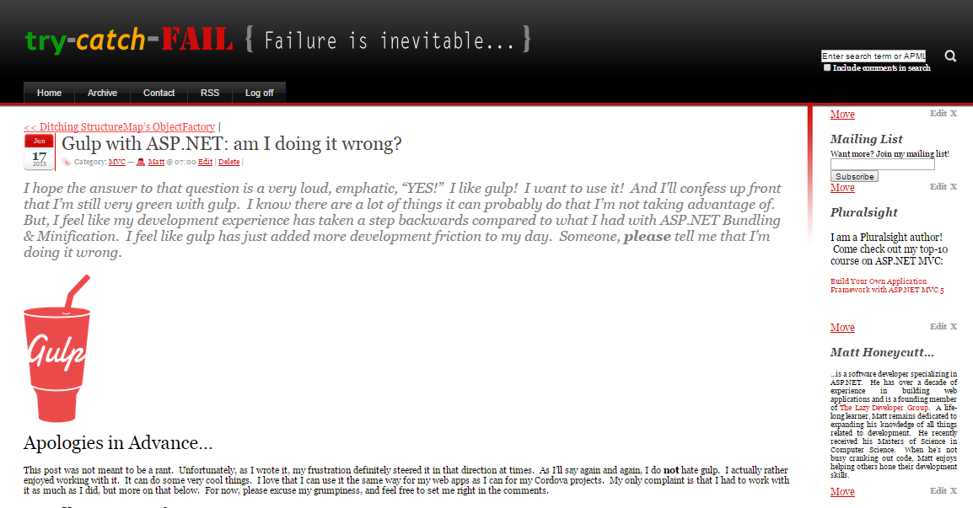
Busy!
!Modern
Poor font choices…

Slide 12
Clean!
Modern!
Easy-to-read font

Slide 13
How do we do better at design?
CHEAT!

Slide 14






Tools we’ll use

Slide 15

Cheater’s Toolbox
Bootstrap
HUGE community
Many things “just work” with it
Responsive!

Slide 16

What’s the seal say?

Slide 17
Bootstrap IS the problem!




Heavily used
Vanilla bootstrap is… meh
✴

It is a starting point
It is not the destination

Slide 18
Cheater’s Toolbox
Bootstrap
Pre-built themes
Lots of great free ones
Most are highly-compatible
Tons of great paid ones!

Slide 19
Theme Sites
w3 Layouts
http://w3layouts.com
Start Bootstrap
http://startbootstrap.com
Bootstrap Zero
http://www.bootstrapzero.com
Bootply
http://www.bootply.com/templates
Bootswatch
http://bootswatch.com
{wrap}bootstrap
https://wrapbootstrap.com

Slide 20

And the seal says….

Slide 21
Cheater’s Toolbox
Bootstrap
Pre-built themes
Image libraries
Don’t just grab from Google!
Many great free image and icon libraries
Buying images can be reasonable, too

Slide 22
Image Libraries
pixabay
https://pixabay.com
morgueFile
http://morguefile.com
picjumbo
https://picjumbo.com
Gratisography
http://gratisography.com
fotolia
https://www.fotolia.com
Dollar Photo Club
https://www.dollarphotoclub.com

Slide 23
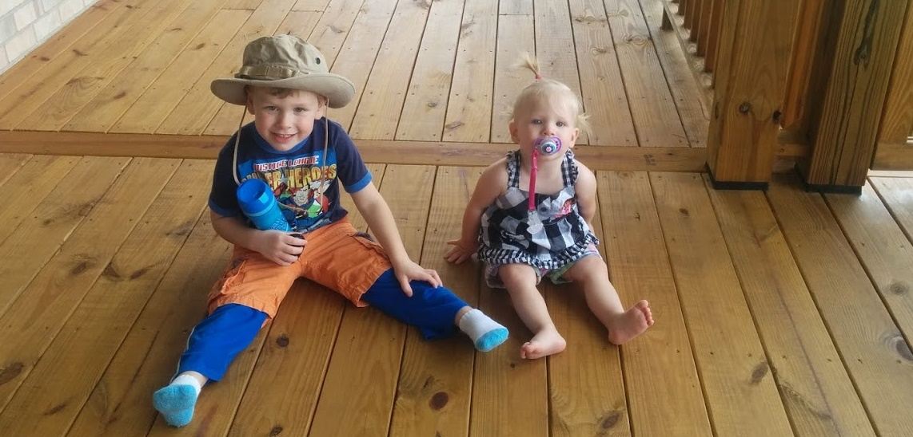
Why I should never be allowed to pick colors…

Slide 24
Cheater’s Toolbox
Bootstrap
Pre-built themes
Image libraries
Color pickers
Let color-savvy people handle this!
You (probably) shouldn’t pick colors
TONS of free tools and resources

Slide 25
Color Tools
COLOURlovers
http://www.colourlovers.com
Adobe Color Wheel
https://color.adobe.com/ create/color-wheel
Google Material Design
http://www.google.com/design/ spec/style/color.html

Slide 26
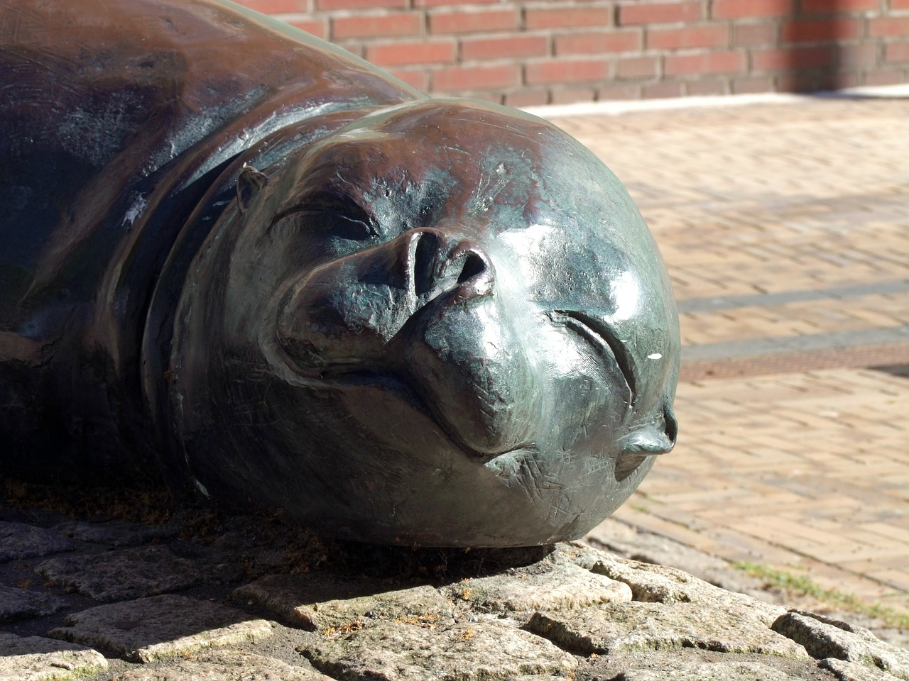
Happy now?

Slide 27
Cheater’s Toolbox
Bootstrap
Pre-built themes
Image libraries
Color pickers
Inspiration
I’m not creative
It’s ok to get ideas!

Slide 28
Inspiration
<Bootsnip>
http://bootsnipp.com
codrops
http://tympanus.net/codrops

Slide 29

Satisfied?

Slide 30
Cheater’s Toolbox
Bootstrap
Pre-built themes
Image libraries
Color pickers
Inspiration

Slide 31
Want more?
Resources: http://heroicapplications.com/beautiful-apps.html
Twitter: @matthoneycutt
Blog: http://trycatchfail.com/blog




