Slide 1
Strongly-Typed AngularJS Apps in ASP.NET MVC
1:15 PM / Ballroom C

Slide 2
Strongly-Typed AngularJS Apps in ASP.NET MVC
Matt Honeycutt |@matthoneycutt http://heroicapplications.com/strongly-typed-angularjs

Slide 3
Who am I?
Software developer for the past 16 years
AngularJS developer for the past two years
Freelance developer & consultant
Author for Pluralsight

Slide 4
Who is this for??
Not for you if…
…you like copy-pasting code and markup.
…you really <3 JavaScript
…hate strong-typing
…hate C# (or Razor)
But it IS for you if…
…you really <3 strong-typing
…like to leverage C#’s type system
…you aren’t afraid of a little magic!

Slide 5
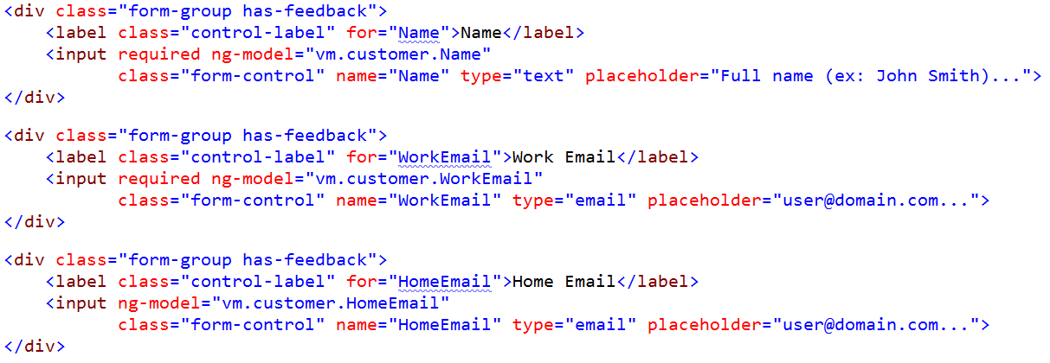
Typical markup… (before)
…

Slide 6
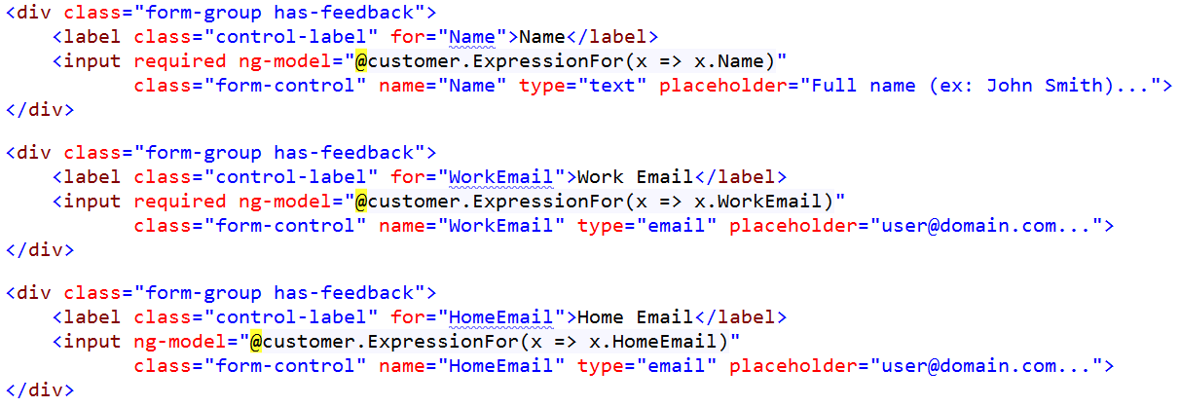
Typical markup… (with a bit of work)
…

Slide 7
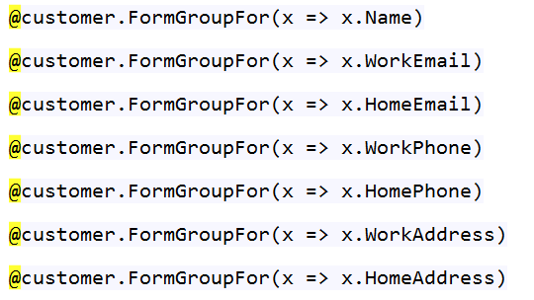
Typical markup… (with a bit more of work)

Slide 8
Typical markup… (the end)

Slide 9
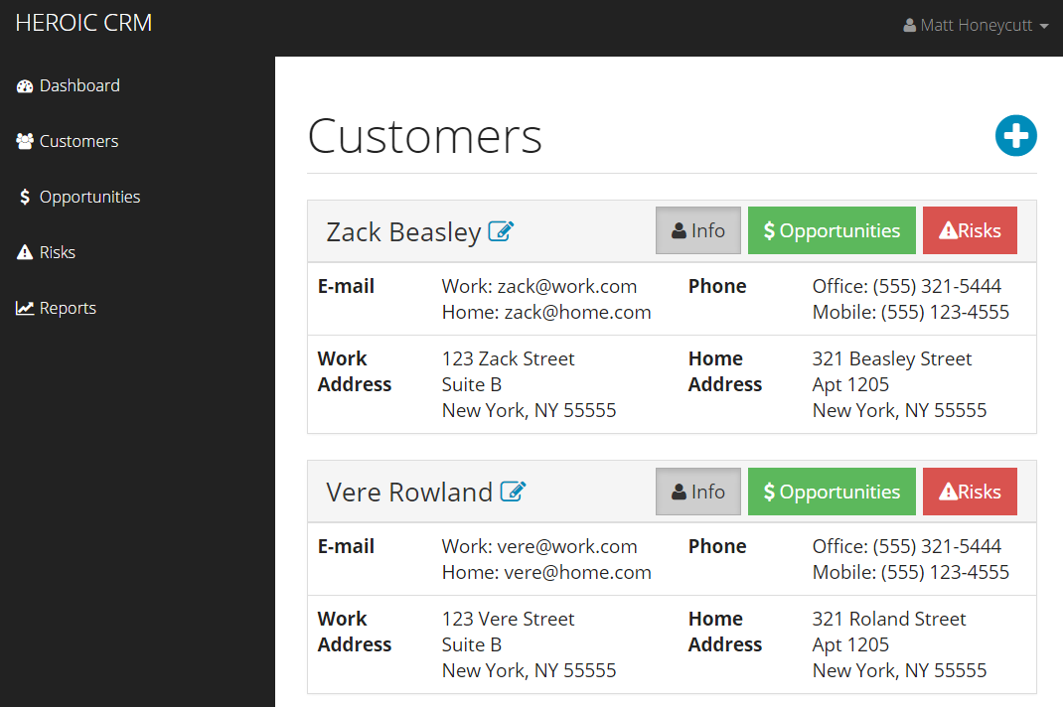
Heroic CRM

Slide 10



Tools we’ll use

Slide 11
Passing Data From MVC Actions to JavaScript
public class CustomerViewModel { public int Id { get; set; } public string Name { get; set; } public string WorkEmail { get; set; } }
{ Id: 5,
Name: ‘john smith’,
WorkEmail: ‘test@user.com’ }

Standard JsonResult

Slide 12
Passing Data From MVC Actions to JavaScript
public class CustomerViewModel { public int Id { get; set; } public string Name { get; set; } public string WorkEmail { get; set; } }
{ id: 5,
name: ‘john smith’,
workEmail: ‘test@user.com’ }

Better JsonResult

Slide 13
Accessing Razor From Client-Side Code


GET http://server.com/Views/View.cshtml

View.cshtml
HTTP 403: Access Denied

GET http://server.com/Customers/Template/View.cshtml


Template Controller

HTTP 200: Ok!


Slide 14
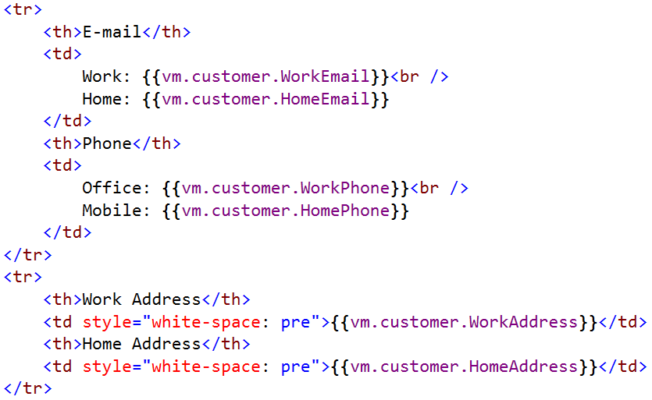
Now…

Slide 15
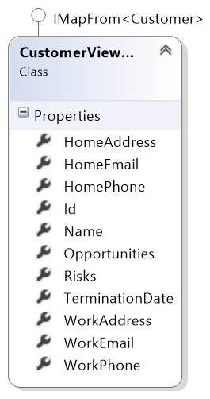
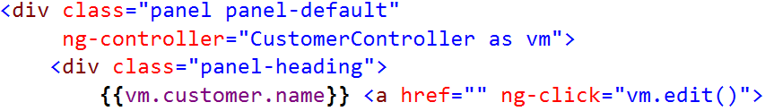
From C# Models to AngularJS Expressions
C# lambda
Client-side expression
x => x.Name
vm.customer.name
Controller-as syntax

Slide 16
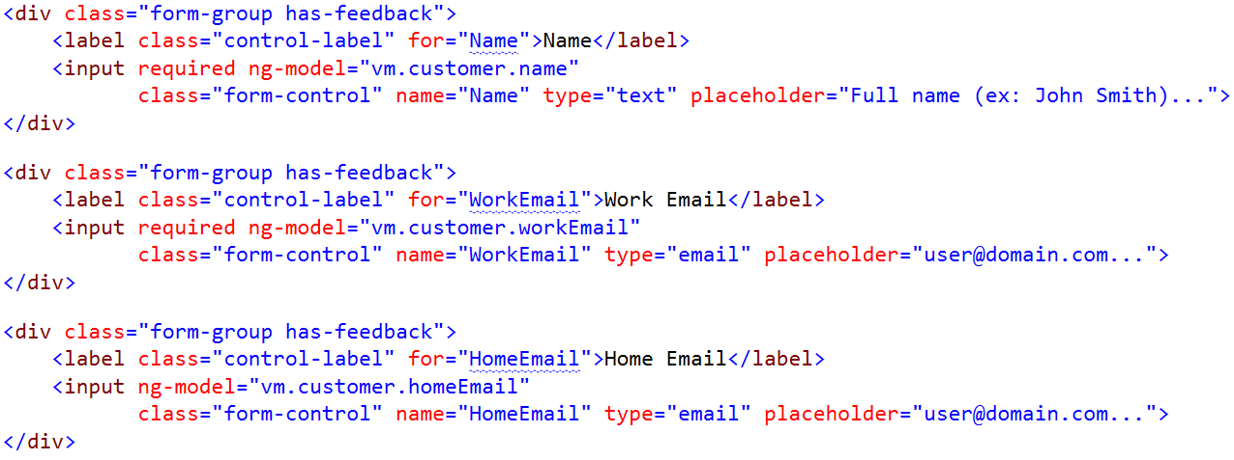
Before

Slide 17
HTML5 Input Types
Input | Valid | Invalid
<input type="email"> | some@user.com | someuser
<input type=“url"> | http://google.com | google.com
<input type=“number"> | 1234 | abc
<input type=“date"> | 01/01/2015 | January 01, 2015
<input type=“time"> | 09:00 PM | 9 am
More…

Slide 18
HTML5 Validation Attributes
Attribute | Valid | Invalid
required | Any value
minlength="5" | abcde | abcd
maxlength="5" | abcde | abcdef
pattern="\d+" | 12345 | 12abc
min="100" | 101 | 99
max="100" | 99 | 101

Slide 19
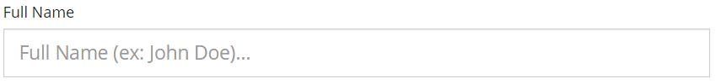


Validation in Heroic CRM
Untouched:
Invalid:
Valid:

Slide 20
Validation in Heroic CRM
Untouched:
Invalid:
Valid:

Slide 21
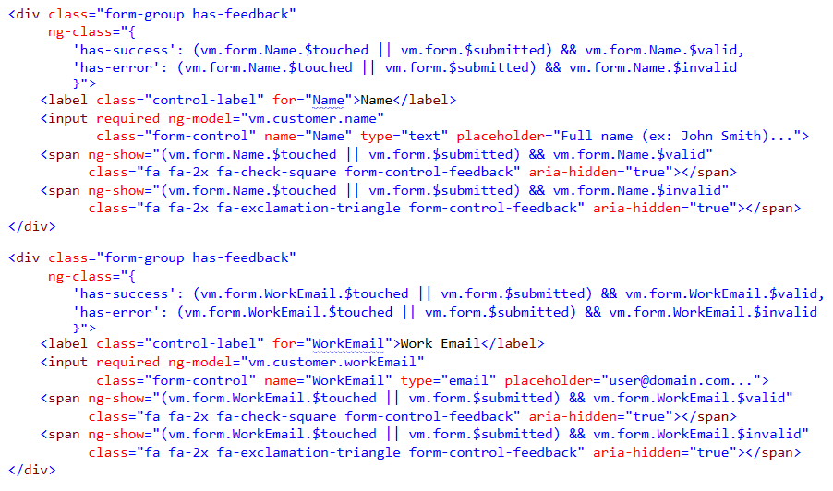
Implementing the Validation

Slide 22
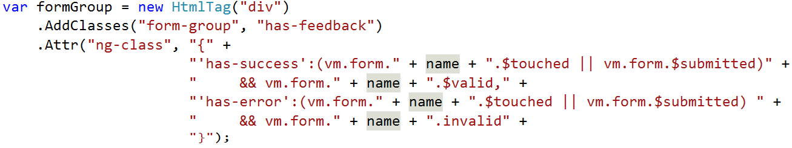
Implementing the Validation

Slide 23
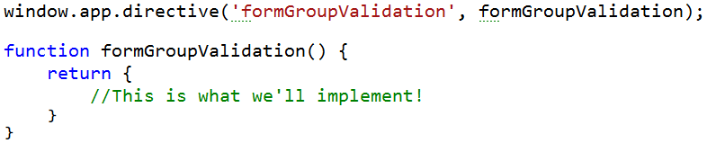

Implementing the Validation
On the client-side…
//MAGIC!
In FormGroupFor…

Slide 24
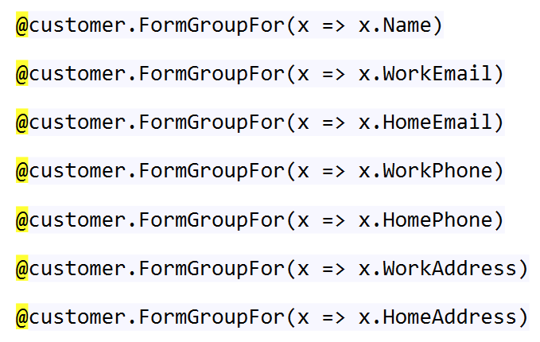
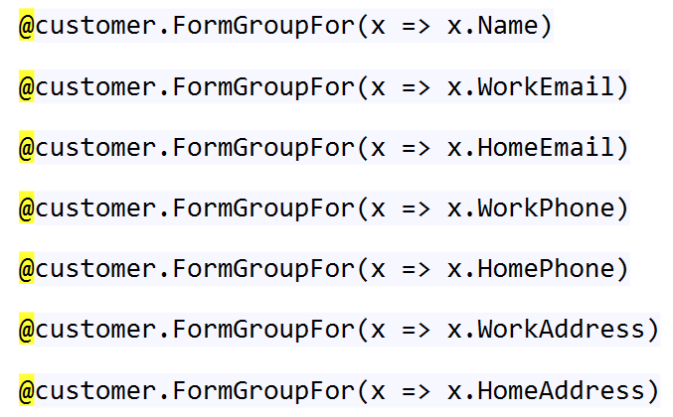
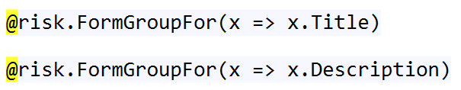
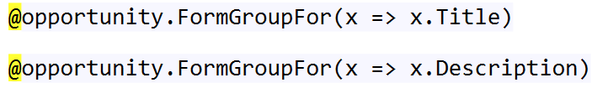
Final Piece: Fully-Conventional Forms

Slide 25
The Final Score
WE NUKED:
79 lines of markup
54 HTML tags
72 CSS classes
134 attributes

Slide 26
Want more?
Resources: http://heroicapplications.com/strongly-typed-angularjs.html
Twitter: @matthoneycutt
Blog: http://trycatchfail.com/blog




