Slide 1
EE545 Final Project
By Matt Klabunde
May 8, 2018

Slide 2
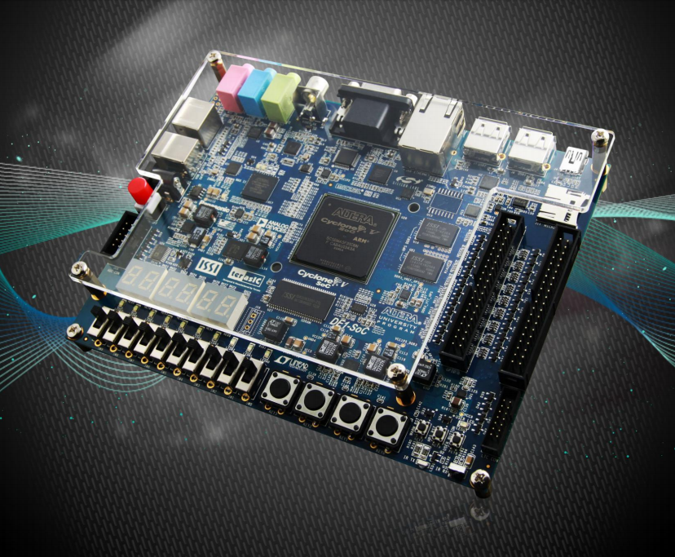
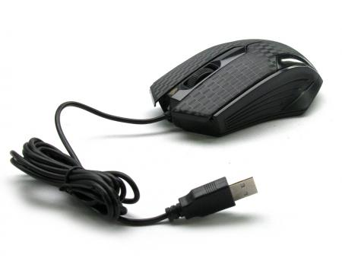
Synopsis
Objective: Control LEDs on DE1-SoC with mouse and keyboard input
Based on Lab 4, except user-controlled instead of program-controlled
Mouse connected to USB terminal on board
Keyboard on laptop connected via UART cable

Slide 3
Stages of development
1. Develop program for LEDs to run indefinitely
2a. Modify program to accommodate mouse input (buttons)
2b. Modify program to accommodate mouse input (movement)
3. Modify program to accommodate keyboard input

Slide 4
Stage 1: LED Program
Based off of Lab 4: My First HPS-FPGA
Required references to hardware
main.c required some modifications
Program runs indefinitely, does not change direction by itself

Slide 5
Stage 2a: Mouse Input (Buttons)
Set a file descriptor to open the mice file located in Linux at /dev/input/mice
Set O_NONBLOCK flag during open call or else the file descriptor would block the while loop when being read from
First byte of data read from file descriptor contained information on left, right, and middle mouse buttons
Assign left, right, and middle variables to corresponding bits of byte
LEDs adjust direction based on status of input

Slide 6
Stage 2B: Mouse Input (Movement)
Use same file descriptor, open call, read call, and byte variable from previous section
Second byte read from file descriptor contained information on x-axis movement
Required signed char variable to account for negative x-axis movement
read() detects changes in mouse orientation
Switched mouse input states by clicking middle button

Slide 7

Stage 3: Keyboard Input
Interact with Linux terminal, receive user input to adjust speed of LED movement
scanf() and speed variable (No error checking)
PROBLEM: scanf() blocks while loop in main(), no flags to set scanf() to non-blocking as in the open() call
SOLUTION: Create new thread for scanf() before entering while loop in main(), put it in its own function and while loop
Speed variable adjusted in new thread and used in original thread
Both loops terminated by Ctrl + C

Slide 8
What Was Learned?
Better understanding of Linux
Where peripheral devices can be accessed in Linux
How to access and use peripheral devices (mouse in particular)
The importance of setting flags for certain variables
The importance of using threads in your program
Better understanding of HPS-to-FPGA communication
Better understanding of physical and virtual memory and their uses

Slide 9
What Could Have Been Improved?
More focus needed on hardware blocks
Poor coding in some cases (Could have benefitted from more function calls)
More research needed into mouse file (Scroll wheel?)
Better adherence to Project Proposal

Slide 10
Resources / References
Lab 4: My_First_HPS-FPGA.pdf
Mouse: https://people.ece.cornell.edu/land/courses/ece5760/DE1_SOC/HPS_peripherials/USB_index.html
Mouse: http://blog.eihis.com/2014/06/26/linux-reading-the-mouse-events-datas/
Mouse, Blocking: https://www.linux.com/forums/software-development/problems-read-and-mice-device-devinputmice
Scroll Wheel: https://stackoverflow.com/questions/15882665/how-to-read-out-scroll-wheel-info-from-dev-input-mice
pthread, Makefile: https://stackoverflow.com/questions/1662909/undefined-reference-to-pthread-create-in-linux
mmap: https://stackoverflow.com/questions/258091/when-should-i-use-mmap-for-file-access
mmap: https://www.gnu.org/software/libc/manual/html_node/Memory_002dmapped-I_002fO.html
mmap: http://man7.org/linux/man-pages/man2/mmap.2.html

