Slide 1
Microphonics GUI R Legg, 4 Aug 2021
GUI intended as one “tab” of the guided commissioning screen for SRF commissioning
Take short dataset for each cavity and plot it in order to look for gross problems
Code uses the directory structure suggested by Sonya:
$PHYSICS_TOP/rf_lcls2/microphonics
Under this, are the individual cavity directories, a few for example:
ACCL_L1B_0310
ACCL_L1B_0320
ACCL_L1B_0330
ACCL_L1B_0340
To be consistent with our other saved data, a new directory is created
(within the individual cavity directory) for each dataset, formatted like this example:
ACCL_L3B_1680_20210624_202608
Full path is:
$PHYSICS_TOP/rf_lcls2/microphonics/ACCL_L3B_1680/ACCL_L3B_1680_20210624_202608

Slide 2
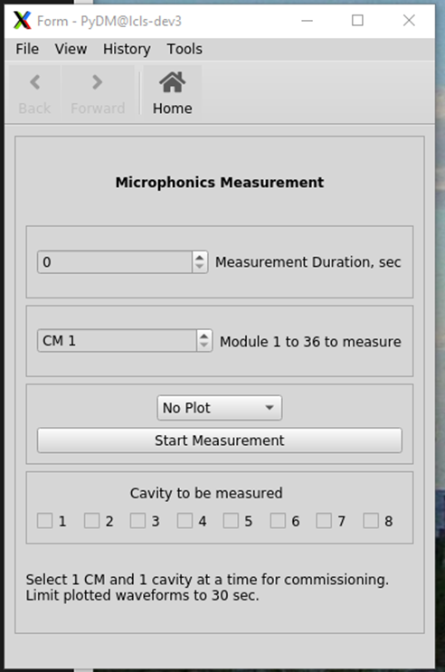
Generic Display https://github.com/rlegg15/Microphonics_tab
How long to take data for?
Script uses 8 second long buffers
Which module to take data from?
(3.9’s aren’t supported presently)
Pulldown menu to select plot type
Which cavity to take data from?
Only 1 cavity at a time for commissioning
Label to communicate with Users
FFT_test.ui

Slide 3
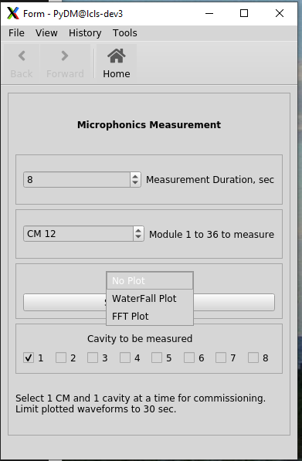
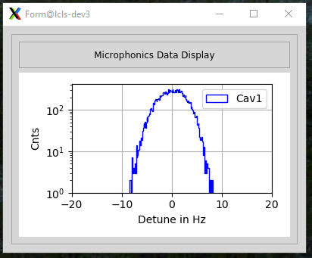
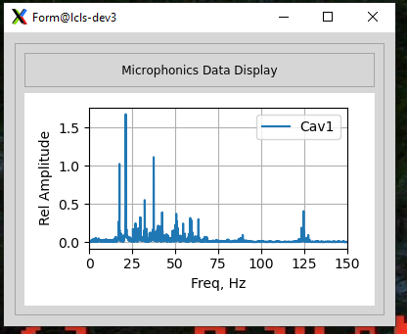
Waterfall or FFT displays or ‘No Plot’ for long, boring runs
As long as CM and cavity selected are NOT changed, existing dataset is used for plots
MicPlot.ui is used for both plot displays
Version on lcls-dev3 has a “FFt_math.dummyFileCreator(lastPath)”
Data shown is from vCM

Slide 4
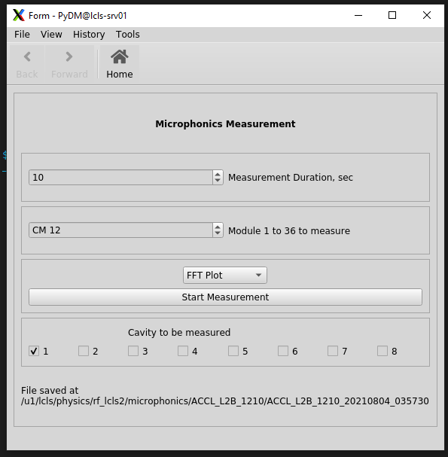
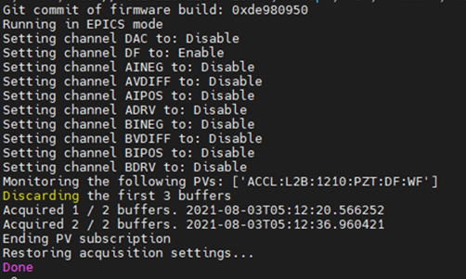
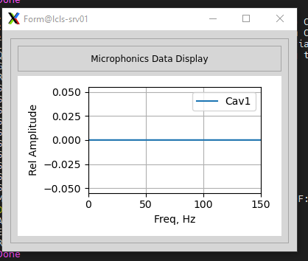
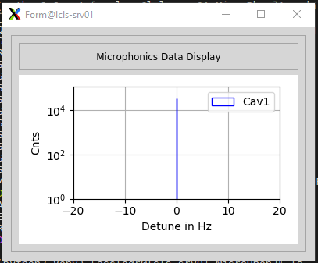
LCLS-II Production ~/rlegg15/gitProj/MicroPhon
Must have python 3 to run (I use ‘source use_python3.sh’)
Command to execute is “pydm CommMicro.py” in the directory above
The stdout is printed for debugging purposes
No rf presently, so delta frequency data is all ‘0’s
Plots are pretty boring.

Slide 5
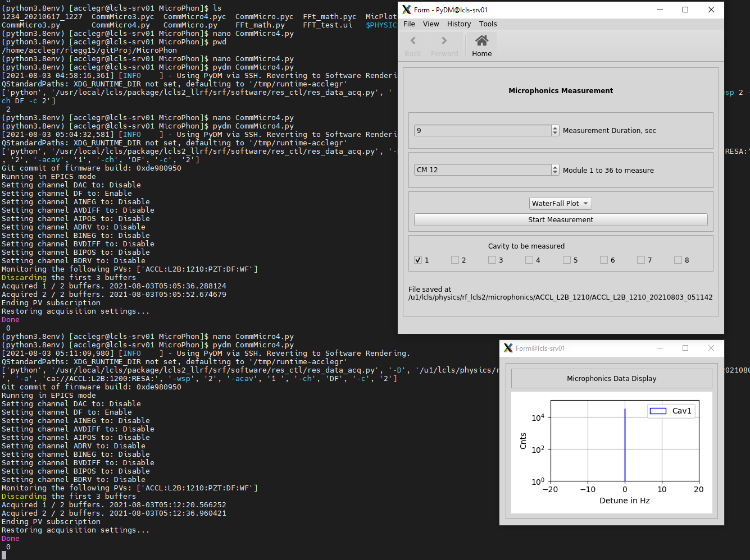

Slide 6
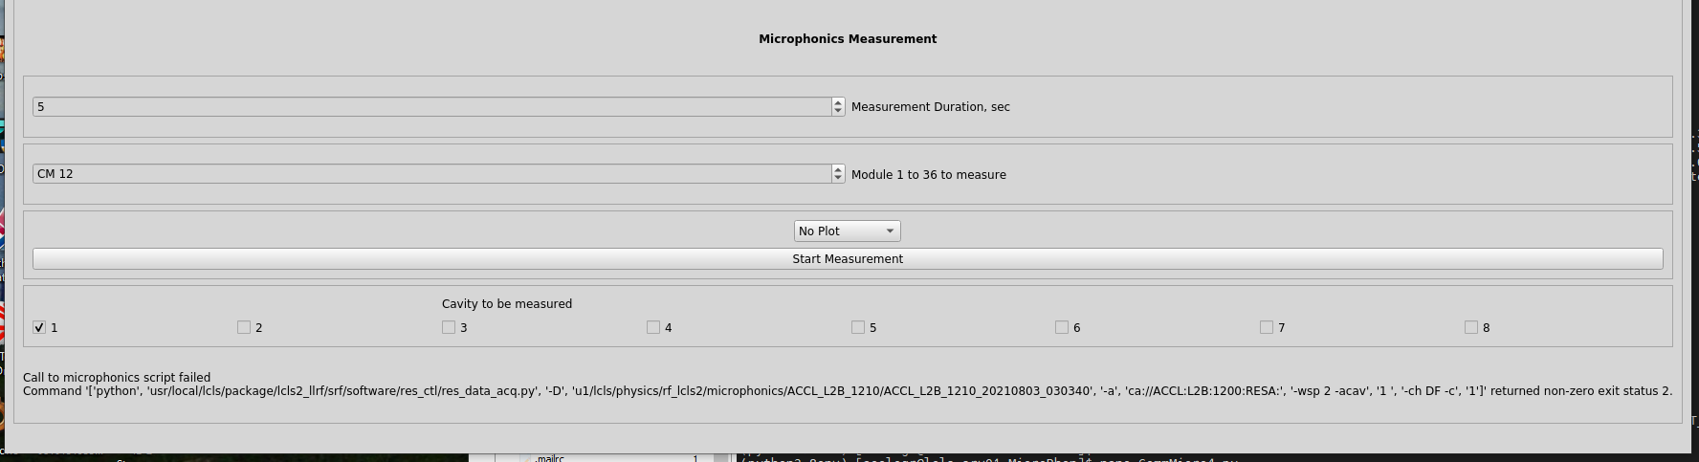
Warts
During data acquisition the display just stops. I’ve tried to intercept stdout and send it line by line to the display without success so far. But this can be worked on in the sandbox offline.
The absolute path names, $PACKAGE_TOP and $PHYSICS_DATA, don’t resolve in the subprocess call. Paths must be fully defined or the makedirectory can go anywhere
The subprocess calls with long command lists, must use ‘ rather than “ as quotes or command is returned with non-zero exit code 2. (Who knows why?)
Lots of exception handling in subprocess call required.
Writes to label don’t always appear. Overwritten? Failed to write?
The code is not split correctly between display/User Interface functions and Get data and analysis functions. Should be separated.
Not enough comments; code can be cryptic at times

Slide 7
Thank you for the attention

Slide 8
from pydm import Display
from PyQt5.QtGui import QStandardItem
from PyQt5.QtWidgets import (QWidgetItem, QCheckBox, QPushButton, QLineEdit,
QGroupBox, QHBoxLayout, QMessageBox, QWidget,
QLabel, QFrame, QComboBox, QRadioButton)
from os import path, pardir, makedirs, listdir
import subprocess
from functools import partial, reduce
from datetime import datetime, timedelta
import sys
import numpy as np
from scipy.fftpack import fft, fftfreq
from matplotlib.backends.backend_qt5agg import FigureCanvasQTAgg
import matplotlib.pyplot as plt
from matplotlib.figure import Figure
import FFt_math
lastPath=''
class MplCanvas(FigureCanvasQTAgg):
# MPLCanvas is the class for the 'canvas' that plots are drawn on and then mapped to the ui
# They are Figure format described in matplotlib 2.2 documentation
def __init__(self, parent=None, width=5, height=4, dpi=100):
fig = Figure(figsize=(width, height), dpi=dpi, tight_layout="true")
self.axes = fig.add_subplot(111)
super(MplCanvas, self).__init__(fig)
class MicDisp(Display):
def __init__(self, parent=None, args=None, ui_filename="FFT_test.ui"):
super(MicDisp, self).__init__(parent=parent, args=args, ui_filename=ui_filename)
self.pathHere = path.dirname(sys.modules[self.__module__].__file__)
def getPath(fileName):
return path.join(self.pathHere, fileName)
self.xfDisp = Display(ui_filename=getPath("MicPlot.ui"))
XfelPlot = MplCanvas(self, width = 20, height =40, dpi=100)
self.xfDisp.ui.Plot3.addWidget(XfelPlot)
self.ui.AcqProg.setText("Select 1 CM and 1 cavity at a time for commissioning. \nLimit plotted waveforms to 30 sec.")
self.ui.StrtBut.clicked.connect(partial(self.setGOVal,XfelPlot)) # call function setGOVal when strtBut is pressed
Imports
The Canvas defines the figure the plots are drawn on

Slide 9
try: try the subprocess call
self.ui.AcqProg.setText("Data acquisition started\n")
process = subprocess.Popen(cmdList, stdout=subprocess.PIPE, stderr=subprocess.PIPE)
out, err = process.communicate() Use communicate() rather than read()
return_code = process.poll()
out = out.decode(sys.stdin.encoding)
err = err.decode(sys.stdin.encoding)
print(out)
if return_code==0: If normal return from call, tell User path and goto plotting
self.ui.AcqProg.setText("File saved at \n"+lastPath)
self.getDataBack(ac)
if return_code !=0: If not a normal return (but still a return), write script failed and error code
e = subprocess.CalledProcessError(return_code, cmdList, output=out)
e.stdout, e.stderr = out, err
self.ui.AcqProg.setText("Call to microphonics script failed \n"+str(e.stderr))
except: If try just flat fails, just write script failed and stop
self.ui.AcqProg.setText("Call to microphonics script failed \n")
Exception handling for subprocess call
Easy FFT of array
def FFTPlot(self, ac, cavUno): ac is name of canvas, XFelPlot (yes, I reuse code)
N = len(cavUno) cavUno is data array
T = 1.0/1000 microphonics data is taken at 1 kHz
yf1 = fft(cavUno) easy fft with scipy
xf = fftfreq(N, T)[:N//2] x axis frequency bins with scipy
ac.axes.plot(xf, 2.0/N * np.abs(yf1[0:N//2])) And you plot with matplotlib and numpy

Slide 10
Build the subprocess command
resScrptSrce = "/usr/local/lcls/package/lcls2_llrf/srf/software/res_ctl/res_data_acq.py“ Delta F acquisition file
morPath = "/u1/lcls/physics/rf_lcls2/microphonics/“ Top part of path to data directory
s1 = datetime.now().strftime("%Y%m%d"+"_"+"%H%M%S") String with the datetime for dir name
botPath = "ACCL_"+liNac+"_"+cmNumSt Cavity name part of path to data dir
if cavNumA != '': cavNumA is cavities 1-4
botPath = botPath+cavNumA[0]+"0/"+botPath+cavNumA[0]+"0_"+s1 so when multicav runs are done, it’s ready
caCmd = "ca://ACCL:"+liNac+":"+str(cmNumSt)+"00:RESA:“ Cavities 1-4 use RESA chassis
if cavNumB != '':
botPath = botPath+cavNumB[0]+"0/"+botPath+cavNumB[0]+"0_"+s1
caCmd = str("ca://ACCL:"+liNac+":"+str(cmNumSt)+"00:RESB:")
lastPath = path.join(morPath, botPath)
makedirs(lastPath, exist_ok=True)
numbWaveF= str(int(timMeas//8)+(timMeas % 8 > 0)) Figure how many buffers are needed
cmdList= ['python',resScrptSrce,'-D',str(lastPath),'-a',caCmd,'-wsp','2','-acav',str(cavNumA),'-ch','DF','-c',numbWaveF] Put it all together

