Slide 1
2D Transformations
Created by MYVYNA team

Slide 2
Why do we need it?
Created by MYVYNA team

Slide 3
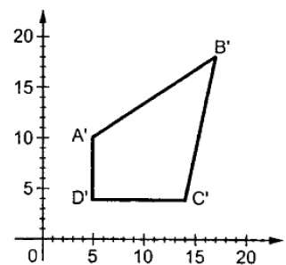
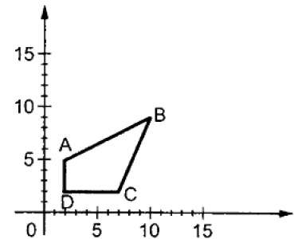
Scaling
Created by MYVYNA team

Slide 4
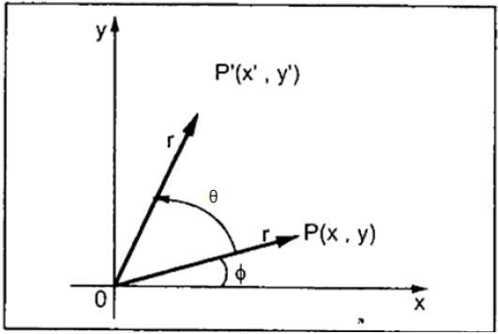
Rotation
Created by MYVYNA team

Slide 5
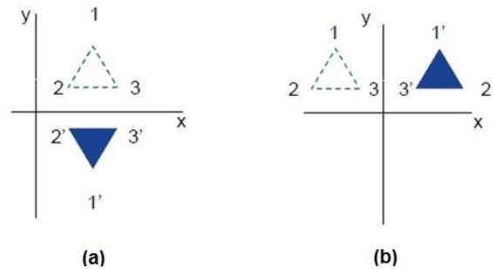
Reflection
Created by MYVYNA team

Slide 6
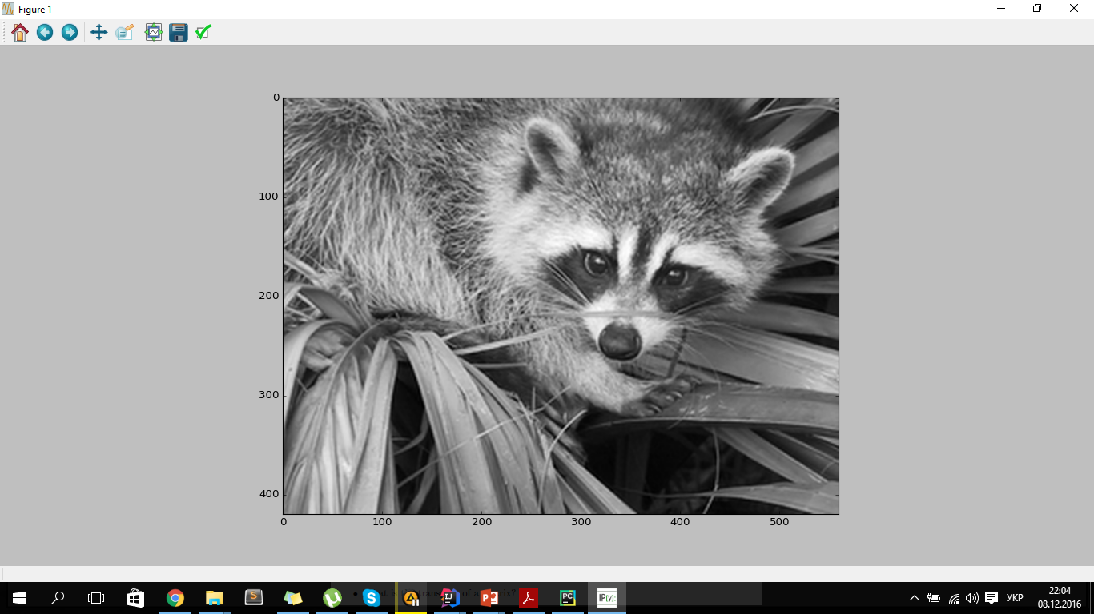
«Black Sad Raccoon»
Created by MYVYNA team

Slide 7
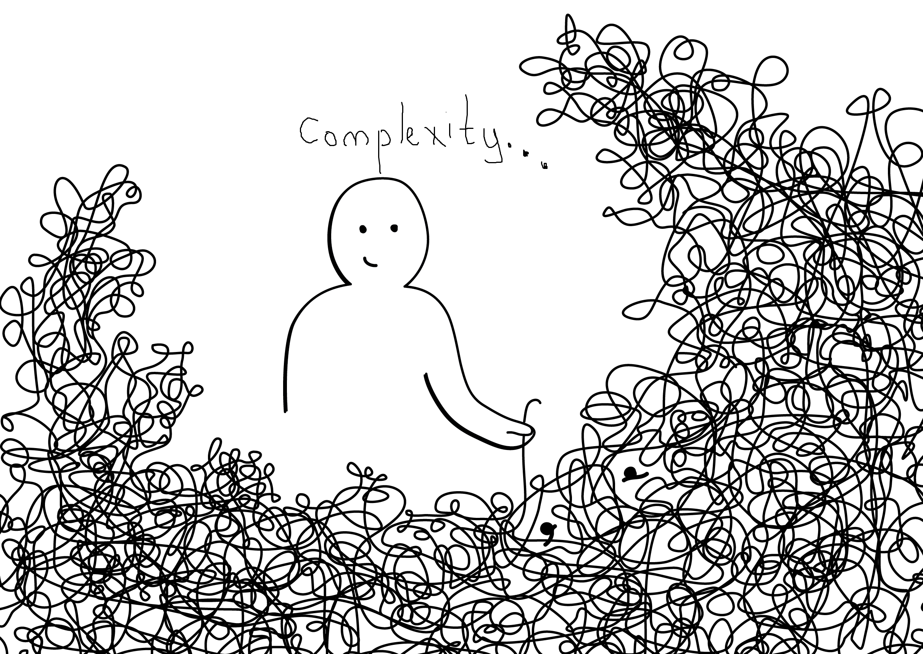
Created by MYVYNA team

Slide 8
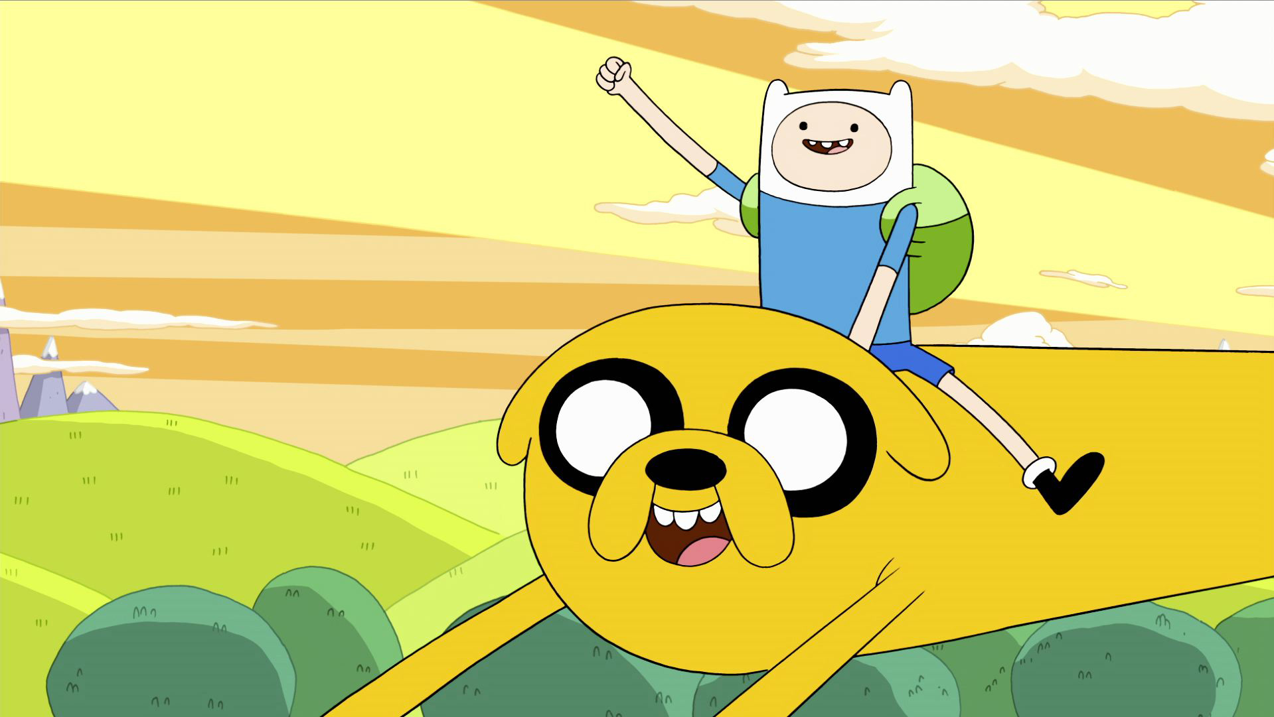
Now it’s…Adventure Time!
MYVYNA
Created by MYVYNA team

Slide 9
Conclusions…
Created by MYVYNA team

Slide 10
Thank you for your attention!
Created by MYVYNA team

