Slide 1

Database Application
By Matthew Pascual-Mead

Slide 2
Issue with tilly’s
Tracking of employee sales was non- existent!
Managers gauged performance based solely on their observations
Results in complaints from sales associates, resulting in an unhealthy work environment

Slide 3

Solution
Create an application to effectively track employee sales and performance in a compact way
Furthermore, could provide other insightful reports to support all levels of management
Ideally, this would improve employee satisfaction (rewards?) and Tilly’s

Slide 4


Related Work
But for stores that do track employee sales, it is often overlooked, unused, or unreliable
There are retail companies that track employee sales within their database systems
As a result, this application seeks to improve sale tracking and give managers better insights into their employees

Slide 5
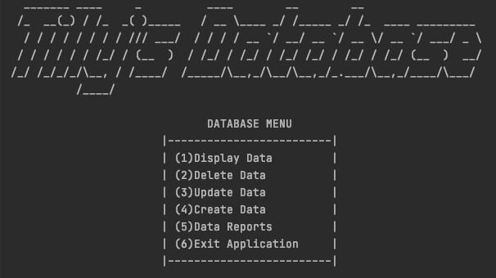
Solution

Slide 6
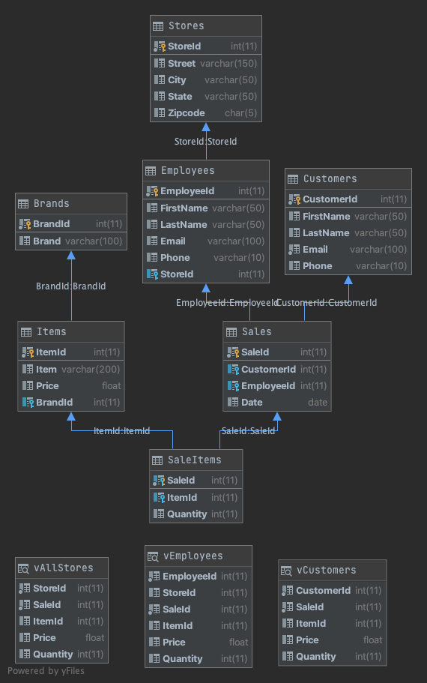
Database Schema

