Slide 1

The Mana Pool
A deck builder for Magic: The Gathering
Created by Matt Mohl

Slide 2
Magic: The Gathering
World’s first trading card game
Die hard fan-base
Not much web presence

Slide 3
What it’s all about
Minimalize design
Content is king here
Easy to use
Great for beginners
Create a helpful community
Incentive to give feedback

Slide 4

Overview
Give users rewards for helping
Experience points will increase level
Higher level = mightier mage

Slide 5
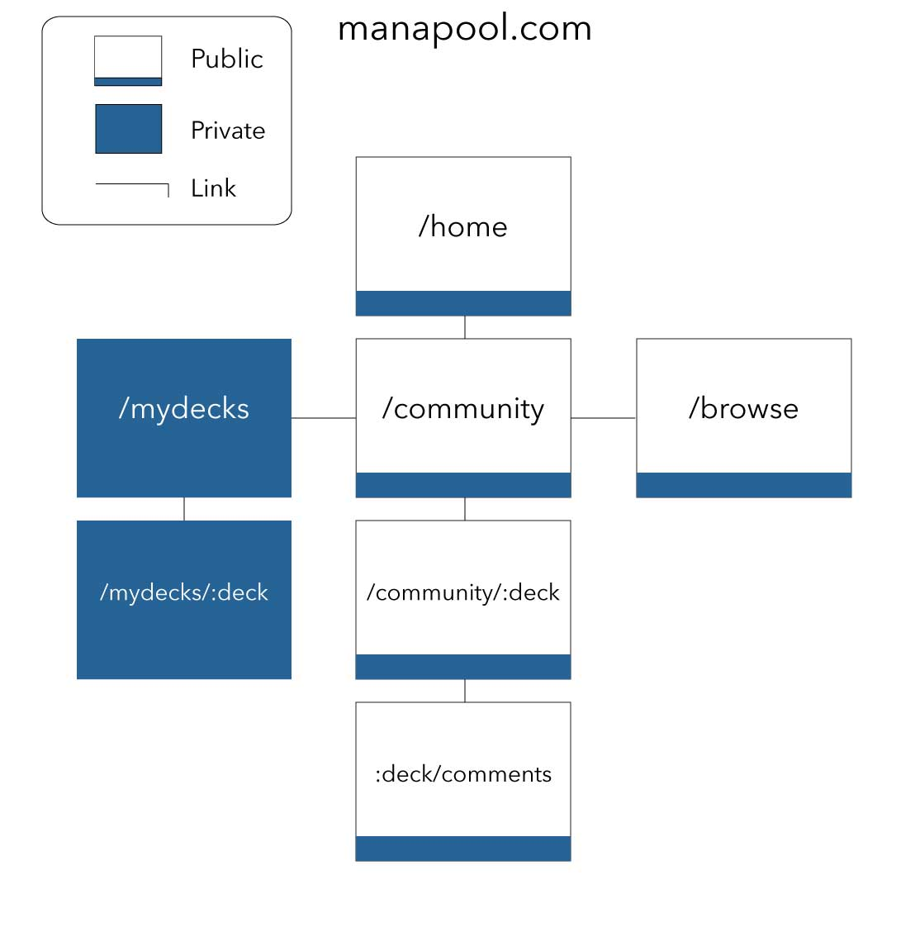
Structure
1.0 Home Page
2.0 My Decks
3.0 Community
4.0 Edit Deck
5.0 View Deck
6.0 Browse

Slide 6
Tech Specifications
Database:
Firebase
One for users and decks
Another for ~18k cards
Logic:
AngularJS
JQuery for custom inputs
Structure / Style:
HTML5 and CSS3

Slide 7


Styling
Header Font-Family
Avenir Next
Everything Else
Calibri
Example Button
.
Main color
(0,25,45) Dark Blue
Positive color
(38,99,150) Blue
Negative color
(232,102,46)

Slide 8
Near Future
Next step is markup and styling
The User system
Login
Register
Browse system
MySQL db
Advanced search

Slide 9
Budget
HTML/CSS markup
1 Week - $2000
User System
1 Week - $1000
Browse System
2 Weeks - $5000
Deck System
2 Weeks - $2000
Comment System
1 Week - $1000
Exp System
1 Week $1000
Total
$12,000

Slide 10
Fin
Questions / Concerns

