Slide 1
KERMIT….
Fabio Massimo Zanzotto
ART
University of Rome Tor Vergata
Rome (Italy)
…virtually @reading group Groningen

Slide 2









$$\hat{y}$$
Decoder Layer
. . .
$$T_{[CLS]}$$
$$T_{1}$$
$$T_{2}$$
. . .
$$T_{n}$$
. . .
. . .
KERMIT
. . .
. . .
Transformer Model
. . .
. . .
. . .
Encoder
Encoder
Encoder
. . .
Encoder
$$E_{[CLS]}$$
$$E_{1}$$
$$E_{2}$$
. . .
$$E_{n}$$
. . .
Input Sentence Tokens
Syntactic Parser
Sentence

Slide 3
. . .
$$T_{[CLS]}$$
$$T_{1}$$
$$T_{2}$$
. . .
$$T_{n}$$
. . .
. . .
KERMIT
. . .
. . .
Transformer Model
. . .
Distributed
Structure
Embedder
. . .
. . .
Encoder
Encoder
Encoder
. . .
Encoder
$$E_{[CLS]}$$
$$E_{1}$$
$$E_{2}$$
. . .
$$E_{n}$$
. . .
Input Sentence Tokens
Syntactic Parser
Sentence

Slide 4


$$\hat{y}$$
Decoder Layer
Universal sentence embeddings
. . .
$$T_{[CLS]}$$
$$T_{1}$$
$$T_{2}$$
. . .
$$T_{n}$$
ELMO
. . .
. . .
KERMIT
. . .
. . .
Transformer Model
. . .
. . .
. . .
Encoder
Encoder
Encoder
. . .
Encoder
XLNET
. . .
BERT
GTP-1,2,3
$$E_{[CLS]}$$
$$E_{1}$$
$$E_{2}$$
$$E_{n}$$
. . .
Universal syntactic interpretations
Input Sentence Tokens
Syntactic Parser
Sentence

Slide 5

The chef cooks the good soup
S
NP
VP
Positive!
D
N
V
NP
.
.
.
.
.
.
.
.
.
.
.
.
The
chef
cooks
D
J
N
the
good
soup
Forward pass

Slide 6
The chef cooks the good soup
S
NP
VP
Positive!
D
N
V
NP
.
.
.
.
.
.
.
.
.
.
.
.
The
chef
cooks
D
J
N
the
good
soup
Interpretation

Slide 7










The chef cooks the good soup
S
NP
VP
Positive!
D
N
V
NP
.
.
.
.
.
.
.
.
.
.
.
.
The
chef
cooks
D
J
N
the
good
soup
1) summing of one-hot vectors representing subtrees
2) embedding subtrees in distributed representations (vectors)
Impossible! The space of subtrees is huge since combinatory with respect to the node labels!

Slide 8
The chef cooks the good soup
S
NP
VP
Positive!
D
N
V
NP
.
.
.
.
.
.
.
.
.
.
.
.
The
chef
cooks
D
J
N
the
good
soup

Slide 9

The chef cooks the good soup
S
ernel-inspired
K
Positive!
NP
VP
ncoder with
E
ecursive
D
N
V
NP
R
M
echanism for
I
.
.
.
.
.
.
The
chef
cooks
D
J
N
nterpretable
T
rees
the
good
soup

Slide 10






















The chef cooks the good soup
S
NP
VP
Positive!
D
N
V
NP
.
.
.
.
.
.
.
.
.
.
.
.
The
chef
cooks
D
J
N
the
good
soup
S
Γ(
NP
VP
)=
$$\text{(}\vec{\text{S}}⊙\text{(}\vec{\text{NP}}\text{)}⊙\text{(}\vec{\text{VP}}⊙\text{(}\vec{\text{V}}⊙\vec{\text{cooks}}\text{)}⊙\text{(}\vec{\text{NP}}\text{)))}$$
V
NP
Shuffled circular convolution
cooks
Random vectors for node labels
Zanzotto&Dell'Arciprete, Distributed Tree Kernels, Proceedings of ICML, 2012

Slide 11
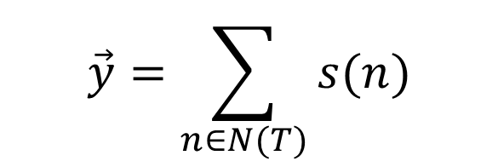











$$\vec{y}=\sum_{n∈N(T)}{s(n)}$$
The chef cooks the good soup
S
ernel-inspired
N(T) is the set of nodes of T
K
NP
VP
ncoder with
E
D
N
V
NP
R
ecursive
M
echanism for
$$s\left(n\right)=\vec{0}$$
if n is terminal
I
.
.
.
The
chef
cooks
D
J
N
nterpretable
T
$$s\left(n\right)=\vec{n}⊙\left(\vec{c_{1}}+\sqrt{λ}s(c_{1})\right)⊙⋯⊙\left(\vec{c_{m}}+\sqrt{λ}s(c_{m})\right)$$
rees
the
good
soup
if n→c₁…c_{m}
Zanzotto&Dell'Arciprete, Distributed Tree Kernels, Proceedings of ICML, 2012

Slide 12
The chef cooks the good soup
S
ernel-inspired
K
Positive!
NP
VP
ncoder with
E
ecursive
D
N
V
NP
R
M
echanism for
I
.
.
.
The
chef
cooks
D
J
N
nterpretable
.
.
.
T
rees
the
good
soup
Forward pass

Slide 13




On demand production of W
The chef cooks the good soup
S
NP
VP
Positive!
D
N
V
NP
.
.
.
.
.
.
.
.
.
.
.
.
The
chef
cooks
D
J
N
the
good
soup
Layer-wise relevance propagation (Bach et al, 2015)
Interpretation

Slide 14
Where does KERMIT come from?

Slide 15
Fabio Massimo Zanzotto, Ioannis Korkontzelos, Francesca Fallucchi, Suresh Manandhar: Estimating Linear Models for Compositional Distributional Semantics. COLING 2010
Fabio Massimo Zanzotto, Lorenzo Dell'Arciprete, Distributed Tree Kernels, Proceedings of ICML, 2012
Fabio Massimo Zanzotto, Lorenzo Ferrone, Marco Baroni: When the Whole Is Not Greater Than the Combination of Its Parts: A "Decompositional" Look at Compositional Distributional Semantics. Comput. Linguistics 41(1): 165-173 (2015)
Lorenzo Ferrone, Fabio Massimo Zanzotto: Towards Syntax-aware Compositional Distributional Semantic Models. COLING 2014
Fabio Massimo Zanzotto, Lorenzo Ferrone:
Can we explain natural language inference decisions taken with neural networks? Inference rules in distributed representations. IJCNN 2017
KERMIT @ EMNLP 2020
Dario Onorati, Pierfrancesco Tommasino, Leonardo Ranaldi, Francesca Fallucchi, Fabio Massimo Zanzotto: Pat-in-the-Loop: Declarative Knowledge for Controlling Neural Networks. Future Internet 12(12): 218 (2020)

Slide 18
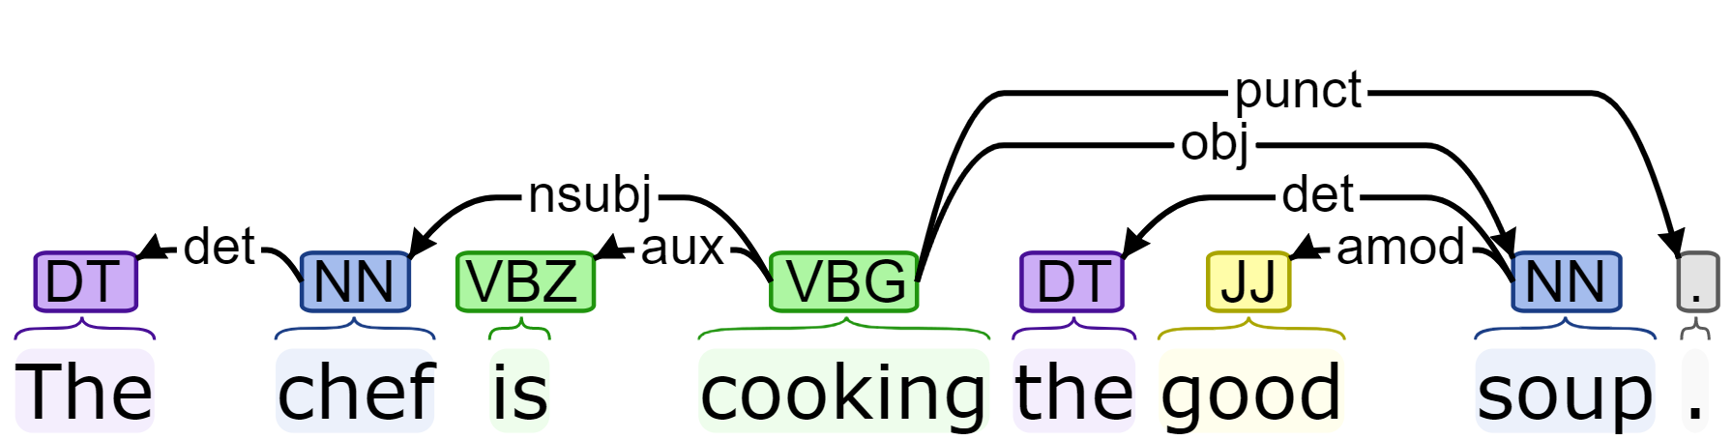
Trees in Natural Language Processing
Constituency Parse Trees
Dependency Parse Trees
S
NP
VP
DT
NN
VBZ
VP
The
chef
is
VBG
NP
cooks
DT
JJ
NN
the
good
soup

Slide 19




Trees and Machine Learning
S
NP
VP
When we were using Kernel Machines
Support Vector Machines
Rosemblat’s Perceptron
We had
Tree Kernels (Duffy&Collins, 200)
DT
NN
VBZ
VP
Machine Learning
Model
The
chef
is
VBG
NP
cooks
DT
JJ
NN
the
good
soup

Slide 20


Tree Kernels
S
VP
S
NP
VP
NP
VP
VP
VB
NP
…
…
John
VB
NP
VB
NP
VB
NP
killed
(…,0,1,0,…………….,0,1,0,…,0,1,0,…….0,0,0,…)
killed
Bob
$$TK\left(T_{1},T_{2}\right)=\left\langle {\vec{T}}_{1},{\vec{T}}_{2}\right\rangle =\left\langle \sum_{i}{α_{i}{\vec{τ}}_{i}},\sum_{j}{β_{j}{\vec{τ}}_{j}}\right\rangle$$
$$TK(x,y)$$
TKs perform weighted counts of common substructures,
S
hiding the dot product between the feature vectors
NP
VP
(…,0,1,0,…………….,0,1,0,…,0,0,0,…….0,1,0,…)
S
VP
VP
John
VB
NP
…
…
NP
VP
VB
NP
VB
NP
murdered
Bob
VB
NP
murdered
Notes:
Here on the left, you have the two structures.
The algorithm of the convolution kernel sees the first structure as the set of its substructures and the same for the second structure. Then, it performs a weighted count of the common substructures.
The genial part of a convolution kernel is that it hides the underlying feature space of the sub-structures.
This feature space is generally huge. You see here a one for each active substructure of the two structures and a zero elsewhere.
For example, the third substructure of the first structure has one on the first vector, that is, it is active and zero on the second…. It is not a substructure of the second structure.
The kernel is then doing with an algorithm an hidden dot product of two huge feature vectors.
Then It makes possible what it’s not feasible.

Slide 21
















Zanzotto&Moschitti, Automatic learning of textual entailments with cross-pair similarities, Coling-ACL, 2006
Moschitti&Zanzotto, Fast and effective kernels for relational learning from texts, ICML, 2007
Zanzotto&Dell’Arciprete, Efficient kernels for sentence pair classification, EMNLP, 2009
Zanzotto, Pennacchiotti, Moschitti, A machine learning approach to textual entailment recognition, Journal of Natural Language Engineering, 2009
Mehdad, Moschitti&Zanzotto, Syntactic/semantic structures for textual entailment recognition, NAACL, 2010

Slide 22
Working on semantics

Slide 23




Working on Semantics
Distributional Semantics
Words can be represented as vectors in vector spaces
Compositional distributional semantics (2005-2015)
Sentences can be represented with vectors
composing vectors for words
$$\vec{cows}$$
$$\vec{beef}$$
$$\vec{\text{cows} \text{eat} \text{animal} \text{extracts} }$$
$$\vec{\text{chickens} \text{eat} \text{beef} \text{extracts} }$$

Slide 24
Compositional Distributional Semantics Models (CDSMs)
Mitchell&Lapata (2008) set a general model for bigrams
that assigns a distributional meaning to a sequence of two words “x y”:
R is the relation between x and y
K is an external knowledge

Slide 25
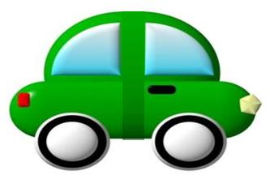

Compositional Distributional Semantics Models (CDSMs)
A “distributional” semantic space
Composing “distributional” meaning
moving car
car
moving
moving hands
hands

Slide 26
Compositional Distributional Semantics Models (CDSMs)
Mitchell&Lapata (2008) set a general model for bigrams
that assigns a distributional meaning to a sequence of two words “x y”:
R is the relation between x and y
K is an external knowledge
x
y
z
moving
hands
moving hands
f

Slide 27
CDSMs: Full Additive Model
The full additive model
Matrices A_{R} and B_{R} can be estimated with:
positive examples taken from dictionaries
multivariate regression models
contact /ˈkɒntækt/ [kon-takt]
2. close interaction
Zanzotto, Korkontzelos, Fallucchi, Manandhar, Estimating Linear Models for Compositional Distributional Semantics, Proceedings of the 23rd COLING, 2010

Slide 28

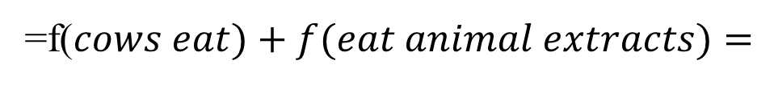
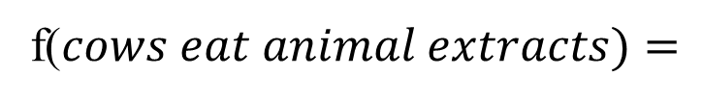
CDSM: Recursive Full Additive Model
eat
Let’s scale up to sentences by recursively applying the model!
VN
VN
cows
extracts
NN
Let’s apply it to real task
animal
f($cows eat animal extracts)=$
Extremely poor results
=f($cows eat)+f(eat animal extracts)=$
=$A_{VN}\vec{eat}+B_{VN}\vec{cows}+A_{VN}\vec{eat}+B_{VN}f(animal extracts)=$
=$A_{VN}\vec{eat}+B_{VN}\vec{cows}+A_{VN}\vec{eat}+B_{VN}A_{NN}\vec{extracts}+{B_{VN}B}_{NN}\vec{animal}$

Slide 29







Recursive Full Additive Model: a closer look
«cows eat animal extracts»
f
$${=2A}_{VN}\vec{eat}+B_{VN}\vec{cows}+B_{VN}A_{NN}\vec{extracts}+{B_{VN}B}_{NN}\vec{animal}$$
$$\vec{v}$$
…
$$∙$$
$$∙$$
$$∙$$
$$\left\langle \vec{v},\vec{u}\right\rangle$$
… evaluating the similarity
$$∙$$
$$\vec{u}$$
$${=2A}_{VN}\vec{eat}+B_{VN}\vec{chickens}+B_{VN}A_{NN}\vec{extracts}+{B_{VN}B}_{NN}\vec{beef}$$
f
«chickens eat beef extracts»
Zanzotto, Ferrone, Baroni, When the whole is not greater than the sum of its parts: A decompositional look at compositional distributional semantics, Computatinal Linguistics, 2015

Slide 30
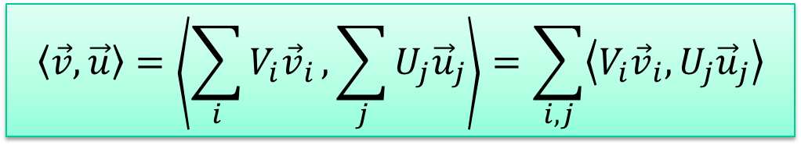
Recursive Full Additive Model: a closer look
meaning
meaning
structure
structure
$${=2A}_{VN}\vec{eat}+B_{VN}\vec{cows}+B_{VN}A_{NN}\vec{extracts}+{B_{VN}B}_{NN}\vec{animal}$$
$$\vec{v}$$
?
<1
$$\vec{u}$$
$${=2A}_{VN}\vec{eat}+B_{VN}\vec{chickens}+B_{VN}A_{NN}\vec{extracts}+{B_{VN}B}_{NN}\vec{beef}$$
structure
meaning
$$\left\langle \vec{v},\vec{u}\right\rangle =\left\langle \sum_{i}{{V_{i}\vec{v}}_{i}},\sum_{j}{U_{j}{\vec{u}}_{j}}\right\rangle =\sum_{i,j}{\left\langle {V_{i}\vec{v}}_{i},U_{j}{\vec{u}}_{j}\right\rangle }$$
Ferrone&Zanzotto, Linear Compositional Distributional Semantics and Structural Kernels, Proceedings of Joint Symposium of Semantic Processing, 2013

Slide 31
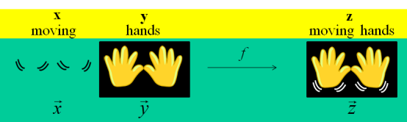
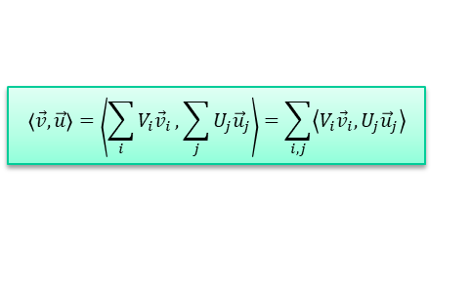

Distributional Semantics
Binary CDS
Recursive CDS
$${B_{VN}B}_{NN}\vec{beef}$$
structure
meaning
$$\left\langle \vec{v},\vec{u}\right\rangle =\left\langle \sum_{i}{{V_{i}\vec{v}}_{i}},\sum_{j}{U_{j}{\vec{u}}_{j}}\right\rangle =\sum_{i,j}{\left\langle {V_{i}\vec{v}}_{i},U_{j}{\vec{u}}_{j}\right\rangle }$$

Slide 32




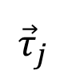

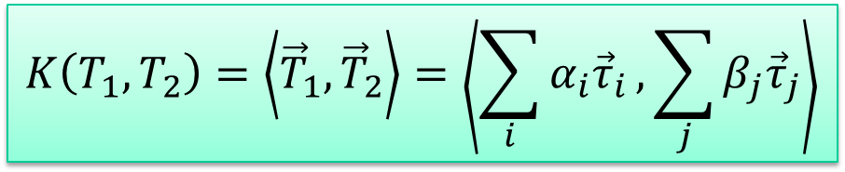
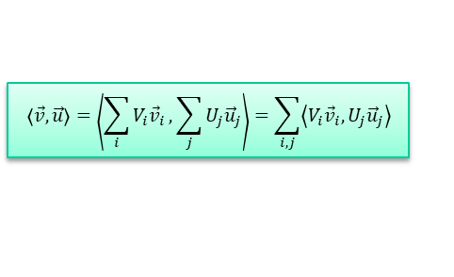

Tree Kernels
$$\left\langle \vec{v},\vec{u}\right\rangle =\left\langle \sum_{i}{{V_{i}\vec{v}}_{i}},\sum_{j}{U_{j}{\vec{u}}_{j}}\right\rangle =\sum_{i,j}{\left\langle {V_{i}\vec{v}}_{i},U_{j}{\vec{u}}_{j}\right\rangle }$$
T
S
VP
S
NP
VP
NP
VP
VP
VB
NP
…
…
John
VB
NP
VB
NP
VB
NP
killed
τ_{i}
τ_{l}
τ_{j}
killed
Bob
$${\vec{τ}}_{i}$$
$${\vec{τ}}_{l}$$
$${\vec{τ}}_{j}$$
$$\vec{T}=\sum_{i}{α_{i}{\vec{τ}}_{i}}$$
…
…
…
$$K\left(T_{1},T_{2}\right)=\left\langle {\vec{T}}_{1},{\vec{T}}_{2}\right\rangle =\left\langle \sum_{i}{α_{i}{\vec{τ}}_{i}},\sum_{j}{β_{j}{\vec{τ}}_{j}}\right\rangle$$

Slide 33
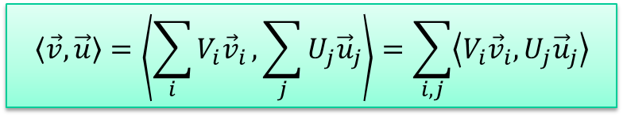
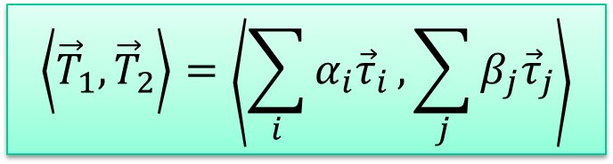
«Convolution Conjecture»
The similarity equations between two vectors/tensors obtained with CDSMs can be decomposed into operations performed on the subparts of the input phrases.
Compositional Distributional Models based on linear algebra and Convolution Kernels are intimately related
For example:
Convolution Kernel
Recursive Full Additive Model
$$\left\langle {\vec{T}}_{1},{\vec{T}}_{2}\right\rangle =\left\langle \sum_{i}{α_{i}{\vec{τ}}_{i}},\sum_{j}{β_{j}{\vec{τ}}_{j}}\right\rangle$$
$$\left\langle \vec{v},\vec{u}\right\rangle =\left\langle \sum_{i}{{V_{i}\vec{v}}_{i}},\sum_{j}{U_{j}{\vec{u}}_{j}}\right\rangle =\sum_{i,j}{\left\langle {V_{i}\vec{v}}_{i},U_{j}{\vec{u}}_{j}\right\rangle }$$
Zanzotto, Ferrone, Baroni, When the whole is not greater than the sum of its parts: A decompositional look at compositional distributional semantics, Computatinal Linguistics, 2015

Slide 34
Tree Kernels and Compositional Distributional Semantic Models
CDSMs’ desiderata
Vectors should be …
… smaller
… obtained with a compositional (recursive) function

Slide 35
Tree Kernels and Compositional Distributional Semantic Models
CDSMs’ desiderata
Vectors should be …
… smaller
… obtained with a compositional (recursive) function

Slide 36

Distributed Tree Kernels
S
VP
S
NP
VP
NP
VP
VP
VB
NP
…
…
John
VB
NP
VB
NP
VB
NP
killed
killed
Bob
(0.239,-0.920,…,0.771)
$$DCK(x,y)$$
DCKs directly perform the dot product between the reduced feature vectors
S
(1.32,0.0280,…,-0.032)
NP
VP
S
VP
VP
John
VB
NP
…
…
NP
VP
VB
NP
VB
NP
murdered
Bob
VB
NP
murdered
Zanzotto&Dell'Arciprete, Distributed Tree Kernels, Proceedings of ICML, 2012
Notes:
We have here a proposal for a novel way of exploiting structured data in learning: the distributed convolution kernels.
I first use a metaphor to introduce the basic idea and, then, I’ll try to be more formal.
Let’s start again from the picture describing the convolution kernels.
You should have already noticed that substructures are now colored. The same color for the same substructure.
Now if I rotate the middle substructure or tree … yes … let’s call them trees … it is easier
By the way, after rotation , I believe you still see that is the same tree.
If I rotate the second tree and I put it on the first tree, you should still see two trees. Let’s do it with the third tree. Things become a little more confused, but we can still see the three trees.
Let’s do the same with the second structure.
Now, looking at the two small boxes, we can still see in the two images that the two structures have common substructures. For example, we can do a count of the common pixel, and this can approximate somehow the count of the common substructures. In this metaphor, we are showing that it is possible to encode substructures in smaller regions of the space and that we can approximate the count of the common substructures .
[CLICK] Thus, it is in principle possible to think that we can encode substructures in small vectors – as the images that you see in the two boxes –
[CLICK] and, then, counting the common substructures is doing the dot product between these two small vectors.
THIS is the distributed convolution kernel that approximates the initial convolution kernel.

Slide 37










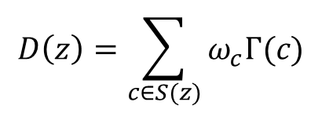

Distributed Tree Kernels
S
VP
S
NP
VP
NP
VP
VP
VB
NP
…
…
John
VB
NP
VB
NP
VB
NP
killed
killed
Bob
$$z$$
$$S\left(z\right)=\{$$
$$c_{j}$$
…
$$c_{i}$$
…
$$c_{k}$$
$$\}$$
$$D:Structures →ℛ^{d}$$
$$Γ:Substructures →ℛ^{d}$$
$$D\left(z\right)=\sum_{c∈S(z)}{ω_{c}Γ(c)}$$
$$\vec{c_{j}}=Γ(c_{j})$$
$$\vec{c_{i}}=Γ(c_{i})$$
$$\vec{c_{k}}=Γ(c_{k})$$
…
…
Zanzotto&Dell'Arciprete, Distributed Tree Kernels, Proceedings of ICML, 2012
Notes:
Now, let’s see more in details what we exactly expect for these distributed convolution kernels.
Let’s give names to the structures and the substructures.
The structure is z and the substructures are c_j, c_i c_k
S of z is the set of all the substructures that we want to activate in the feature space given the structure z.
What we need are two functions.
The first is a gamma function that takes substructures and maps them into a space R d. For each substructure we need a vector that is nearly orthonormal with respect to the other vectors. Nearly orthonormal means that if two vectors represent the same structure, their dot product is nearly one, otherwise if the two vectors represent two different substructures their dot product should be nearly zero.
The second function is a function D of z that takes a structures and produces a vector that represents all the substructures. This in principle can be obtained by summing up vectors gamma c with a scalar weight omega c on all the substructures in the set S of z.
The final vector is in R d.

Slide 38
Distributed Tree Kernels
S
VP
S
VP
S
VP
NP
VP
NP
VP
VP
VB
NP
VB
NP
…
…
NP
VP
VB
NP
killed
John
VB
NP
VB
NP
VB
NP
killed
VB
NP
killed
Bob
$$D:Structures →ℛ^{d}$$
$$Γ:Substructures →ℛ^{d}$$
$$D\left(z\right)=\sum_{c∈S(z)}{ω_{c}Γ(c)}$$
$$\vec{c_{j}}=Γ(c_{j})$$
$$\vec{c_{i}}=Γ(c_{i})$$
$$\vec{c_{k}}=Γ(c_{k})$$
…
…
Notes:
Going back to the metaphor, the vectors gamma c are kind of representing rotated colored trees
whereas vectors D z represent the figure containings all the subrees… a sort of sum of the subtrees.

Slide 39

Names for the «Distributed» World
As we are encoding structures in small vectors, we follow the tradition of distributed representations for structures (Plate, 1994)
Distributed Tree Kernels (DTK)
$$DTK(x,y)=\left\langle D\left(x\right),D(y)\right\rangle$$
Distributed Trees
Distributed Tree Fragments
$$D\left(z\right)=\sum_{c∈S(z)}{ω_{c}Γ(c)}$$
$$\vec{c_{j}}=Γ(c_{j})$$
$$\vec{c_{i}}=Γ(c_{i})$$
$$\vec{c_{k}}=Γ(c_{k})$$
Notes:
Giving names to these new – old - objects.
We are defining this new way of representing structures in the tradition of the distributed representations for structures.
Vectors derived from functions gamma are the distributed structures.
D of z that represents all the structures is the distributed convolution structure.
The distributed convolution kernel between two structures x an y IS THEN the dot product between two distributed structures D x and D y

Slide 40
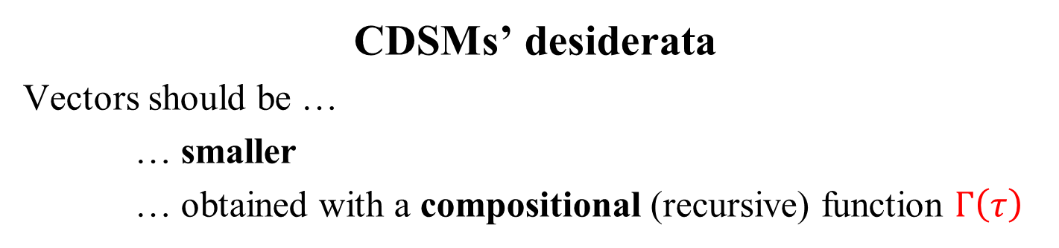
Tree Kernels and Compositional Distributional Semantic Models
CDSMs’ desiderata
Vectors should be …
… smaller
… obtained with a compositional (recursive) function $Γ\left(τ\right)$
Additional issues:
Distributed Tree Fragments are a nearly orthonormal base of R^{d}
Distributed Trees can be efficiently computed
DTKs shuold approximate Tree Kernels
$$δ\left(τ_{1},τ_{2}\right)−ε<\left\langle Γ\left(τ_{1}\right),Γ\left(τ_{2}\right)\right\rangle <δ\left(τ_{1},τ_{2}\right)+ε$$
$$TK\left(x,y\right)−Jε<\left\langle D\left(x\right),D(y)\right\rangle <TK\left(x,y\right)+Jε$$
Zanzotto&Dell'Arciprete, Distributed Tree Kernels, Proceedings of ICML, 2012

Slide 41
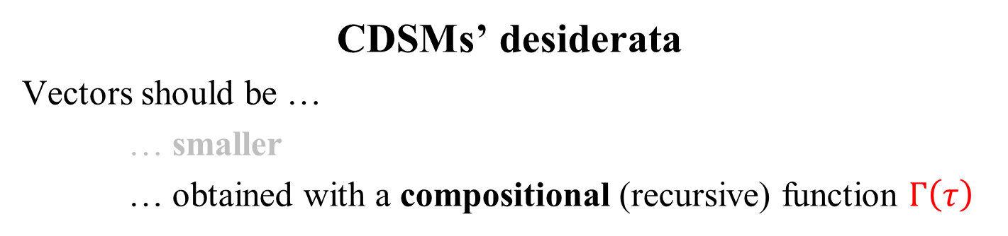
Tree Kernels and Compositional Distributional Semantic Models
CDSMs’ desiderata
Vectors should be …
… smaller
… obtained with a compositional (recursive) function $Γ\left(τ\right)$
Additional issues:
Distributed Tree Fragments are a nearly orthonormal base of R^{d}
Distributed Trees can be efficiently computed
DTKs shuold approximate Tree Kernels
$$δ\left(τ_{1},τ_{2}\right)−ε<\left\langle Γ\left(τ_{1}\right),Γ\left(τ_{2}\right)\right\rangle <δ\left(τ_{1},τ_{2}\right)+ε$$
$$TK\left(x,y\right)−Jε<\left\langle D\left(x\right),D(y)\right\rangle <TK\left(x,y\right)+Jε$$
Zanzotto&Dell'Arciprete, Distributed Tree Kernels, Proceedings of ICML, 2012

Slide 42
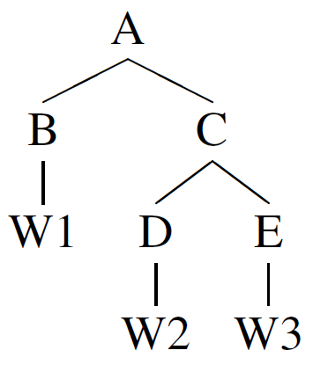
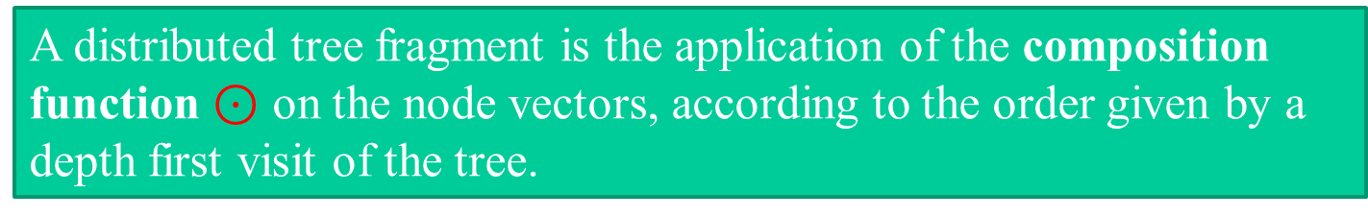

Compositionally building Distributed Tree Fragments
Basic elements
N a set of nearly orthogonal random vectors for node labels
$⊙$ a basic vector composition function with some ideal properties
A distributed tree fragment is the application of the composition function $⊙$ on the node vectors, according to the order given by a depth first visit of the tree.
Γ(
)=
$$\text{(}\vec{\text{A}}⊙\text{(}\vec{\text{B}}⊙\vec{\text{W}\text{1}}\text{)}⊙\text{(}\vec{\text{C}}⊙\text{(}\vec{\text{D}}⊙\vec{\text{W}\text{2}}\text{)}⊙\text{(}\vec{\text{E}}⊙\vec{\text{W}\text{3}}\text{)))}$$
Zanzotto&Dell'Arciprete, Distributed Tree Kernels, Proceedings of ICML, 2012

Slide 43


Compositionally building Distributed Tree Fragments
Properties of the Ideal function $⊙$
Approximation
$\left\|\vec{a}⊙\vec{b}\right\|=\left\|\vec{a}\right\|\left\|\vec{b}\right\|$
$\left|\left\langle \vec{t},\vec{a}\right\rangle \right|<ε$ if $\vec{t}≠\vec{a}$
$\left|\left\langle \vec{a}⊙\vec{b},\vec{c}⊙\vec{d}\right\rangle \right|<ε$ if $\left|\left\langle \vec{a},\vec{c}\right\rangle \right|<ε$ or $\left|\left\langle \vec{b}, \vec{d}\right\rangle \right|<ε$
Non-commutativity with a very high degree k
Non-associativity
Bilinearity
With the above properties, we demonstrated that
$$δ\left(τ_{1},τ_{2}\right)−ε<\left\langle Γ\left(τ_{1}\right),Γ\left(τ_{2}\right)\right\rangle <δ\left(τ_{1},τ_{2}\right)+ε$$
(see Lemma 4 and Lemma 5 in the paper)
Zanzotto&Dell'Arciprete, Distributed Tree Kernels, Proceedings of ICML, 2012

Slide 44
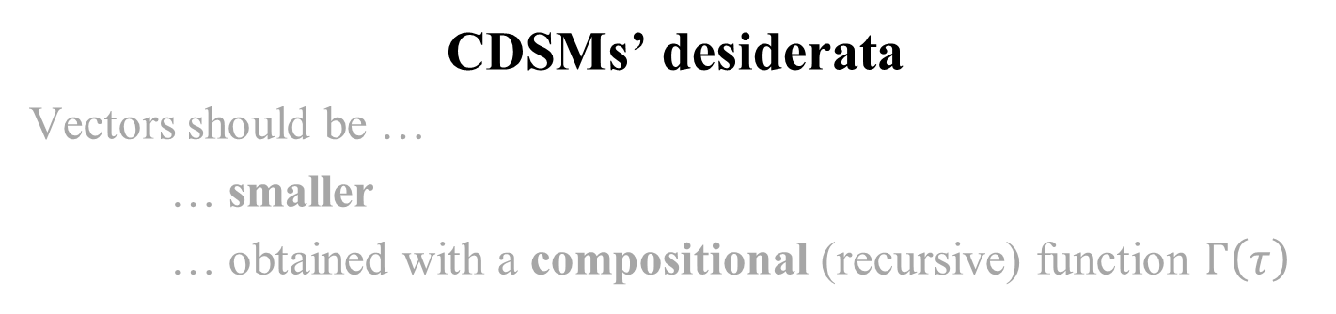
Tree Kernels and Compositional Distributional Semantic Models
CDSMs’ desiderata
Vectors should be …
… smaller
… obtained with a compositional (recursive) function $Γ\left(τ\right)$
Additional issues:
Distributed Tree Fragments are a nearly orthonormal base of R^{d}
Distributed Trees can be efficiently computed
DTKs shuold approximate Tree Kernels
$$δ\left(τ_{1},τ_{2}\right)−ε<\left\langle Γ\left(τ_{1}\right),Γ\left(τ_{2}\right)\right\rangle <δ\left(τ_{1},τ_{2}\right)+ε$$
$$TK\left(x,y\right)−Jε<\left\langle D\left(x\right),D(y)\right\rangle <TK\left(x,y\right)+Jε$$
Zanzotto&Dell'Arciprete, Distributed Tree Kernels, Proceedings of ICML, 2012

Slide 45

Building Distributed Trees
Given a tree T, the distributed representation of its subtrees is the vector:
where S(T) is the set of the subtrees of T
$$\vec{T}=\sum_{τ∈S(T)}{α_{i}Γ\left(τ_{i}\right)}$$
S
S
S(
NP
VP
) = {
S
,
NP
VP
}
NNS
VB
NP
NP
NP
VP
…
Farmers
feed
VB
NP
NP
NNS
VB
NP
NP
NNS
NN
NNS
NNS
Farmers
cows
animal
extracts
Zanzotto&Dell'Arciprete, Distributed Tree Kernels, Proceedings of ICML, 2012

Slide 46


Building Distributed Trees
A more efficient approach
N(T) is the set of nodes of T
s(n) is defined as:
$$\vec{T}=\sum_{n∈N(T)}{s(n)}$$
$$s\left(n\right)=\vec{0}$$
if n is terminal
$$s\left(n\right)=\vec{n}⊙\left(\vec{c_{1}}+\sqrt{λ}s(c_{1})\right)⊙⋯⊙\left(\vec{c_{m}}+\sqrt{λ}s(c_{m})\right)$$
if n→c₁…c_{m}
Computing a Distributed Tree is linear with respect to the size of N(T)
Zanzotto&Dell'Arciprete, Distributed Tree Kernels, Proceedings of ICML, 2012

Slide 47
Tree Kernels and Compositional Distributional Semantic Models
CDSMs’ desiderata
Vectors should be …
… smaller
… obtained with a compositional (recursive) function $Γ\left(τ\right)$
Additional issues:
Distributed Tree Fragments are a nearly orthonormal base of R^{d}
Distributed Trees can be efficiently computed
DTKs shuold approximate Tree Kernels
$$δ\left(τ_{1},τ_{2}\right)−ε<\left\langle Γ\left(τ_{1}\right),Γ\left(τ_{2}\right)\right\rangle <δ\left(τ_{1},τ_{2}\right)+ε$$
$$TK\left(x,y\right)−Jε<\left\langle D\left(x\right),D(y)\right\rangle <TK\left(x,y\right)+Jε$$
Zanzotto&Dell'Arciprete, Distributed Tree Kernels, Proceedings of ICML, 2012

Slide 48
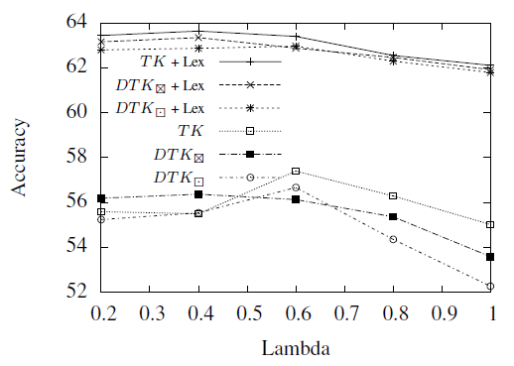
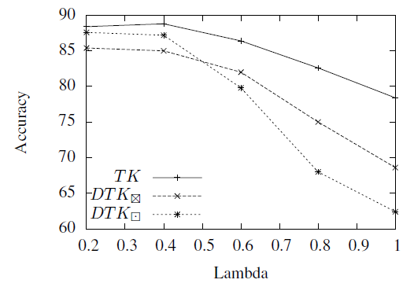
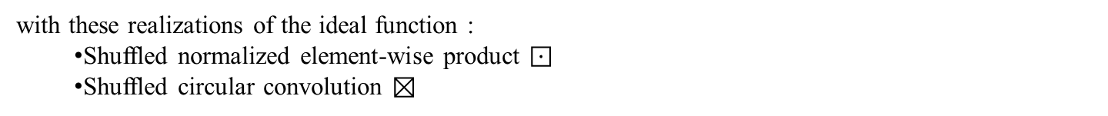
Task-based Analysis
Question Classification
Recognizing Textual Entailment
with these realizations of the ideal function :
Shuffled normalized element-wise product $⊡$
Shuffled circular convolution $⊠$
Zanzotto&Dell'Arciprete, Distributed Tree Kernels, Proceedings of ICML, 2012

Slide 49
Remarks
Distributed Tree Kernels (DTK)
$$DTK(x,y)=\left\langle D\left(x\right),D(y)\right\rangle$$
DTKs approximate Tree Kernels
Distributed Trees
Distributed Tree Fragments
$$D\left(z\right)=\sum_{c∈S(z)}{ω_{c}Γ(c)}$$
$$\vec{c_{j}}=Γ(c_{j})$$
$$\vec{c_{i}}=Γ(c_{i})$$
$$\vec{c_{k}}=Γ(c_{k})$$

Slide 50
Conclusions (in 2012)
A new and faster way to Learn with Structures
DTKs change the complexity as they can be used with Linear Kernel Machines
 | SVM+TK | LinearSVM+DTK
 |  | Shuf. Prod. | Shuf. Circ. Conv.
Training | O(n³|N(T)|²) | O(n|N(T)|d) | O(n|N(T)|d log d)
Classification | O(n|N(T)|²) | O(|N(T)|d) | O(|N(T)|d log d)
n: # of training examples
|N(T)|: # of nodes of the tree T
Zanzotto&Dell'Arciprete, Distributed Convolution Kernels on Countable Sets,
still unpublished manuscript

Slide 51
The Revenge Era of Neural Networks

Slide 52
KERMIT: Complementing Transformer Architectures with Encoders of Explicit Syntactic Interpretations
Fabio Massimo Zanzotto*, Andrea Santilli*, Leonardo Ranaldi⁺,
Dario Onorati*, Pierfrancesco Tommasino*, Francesca Fallucchi⁺
*ART, University of Rome Tor Vergata , Rome (Italy)
⁺Marconi Univesity, Rome (Italy)
EMNLP 2020, formerly in Domenican Republic

Slide 53






ELMO
BERT
XLNET
GTP-1,2,3
Universal sentence embeddings
The chef cooks the good soup

Slide 54


ELMO
BERT
XLNET
GTP-1,2,3
Universal sentence embeddings
The chef cooks the good soup
S
Universal syntactic interpretations
NP
VP
D
N
V
NP
The
chef
cooks
D
J
N
the
good
soup

Slide 55






are Distributed Representations
are Neural Network Ready
Universal sentence embeddings
encode some Syntactic Information
but it is not clear how!
are Symbolic Representations
S
are explict and understandable
Universal syntactic interpretations
NP
VP
are not Neural Network Ready
D
N
V
NP
The
chef
cooks
D
J
N
the
good
soup

Slide 56
Our proposal
We want to use universal syntactic intepretations in Neural Networks, since these interpretations:
1) are understandable
2) carry a long story of linguistic analysis

Slide 57

$$\hat{y}$$
Decoder Layer
Universal sentence embeddings
. . .
$$T_{[CLS]}$$
$$T_{1}$$
$$T_{2}$$
. . .
$$T_{n}$$
ELMO
. . .
. . .
KERMIT
. . .
. . .
Transformer Model
. . .
. . .
. . .
Encoder
Encoder
Encoder
. . .
Encoder
XLNET
. . .
BERT
GTP-1,2,3
$$E_{[CLS]}$$
$$E_{1}$$
$$E_{2}$$
$$E_{n}$$
. . .
Universal syntactic interpretations
Input Sentence Tokens
Syntactic Parser
Sentence

Slide 58
The chef cooks the good soup
S
NP
VP
Positive!
D
N
V
NP
.
.
.
.
.
.
.
.
.
.
.
.
The
chef
cooks
D
J
N
the
good
soup
Forward pass

Slide 59
The chef cooks the good soup
S
NP
VP
Positive!
D
N
V
NP
.
.
.
.
.
.
.
.
.
.
.
.
The
chef
cooks
D
J
N
the
good
soup
Interpretation

Slide 60
The chef cooks the good soup
S
NP
VP
Positive!
D
N
V
NP
.
.
.
.
.
.
.
.
.
.
.
.
The
chef
cooks
D
J
N
the
good
soup
1) summing of one-hot vectors representing subtrees
2) embedding subtrees in distributed representations (vectors)
Impossible! The space of subtrees is huge since combinatory with respect to the node labels!

Slide 61
The chef cooks the good soup
S
NP
VP
Positive!
D
N
V
NP
.
.
.
.
.
.
.
.
.
.
.
.
The
chef
cooks
D
J
N
the
good
soup

Slide 62
The chef cooks the good soup
S
ernel-inspired
K
Positive!
NP
VP
ncoder with
E
ecursive
D
N
V
NP
R
M
echanism for
I
.
.
.
.
.
.
The
chef
cooks
D
J
N
nterpretable
T
rees
the
good
soup

Slide 63
The chef cooks the good soup
S
NP
VP
Positive!
D
N
V
NP
.
.
.
.
.
.
.
.
.
.
.
.
The
chef
cooks
D
J
N
the
good
soup
S
Γ(
NP
VP
)=
$$\text{(}\vec{\text{S}}⊙\text{(}\vec{\text{NP}}\text{)}⊙\text{(}\vec{\text{VP}}⊙\text{(}\vec{\text{V}}⊙\vec{\text{cooks}}\text{)}⊙\text{(}\vec{\text{NP}}\text{)))}$$
V
NP
Shuffled circular convolution
cooks
Random vectors for node labels
Zanzotto&Dell'Arciprete, Distributed Tree Kernels, Proceedings of ICML, 2012

Slide 64
$$\vec{y}=\sum_{n∈N(T)}{s(n)}$$
The chef cooks the good soup
S
ernel-inspired
N(T) is the set of nodes of T
K
NP
VP
ncoder with
E
D
N
V
NP
R
ecursive
M
echanism for
$$s\left(n\right)=\vec{0}$$
if n is terminal
I
.
.
.
The
chef
cooks
D
J
N
nterpretable
T
$$s\left(n\right)=\vec{n}⊙\left(\vec{c_{1}}+\sqrt{λ}s(c_{1})\right)⊙⋯⊙\left(\vec{c_{m}}+\sqrt{λ}s(c_{m})\right)$$
rees
the
good
soup
if n→c₁…c_{m}
Zanzotto&Dell'Arciprete, Distributed Tree Kernels, Proceedings of ICML, 2012

Slide 65
The chef cooks the good soup
S
ernel-inspired
K
Positive!
NP
VP
ncoder with
E
ecursive
D
N
V
NP
R
M
echanism for
I
.
.
.
The
chef
cooks
D
J
N
nterpretable
.
.
.
T
rees
the
good
soup
Forward pass

Slide 66
On demand production of W
The chef cooks the good soup
S
NP
VP
Positive!
D
N
V
NP
.
.
.
.
.
.
.
.
.
.
.
.
The
chef
cooks
D
J
N
the
good
soup
Layer-wise relevance propagation (Bach et al, 2015)
Interpretation

Slide 68
$$\hat{y}$$
Decoder Layer
Universal sentence embeddings
. . .
$$T_{[CLS]}$$
$$T_{1}$$
$$T_{2}$$
. . .
$$T_{n}$$
ELMO
. . .
. . .
KERMIT
. . .
. . .
Transformer Model
. . .
. . .
. . .
Encoder
Encoder
Encoder
. . .
Encoder
XLNET
. . .
BERT
GTP-1,2,3
$$E_{[CLS]}$$
$$E_{1}$$
$$E_{2}$$
$$E_{n}$$
. . .
Universal syntactic interpretations
Input Sentence Tokens
Syntactic Parser
Sentence

Slide 69
Syntactic-sensitivity test for tasks

Slide 70
















$$\hat{y}$$
Decoder Layer
$$T_{[CLS]}$$
$$T_{1}$$
$$T_{2}$$
. . .
$$T_{n}$$
. . .
Transformer Model
. . .
Encoder
Encoder
Encoder
. . .
Encoder
$$E_{[CLS]}$$
$$E_{1}$$
$$E_{2}$$
. . .
$$E_{n}$$
The
chef
cooks
soup
The
chef
cooks
good
soup
The
chef
cooks
good
soup
The
chef
cooks
the
good
soup
the
good
the
the
BERT
. . .
Input Sentence Tokens
BERT-Reverse
BERT-Random
Sentence

Slide 71
Experiments

Slide 72
Experimental set-up
Datasets: four classification tasks (Zhang et al., 2015):
AGNews, a news classification task with 4 target classes
DBPedia, a classification task over wikipedia with 14 classes
Yelp Polarity, a binary sentiment classification task of Yelp reviews
Yelp Review, a sentiment classification task with 5 classes
We created a smaller version (11%) of the original training datasets
Parser: Stanford’s CoreNLP probabilistic context-free grammar parser (Manning et al., 2014)
Transformers: BERT, XLNET
System configurations:
Pure Transformers: BERT, XLNET
Syntactic Sensitivity Test: BERT-Revert, BERT-Random
KERMIT, KERMIT+XLNET, KERMIT+BERT

Slide 73
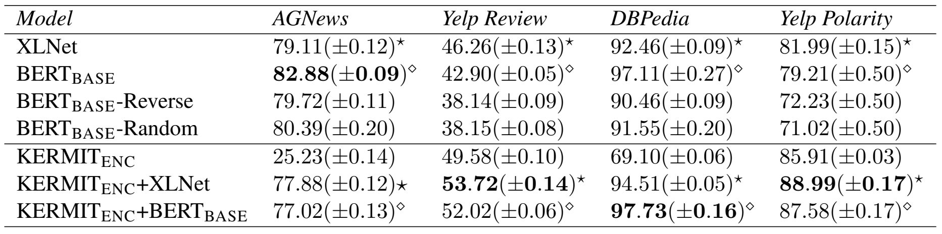













Accuracy over the tasks

Slide 74





Accuracy over the tasks

Slide 75
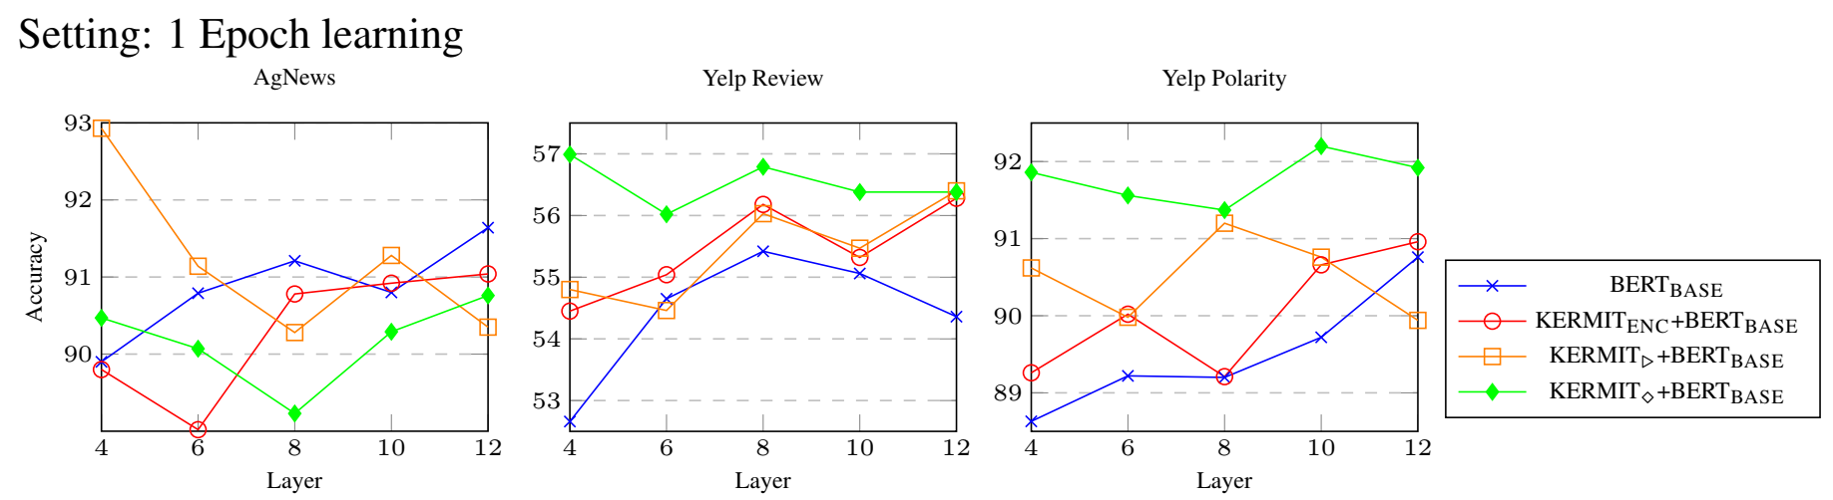
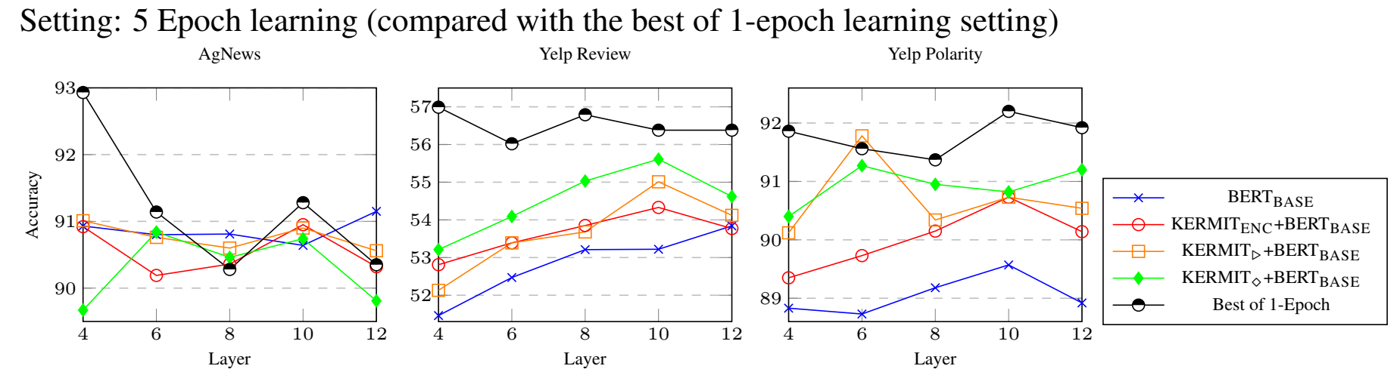

Slide 76
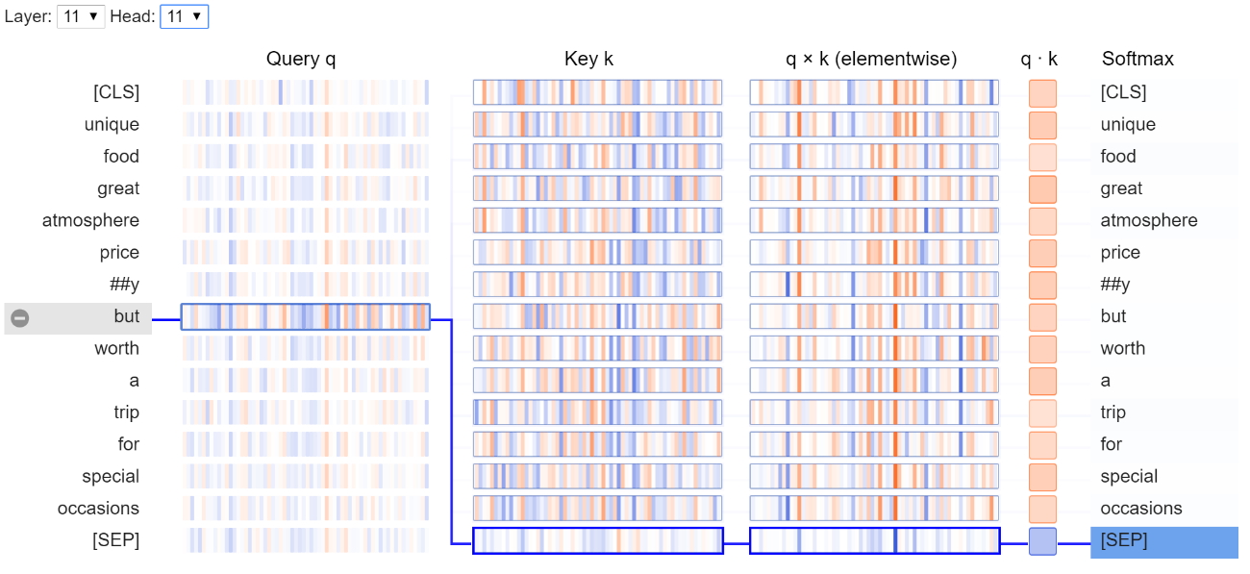
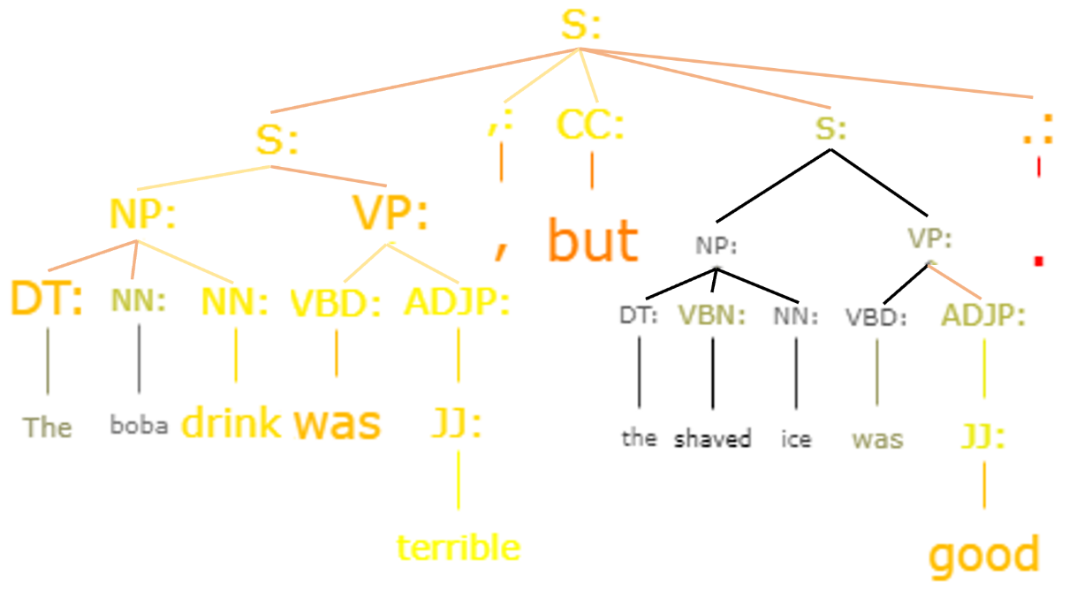
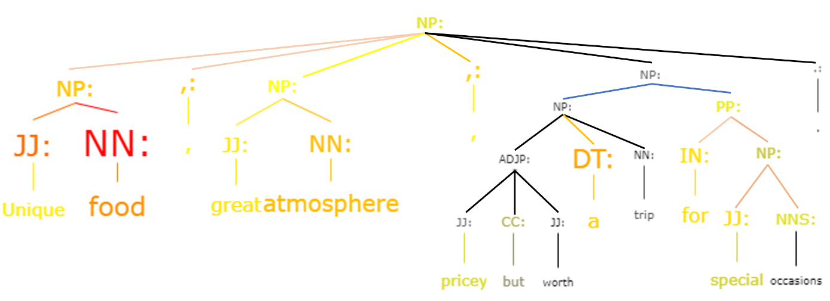
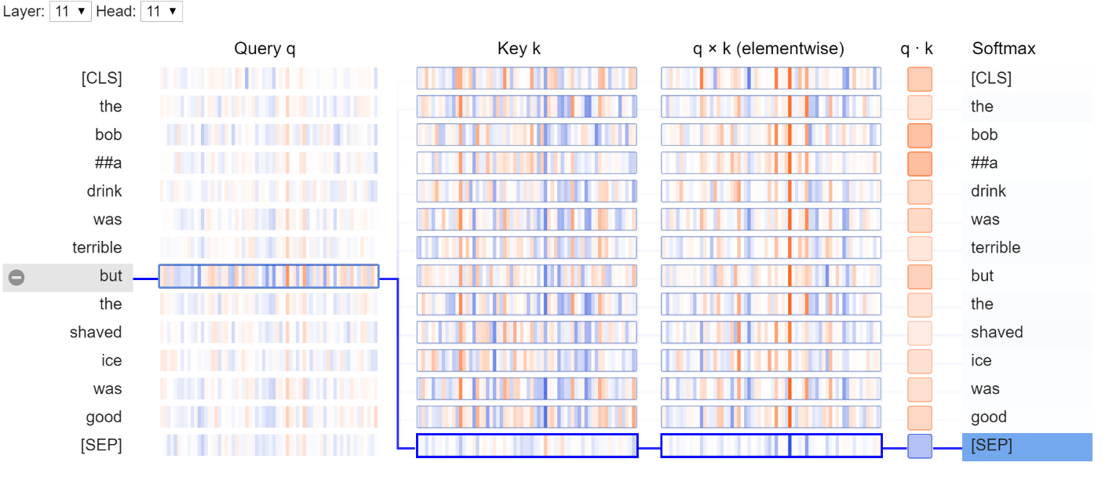
Qualitative Analisys
“Unique food, great atmosphere, pricey but worth a trip for special occasions.”
“The boba drink was terrible, but the shaved ice was good.”

Slide 77
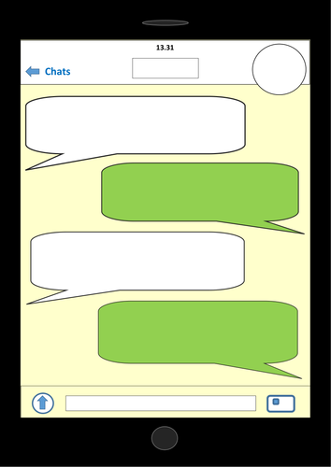



Kermit
.......….....
The chef cook the good soup!
You can say that again!
The chef cook the good soup!

Slide 78


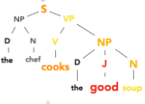


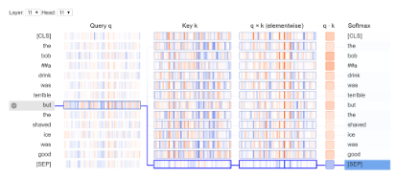

Thank you for your precious attention!
https://github.com/ART-Group-it/KERMIT

Slide 79
Not only Trees for Recognizing Textual Entailment

Slide 80
Tripartite Directed Acyclic Graphs (tDAG)
As for Feature Structures…
VP
S
VB
NP
X
NP
Y
NP
X
VP
feed
VB
NP
Y
eat
S
S
NP
1
VP
NP
VP
NNS
1
VB
NP
3
NNS
VB
NP
1
NP
3
Cows
eat
Farmers
feed
NN
NNS
NN
2
NNS
3
NNS
1
2
3
1
cows
animal
extracts
animal
extracts
1
2
3
2
3
Zanzotto&Dell’Arciprete, Efficient kernels for sentence pair classification, EMNLP, 2009

Slide 81
Tripartite Directed Acyclic Graphs (tDAG)
VP
S
VB
NP
X
NP
Y
NP
X
VP
feed
VB
NP
Y
eat
S
S
NP
1
VP
NP
VP
NNS
1
VB
NP
3
NNS
VB
NP
1
NP
3
Cows
eat
Farmers
feed
NN
NNS
NN
2
NNS
3
NNS
1
2
3
1
cows
animal
extracts
animal
extracts
1
2
3
2
3
Zanzotto&Dell’Arciprete, Efficient kernels for sentence pair classification, EMNLP, 2009

Slide 82
Zanzotto&Moschitti, Automatic learning of textual entailments with cross-pair similarities, Coling-ACL, 2006
Moschitti&Zanzotto, Fast and effective kernels for relational learning from texts, ICML, 2007
Zanzotto&Dell’Arciprete, Efficient kernels for sentence pair classification, EMNLP, 2009
Zanzotto, Pennacchiotti, Moschitti, A machine learning approach to textual entailment recognition, Journal of Natural Language Engineering, 2009
Mehdad, Moschitti&Zanzotto, Syntactic/semantic structures for textual entailment recognition, NAACL, 2010

Slide 83
An apparent digression: Compositional Distributional Semantics

Slide 84
Distributed Tree Kernels

Slide 85
Distributed Tree Kernels and Neural Networks

Slide 86
Building Distributed Parse Trees from Sentences

Slide 87
Learning RTE Classifiers: the feature space
Training examples
P₁: T₁⇒ H₁
T₁
“Farmers feed cows animal extracts”
H₁
“Cows eat animal extracts”
VP
S
VB
NP
X
NP
Y
→
NP
X
VP
feed
VB
NP
Y
Relevant Features
feed → eat
X
Y
X
Y
eat
Rules with Variables (First-order rules)
P₃: T₃⇒ H₃
T₃
“Mothers feed babies milk”
H₃
“Babies eat milk”
Classification
Zanzotto&Moschitti, Automatic learning of textual entailments with cross-pair similarities, Coling-ACL, 2006

Slide 88
All we need is trees! Sometimes we need more…

