Slide 1
Visualisation of Mobile App Usage
Matthew James O’Hare - 2255357o

Slide 2
Project Overview
Motivation:
2.87 billion mobile users across the world
Statistical methods limits the understanding that can be achieved
Aims:
Visualise mobile app usage
Compare dimensionality reduction algorithms

Slide 3
Design
Requirements:
Algorithms
Pre-processing data
Distance metric
Clustering
Evaluation
Technologies

Slide 4
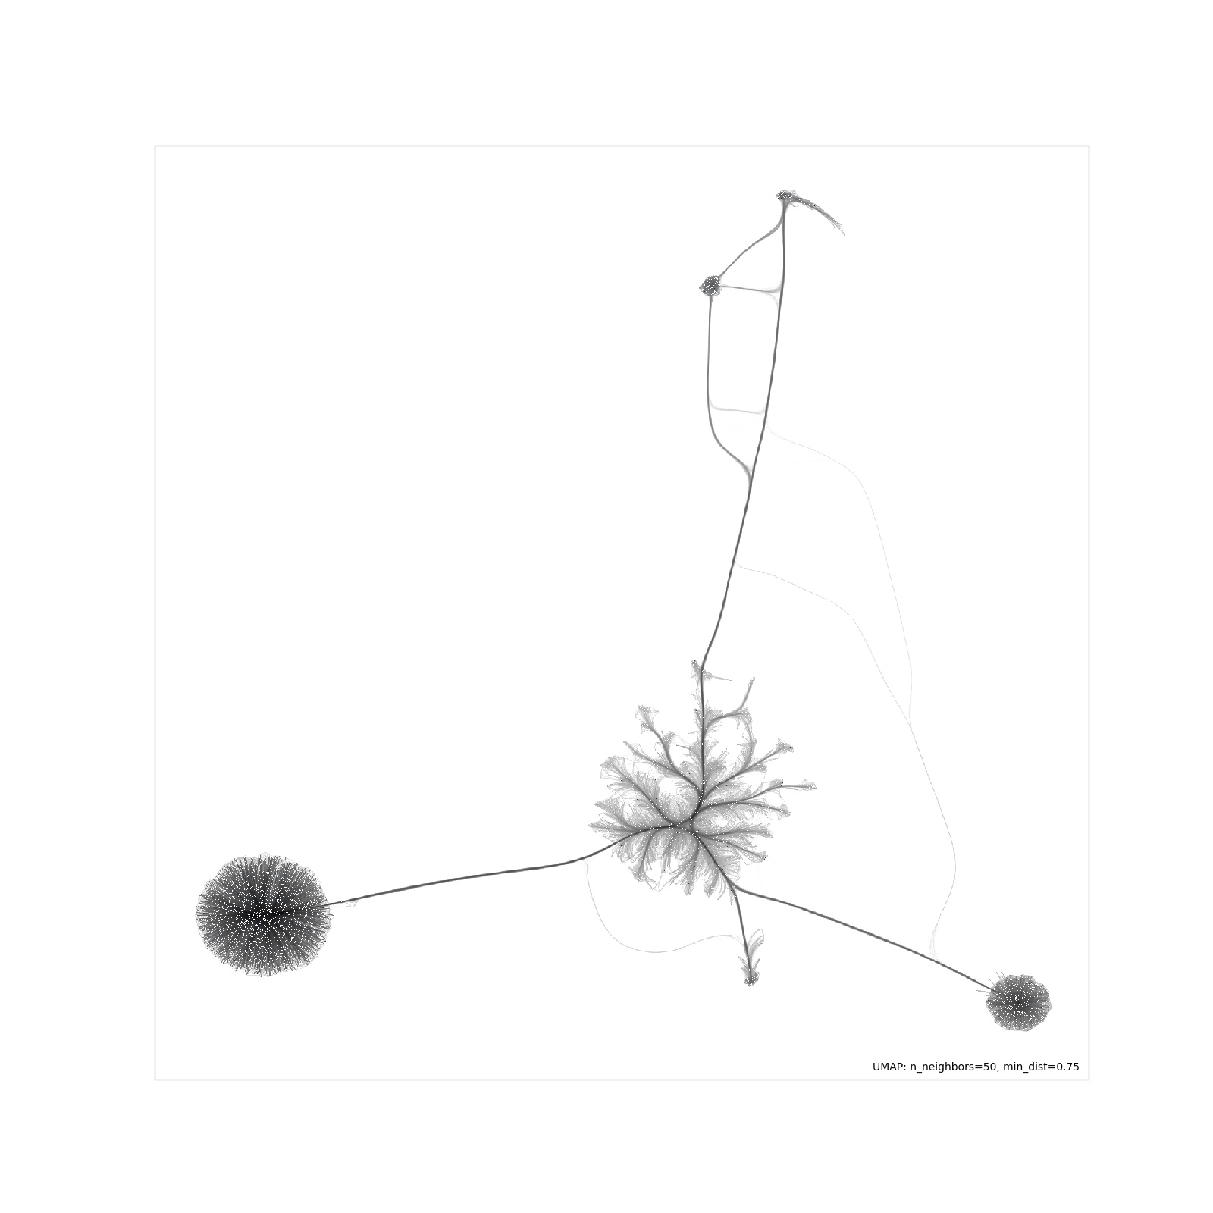

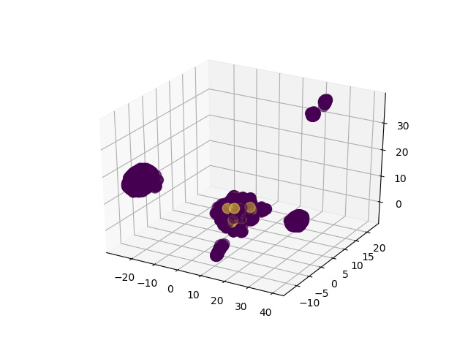
Implementation
Pre-processing data
Distance metric
Clustering
Algorithms
Command line execution
Connectivity Layout
Interactive Layout
3D Layout

Slide 5
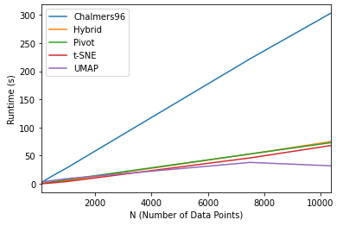
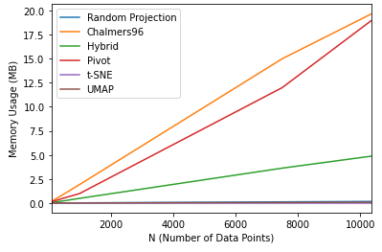
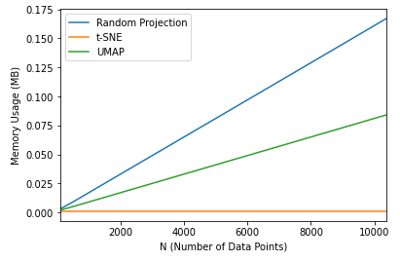
Evaluation
Visual Layout
Runtimes
Memory Usage
Runtimes
Memory Usage

Slide 6
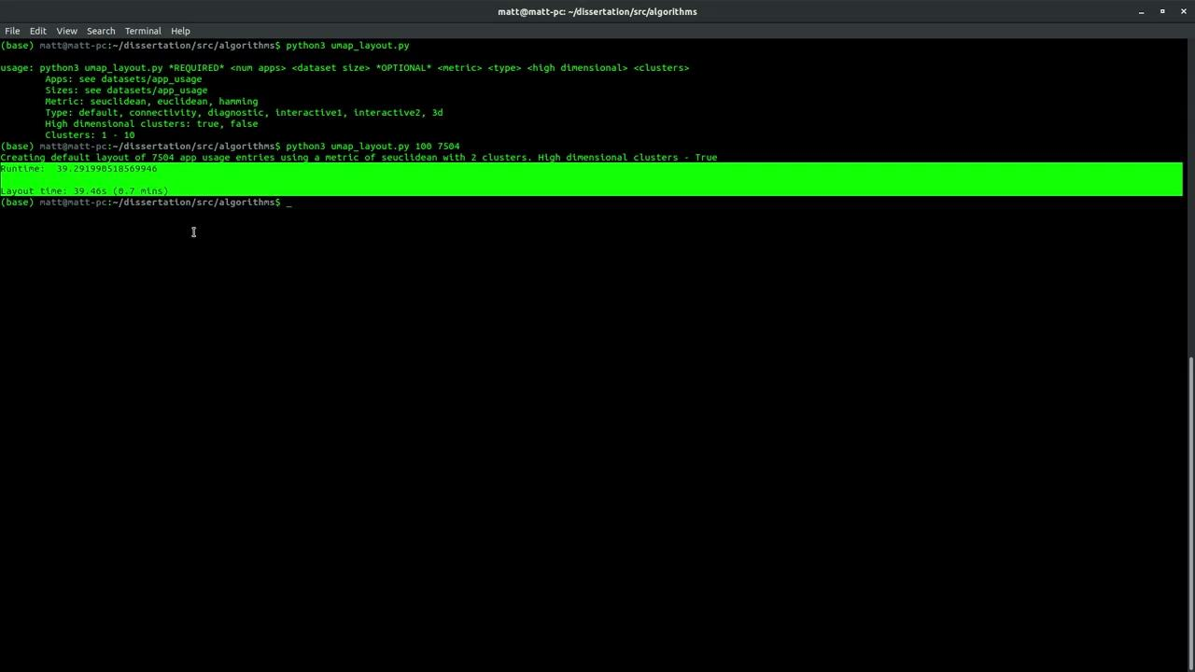
Demonstration

Slide 7
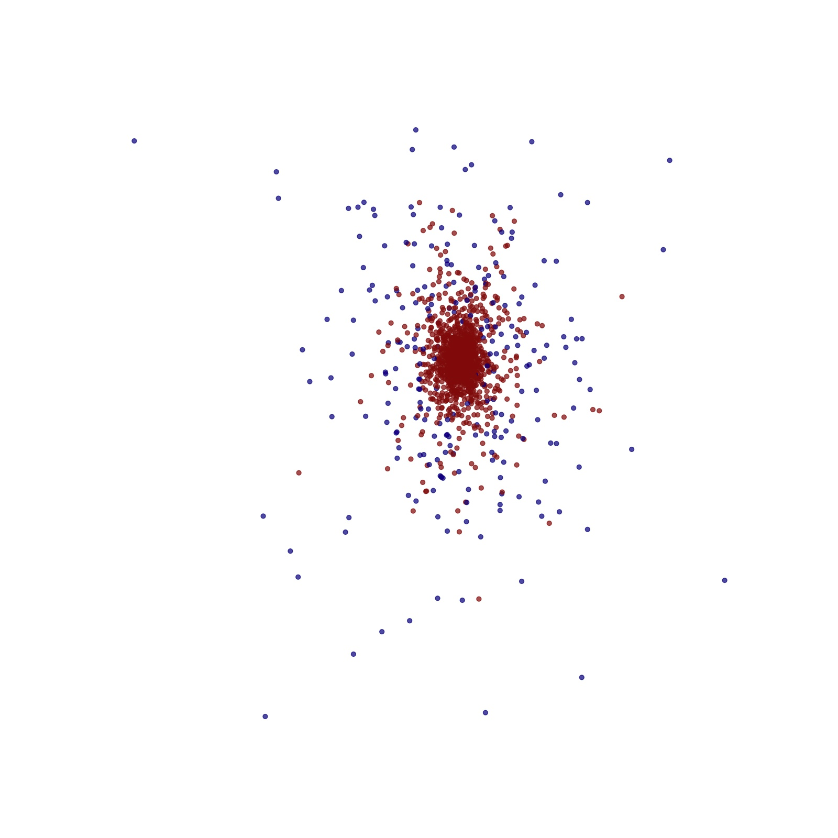
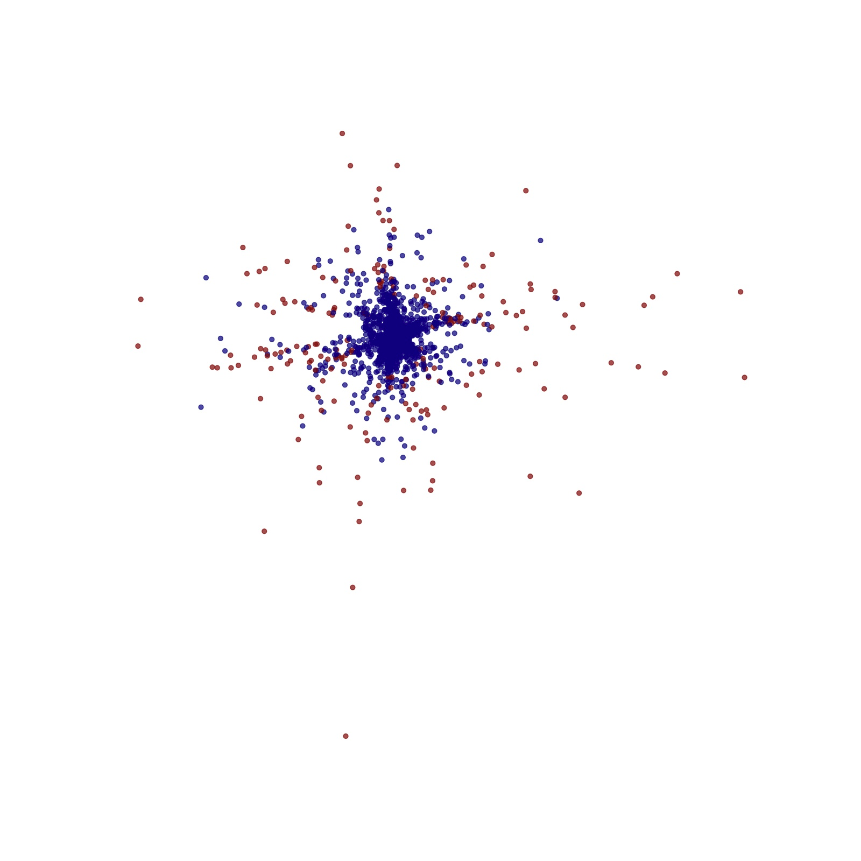
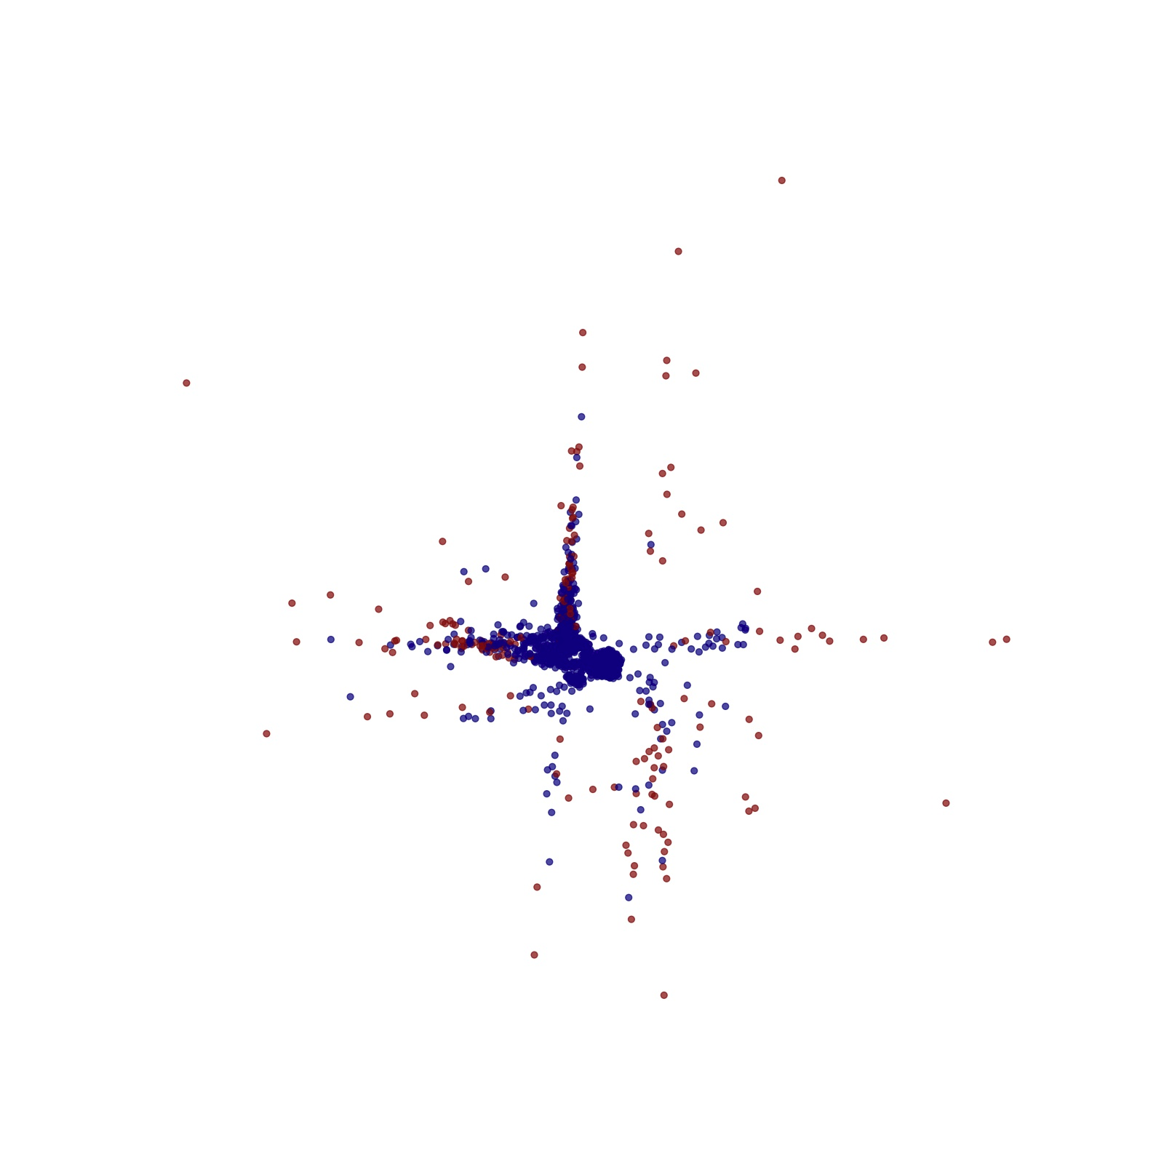
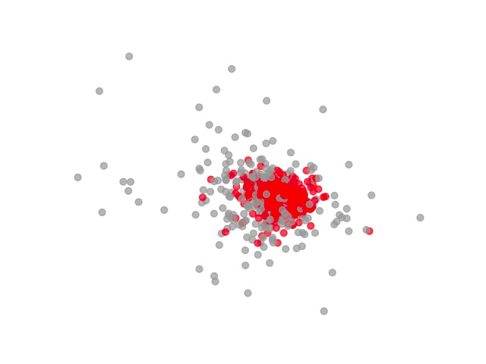
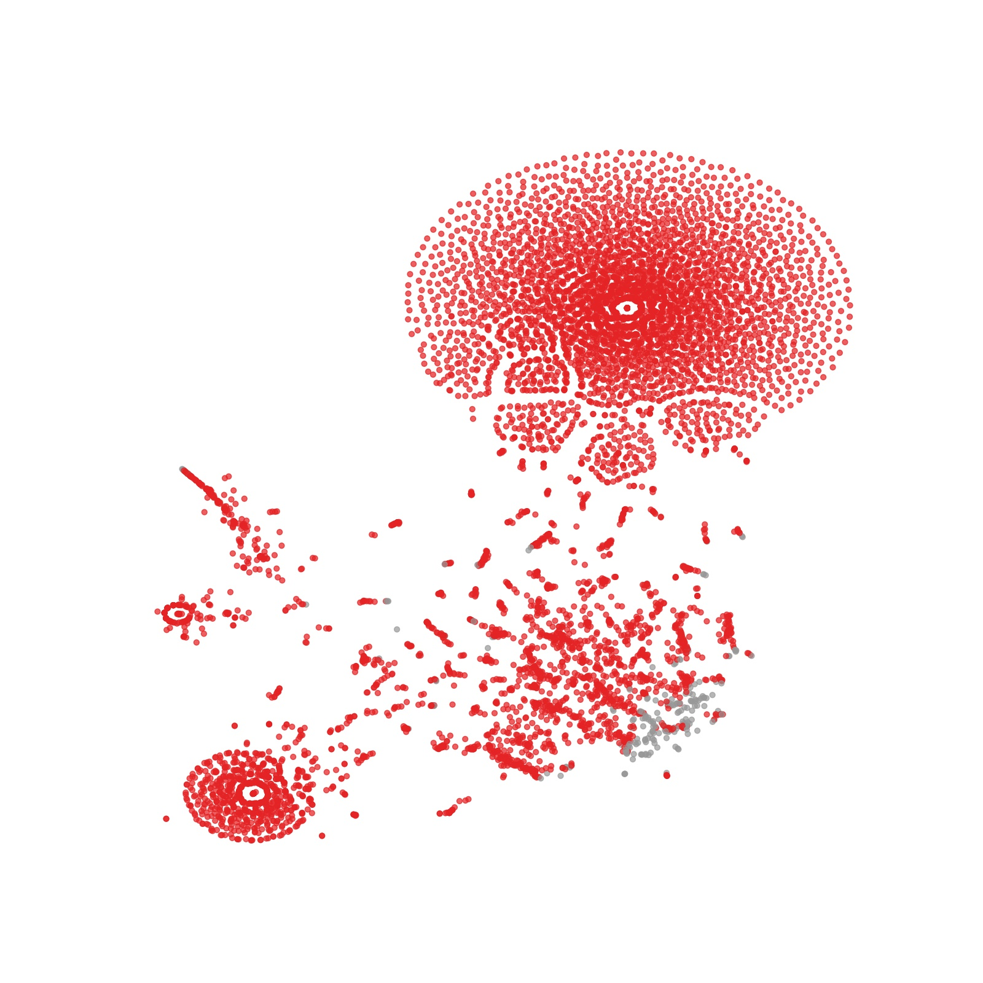
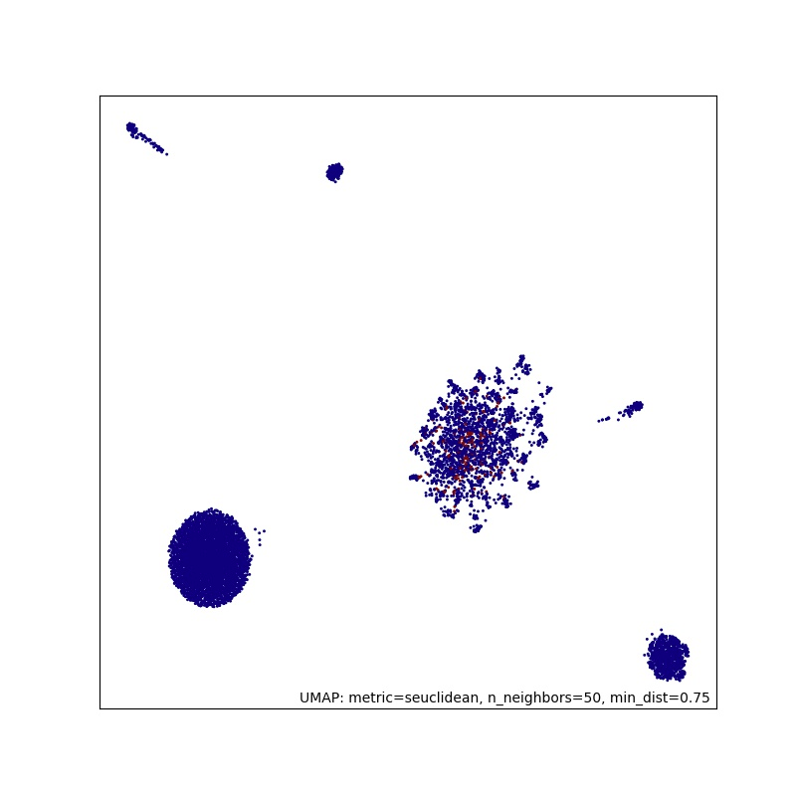
Other Layouts
Chalmers’ 1996
Hybrid Layout
Pivot Layout
Random Projection
t-SNE
UMAP

Slide 8
Conclusion
What this project achieved
Key point: never underestimate the importance and effectiveness of a carefully planned and thought out process

