Slide 1

Project Presentation
Artificial Intelligence Augmented Student-Centred Learning Platform

Slide 2
目录
CONTENTS
1 .Brief introduction and objectives of the project
项目的简介与目标
2 .Market analysis of the same type of business
市场同类型商业分析
3 .Current project progress
目前项目进度
4 . Risk estimation and response
风险的预估和应对

Slide 3
0
1
Meet the Team
----

Slide 4

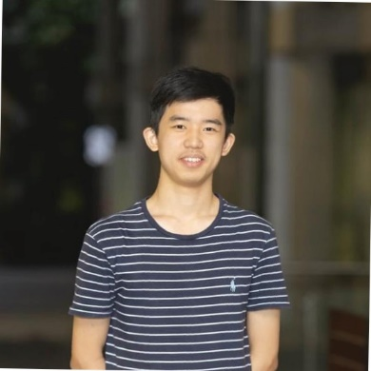
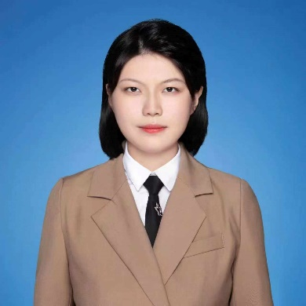
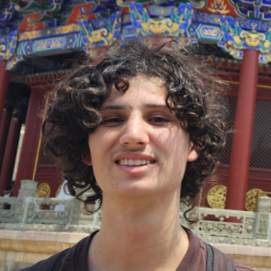
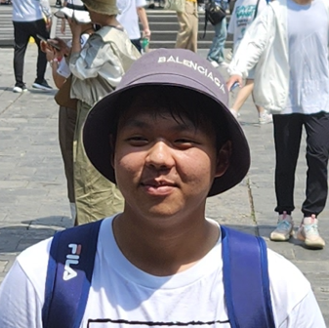
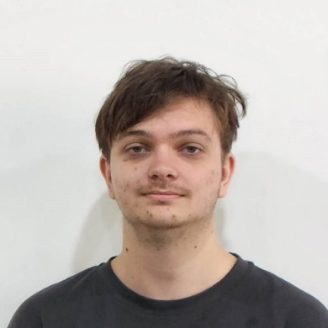
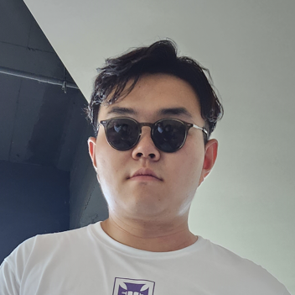
Team
Introduction
Matt Choy
B. Engg (Software)
Richard Yu
B. Engg & B. CS
肖奕弛
B. CS
Harrison Wills
B. Math & B. CS
Kevin Luo
B. Engg (Software)
Ryan McNeilly
B. Math & B. CS
将允浩
B. CS
Notes:
Introducing smartClass: Revolutionizing Lecture Transcription and Question Generation with AI. smartClass utilizes cutting-edge AI technology to transcribe uploaded lecture videos accurately and generate relevant questions. It eliminates the need for manual transcription, saving educators valuable time. By analyzing transcriptions, smartClass intelligently generates questions that test students' comprehension and promote active learning. The searchable transcriptions facilitate easy topic retrieval for comprehensive review, while the generated questions serve as valuable study aids. With smartClass, we aim to transform education by providing an efficient and engaging learning experience, where lectures become easily searchable, and questions are seamlessly generated. Join us on this exciting journey as we usher in a new era of intelligent education with smartClass.

Slide 5



Problem
Space
Notes:
1.Improve educators' productivity by automating the process of transcribing lectures and generating questions.
2.Generate relevant and insightful questions from transcriptions to enhance student learning and assessment.
3.Automate lecture transcription using AI for efficient content accessibility.

Slide 6
0
2
Business Analysis
市场同类型商业分析

Slide 7
Business Opportunities
Notes:
Potential for commercializing the smartClass platform as a service, offering transcription and question generation capabilities to educational institutions and online learning platforms.
Integration opportunities with existing learning management systems (LMS) or educational platforms to enhance their functionality and provide value-added services.
Expansion into the corporate training sector, offering automated transcription and question generation for training videos and webinars.
Partnership opportunities with educational content creators or publishers to integrate smartClass capabilities into their offerings, adding value and increasing engagement.
Possibility of leveraging the generated transcriptions and questions for data analytics and insights on student performance, allowing for targeted interventions and personalized learning experiences.

Slide 8
0
3
Current project progress
目前项目进度

Slide 9
Feasibility
Notes:
To begin the project, we began scoping out the core functionality required for the application. From this, we identified the components of the project that require feasibility studies before going ahead with the project.

Slide 10
Project progress
Notes:
Progress
Despite this idea being less than a week old, significant progress has been made in the development of smartClass. Our team has completed a functional website which allows users to login, view their courses, enrol in new courses and complete lessons. An admin page has also been developed which can be used by teachers to upload videos to the system.
Progress demonstrates delivery
These accomplished milestones indicate a solid foundation and an efficient workflow in place. The team's ability to swiftly implement crucial features within a short timeframe suggests a focused and organized approach to development. With this level of progress demonstrated early on, combined with effective planning and allocation of resources, it is highly plausible that the smartClass project will be successfully completed within the three-week deadline.

Slide 11
0
4
Risk estimation and response
风险预估和应对

Slide 12
Risk estimation and response
Notes:
This project entails certain risks that should be acknowledged and managed effectively to ensure successful completion and timely delivery. Examples of these include:
•Scope Creep: Clearly define and manage project scope, implement a change management process, and regularly review scope to ensure alignment with objectives.
•Insufficient Prompt Engineering: Conduct thorough research, experimentation, and inve
•st in data preprocessing and fine-tuning of AI models.
•Illness of Team Members: Encourage work-life balance, foster a supportive team environment, and maintain clear documentation for knowledge sharing and task delegation.
•Improper Definition of Requirements: Invest time in requirements gathering, engage stakeholders, document and validate requirements throughout the project.
•Insufficient Prior Studies into Core Technologies: Conduct in-depth research, engage experts, and establish a learning culture within the team
•Lack of Rigorous Prior Studies into Core Technologies: Implement a validation and evaluation process, conduct rigorous testing, involve experts and gather user feedback.
Mitigating these risks requires proactive project management, effective communication, and continuous monitoring. Flexibility and adaptability will be crucial for successful completion within the established timelines.
Most importantly, this entire presentation was generated with the help of ChatGPT, so yeah, we are the future of education

Slide 13
Thanks for watching

