Slide 1
Airbnb Excel Lab
By Matthew Pan

Slide 2
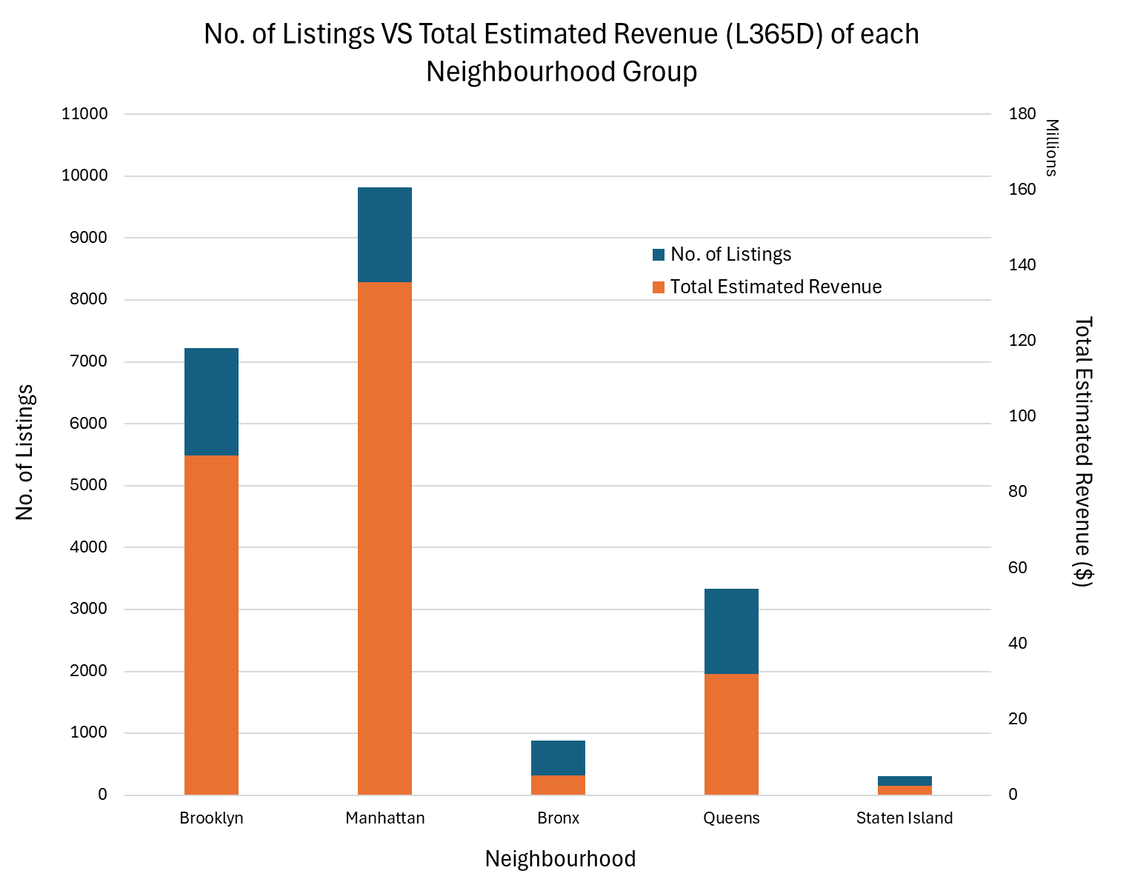
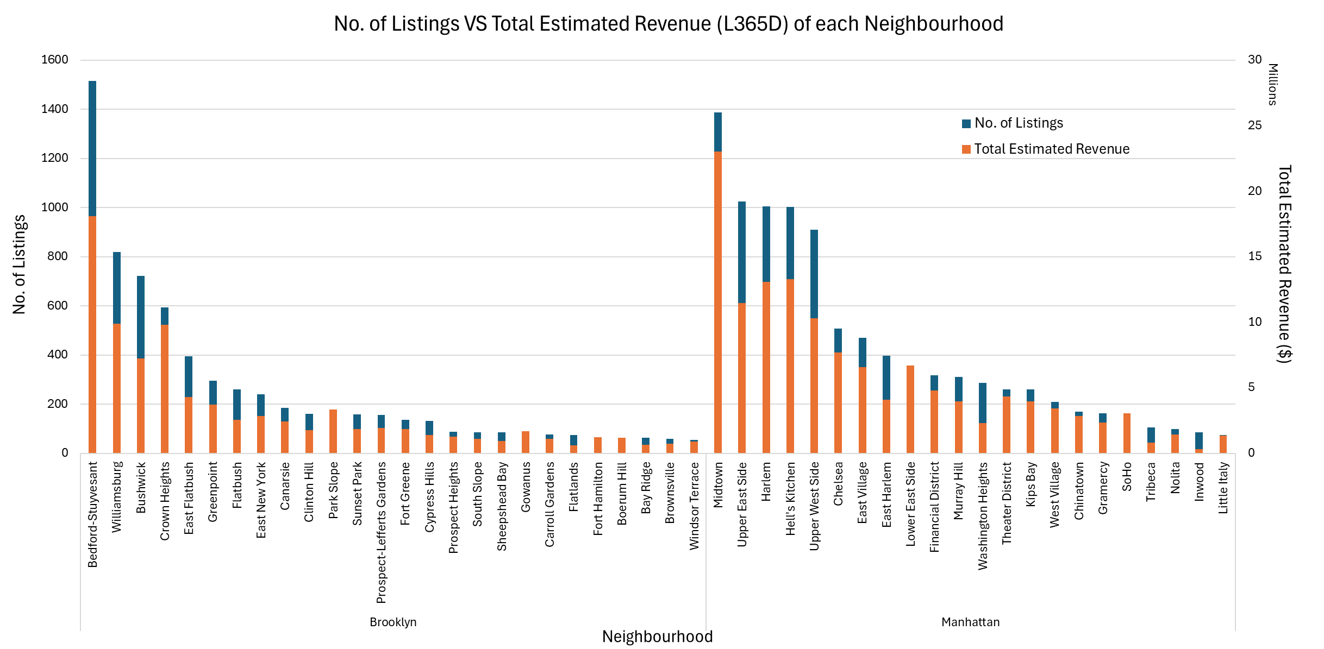
Q1. Which neighbourhoods host the most listings?
1516 listings / $18 million
1387 listings / $23 million
9813 listings
$135.5 million
38.9%
7221 listings
$89.8 million
Amongst neighbourhood groups, Manhattan hosted the highest listings of 9813, generating a total revenue of $135.5 million.
Bedford-Stuyvesant generated a total revenue of $18 million from 1516 listings, the most in NY City.
Midtown generated the highest total revenue of $23 million from 1387 listings.

Slide 3
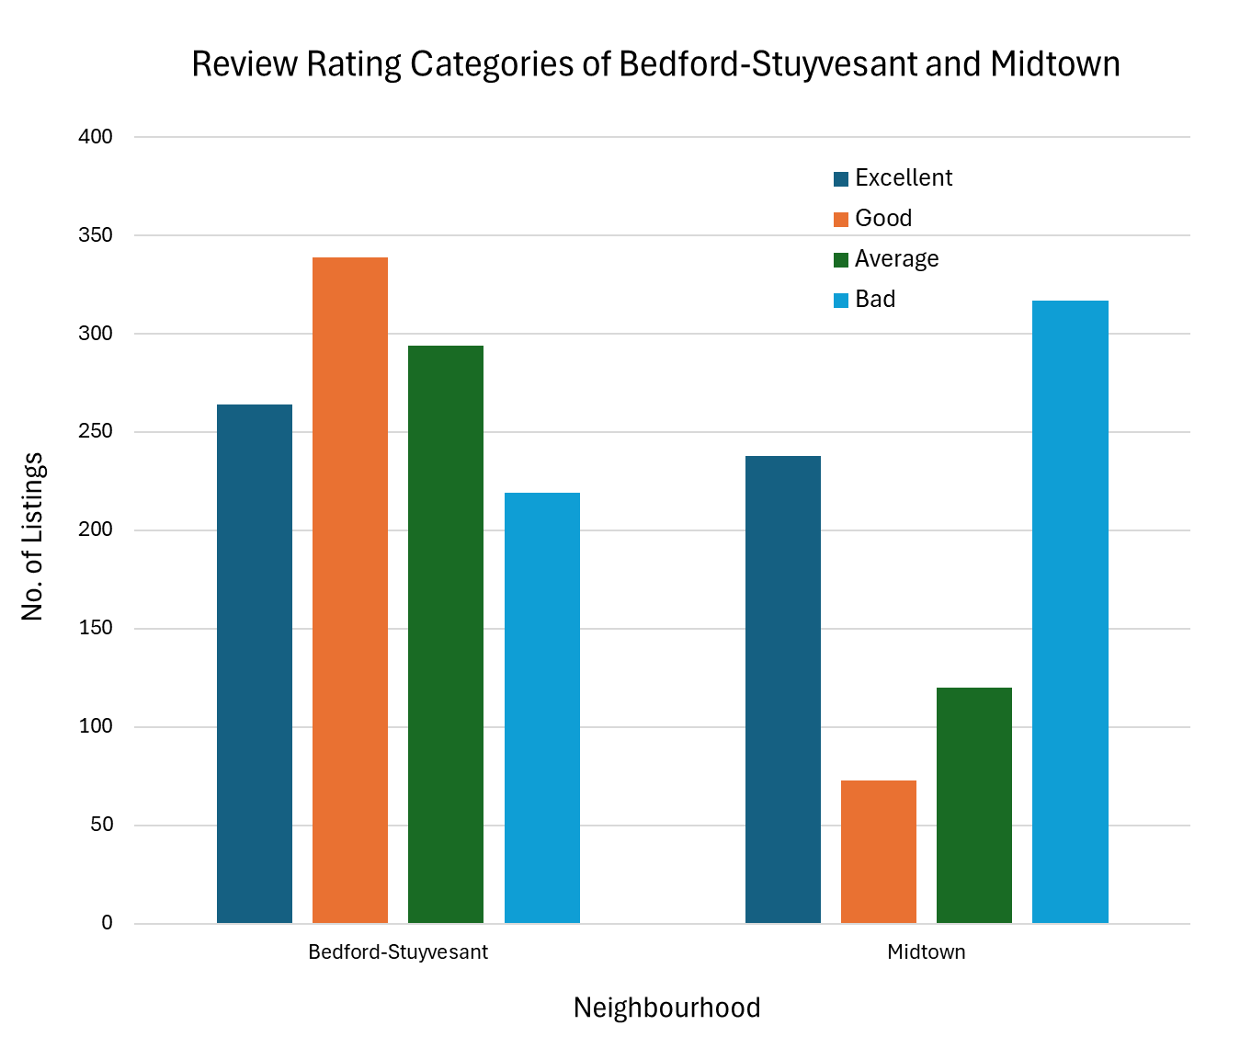
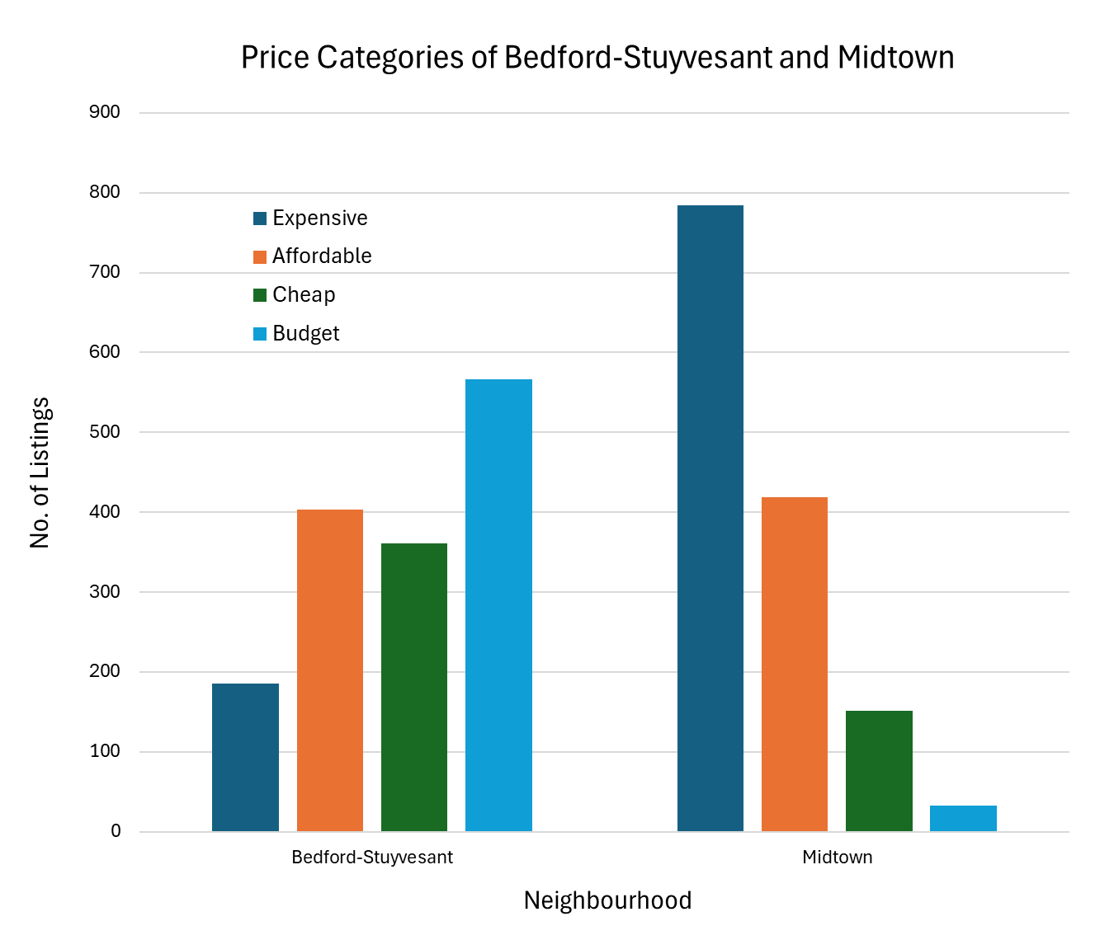
Q1. Which neighbourhoods host the most listings?
13.2%
784
Rating Category | Rating Range
Bad | 1.00 – 4.66
Average | 4.67 – 4.84
Good | 4.85 – 4.99
Excellent | 5.00
317
264
566
238
219
Price Category | Price Range
Budget | $7 – $84
Cheap | $85 – $139
Affordable | $140 – $238
Expensive | $239 – $19,999
Premium | >= $20,000
Midtown received a higher proportion of Bad reviews as compared to Bedford-Stuyvesant listings.
Bedford-Stuyvesant listings are priced mainly in the Budget price range.
Midtown listings are priced mainly in the Expensive price range.

Slide 4
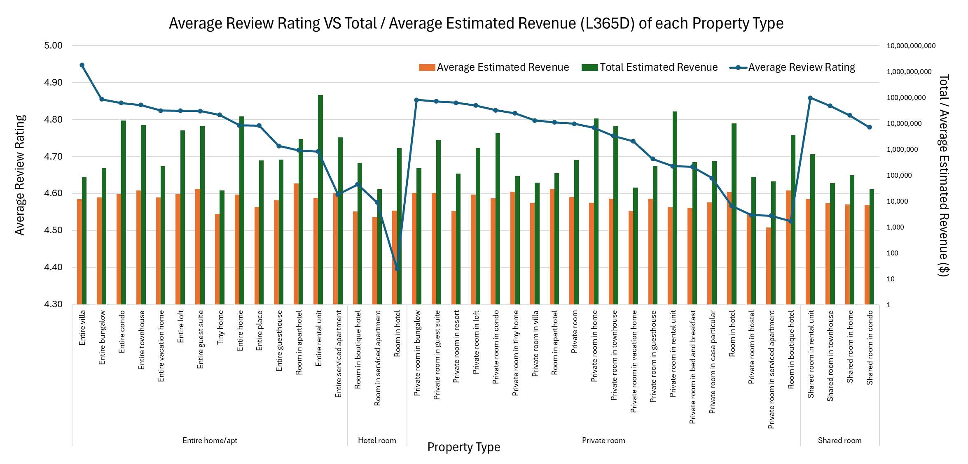
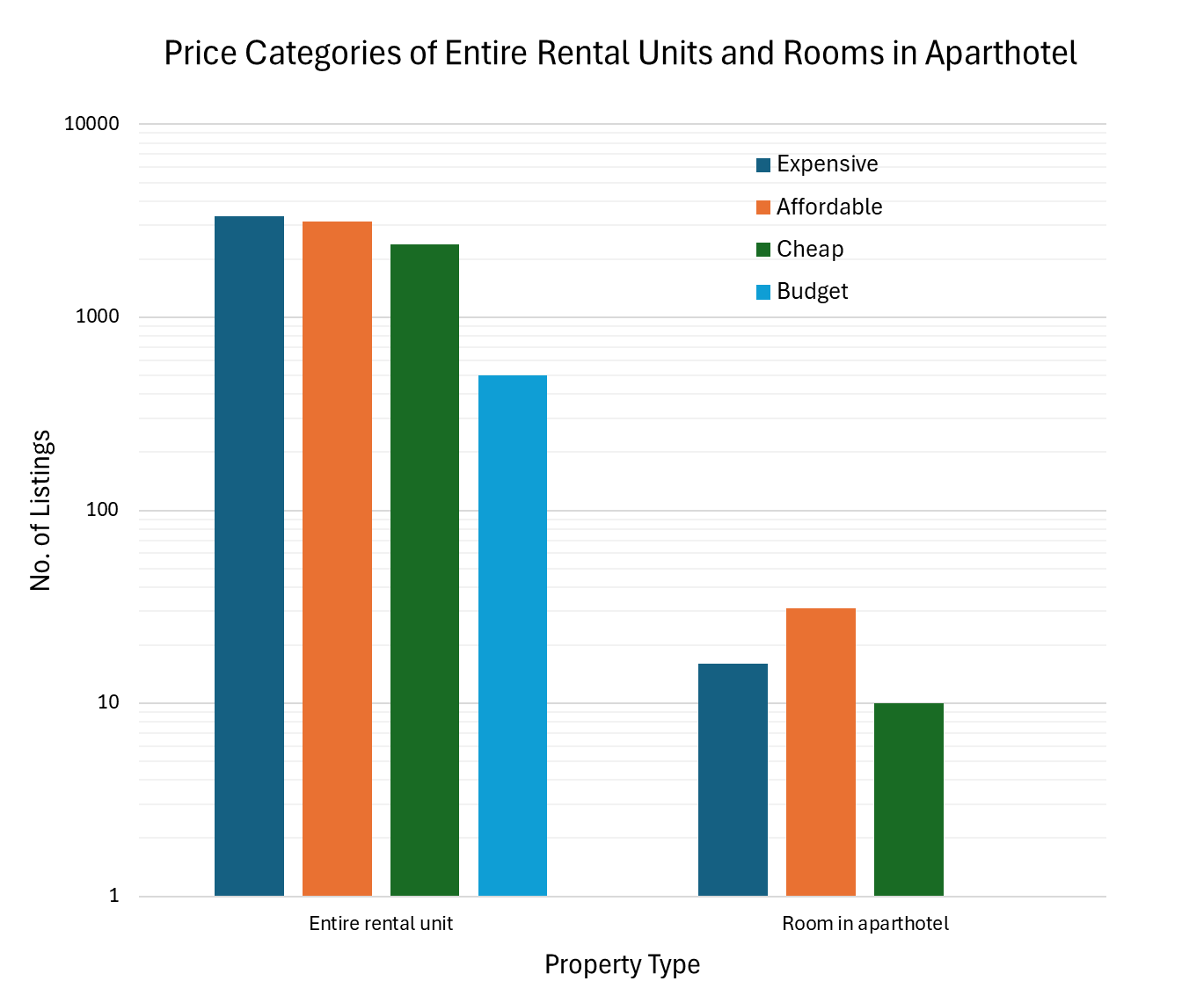
Q2. What property types receive the most positive reviews?
4.95 rating
$11,972
(Avg Rev)
4.72 rating
$47,623
(Avg Rev)
4.71 rating
$126.5 million
(Total Rev)
3344
3146
31
16
Entire villas received the highest average review rating of 4.95 but only earned $11,972 in average revenue.
Entire rental units received a 4.71 rating, earned the highest total rev. $126.5 m, priced mostly in the Expensive & Affordable range.
Room in aparthotels received a 4.72 rating, earned the highest average rev. $47,623, with no listings in the Budget range

Slide 5
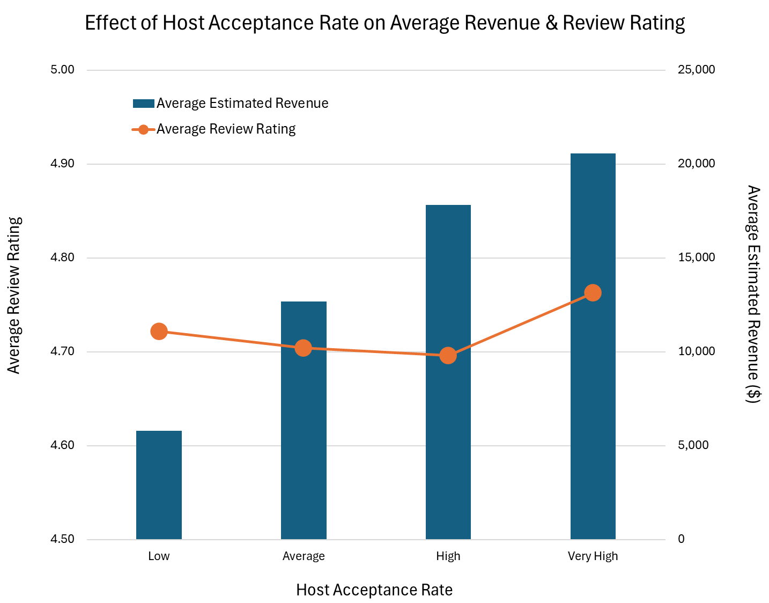
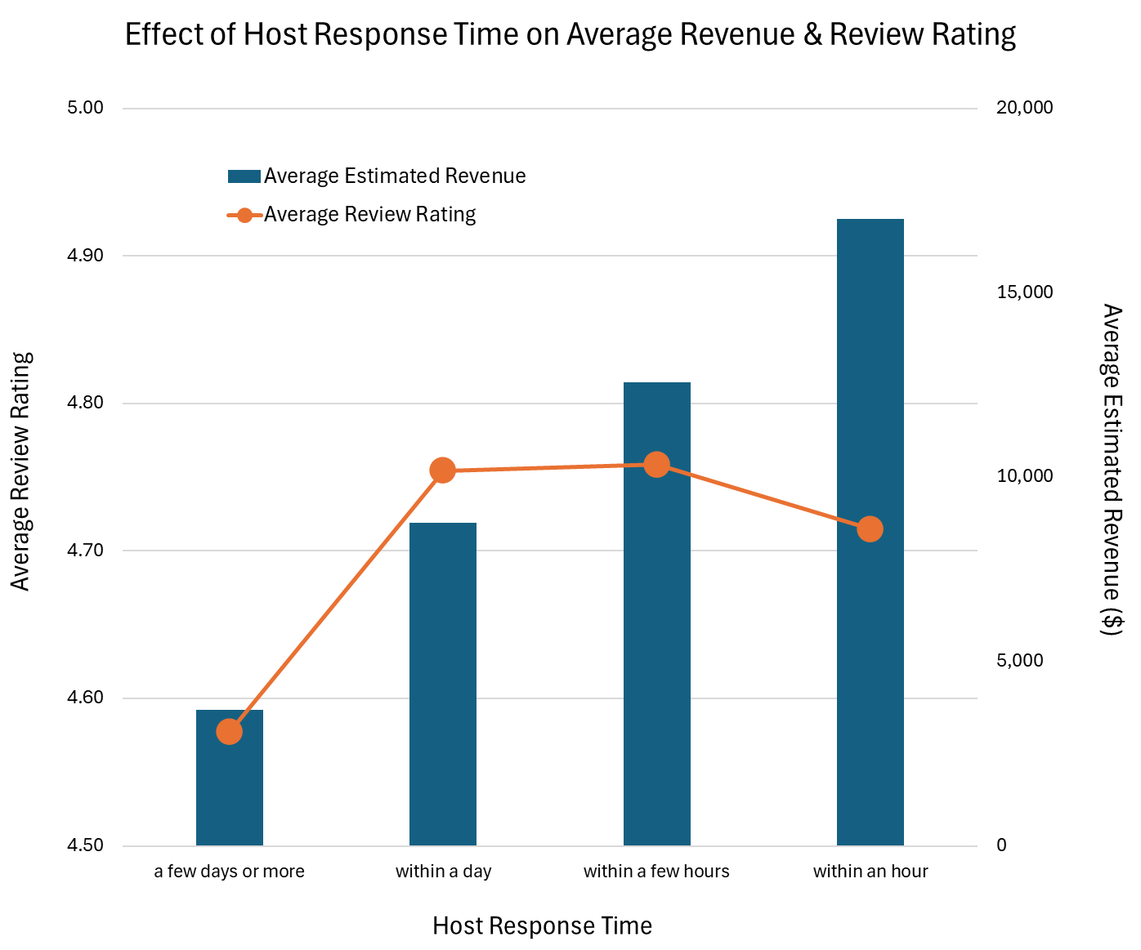
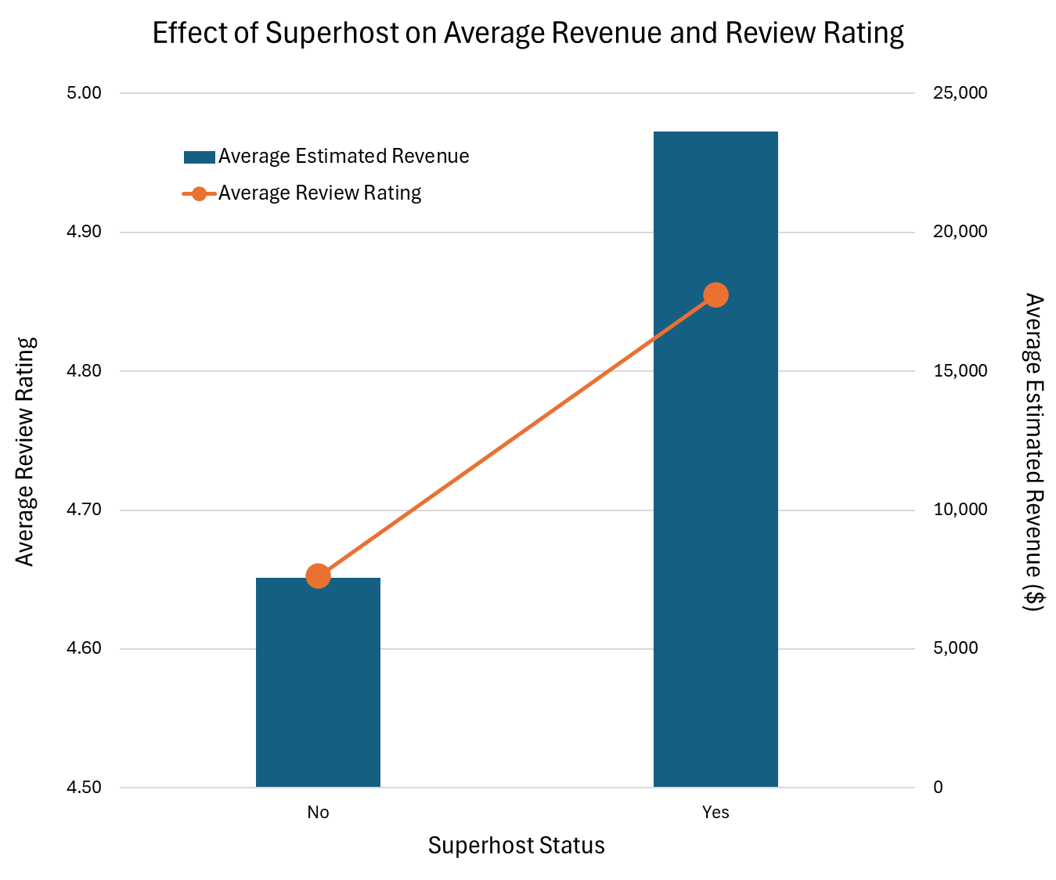
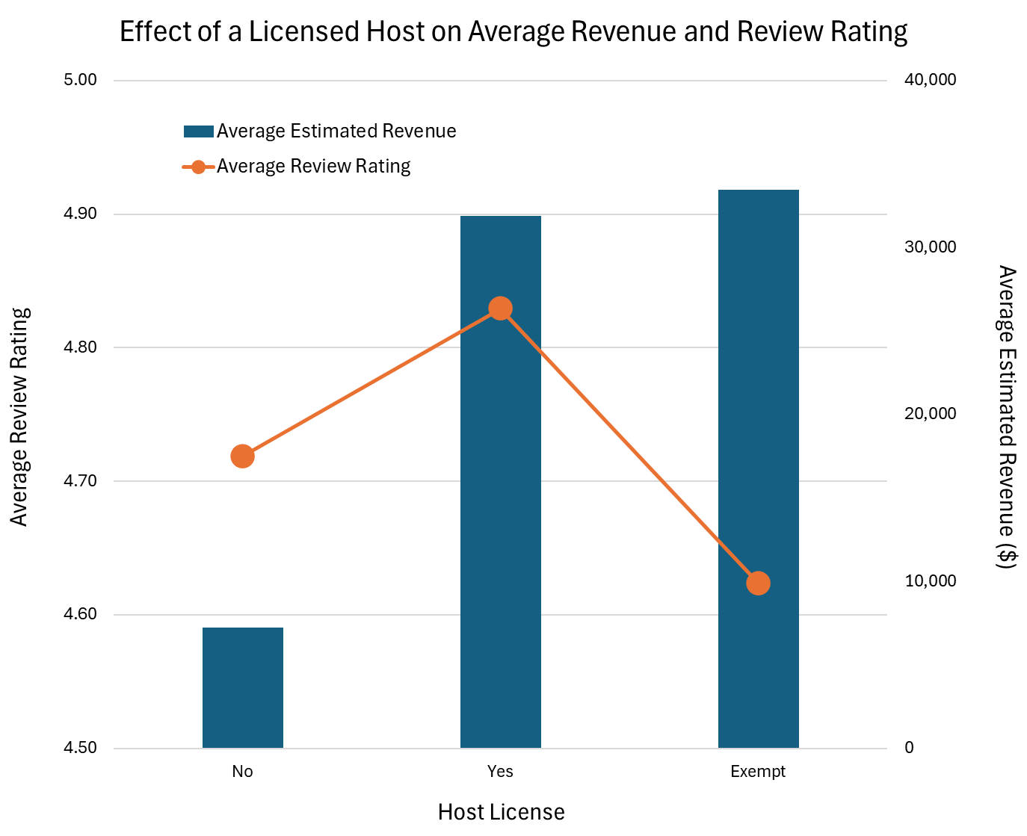
Q3. How much revenue do successful hosts generate?
$20,573
(355%)
$17,003
(462%)
$23,626
(312%)
$7,570
(100%)
$5,802
(100%)
$3,679
(100%)
Successful hosts are defined as hosts who have superhost status, are licensed, and have a high acceptance rate and response time.
The variables superhost, host license, response time, acceptance rate led to huge increases of up to 212%, 361%, 362%, and 255%, respectively, in average estimated revenue generated for the last 365 days.
Review ratings displayed little to no correlation to revenue.
$33,444
(461%)
$7,250
(100%)

Slide 6
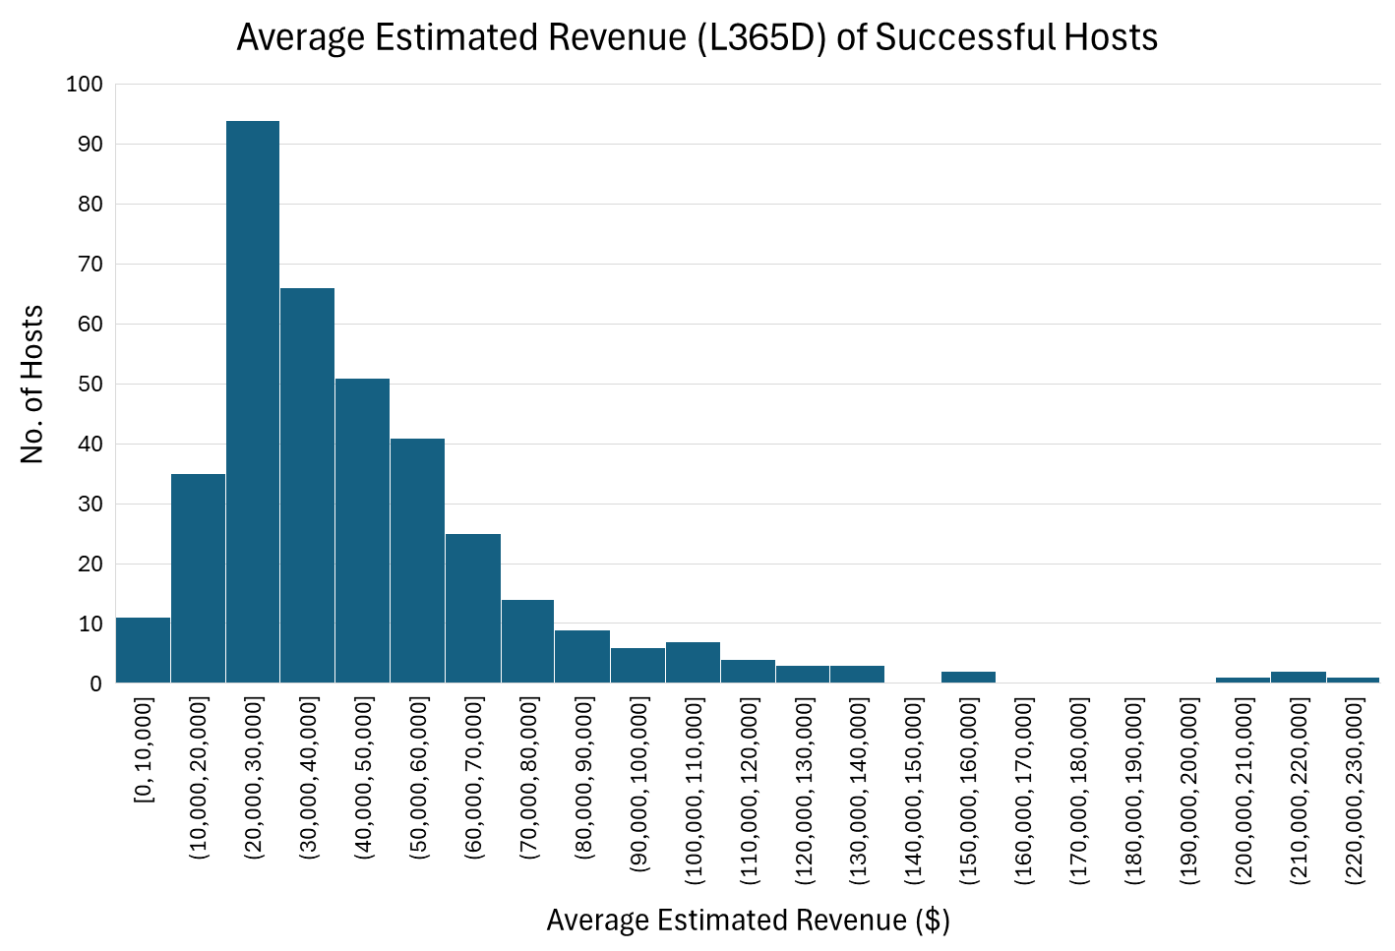
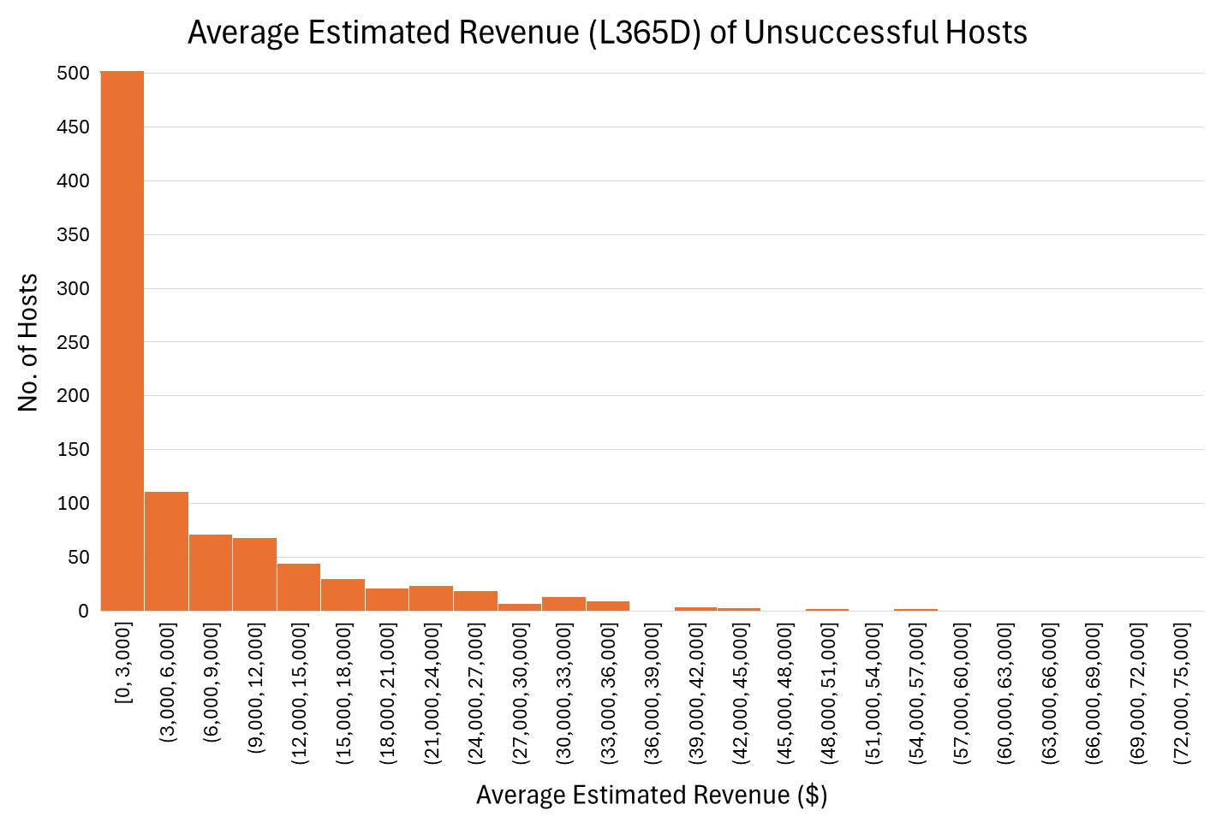
Q3. How much revenue do successful hosts generate?
Successful hosts generated an averaged average estimated revenue of $45,182, a median average revenue of $36,975, and a maximum average revenue of $221,760.
Unsuccessful hosts generated an averaged average estimated revenue of $6,661, a median average revenue of $1,900, and a maximum average revenue of $74,715.

Slide 7
Recommendation
Bedford-Stuyvesant and Midtown are good locations for Airbnb investments as they host the highest number of listings and generate the highest total revenue in New York City
Bedford-Stuyvesant, in Brooklyn, is a more affordable location with lower prices
Midtown, in Manhattan, is a more expensive location with higher prices
Entire rental units and Rooms in aparthotels are good property types for Airbnb investments because they generate the highest total and average revenue, respectively.
These property types do not receive the most positive reviews but review ratings have little to no correlation with revenue generated.
Hosts who have superhost status, are licensed, and have a high acceptance rate and response time are the best hosts to invest in because they generate significantly higher average, median, and maximum revenue than others.

Slide 8

Q & A
THANK YOU FOR YOUR TIME!

