Slide 1

Greenify
Matteo R., Amedeo C., Savvas A., Constantinos O.

Slide 2
Slide #1 - Learnings to Action
Following the Project Management Review (PMR), our AI Entrepreneurship project adopts a meticulously guided trajectory for success. We meticulously analyze PMR feedback, refining our plan to align with standards and expectations. In the implementation phase, we rigorously track progress against milestones, ensuring the AI device meets reliability and usability benchmarks through rigorous testing. Iterative refinement, based on user feedback, enhances device performance continuously. Deployment into real-world environments marks a pivotal phase, with diligent monitoring facilitating ongoing evaluation and refinement. Regular progress meetings foster collaboration, complemented by steadfast commitment to tracking key metrics, managing risks, and engaging stakeholders. This holistic approach ensures adept navigation of challenges while staying aligned with overarching goals. Scheduled PMR sessions assess project progress, addressing challenges like technical issues or resource constraints. Analysis of project metrics during PMR provides insights, guiding improvements. Through these strategic steps, our AI Entrepreneurship project is poised for success, driven by continuous refinement and alignment with project objectives.

Slide 3
Slide #2 - BHM Selection
We chose the residential homeowners market segment due to its broad appeal and pressing need for energy management solutions. With rising energy costs and increased environmental awareness, homeowners are keen to reduce consumption. This segment encompasses urban and suburban dwellers, with or without solar panels, ensuring ample market penetration opportunities. Moreover, targeting homeowners interested in renewable energy integration allows us to offer additional benefits to sustainability-minded consumers. The homogeneity of this market facilitates uniform product sales and word-of-mouth promotion, leveraging satisfied customers to expand our reach. Alternative market segments, such as blocks of flats, government buildings, and industrial sites, were considered but deemed less suitable. Blocks of flats have distinct sales cycles and communal facility needs, while the public sector's slower adoption rates and procurement procedures pose challenges. Similarly, industrial and factory settings have unique energy management requirements that diverge significantly from residential needs. Private entities within the public sector, like hospitals, may also have stringent regulations that complicate product adoption. By focusing on the residential homeowners segment, we maximize market fit and potential for product success.

Slide 4
Slide #3 – The process
Regarding team dynamics, the process encouraged open communication and collaboration among team members. Each member had the opportunity to express their opinions and contribute to the decision-making process. We divided the workload among each member, and then we came together to review and check everything at the end. Having these predefined norms was certainly helpful as they provided a structured framework for evaluating and comparing different market segments.
We intend to refine team dynamics for the remainder of the semester by implementing the following strategies:
Regular check-ins: We will schedule regular check-in meetings to ensure that everyone is on the same page and address any issues or concerns promptly.
Clear roles and responsibilities: We will clarify roles and responsibilities within the team to ensure that everyone knows what is expected of them and can contribute effectively to the project.
Encourage feedback: We will create a feedback culture where team members feel comfortable providing constructive feedback and suggestions for improvement.
Promote collaboration: We will encourage collaboration and knowledge sharing among team members to leverage each other's strengths and skills.
These strategies will help us enhance team dynamics and maintain effective communication and collaboration throughout the project.

Slide 5
Slide #4 – TAM (Step #4)
The Business Household Market (BHM) boasts an estimated 450,000 households, with each household potentially generating $200 in annual revenue, assuming 10% of their $2,000 yearly budget is allocated to the offered solution. Presently, consumers spend $200 annually on smart home devices, contributing to a total market expenditure of approximately $90 million yearly. The aim is to capture 10% of this market, equating to $9 million annually. These figures are subject to change, influenced by factors such as increasing smart home adoption rates, advancements in AI and IoT technology, and government policies emphasizing energy efficiency. Market growth hinges on variables like new home sales, government incentives for smart home technology adoption, and consumer spending trends influenced by interest rates. The opportunity lies in both overall market expansion and a trend toward more intelligent solutions. While the Total Addressable Market (TAM) appears substantial, further segmentation could optimize resource allocation and provide a more precise evaluation of market potential. This approach enables a targeted focus on specific subsegments or geographic areas, ensuring maximum effectiveness in resource allocation. As the smart home sector evolves and embraces more sophisticated technologies, there's significant potential for growth and market penetration, making the BHM a promising space for investment and attention.

Slide 6

Slide #5 – Persona (Step #5)
Danai Kosh, a 23-year-old European woman, is a multifaceted individual juggling her studies in Business Administration alongside a consultant role in digital transformation. Her priorities encompass self-care, academic success, professional growth, and financial planning, underpinned by a blend of creativity and analytical prowess. With a fervent passion for dance, diving, biking, swimming, and fitness, Danai draws inspiration from Walt Disney's philosophy of dreaming big. Her daily routine seamlessly integrates work, university commitments, and fitness endeavors, supplemented by insights gleaned from diverse sources such as social media, news apps, university, work, and gym interactions. As a working student navigating financial constraints, Danai epitomizes the challenges faced by many young adults in managing expenses and savings amidst escalating costs. Her dynamic lifestyle and financial sensibilities make her an ideal target persona for tailored solutions aimed at optimizing budget management and achieving personal and professional aspirations. Focusing on Danai enables the development of strategies tailored to her specific needs, ensuring effective utilization of resources to navigate the complexities of balancing work, studies, and financial stability.

Slide 7
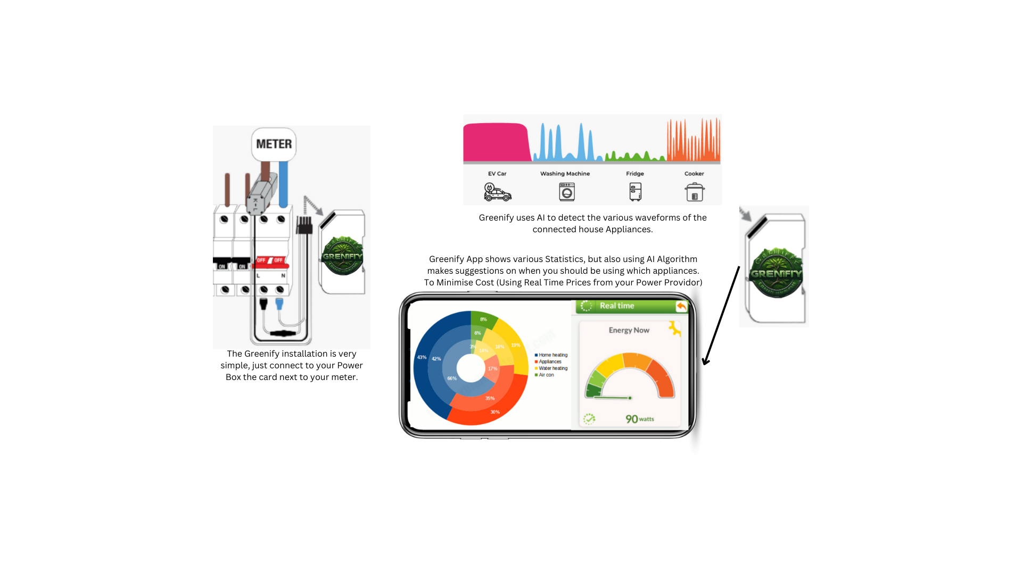
Slide #6 – Full Life Cycle Use Case (Step #6)
In the full life cycle case, we assessed the individuals directly involved in the product's lifecycle, from those determining what the product should do and how, to those installing and configuring it, the payment method, and how it compares to other products.
Finally, we inserted images of what the product would look like and what it could do.

Slide 8
Slide #7 – High Level Product Specification (Step #7)
The product alignment with the Persona's priorities is crucial for ensuring that the AI device effectively meets the user's needs and expectations. By aligning the features, functions, and benefits of the product with the Persona's top priorities, we can deliver value and enhance user satisfaction.
The high-level product specification has been reviewed with the Persona, who provided valuable feedback. While the Persona appreciated the thoroughness of the specifications, they expressed the need for more details regarding the user interface, ease of use, privacy, and security considerations. In response, we have iterated based on the Persona's feedback by enhancing the user interface, improving privacy and security features, providing comprehensive documentation, offering user training and support, and implementing a feedback mechanism.
Through this iterative process, we aim to ensure that the high-level product specification is not only interesting but also satisfies the Persona's priorities effectively. By addressing the Persona's feedback and refining the product accordingly, we can enhance user satisfaction and maximize the product's potential to meet the needs of our target audience.

Slide 9
Slide #8 – Quantified Value Proposition (Step #8)
The current focus of the business lies in residential homeowners seeking to manage energy consumption, presenting a diverse market encompassing urban and suburban dwellers, irrespective of solar panel installation. Urgency is fueled by rising energy costs and environmental awareness. Targeting a subset interested in renewable energy integration offers added value. Opportunities for improvement include leveraging AI for precise energy management, personalized recommendations, and deeper engagement through features promoting conservation. Enhanced compatibility with smart home ecosystems and renewables, along with strategic partnerships, could bolster market presence and customer loyalty. Innovations in technology and collaborations position the business to meet the rising demand for sustainable living solutions.

