Slide 1











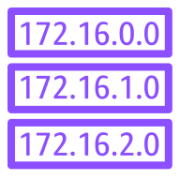

AWS Cloud
Region
VPC
Auto Scaling group
Availability Zone 1
Availability Zone 2
S3 bucket
Public subnet
Private subnet
Private subnet
Public subnet
Security group
IAM Role
NAT gateway
Amazon Elastic Compute Cloud (Amazon EC2)
Amazon Elastic Compute Cloud (Amazon EC2)
NAT gateway
Internet gateway
Security group
Application Load Balancer

