Slide 1
TITLE AND BIG QUESTION
1 / 12
Jobs and their tasks
Year A · Week 2 · 9–13 November 2026 · 40 minutes
What tasks do people do at work?
This helps me find out what different jobs involve.
Term theme: Identity & Belonging
CAREERS-BUILD-A2-W02
Public edition
Lesson resource · CC BY-NC-SA 4.0: free for classroom use, share and adapt with credit, no resale
Notes:
CAREERS-BUILD-A2-W02 · Year A · Week beginning 9 November 2026
Term theme: Identity & Belonging
Thread tags: SMSC S/So (M/C: none); British Values IL/MR (D/RL/T: none).
Title and big question: 0 minutes.
Teacher: Read the big question and careers line before the timed sequence.
Routes: Supported: choose between two role cards; make two job-to-task matches with reading support. Independent: sort all six task cards, then record two different role matches and one reason. Aspire: explain how a skill could be used in more than one role, using the supplied briefs.
Evidence: Two recorded job-to-task matches and the learner’s reason, spoken, selected or written.
Careers: This helps me find out what different jobs involve.
Source: owner_orders/BUILD_Careers_Autumn2_YearA_outline; revision approved-2026-10-26.
Fictional worker illustration is an authored visual prompt, not evidence of a real employer or vacancy.
Week 7 is the assessing lesson.
Sources and limits: FACTS_LEDGER.md
Lesson resource · CC BY-NC-SA 4.0: free for classroom use, share and adapt with credit, no resale

Slide 2
ARRIVAL AND REGULATION
2 / 12 · 3 min
A calm start
Choose a calm place to sit.
Ask for a short pause if needed.
Keep the work space clear.
Ask for help with the words.
Use a point, a word or your aid.
Let each person have time.
CAREERS-BUILD-A2-W02
Public edition
Lesson resource · CC BY-NC-SA 4.0: free for classroom use, share and adapt with credit, no resale
Notes:
CAREERS-BUILD-A2-W02 · Year A · Week beginning 9 November 2026
Term theme: Identity & Belonging
Thread tags: SMSC S/So (M/C: none); British Values IL/MR (D/RL/T: none).
Arrival and regulation: 3 minutes.
Teacher: Offer a calm seat, usual communication aid and help choice. No personal disclosure is required.
Routes: Supported: choose between two role cards; make two job-to-task matches with reading support. Independent: sort all six task cards, then record two different role matches and one reason. Aspire: explain how a skill could be used in more than one role, using the supplied briefs.
Evidence: Two recorded job-to-task matches and the learner’s reason, spoken, selected or written.
Careers: This helps me find out what different jobs involve.
Source: owner_orders/BUILD_Careers_Autumn2_YearA_outline; revision approved-2026-10-26.
Fictional worker illustration is an authored visual prompt, not evidence of a real employer or vacancy.
Week 7 is the assessing lesson.
Sources and limits: FACTS_LEDGER.md
Lesson resource · CC BY-NC-SA 4.0: free for classroom use, share and adapt with credit, no resale

Slide 3
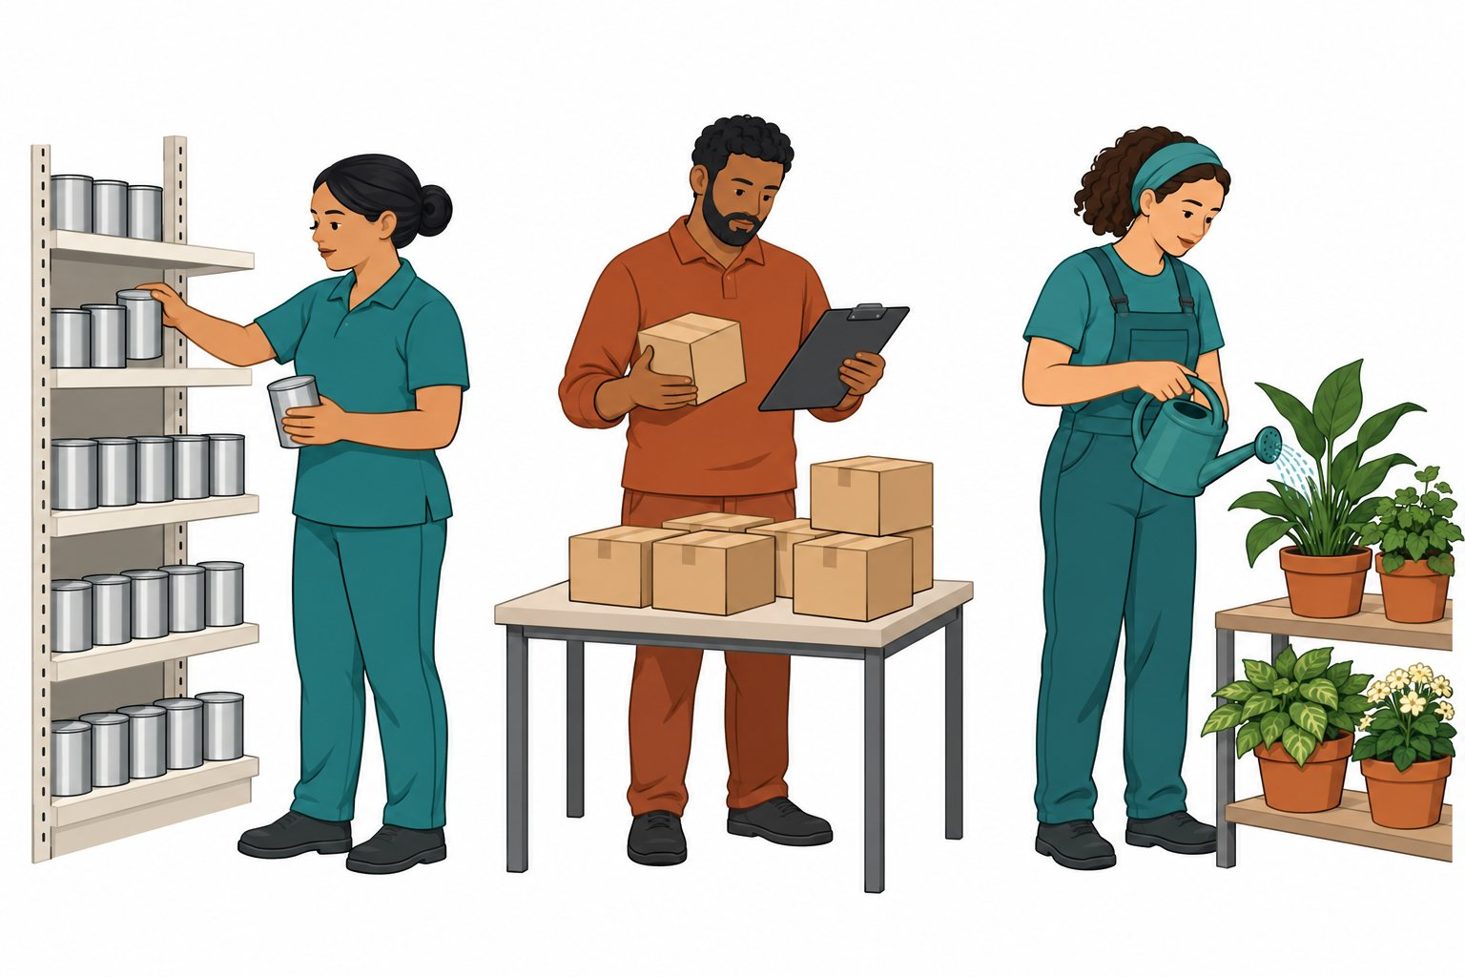
STARTER
3 / 12 · 3 min
Look at the workers
Look at the three scenes.
Which worker cares for plants?
Which worker checks boxes?
Point to a job and its task.
CAREERS-BUILD-A2-W02
Public edition
Lesson resource · CC BY-NC-SA 4.0: free for classroom use, share and adapt with credit, no resale
Notes:
CAREERS-BUILD-A2-W02 · Year A · Week beginning 9 November 2026
Term theme: Identity & Belonging
Thread tags: SMSC S/So (M/C: none); British Values IL/MR (D/RL/T: none).
Starter: 3 minutes.
Teacher: Read the fictional role captions. Ask about the action, not the worker’s appearance. Accept pointing, speech or an aid.
Routes: Supported: choose between two role cards; make two job-to-task matches with reading support. Independent: sort all six task cards, then record two different role matches and one reason. Aspire: explain how a skill could be used in more than one role, using the supplied briefs.
Evidence: Two recorded job-to-task matches and the learner’s reason, spoken, selected or written.
Careers: This helps me find out what different jobs involve.
Source: owner_orders/BUILD_Careers_Autumn2_YearA_outline; revision approved-2026-10-26.
Fictional worker illustration is an authored visual prompt, not evidence of a real employer or vacancy.
Week 7 is the assessing lesson.
Sources and limits: FACTS_LEDGER.md
Lesson resource · CC BY-NC-SA 4.0: free for classroom use, share and adapt with credit, no resale

Slide 4
TODAY
4 / 12
Today
Match two job roles to the tasks people do.
I can match two jobs to tasks.
I can choose a role to look at.
I can give one reason for my choice.
CAREERS-BUILD-A2-W02
Public edition
Lesson resource · CC BY-NC-SA 4.0: free for classroom use, share and adapt with credit, no resale
Notes:
CAREERS-BUILD-A2-W02 · Year A · Week beginning 9 November 2026
Term theme: Identity & Belonging
Thread tags: SMSC S/So (M/C: none); British Values IL/MR (D/RL/T: none).
Today: 0 minutes.
Teacher: Read the approved objective and three success checks. Explain any new word with a concrete action.
Routes: Supported: choose between two role cards; make two job-to-task matches with reading support. Independent: sort all six task cards, then record two different role matches and one reason. Aspire: explain how a skill could be used in more than one role, using the supplied briefs.
Evidence: Two recorded job-to-task matches and the learner’s reason, spoken, selected or written.
Careers: This helps me find out what different jobs involve.
Source: owner_orders/BUILD_Careers_Autumn2_YearA_outline; revision approved-2026-10-26.
Fictional worker illustration is an authored visual prompt, not evidence of a real employer or vacancy.
Week 7 is the assessing lesson.
Sources and limits: FACTS_LEDGER.md
Lesson resource · CC BY-NC-SA 4.0: free for classroom use, share and adapt with credit, no resale

Slide 5
I DO
5 / 12 · 5 min
Watch the model
This is a made-up garden job.
The worker cares for plants.
This task says: give water to pots.
That task fits the garden role.
I check the role card to be sure.
I chose it because plants need care.
Read the role. Match the task. Give a reason.
CAREERS-BUILD-A2-W02
Public edition
Lesson resource · CC BY-NC-SA 4.0: free for classroom use, share and adapt with credit, no resale
Notes:
CAREERS-BUILD-A2-W02 · Year A · Week beginning 9 November 2026
Term theme: Identity & Belonging
Thread tags: SMSC S/So (M/C: none); British Values IL/MR (D/RL/T: none).
I Do: 5 minutes.
Teacher: Model the six lines, using a separate token set or task card. Identify the stated fact that supports the match. Do not record the adult model as learner evidence.
Routes: Supported: choose between two role cards; make two job-to-task matches with reading support. Independent: sort all six task cards, then record two different role matches and one reason. Aspire: explain how a skill could be used in more than one role, using the supplied briefs.
Evidence: Two recorded job-to-task matches and the learner’s reason, spoken, selected or written.
Careers: This helps me find out what different jobs involve.
Source: owner_orders/BUILD_Careers_Autumn2_YearA_outline; revision approved-2026-10-26.
Fictional worker illustration is an authored visual prompt, not evidence of a real employer or vacancy.
Week 7 is the assessing lesson.
Sources and limits: FACTS_LEDGER.md
Lesson resource · CC BY-NC-SA 4.0: free for classroom use, share and adapt with credit, no resale

Slide 6
WE DO
6 / 12 · 5 min
Which task fits
Which task fits the made-up garden job?
A Give water to pots.
B Check boxes on a list.
C Put tins on a shelf.
CAREERS-BUILD-A2-W02
Public edition
Lesson resource · CC BY-NC-SA 4.0: free for classroom use, share and adapt with credit, no resale
Notes:
CAREERS-BUILD-A2-W02 · Year A · Week beginning 9 November 2026
Term theme: Identity & Belonging
Thread tags: SMSC S/So (M/C: none); British Values IL/MR (D/RL/T: none).
We Do: 5 minutes.
Teacher: A fits the supplied garden role. B is the store role and C the shop role in this particular brief. Real jobs can share tasks; do not teach a universal rule from these fictional examples. Recheck with a new task card and ask what fact in the role brief supports the match.
Routes: Supported: choose between two role cards; make two job-to-task matches with reading support. Independent: sort all six task cards, then record two different role matches and one reason. Aspire: explain how a skill could be used in more than one role, using the supplied briefs.
Evidence: Two recorded job-to-task matches and the learner’s reason, spoken, selected or written.
Careers: This helps me find out what different jobs involve.
Source: owner_orders/BUILD_Careers_Autumn2_YearA_outline; revision approved-2026-10-26.
Fictional worker illustration is an authored visual prompt, not evidence of a real employer or vacancy.
Week 7 is the assessing lesson.
Sources and limits: FACTS_LEDGER.md
Lesson resource · CC BY-NC-SA 4.0: free for classroom use, share and adapt with credit, no resale

Slide 7
YOU DO PRACTICE
7 / 12 · 12 min
Try the task
Choose the help you need.
Supported: match two job tasks.
Independent: sort all six cards.
Aspire: find a skill two jobs share.
Choose a role. Give one reason.
CAREERS-BUILD-A2-W02
Public edition
Lesson resource · CC BY-NC-SA 4.0: free for classroom use, share and adapt with credit, no resale
Notes:
CAREERS-BUILD-A2-W02 · Year A · Week beginning 9 November 2026
Term theme: Identity & Belonging
Thread tags: SMSC S/So (M/C: none); British Values IL/MR (D/RL/T: none).
You Do practice: 12 minutes.
Teacher: Use four minutes to explore the three fictional role briefs. Use five minutes to sort tasks: all routes record two different job-role matches, with the Supported route choosing between two roles. Use three minutes to choose a role and give a reason from its brief. Ask for a clarification or improvement after one specific prompt; keep the first response.
Routes: Supported: choose between two role cards; make two job-to-task matches with reading support. Independent: sort all six task cards, then record two different role matches and one reason. Aspire: explain how a skill could be used in more than one role, using the supplied briefs.
Evidence: Two recorded job-to-task matches and the learner’s reason, spoken, selected or written.
Careers: This helps me find out what different jobs involve.
Source: owner_orders/BUILD_Careers_Autumn2_YearA_outline; revision approved-2026-10-26.
Fictional worker illustration is an authored visual prompt, not evidence of a real employer or vacancy.
Week 7 is the assessing lesson.
Sources and limits: FACTS_LEDGER.md
Lesson resource · CC BY-NC-SA 4.0: free for classroom use, share and adapt with credit, no resale

Slide 8
YOU DO EVIDENCE
8 / 12 · 6 min
My work
Keep two job and task matches.
Show the role you chose.
Keep your reason in your own words.
Note the help and the next step.
CAREERS-BUILD-A2-W02
Public edition
Lesson resource · CC BY-NC-SA 4.0: free for classroom use, share and adapt with credit, no resale
Notes:
CAREERS-BUILD-A2-W02 · Year A · Week beginning 9 November 2026
Term theme: Identity & Belonging
Thread tags: SMSC S/So (M/C: none); British Values IL/MR (D/RL/T: none).
You Do evidence: 6 minutes.
Teacher: Capture each learner’s actual match, reason and practical action as applicable. Record prompts and changed responses separately. Do not infer learning from a group answer.
Routes: Supported: choose between two role cards; make two job-to-task matches with reading support. Independent: sort all six task cards, then record two different role matches and one reason. Aspire: explain how a skill could be used in more than one role, using the supplied briefs.
Evidence: Two recorded job-to-task matches and the learner’s reason, spoken, selected or written.
Careers: This helps me find out what different jobs involve.
Source: owner_orders/BUILD_Careers_Autumn2_YearA_outline; revision approved-2026-10-26.
Fictional worker illustration is an authored visual prompt, not evidence of a real employer or vacancy.
Week 7 is the assessing lesson.
Sources and limits: FACTS_LEDGER.md
Lesson resource · CC BY-NC-SA 4.0: free for classroom use, share and adapt with credit, no resale

Slide 9
TIDY AND EVIDENCE CHECK
9 / 12 · 4 min
Tidy and check
1
Check the code on both sheets.
2
Keep the work and note the help.
3
Put the cards away with care.
4
Tell the adult the next step.
CAREERS-BUILD-A2-W02
Public edition
Lesson resource · CC BY-NC-SA 4.0: free for classroom use, share and adapt with credit, no resale
Notes:
CAREERS-BUILD-A2-W02 · Year A · Week beginning 9 November 2026
Term theme: Identity & Belonging
Thread tags: SMSC S/So (M/C: none); British Values IL/MR (D/RL/T: none).
Tidy and evidence check: 4 minutes.
Teacher: Check learner IDs, actual work references and support. Store the evidence only when it exists; leave gaps visible.
Routes: Supported: choose between two role cards; make two job-to-task matches with reading support. Independent: sort all six task cards, then record two different role matches and one reason. Aspire: explain how a skill could be used in more than one role, using the supplied briefs.
Evidence: Two recorded job-to-task matches and the learner’s reason, spoken, selected or written.
Careers: This helps me find out what different jobs involve.
Source: owner_orders/BUILD_Careers_Autumn2_YearA_outline; revision approved-2026-10-26.
Fictional worker illustration is an authored visual prompt, not evidence of a real employer or vacancy.
Week 7 is the assessing lesson.
Sources and limits: FACTS_LEDGER.md
Lesson resource · CC BY-NC-SA 4.0: free for classroom use, share and adapt with credit, no resale

Slide 10
EXIT TICKET
10 / 12 · 2 min
Exit task
Which two jobs did you match?
What task fits the role you chose?
What fact helped you choose?
CAREERS-BUILD-A2-W02
Public edition
Lesson resource · CC BY-NC-SA 4.0: free for classroom use, share and adapt with credit, no resale
Notes:
CAREERS-BUILD-A2-W02 · Year A · Week beginning 9 November 2026
Term theme: Identity & Belonging
Thread tags: SMSC S/So (M/C: none); British Values IL/MR (D/RL/T: none).
Exit ticket: 2 minutes.
Teacher: Take an individual exit response. Agree one next teaching step, without requiring public speaking.
Routes: Supported: choose between two role cards; make two job-to-task matches with reading support. Independent: sort all six task cards, then record two different role matches and one reason. Aspire: explain how a skill could be used in more than one role, using the supplied briefs.
Evidence: Two recorded job-to-task matches and the learner’s reason, spoken, selected or written.
Careers: This helps me find out what different jobs involve.
Source: owner_orders/BUILD_Careers_Autumn2_YearA_outline; revision approved-2026-10-26.
Fictional worker illustration is an authored visual prompt, not evidence of a real employer or vacancy.
Week 7 is the assessing lesson.
Sources and limits: FACTS_LEDGER.md
Lesson resource · CC BY-NC-SA 4.0: free for classroom use, share and adapt with credit, no resale

Slide 11
VOCABULARY
11 / 12
Words that help
Job: Work a person does.
Shop: A place where goods are sold.
Role: A part you have in a job.
Store: A place to keep goods.
Reason: Why you chose something.
Task: A piece of work.
Match: Put things that fit together.
CAREERS-BUILD-A2-W02
Public edition
Lesson resource · CC BY-NC-SA 4.0: free for classroom use, share and adapt with credit, no resale
Notes:
CAREERS-BUILD-A2-W02 · Year A · Week beginning 9 November 2026
Term theme: Identity & Belonging
Thread tags: SMSC S/So (M/C: none); British Values IL/MR (D/RL/T: none).
Vocabulary: 0 minutes.
Teacher: Read and show each word with an action or concrete example. Keep the mat available.
Routes: Supported: choose between two role cards; make two job-to-task matches with reading support. Independent: sort all six task cards, then record two different role matches and one reason. Aspire: explain how a skill could be used in more than one role, using the supplied briefs.
Evidence: Two recorded job-to-task matches and the learner’s reason, spoken, selected or written.
Careers: This helps me find out what different jobs involve.
Source: owner_orders/BUILD_Careers_Autumn2_YearA_outline; revision approved-2026-10-26.
Fictional worker illustration is an authored visual prompt, not evidence of a real employer or vacancy.
Week 7 is the assessing lesson.
Sources and limits: FACTS_LEDGER.md
Lesson resource · CC BY-NC-SA 4.0: free for classroom use, share and adapt with credit, no resale

Slide 12
STAFF BRIEF
12 / 12
Staff brief
Read the planner and support route.
Use only fictional roles and settings.
Scribe exact words; record help.
Keep each learner’s own evidence.
Week 7 is the assessing lesson.
CAREERS-BUILD-A2-W02
Public edition
Lesson resource · CC BY-NC-SA 4.0: free for classroom use, share and adapt with credit, no resale
Notes:
CAREERS-BUILD-A2-W02 · Year A · Week beginning 9 November 2026
Term theme: Identity & Belonging
Thread tags: SMSC S/So (M/C: none); British Values IL/MR (D/RL/T: none).
Staff brief: 0 minutes.
Teacher: All worker profiles, job roles, employers and settings are fictional. Use only the supplied classroom tasks; no real employers, applications or personal contact details. No names are required. Do not ask about family, body or private experiences. Respect a choice to pause or respond privately. No forced pair work or public performance. Follow the setting’s safeguarding route if a concern is raised.
Routes: Supported: choose between two role cards; make two job-to-task matches with reading support. Independent: sort all six task cards, then record two different role matches and one reason. Aspire: explain how a skill could be used in more than one role, using the supplied briefs.
Evidence: Two recorded job-to-task matches and the learner’s reason, spoken, selected or written.
Careers: This helps me find out what different jobs involve.
Source: owner_orders/BUILD_Careers_Autumn2_YearA_outline; revision approved-2026-10-26.
Fictional worker illustration is an authored visual prompt, not evidence of a real employer or vacancy.
Week 7 is the assessing lesson.
Sources and limits: FACTS_LEDGER.md
Lesson resource · CC BY-NC-SA 4.0: free for classroom use, share and adapt with credit, no resale

