Slide 1
TITLE AND BIG QUESTION
1 / 12
Follow the steps
Year A · Week 3 · 16–20 November 2026 · 40 minutes
A worker must pack a set. How can they check it?
This helps me follow instructions and check my work.
Term theme: Identity & Belonging
CAREERS-BUILD-A2-W03
Public edition
Lesson resource · CC BY-NC-SA 4.0: free for classroom use, share and adapt with credit, no resale
Notes:
CAREERS-BUILD-A2-W03 · Year A · Week beginning 16 November 2026
Term theme: Identity & Belonging
Thread tags: SMSC S/So (M/C: none); British Values IL/MR (D/RL/T: none).
Title and big question: 0 minutes.
Teacher: Read the big question and careers line before the timed sequence.
Routes: Supported: read the two picture cards together, choose which comes first, then carry out both steps with prompts recorded. Independent: order both picture cards, pack the set and compare it with the final picture. Aspire: check a separate mock pack with an extra or missing square, explain the error and correct it.
Evidence: Sequenced instructions, the completed task and an observation recording accuracy and prompts.
Careers: This helps me follow instructions and check my work.
Source: owner_orders/BUILD_Careers_Autumn2_YearA_outline; revision approved-2026-10-26.
The fictional illustration supports a paper rehearsal. Exact tasks and any fixed replies are in Support Cards and Staff Answers.
Week 7 is the assessing lesson.
Sources and limits: FACTS_LEDGER.md
Lesson resource · CC BY-NC-SA 4.0: free for classroom use, share and adapt with credit, no resale

Slide 2
ARRIVAL AND REGULATION
2 / 12 · 3 min
A calm start
Choose a calm place to sit.
Ask for a short pause if needed.
Keep the work space clear.
Ask for help with the words.
Use a point, a word or your aid.
Let each person have time.
CAREERS-BUILD-A2-W03
Public edition
Lesson resource · CC BY-NC-SA 4.0: free for classroom use, share and adapt with credit, no resale
Notes:
CAREERS-BUILD-A2-W03 · Year A · Week beginning 16 November 2026
Term theme: Identity & Belonging
Thread tags: SMSC S/So (M/C: none); British Values IL/MR (D/RL/T: none).
Arrival and regulation: 3 minutes.
Teacher: Offer a calm seat, usual communication aid and help choice. No personal disclosure is required.
Routes: Supported: read the two picture cards together, choose which comes first, then carry out both steps with prompts recorded. Independent: order both picture cards, pack the set and compare it with the final picture. Aspire: check a separate mock pack with an extra or missing square, explain the error and correct it.
Evidence: Sequenced instructions, the completed task and an observation recording accuracy and prompts.
Careers: This helps me follow instructions and check my work.
Source: owner_orders/BUILD_Careers_Autumn2_YearA_outline; revision approved-2026-10-26.
The fictional illustration supports a paper rehearsal. Exact tasks and any fixed replies are in Support Cards and Staff Answers.
Week 7 is the assessing lesson.
Sources and limits: FACTS_LEDGER.md
Lesson resource · CC BY-NC-SA 4.0: free for classroom use, share and adapt with credit, no resale

Slide 3
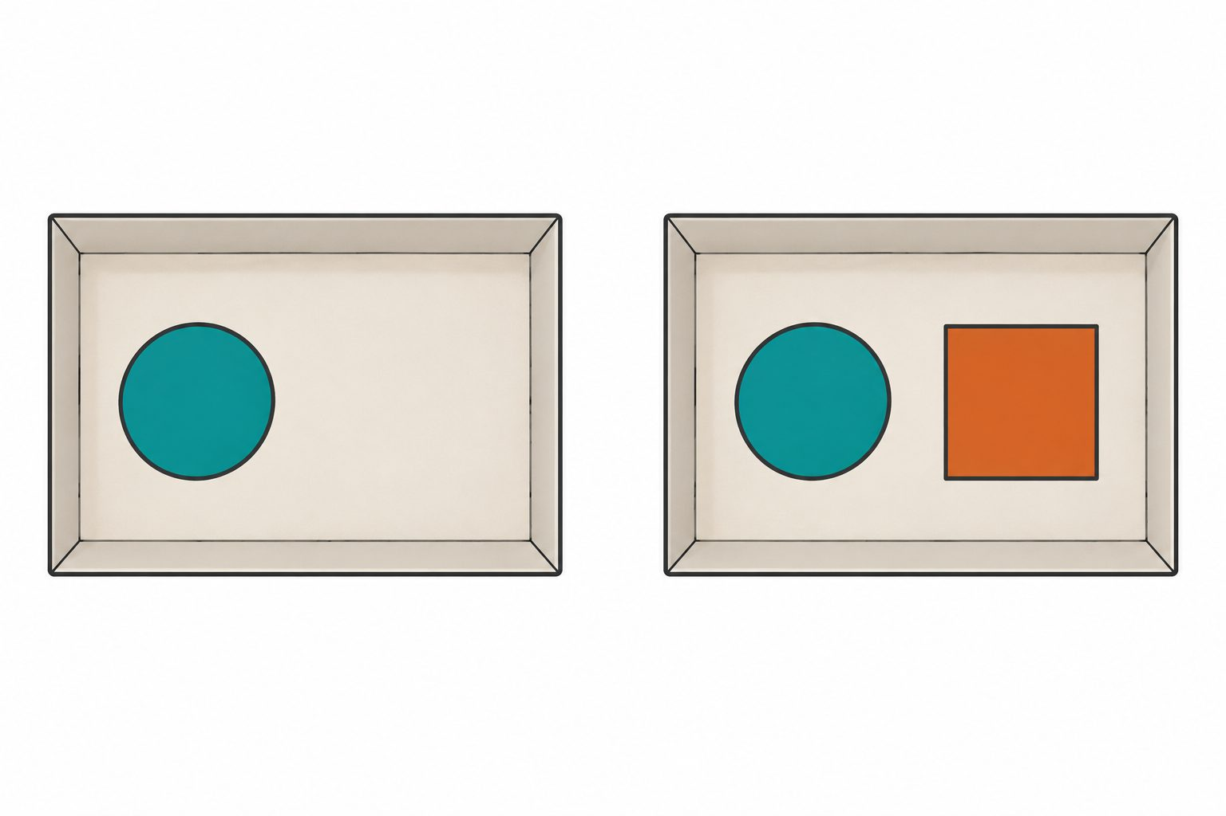
STARTER
3 / 12 · 3 min
The picture steps
This is a made-up packing task.
What is in the first tray?
What has changed in the next tray?
Which card must go in first?
CAREERS-BUILD-A2-W03
Public edition
Lesson resource · CC BY-NC-SA 4.0: free for classroom use, share and adapt with credit, no resale
Notes:
CAREERS-BUILD-A2-W03 · Year A · Week beginning 16 November 2026
Term theme: Identity & Belonging
Thread tags: SMSC S/So (M/C: none); British Values IL/MR (D/RL/T: none).
Starter: 3 minutes.
Teacher: Read the fictional task. Ask about the step or missing detail. Accept pointing, speech or an aid.
Routes: Supported: read the two picture cards together, choose which comes first, then carry out both steps with prompts recorded. Independent: order both picture cards, pack the set and compare it with the final picture. Aspire: check a separate mock pack with an extra or missing square, explain the error and correct it.
Evidence: Sequenced instructions, the completed task and an observation recording accuracy and prompts.
Careers: This helps me follow instructions and check my work.
Source: owner_orders/BUILD_Careers_Autumn2_YearA_outline; revision approved-2026-10-26.
The fictional illustration supports a paper rehearsal. Exact tasks and any fixed replies are in Support Cards and Staff Answers.
Week 7 is the assessing lesson.
Sources and limits: FACTS_LEDGER.md
Lesson resource · CC BY-NC-SA 4.0: free for classroom use, share and adapt with credit, no resale

Slide 4
TODAY
4 / 12
Today
Follow two work steps. Check the result.
Put the two step cards in order.
Pack the cards in the tray.
Check the pack and show any change.
CAREERS-BUILD-A2-W03
Public edition
Lesson resource · CC BY-NC-SA 4.0: free for classroom use, share and adapt with credit, no resale
Notes:
CAREERS-BUILD-A2-W03 · Year A · Week beginning 16 November 2026
Term theme: Identity & Belonging
Thread tags: SMSC S/So (M/C: none); British Values IL/MR (D/RL/T: none).
Today: 0 minutes.
Teacher: Read the approved objective and three success checks. Explain any new word with a concrete action.
Routes: Supported: read the two picture cards together, choose which comes first, then carry out both steps with prompts recorded. Independent: order both picture cards, pack the set and compare it with the final picture. Aspire: check a separate mock pack with an extra or missing square, explain the error and correct it.
Evidence: Sequenced instructions, the completed task and an observation recording accuracy and prompts.
Careers: This helps me follow instructions and check my work.
Source: owner_orders/BUILD_Careers_Autumn2_YearA_outline; revision approved-2026-10-26.
The fictional illustration supports a paper rehearsal. Exact tasks and any fixed replies are in Support Cards and Staff Answers.
Week 7 is the assessing lesson.
Sources and limits: FACTS_LEDGER.md
Lesson resource · CC BY-NC-SA 4.0: free for classroom use, share and adapt with credit, no resale

Slide 5
I DO
5 / 12 · 5 min
Watch the model
First, put one circle card in the tray.
Next, put one square next to the circle.
Now stop and check the pack.
There is one of each shape.
The cards are next to each other.
A spare square stays out of the tray.
First one circle. Next one square. Then check.
CAREERS-BUILD-A2-W03
Public edition
Lesson resource · CC BY-NC-SA 4.0: free for classroom use, share and adapt with credit, no resale
Notes:
CAREERS-BUILD-A2-W03 · Year A · Week beginning 16 November 2026
Term theme: Identity & Belonging
Thread tags: SMSC S/So (M/C: none); British Values IL/MR (D/RL/T: none).
I Do: 5 minutes.
Teacher: Model the six lines with a separate set. Week 3: show the two packing steps and check. Week 4: model a question, reply and action. Do not record an adult model as learner evidence.
Routes: Supported: read the two picture cards together, choose which comes first, then carry out both steps with prompts recorded. Independent: order both picture cards, pack the set and compare it with the final picture. Aspire: check a separate mock pack with an extra or missing square, explain the error and correct it.
Evidence: Sequenced instructions, the completed task and an observation recording accuracy and prompts.
Careers: This helps me follow instructions and check my work.
Source: owner_orders/BUILD_Careers_Autumn2_YearA_outline; revision approved-2026-10-26.
The fictional illustration supports a paper rehearsal. Exact tasks and any fixed replies are in Support Cards and Staff Answers.
Week 7 is the assessing lesson.
Sources and limits: FACTS_LEDGER.md
Lesson resource · CC BY-NC-SA 4.0: free for classroom use, share and adapt with credit, no resale

Slide 6
WE DO
6 / 12 · 5 min
Which next step
One circle is in the tray. What comes next?
A Put one square next to the circle.
B Put two squares in the tray.
C Leave out the square.
CAREERS-BUILD-A2-W03
Public edition
Lesson resource · CC BY-NC-SA 4.0: free for classroom use, share and adapt with credit, no resale
Notes:
CAREERS-BUILD-A2-W03 · Year A · Week beginning 16 November 2026
Term theme: Identity & Belonging
Thread tags: SMSC S/So (M/C: none); British Values IL/MR (D/RL/T: none).
We Do: 5 minutes.
Teacher: A follows the second instruction. B adds an extra square; C leaves the pack incomplete. A final correct pack alone does not prove the order of actions, so observe the steps as they happen. Reteach with the two picture cards: a circle must already be present before a square can go next to it.
Routes: Supported: read the two picture cards together, choose which comes first, then carry out both steps with prompts recorded. Independent: order both picture cards, pack the set and compare it with the final picture. Aspire: check a separate mock pack with an extra or missing square, explain the error and correct it.
Evidence: Sequenced instructions, the completed task and an observation recording accuracy and prompts.
Careers: This helps me follow instructions and check my work.
Source: owner_orders/BUILD_Careers_Autumn2_YearA_outline; revision approved-2026-10-26.
The fictional illustration supports a paper rehearsal. Exact tasks and any fixed replies are in Support Cards and Staff Answers.
Week 7 is the assessing lesson.
Sources and limits: FACTS_LEDGER.md
Lesson resource · CC BY-NC-SA 4.0: free for classroom use, share and adapt with credit, no resale

Slide 7
YOU DO PRACTICE
7 / 12 · 12 min
Try the task
Choose the help needed for this task.
Supported: order two cards with help.
Independent: order, pack and check.
Aspire: find and fix a pack error.
Keep the first try and any change.
CAREERS-BUILD-A2-W03
Public edition
Lesson resource · CC BY-NC-SA 4.0: free for classroom use, share and adapt with credit, no resale
Notes:
CAREERS-BUILD-A2-W03 · Year A · Week beginning 16 November 2026
Term theme: Identity & Belonging
Thread tags: SMSC S/So (M/C: none); British Values IL/MR (D/RL/T: none).
You Do practice: 12 minutes.
Teacher: Use four minutes to order the two picture cards and keep a record of the first choice. Use five minutes to carry out the two packing steps on the printed tray mat. Use three minutes to compare the pack with the picture, identify help used and correct an error if needed. For Aspire, use a separate mock pack with one extra or missing square.
Routes: Supported: read the two picture cards together, choose which comes first, then carry out both steps with prompts recorded. Independent: order both picture cards, pack the set and compare it with the final picture. Aspire: check a separate mock pack with an extra or missing square, explain the error and correct it.
Evidence: Sequenced instructions, the completed task and an observation recording accuracy and prompts.
Careers: This helps me follow instructions and check my work.
Source: owner_orders/BUILD_Careers_Autumn2_YearA_outline; revision approved-2026-10-26.
The fictional illustration supports a paper rehearsal. Exact tasks and any fixed replies are in Support Cards and Staff Answers.
Week 7 is the assessing lesson.
Sources and limits: FACTS_LEDGER.md
Lesson resource · CC BY-NC-SA 4.0: free for classroom use, share and adapt with credit, no resale

Slide 8
YOU DO EVIDENCE
8 / 12 · 6 min
My work
Keep the order of the two step cards.
Keep the packed set or its work record.
Show what the check found.
The adult notes the steps and the help.
CAREERS-BUILD-A2-W03
Public edition
Lesson resource · CC BY-NC-SA 4.0: free for classroom use, share and adapt with credit, no resale
Notes:
CAREERS-BUILD-A2-W03 · Year A · Week beginning 16 November 2026
Term theme: Identity & Belonging
Thread tags: SMSC S/So (M/C: none); British Values IL/MR (D/RL/T: none).
You Do evidence: 6 minutes.
Teacher: Capture each learner’s actual sequence or question, reply and action as applicable. Record prompts and changed responses separately. Do not infer learning from a group answer.
Routes: Supported: read the two picture cards together, choose which comes first, then carry out both steps with prompts recorded. Independent: order both picture cards, pack the set and compare it with the final picture. Aspire: check a separate mock pack with an extra or missing square, explain the error and correct it.
Evidence: Sequenced instructions, the completed task and an observation recording accuracy and prompts.
Careers: This helps me follow instructions and check my work.
Source: owner_orders/BUILD_Careers_Autumn2_YearA_outline; revision approved-2026-10-26.
The fictional illustration supports a paper rehearsal. Exact tasks and any fixed replies are in Support Cards and Staff Answers.
Week 7 is the assessing lesson.
Sources and limits: FACTS_LEDGER.md
Lesson resource · CC BY-NC-SA 4.0: free for classroom use, share and adapt with credit, no resale

Slide 9
TIDY AND EVIDENCE CHECK
9 / 12 · 4 min
Tidy and check
1
Check the code on both sheets.
2
Keep the work and note the help.
3
Put the cards away with care.
4
Tell the adult the next step.
CAREERS-BUILD-A2-W03
Public edition
Lesson resource · CC BY-NC-SA 4.0: free for classroom use, share and adapt with credit, no resale
Notes:
CAREERS-BUILD-A2-W03 · Year A · Week beginning 16 November 2026
Term theme: Identity & Belonging
Thread tags: SMSC S/So (M/C: none); British Values IL/MR (D/RL/T: none).
Tidy and evidence check: 4 minutes.
Teacher: Check learner IDs, actual work references and support. Store the evidence only when it exists; leave gaps visible.
Routes: Supported: read the two picture cards together, choose which comes first, then carry out both steps with prompts recorded. Independent: order both picture cards, pack the set and compare it with the final picture. Aspire: check a separate mock pack with an extra or missing square, explain the error and correct it.
Evidence: Sequenced instructions, the completed task and an observation recording accuracy and prompts.
Careers: This helps me follow instructions and check my work.
Source: owner_orders/BUILD_Careers_Autumn2_YearA_outline; revision approved-2026-10-26.
The fictional illustration supports a paper rehearsal. Exact tasks and any fixed replies are in Support Cards and Staff Answers.
Week 7 is the assessing lesson.
Sources and limits: FACTS_LEDGER.md
Lesson resource · CC BY-NC-SA 4.0: free for classroom use, share and adapt with credit, no resale

Slide 10
EXIT TICKET
10 / 12 · 2 min
Exit task
Which step came first?
What did the final check show?
What help was needed for the task?
CAREERS-BUILD-A2-W03
Public edition
Lesson resource · CC BY-NC-SA 4.0: free for classroom use, share and adapt with credit, no resale
Notes:
CAREERS-BUILD-A2-W03 · Year A · Week beginning 16 November 2026
Term theme: Identity & Belonging
Thread tags: SMSC S/So (M/C: none); British Values IL/MR (D/RL/T: none).
Exit ticket: 2 minutes.
Teacher: Take an individual exit response. Agree one next teaching step, without requiring public speaking.
Routes: Supported: read the two picture cards together, choose which comes first, then carry out both steps with prompts recorded. Independent: order both picture cards, pack the set and compare it with the final picture. Aspire: check a separate mock pack with an extra or missing square, explain the error and correct it.
Evidence: Sequenced instructions, the completed task and an observation recording accuracy and prompts.
Careers: This helps me follow instructions and check my work.
Source: owner_orders/BUILD_Careers_Autumn2_YearA_outline; revision approved-2026-10-26.
The fictional illustration supports a paper rehearsal. Exact tasks and any fixed replies are in Support Cards and Staff Answers.
Week 7 is the assessing lesson.
Sources and limits: FACTS_LEDGER.md
Lesson resource · CC BY-NC-SA 4.0: free for classroom use, share and adapt with credit, no resale

Slide 11
VOCABULARY
11 / 12
Words that help
Step: One part of a task.
Check: Look to see if the result is right.
First: The part that comes before the rest.
Tray: A space used to hold the cards.
Result: What is there when the task is done.
Next: The part that comes after this one.
Pack: Put the needed items in a set.
CAREERS-BUILD-A2-W03
Public edition
Lesson resource · CC BY-NC-SA 4.0: free for classroom use, share and adapt with credit, no resale
Notes:
CAREERS-BUILD-A2-W03 · Year A · Week beginning 16 November 2026
Term theme: Identity & Belonging
Thread tags: SMSC S/So (M/C: none); British Values IL/MR (D/RL/T: none).
Vocabulary: 0 minutes.
Teacher: Read and show each word with an action or concrete example. Keep the mat available.
Routes: Supported: read the two picture cards together, choose which comes first, then carry out both steps with prompts recorded. Independent: order both picture cards, pack the set and compare it with the final picture. Aspire: check a separate mock pack with an extra or missing square, explain the error and correct it.
Evidence: Sequenced instructions, the completed task and an observation recording accuracy and prompts.
Careers: This helps me follow instructions and check my work.
Source: owner_orders/BUILD_Careers_Autumn2_YearA_outline; revision approved-2026-10-26.
The fictional illustration supports a paper rehearsal. Exact tasks and any fixed replies are in Support Cards and Staff Answers.
Week 7 is the assessing lesson.
Sources and limits: FACTS_LEDGER.md
Lesson resource · CC BY-NC-SA 4.0: free for classroom use, share and adapt with credit, no resale

Slide 12
STAFF BRIEF
12 / 12
Staff brief
Read the planner and support route.
Use only fictional roles and settings.
Scribe exact words; record help.
Keep each learner’s own evidence.
Week 7 is the assessing lesson.
CAREERS-BUILD-A2-W03
Public edition
Lesson resource · CC BY-NC-SA 4.0: free for classroom use, share and adapt with credit, no resale
Notes:
CAREERS-BUILD-A2-W03 · Year A · Week beginning 16 November 2026
Term theme: Identity & Belonging
Thread tags: SMSC S/So (M/C: none); British Values IL/MR (D/RL/T: none).
Staff brief: 0 minutes.
Teacher: All worker profiles, job roles, employers and settings are fictional. Use only large paper cards and the supplied tray mats on a clear table. Adults prepare any cutting. No lifting, machinery, sharp tools or real workplace task is needed. Do not ask about body, family or private experiences. No names are required. Respect a pause or quiet response, with no forced partner work or public performance. A learner can query an unclear or unsafe instruction. Follow the setting’s safeguarding route if a concern is raised.
Routes: Supported: read the two picture cards together, choose which comes first, then carry out both steps with prompts recorded. Independent: order both picture cards, pack the set and compare it with the final picture. Aspire: check a separate mock pack with an extra or missing square, explain the error and correct it.
Evidence: Sequenced instructions, the completed task and an observation recording accuracy and prompts.
Careers: This helps me follow instructions and check my work.
Source: owner_orders/BUILD_Careers_Autumn2_YearA_outline; revision approved-2026-10-26.
The fictional illustration supports a paper rehearsal. Exact tasks and any fixed replies are in Support Cards and Staff Answers.
Week 7 is the assessing lesson.
Sources and limits: FACTS_LEDGER.md
Lesson resource · CC BY-NC-SA 4.0: free for classroom use, share and adapt with credit, no resale

