Slide 1
TITLE AND BIG QUESTION
1 / 12
My part in a team
Year A · Week 5 · 30 November–4 December 2026 · 40 minutes
A team has five cards. One sorts. One counts. One checks. How does each role help?
This helps me understand responsibility and working with others.
Term theme: Identity & Belonging
CAREERS-BUILD-A2-W05
Public edition
Lesson resource · CC BY-NC-SA 4.0: free for classroom use, share and adapt with credit, no resale
Notes:
CAREERS-BUILD-A2-W05 · Year A · Week beginning 30 November 2026
Term theme: Identity & Belonging
Thread tags: SMSC S/So (M/C: none); British Values IL/MR (D/RL/T: none).
Title and big question: 0 minutes.
Teacher: Read the big question and careers line. This is formative; Week 7 assesses.
Evidence: An individual role record, observed contribution and a short learner reflection.
Where this leads: This helps me understand responsibility and working with others.
Source: owner_orders/BUILD_Careers_Autumn2_YearA_outline, revision approved-2026-10-26. Tasks authored first-issue-2026-10-26.
Lesson resource · CC BY-NC-SA 4.0: free for classroom use, share and adapt with credit, no resale

Slide 2
ARRIVAL AND REGULATION
2 / 12 · 3 min
A calm start
Choose a calm place to sit.
Ask for a short pause if needed.
Keep the work space clear.
Ask for help with the words.
Use a point, a word or your aid.
Let each person have time.
CAREERS-BUILD-A2-W05
Public edition
Lesson resource · CC BY-NC-SA 4.0: free for classroom use, share and adapt with credit, no resale
Notes:
CAREERS-BUILD-A2-W05 · Year A · Week beginning 30 November 2026
Term theme: Identity & Belonging
Thread tags: SMSC S/So (M/C: none); British Values IL/MR (D/RL/T: none).
Arrival and regulation: 3 minutes.
Teacher: Offer response mode and pause. Avoid pressure to speak publicly.
Evidence: An individual role record, observed contribution and a short learner reflection.
Where this leads: This helps me understand responsibility and working with others.
Source: owner_orders/BUILD_Careers_Autumn2_YearA_outline, revision approved-2026-10-26. Tasks authored first-issue-2026-10-26.
Lesson resource · CC BY-NC-SA 4.0: free for classroom use, share and adapt with credit, no resale

Slide 3
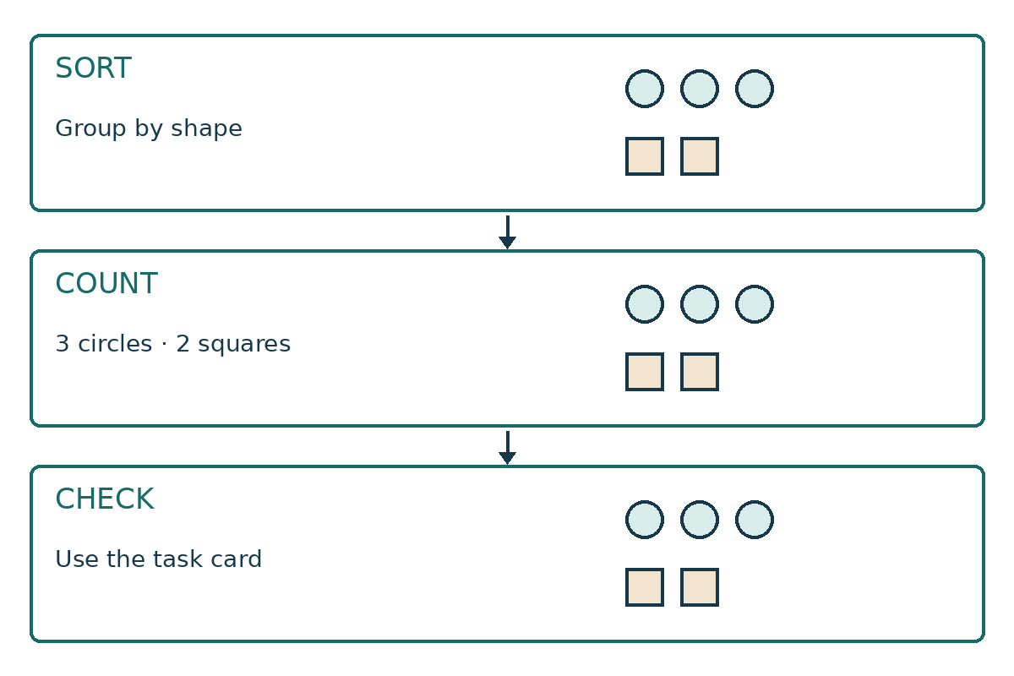
STARTER
3 / 12 · 3 min
One task three roles
This team must sort five cards.
One worker sorts the shapes.
One counts. One checks.
How does each role help?
CAREERS-BUILD-A2-W05
Public edition
Lesson resource · CC BY-NC-SA 4.0: free for classroom use, share and adapt with credit, no resale
Notes:
CAREERS-BUILD-A2-W05 · Year A · Week beginning 30 November 2026
Term theme: Identity & Belonging
Thread tags: SMSC S/So (M/C: none); British Values IL/MR (D/RL/T: none).
Starter: 3 minutes.
Teacher: Read the labelled model diagram. It is an authored teaching model, not learner evidence.
Evidence: An individual role record, observed contribution and a short learner reflection.
Where this leads: This helps me understand responsibility and working with others.
Source: owner_orders/BUILD_Careers_Autumn2_YearA_outline, revision approved-2026-10-26. Tasks authored first-issue-2026-10-26.
Lesson resource · CC BY-NC-SA 4.0: free for classroom use, share and adapt with credit, no resale

Slide 4
TODAY
4 / 12
Today
Do an agreed role. Show how it helps the team.
Choose and agree one role.
Do that part and pass the work on.
Show how that part helps the team.
CAREERS-BUILD-A2-W05
Public edition
Lesson resource · CC BY-NC-SA 4.0: free for classroom use, share and adapt with credit, no resale
Notes:
CAREERS-BUILD-A2-W05 · Year A · Week beginning 30 November 2026
Term theme: Identity & Belonging
Thread tags: SMSC S/So (M/C: none); British Values IL/MR (D/RL/T: none).
Today: 0 minutes.
Teacher: Read the approved objective in the planner and these short success checks.
Evidence: An individual role record, observed contribution and a short learner reflection.
Where this leads: This helps me understand responsibility and working with others.
Source: owner_orders/BUILD_Careers_Autumn2_YearA_outline, revision approved-2026-10-26. Tasks authored first-issue-2026-10-26.
Lesson resource · CC BY-NC-SA 4.0: free for classroom use, share and adapt with credit, no resale

Slide 5
I DO
5 / 12 · 5 min
Watch the model
The sorter puts each shape in a group.
They say: the shapes are sorted. Please count.
The counter finds three circles and two squares.
They say: please check these totals.
The checker uses the task card.
Each worker helps the next person.
Sort. Pass on. Count. Pass on. Check.
CAREERS-BUILD-A2-W05
Public edition
Lesson resource · CC BY-NC-SA 4.0: free for classroom use, share and adapt with credit, no resale
Notes:
CAREERS-BUILD-A2-W05 · Year A · Week beginning 30 November 2026
Term theme: Identity & Belonging
Thread tags: SMSC S/So (M/C: none); British Values IL/MR (D/RL/T: none).
I do: 5 minutes.
Teacher: The fictional sorter groups three circles and two squares. They say, “The cards are sorted by shape. Please count each group.” The counter counts each group and says, “Three circles and two squares. Please check the task card.” The checker compares both shape and number with the task card. The team needs three circles and two squares, all sorted by shape. Each worker can explain how their part helps the next person.
Evidence: An individual role record, observed contribution and a short learner reflection.
Where this leads: This helps me understand responsibility and working with others.
Source: owner_orders/BUILD_Careers_Autumn2_YearA_outline, revision approved-2026-10-26. Tasks authored first-issue-2026-10-26.
Lesson resource · CC BY-NC-SA 4.0: free for classroom use, share and adapt with credit, no resale

Slide 6
WE DO
6 / 12 · 5 min
Which handover helps
The sorter has done their part. What helps next?
A The shapes are sorted. Please count each group.
B Say nothing and leave the work.
C Take over the next worker’s role.
CAREERS-BUILD-A2-W05
Public edition
Lesson resource · CC BY-NC-SA 4.0: free for classroom use, share and adapt with credit, no resale
Notes:
CAREERS-BUILD-A2-W05 · Year A · Week beginning 30 November 2026
Term theme: Identity & Belonging
Thread tags: SMSC S/So (M/C: none); British Values IL/MR (D/RL/T: none).
We do: 5 minutes.
Teacher: A is the useful handover: it states what is done and what the next person needs to do. B leaves the next worker to guess; C takes over their role. If uncertain, show the role cards again and model a handover with a separate set. A clear point to the completed group and next role card can communicate the same message.
Evidence: An individual role record, observed contribution and a short learner reflection.
Where this leads: This helps me understand responsibility and working with others.
Source: owner_orders/BUILD_Careers_Autumn2_YearA_outline, revision approved-2026-10-26. Tasks authored first-issue-2026-10-26.
Lesson resource · CC BY-NC-SA 4.0: free for classroom use, share and adapt with credit, no resale

Slide 7
YOU DO PRACTICE
7 / 12 · 12 min
Try the task
Choose and agree a role.
Supported: do the role with a prompt or stem.
Independent: do the role and pass the work on.
Aspire: spot a gap in a new mock set.
Show how that role helped the team.
CAREERS-BUILD-A2-W05
Public edition
Lesson resource · CC BY-NC-SA 4.0: free for classroom use, share and adapt with credit, no resale
Notes:
CAREERS-BUILD-A2-W05 · Year A · Week beginning 30 November 2026
Term theme: Identity & Belonging
Thread tags: SMSC S/So (M/C: none); British Values IL/MR (D/RL/T: none).
You do practice: 12 minutes.
Teacher: Use two minutes to choose and agree roles. Use six minutes for the sort → count → check chain and clear handovers. Use four minutes to review each contribution and, if useful, retry after a specific prompt. The sorter groups the cards by shape; the counter reports each total; the checker compares the work with the task card. Keep the first attempt separate from any repair. An adult can take the other roles. Routes: Choose between two role cards with help. Carry out the agreed role, use a handover stem and point or say how it helped. Record each prompt. Agree a role, complete it and pass the work on with a clear message. Explain one way the contribution helped the team. Complete the agreed role, then inspect a separate mock set with one square missing. Explain what the next worker needs to know and suggest a clear repair.
Evidence: An individual role record, observed contribution and a short learner reflection.
Where this leads: This helps me understand responsibility and working with others.
Source: owner_orders/BUILD_Careers_Autumn2_YearA_outline, revision approved-2026-10-26. Tasks authored first-issue-2026-10-26.
Lesson resource · CC BY-NC-SA 4.0: free for classroom use, share and adapt with credit, no resale

Slide 8
YOU DO EVIDENCE
8 / 12 · 6 min
My part
Keep the role that was agreed.
Show what was done and passed on.
Show how that helped the next worker.
Keep the help used and any change.
CAREERS-BUILD-A2-W05
Public edition
Lesson resource · CC BY-NC-SA 4.0: free for classroom use, share and adapt with credit, no resale
Notes:
CAREERS-BUILD-A2-W05 · Year A · Week beginning 30 November 2026
Term theme: Identity & Belonging
Thread tags: SMSC S/So (M/C: none); British Values IL/MR (D/RL/T: none).
You do evidence: 6 minutes.
Teacher: For each learner, record the agreed role, their actual action and accuracy, the handover words or gesture, the recipient’s response and the learner’s explanation of how that action helped. Keep prompts and changes separate. A finished team set does not prove every person contributed. Observe each learner’s own role as it happens.
Evidence: An individual role record, observed contribution and a short learner reflection.
Where this leads: This helps me understand responsibility and working with others.
Source: owner_orders/BUILD_Careers_Autumn2_YearA_outline, revision approved-2026-10-26. Tasks authored first-issue-2026-10-26.
Lesson resource · CC BY-NC-SA 4.0: free for classroom use, share and adapt with credit, no resale

Slide 9
TIDY AND EVIDENCE CHECK
9 / 12 · 4 min
Tidy and check
1
Check the code on both sheets.
2
Keep the work and note the help.
3
Put the cards away with care.
4
Tell the adult the next step.
CAREERS-BUILD-A2-W05
Public edition
Lesson resource · CC BY-NC-SA 4.0: free for classroom use, share and adapt with credit, no resale
Notes:
CAREERS-BUILD-A2-W05 · Year A · Week beginning 30 November 2026
Term theme: Identity & Belonging
Thread tags: SMSC S/So (M/C: none); British Values IL/MR (D/RL/T: none).
Tidy and evidence check: 4 minutes.
Teacher: Check learner identifiers and work references before tidying. Do not bank blank forms.
Evidence: An individual role record, observed contribution and a short learner reflection.
Where this leads: This helps me understand responsibility and working with others.
Source: owner_orders/BUILD_Careers_Autumn2_YearA_outline, revision approved-2026-10-26. Tasks authored first-issue-2026-10-26.
Lesson resource · CC BY-NC-SA 4.0: free for classroom use, share and adapt with credit, no resale

Slide 10
EXIT TICKET
10 / 12 · 2 min
Exit task
What was the agreed role?
How did that part help the team?
What could make the next try clearer?
CAREERS-BUILD-A2-W05
Public edition
Lesson resource · CC BY-NC-SA 4.0: free for classroom use, share and adapt with credit, no resale
Notes:
CAREERS-BUILD-A2-W05 · Year A · Week beginning 30 November 2026
Term theme: Identity & Belonging
Thread tags: SMSC S/So (M/C: none); British Values IL/MR (D/RL/T: none).
Exit ticket: 2 minutes.
Teacher: Record an individual response. Use the question to identify a next teaching step.
Evidence: An individual role record, observed contribution and a short learner reflection.
Where this leads: This helps me understand responsibility and working with others.
Source: owner_orders/BUILD_Careers_Autumn2_YearA_outline, revision approved-2026-10-26. Tasks authored first-issue-2026-10-26.
Lesson resource · CC BY-NC-SA 4.0: free for classroom use, share and adapt with credit, no resale

Slide 11
VOCABULARY
11 / 12
Words that help
Role: One part of the work.
Check: Look to see if the work is right.
Team: People who work on a shared task.
Pass on: Give work and a clear note to the next person.
Sort: Put things into groups.
Help: Make a task easier to do.
Count: Find how many there are.
CAREERS-BUILD-A2-W05
Public edition
Lesson resource · CC BY-NC-SA 4.0: free for classroom use, share and adapt with credit, no resale
Notes:
CAREERS-BUILD-A2-W05 · Year A · Week beginning 30 November 2026
Term theme: Identity & Belonging
Thread tags: SMSC S/So (M/C: none); British Values IL/MR (D/RL/T: none).
Vocabulary: 0 minutes.
Teacher: Keep the vocabulary available. Read aloud or use usual communication aid.
Evidence: An individual role record, observed contribution and a short learner reflection.
Where this leads: This helps me understand responsibility and working with others.
Source: owner_orders/BUILD_Careers_Autumn2_YearA_outline, revision approved-2026-10-26. Tasks authored first-issue-2026-10-26.
Lesson resource · CC BY-NC-SA 4.0: free for classroom use, share and adapt with credit, no resale

Slide 12
STAFF BRIEF
12 / 12
Staff brief
Read the planner and support route.
Use only fictional roles and settings.
Scribe exact words; record help.
Keep each learner’s own evidence.
Week 7 is the assessing lesson.
CAREERS-BUILD-A2-W05
Public edition
Lesson resource · CC BY-NC-SA 4.0: free for classroom use, share and adapt with credit, no resale
Notes:
CAREERS-BUILD-A2-W05 · Year A · Week beginning 30 November 2026
Term theme: Identity & Belonging
Thread tags: SMSC S/So (M/C: none); British Values IL/MR (D/RL/T: none).
Staff brief: 0 minutes.
Teacher: Read the Planner and Staff Answers. For each team, print Support Cards pages 1–3. Adults cut the five large shape cards on page 2: three circles and two squares. Keep the sorting mat on page 3 whole. Use a separate set for the adult model. Each learner needs both evidence pages. Agree sort, count and check roles before starting; record who does each role. Use teams of two or three. An adult fills any unchosen role. For four learners, use two pairs with adult support. A learner may work with an adult instead of peers. Everyone completes a role; no learner is assessed only as an observer.
Evidence: An individual role record, observed contribution and a short learner reflection.
Where this leads: This helps me understand responsibility and working with others.
Source: owner_orders/BUILD_Careers_Autumn2_YearA_outline, revision approved-2026-10-26. Tasks authored first-issue-2026-10-26.
Lesson resource · CC BY-NC-SA 4.0: free for classroom use, share and adapt with credit, no resale

