Slide 1
TITLE AND BIG QUESTION
1 / 12
Feelings and body clues
Year A · Week 2 · 9–13 November 2026 · 40 minutes
What could help a young person who feels tense?
This helps me notice when I need a pause or support during a task.
Term theme: Identity & Belonging
RSHE-BUILD-A2-W02
Public edition
Lesson resource · CC BY-NC-SA 4.0: free for classroom use, share and adapt with credit, no resale
Notes:
RSHE-BUILD-A2-W02 · Year A · Week beginning 9 November 2026
Term theme: Identity & Belonging
Thread tags: SMSC S/M/So (C: none); British Values IL/MR (D/RL/T: none).
Title and big question: 0 minutes.
Teacher: Read the big question and approved careers line as a statement, not an invitation to personal disclosure.
Routes: Supported: work through two stories with two feeling and action choices at a time; read or scribe as needed. Independent: record two story responses, each with a possible feeling, a stated clue and a reason for a helpful response. Aspire: explain a second plausible response or why a clue cannot prove a feeling; add a further help step.
Evidence: Two scenario responses and a selected help or pause action, with reasoning and prompts recorded.
Careers: This helps me notice when I need a pause or support during a task.
Source: owner_orders/BUILD_RSHE_Autumn2_YearA_outline; revision approved-2026-10-26.
Fictional illustration supports the story; appearance is not proof of a feeling or a safe relationship.
Week 7 is the assessing lesson.
Sources and limits: FACTS_LEDGER.md
Lesson resource · CC BY-NC-SA 4.0: free for classroom use, share and adapt with credit, no resale

Slide 2
ARRIVAL AND REGULATION
2 / 12 · 3 min
A calm start
These stories are all made up.
No one needs to share a real story.
A young person can ask for a pause.
A young person can use an aid.
A young person can pass on a question.
Each person can have time.
RSHE-BUILD-A2-W02
Public edition
Lesson resource · CC BY-NC-SA 4.0: free for classroom use, share and adapt with credit, no resale
Notes:
RSHE-BUILD-A2-W02 · Year A · Week beginning 9 November 2026
Term theme: Identity & Belonging
Thread tags: SMSC S/M/So (C: none); British Values IL/MR (D/RL/T: none).
Arrival and regulation: 3 minutes.
Teacher: Read the fictional-case boundary. Offer a pass, quiet response and usual aid without asking why.
Routes: Supported: work through two stories with two feeling and action choices at a time; read or scribe as needed. Independent: record two story responses, each with a possible feeling, a stated clue and a reason for a helpful response. Aspire: explain a second plausible response or why a clue cannot prove a feeling; add a further help step.
Evidence: Two scenario responses and a selected help or pause action, with reasoning and prompts recorded.
Careers: This helps me notice when I need a pause or support during a task.
Source: owner_orders/BUILD_RSHE_Autumn2_YearA_outline; revision approved-2026-10-26.
Fictional illustration supports the story; appearance is not proof of a feeling or a safe relationship.
Week 7 is the assessing lesson.
Sources and limits: FACTS_LEDGER.md
Lesson resource · CC BY-NC-SA 4.0: free for classroom use, share and adapt with credit, no resale

Slide 3
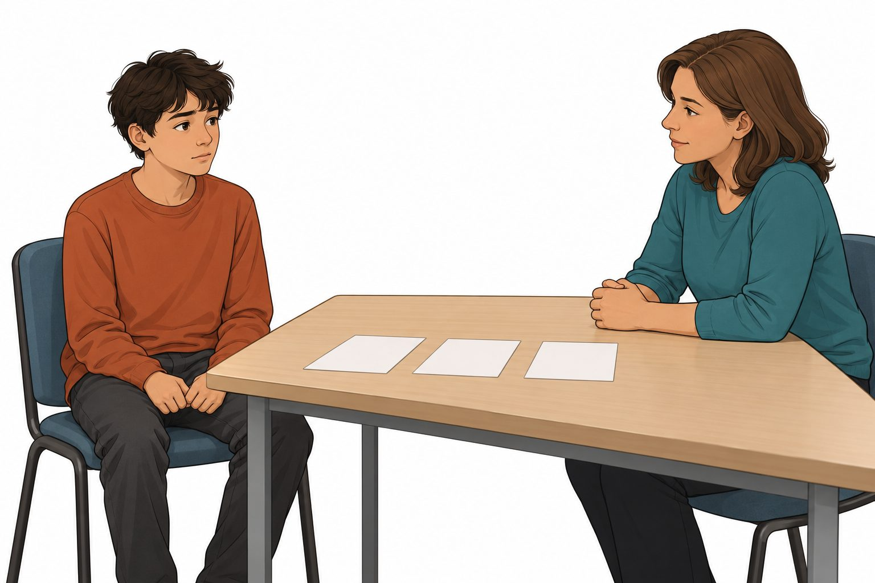
STARTER
3 / 12 · 3 min
The young person’s story
This is a made-up young person.
The story says their hands feel tight.
The task feels hard to start.
What could the person do next?
RSHE-BUILD-A2-W02
Public edition
Lesson resource · CC BY-NC-SA 4.0: free for classroom use, share and adapt with credit, no resale
Notes:
RSHE-BUILD-A2-W02 · Year A · Week beginning 9 November 2026
Term theme: Identity & Belonging
Thread tags: SMSC S/M/So (C: none); British Values IL/MR (D/RL/T: none).
Starter: 3 minutes.
Teacher: Read the story before interpreting the image. Ask about the stated action or clue, never the learner’s own life.
Routes: Supported: work through two stories with two feeling and action choices at a time; read or scribe as needed. Independent: record two story responses, each with a possible feeling, a stated clue and a reason for a helpful response. Aspire: explain a second plausible response or why a clue cannot prove a feeling; add a further help step.
Evidence: Two scenario responses and a selected help or pause action, with reasoning and prompts recorded.
Careers: This helps me notice when I need a pause or support during a task.
Source: owner_orders/BUILD_RSHE_Autumn2_YearA_outline; revision approved-2026-10-26.
Fictional illustration supports the story; appearance is not proof of a feeling or a safe relationship.
Week 7 is the assessing lesson.
Sources and limits: FACTS_LEDGER.md
Lesson resource · CC BY-NC-SA 4.0: free for classroom use, share and adapt with credit, no resale

Slide 4
TODAY
4 / 12
Today
Spot how a young person may feel. Choose a helpful act.
Match a clue to a made-up story.
Choose help or a pause for the person.
Give a reason from the story.
RSHE-BUILD-A2-W02
Public edition
Lesson resource · CC BY-NC-SA 4.0: free for classroom use, share and adapt with credit, no resale
Notes:
RSHE-BUILD-A2-W02 · Year A · Week beginning 9 November 2026
Term theme: Identity & Belonging
Thread tags: SMSC S/M/So (C: none); British Values IL/MR (D/RL/T: none).
Today: 0 minutes.
Teacher: Read the accessible objective and checks. Keep the exact approved objective in the Planner.
Routes: Supported: work through two stories with two feeling and action choices at a time; read or scribe as needed. Independent: record two story responses, each with a possible feeling, a stated clue and a reason for a helpful response. Aspire: explain a second plausible response or why a clue cannot prove a feeling; add a further help step.
Evidence: Two scenario responses and a selected help or pause action, with reasoning and prompts recorded.
Careers: This helps me notice when I need a pause or support during a task.
Source: owner_orders/BUILD_RSHE_Autumn2_YearA_outline; revision approved-2026-10-26.
Fictional illustration supports the story; appearance is not proof of a feeling or a safe relationship.
Week 7 is the assessing lesson.
Sources and limits: FACTS_LEDGER.md
Lesson resource · CC BY-NC-SA 4.0: free for classroom use, share and adapt with credit, no resale

Slide 5
I DO
5 / 12 · 5 min
A helpful response
A young person says the task feels hard.
Their hands feel tight in this story.
They may feel tense or unsure.
They could ask for a short pause.
Then an adult could show one step.
A clue does not prove how all people feel.
Use the story. A picture cannot prove a feeling.
RSHE-BUILD-A2-W02
Public edition
Lesson resource · CC BY-NC-SA 4.0: free for classroom use, share and adapt with credit, no resale
Notes:
RSHE-BUILD-A2-W02 · Year A · Week beginning 9 November 2026
Term theme: Identity & Belonging
Thread tags: SMSC S/M/So (C: none); British Values IL/MR (D/RL/T: none).
I Do: 5 minutes.
Teacher: Model only the fictional case using a separate set. The adult model is not learner evidence.
Routes: Supported: work through two stories with two feeling and action choices at a time; read or scribe as needed. Independent: record two story responses, each with a possible feeling, a stated clue and a reason for a helpful response. Aspire: explain a second plausible response or why a clue cannot prove a feeling; add a further help step.
Evidence: Two scenario responses and a selected help or pause action, with reasoning and prompts recorded.
Careers: This helps me notice when I need a pause or support during a task.
Source: owner_orders/BUILD_RSHE_Autumn2_YearA_outline; revision approved-2026-10-26.
Fictional illustration supports the story; appearance is not proof of a feeling or a safe relationship.
Week 7 is the assessing lesson.
Sources and limits: FACTS_LEDGER.md
Lesson resource · CC BY-NC-SA 4.0: free for classroom use, share and adapt with credit, no resale

Slide 6
WE DO
6 / 12 · 5 min
A choice for the young person
A young person says the task feels too much.
A Pause and ask a trusted adult for help.
B Keep going with no help at all.
C Guess their feeling from their face alone.
RSHE-BUILD-A2-W02
Public edition
Lesson resource · CC BY-NC-SA 4.0: free for classroom use, share and adapt with credit, no resale
Notes:
RSHE-BUILD-A2-W02 · Year A · Week beginning 9 November 2026
Term theme: Identity & Belonging
Thread tags: SMSC S/M/So (C: none); British Values IL/MR (D/RL/T: none).
We Do: 5 minutes.
Teacher: A is a helpful response to the stated difficulty. B ignores the request for support. C treats an appearance as proof. Tension, a warm face or a fast heartbeat can have different meanings. Do not diagnose or ask learners to check their own bodies. Reteach with the uncertain-instruction card: a question or step-by-step help can fit.
Routes: Supported: work through two stories with two feeling and action choices at a time; read or scribe as needed. Independent: record two story responses, each with a possible feeling, a stated clue and a reason for a helpful response. Aspire: explain a second plausible response or why a clue cannot prove a feeling; add a further help step.
Evidence: Two scenario responses and a selected help or pause action, with reasoning and prompts recorded.
Careers: This helps me notice when I need a pause or support during a task.
Source: owner_orders/BUILD_RSHE_Autumn2_YearA_outline; revision approved-2026-10-26.
Fictional illustration supports the story; appearance is not proof of a feeling or a safe relationship.
Week 7 is the assessing lesson.
Sources and limits: FACTS_LEDGER.md
Lesson resource · CC BY-NC-SA 4.0: free for classroom use, share and adapt with credit, no resale

Slide 7
YOU DO PRACTICE
7 / 12 · 12 min
The story task
The task is about the made-up young person.
Supported: use two choices for each story.
Independent: use two stories.
Aspire: give one more feeling.
Could the person pause, ask or get help?
RSHE-BUILD-A2-W02
Public edition
Lesson resource · CC BY-NC-SA 4.0: free for classroom use, share and adapt with credit, no resale
Notes:
RSHE-BUILD-A2-W02 · Year A · Week beginning 9 November 2026
Term theme: Identity & Belonging
Thread tags: SMSC S/M/So (C: none); British Values IL/MR (D/RL/T: none).
You Do practice: 12 minutes.
Teacher: Use four minutes to read two fictional stories and select feeling words and stated clues. Use five minutes to choose a helpful response for each, including a pause or help action. Use three minutes to give reasons and consider another plausible feeling or help route. All routes retain two separate story responses. A different reasonable feeling is accepted when linked to the story.
Routes: Supported: work through two stories with two feeling and action choices at a time; read or scribe as needed. Independent: record two story responses, each with a possible feeling, a stated clue and a reason for a helpful response. Aspire: explain a second plausible response or why a clue cannot prove a feeling; add a further help step.
Evidence: Two scenario responses and a selected help or pause action, with reasoning and prompts recorded.
Careers: This helps me notice when I need a pause or support during a task.
Source: owner_orders/BUILD_RSHE_Autumn2_YearA_outline; revision approved-2026-10-26.
Fictional illustration supports the story; appearance is not proof of a feeling or a safe relationship.
Week 7 is the assessing lesson.
Sources and limits: FACTS_LEDGER.md
Lesson resource · CC BY-NC-SA 4.0: free for classroom use, share and adapt with credit, no resale

Slide 8
YOU DO EVIDENCE
8 / 12 · 6 min
The story record
Keep a response for each of two stories.
Show the clue stated in each story.
Show a help or pause choice.
Keep the reason and any change.
RSHE-BUILD-A2-W02
Public edition
Lesson resource · CC BY-NC-SA 4.0: free for classroom use, share and adapt with credit, no resale
Notes:
RSHE-BUILD-A2-W02 · Year A · Week beginning 9 November 2026
Term theme: Identity & Belonging
Thread tags: SMSC S/M/So (C: none); British Values IL/MR (D/RL/T: none).
You Do evidence: 6 minutes.
Teacher: Record the actual case response, explanation and support. Do not infer understanding from a group answer.
Routes: Supported: work through two stories with two feeling and action choices at a time; read or scribe as needed. Independent: record two story responses, each with a possible feeling, a stated clue and a reason for a helpful response. Aspire: explain a second plausible response or why a clue cannot prove a feeling; add a further help step.
Evidence: Two scenario responses and a selected help or pause action, with reasoning and prompts recorded.
Careers: This helps me notice when I need a pause or support during a task.
Source: owner_orders/BUILD_RSHE_Autumn2_YearA_outline; revision approved-2026-10-26.
Fictional illustration supports the story; appearance is not proof of a feeling or a safe relationship.
Week 7 is the assessing lesson.
Sources and limits: FACTS_LEDGER.md
Lesson resource · CC BY-NC-SA 4.0: free for classroom use, share and adapt with credit, no resale

Slide 9
TIDY AND EVIDENCE CHECK
9 / 12 · 4 min
Tidy and check
1
Keep the work about the made-up person.
2
Keep each story and its response together.
3
The adult notes the help and any change.
4
Which next step could help the person?
RSHE-BUILD-A2-W02
Public edition
Lesson resource · CC BY-NC-SA 4.0: free for classroom use, share and adapt with credit, no resale
Notes:
RSHE-BUILD-A2-W02 · Year A · Week beginning 9 November 2026
Term theme: Identity & Belonging
Thread tags: SMSC S/M/So (C: none); British Values IL/MR (D/RL/T: none).
Tidy and evidence check: 4 minutes.
Teacher: Check the case references and learner ID. Keep prompts and changed responses distinct.
Routes: Supported: work through two stories with two feeling and action choices at a time; read or scribe as needed. Independent: record two story responses, each with a possible feeling, a stated clue and a reason for a helpful response. Aspire: explain a second plausible response or why a clue cannot prove a feeling; add a further help step.
Evidence: Two scenario responses and a selected help or pause action, with reasoning and prompts recorded.
Careers: This helps me notice when I need a pause or support during a task.
Source: owner_orders/BUILD_RSHE_Autumn2_YearA_outline; revision approved-2026-10-26.
Fictional illustration supports the story; appearance is not proof of a feeling or a safe relationship.
Week 7 is the assessing lesson.
Sources and limits: FACTS_LEDGER.md
Lesson resource · CC BY-NC-SA 4.0: free for classroom use, share and adapt with credit, no resale

Slide 10
EXIT TICKET
10 / 12 · 2 min
Exit task
What clue is stated in the story?
Which act could help the young person?
Could the clue have more than one meaning?
RSHE-BUILD-A2-W02
Public edition
Lesson resource · CC BY-NC-SA 4.0: free for classroom use, share and adapt with credit, no resale
Notes:
RSHE-BUILD-A2-W02 · Year A · Week beginning 9 November 2026
Term theme: Identity & Belonging
Thread tags: SMSC S/M/So (C: none); British Values IL/MR (D/RL/T: none).
Exit ticket: 2 minutes.
Teacher: Use the three questions about the fictional young person. Agree a next teaching step.
Routes: Supported: work through two stories with two feeling and action choices at a time; read or scribe as needed. Independent: record two story responses, each with a possible feeling, a stated clue and a reason for a helpful response. Aspire: explain a second plausible response or why a clue cannot prove a feeling; add a further help step.
Evidence: Two scenario responses and a selected help or pause action, with reasoning and prompts recorded.
Careers: This helps me notice when I need a pause or support during a task.
Source: owner_orders/BUILD_RSHE_Autumn2_YearA_outline; revision approved-2026-10-26.
Fictional illustration supports the story; appearance is not proof of a feeling or a safe relationship.
Week 7 is the assessing lesson.
Sources and limits: FACTS_LEDGER.md
Lesson resource · CC BY-NC-SA 4.0: free for classroom use, share and adapt with credit, no resale

Slide 11
VOCABULARY
11 / 12
Words that help
Feeling: How a person feels at a time.
Pause: Stop for a short time.
Clue: A sign that may help explain something.
Comfort: A sense of ease or feeling settled.
Help: Support with a need or task.
Calm: At ease or settled.
Tense: Not at ease; tight or on edge.
RSHE-BUILD-A2-W02
Public edition
Lesson resource · CC BY-NC-SA 4.0: free for classroom use, share and adapt with credit, no resale
Notes:
RSHE-BUILD-A2-W02 · Year A · Week beginning 9 November 2026
Term theme: Identity & Belonging
Thread tags: SMSC S/M/So (C: none); British Values IL/MR (D/RL/T: none).
Vocabulary: 0 minutes.
Teacher: Explain each word through the supplied fictional story. No personal examples or body checks.
Routes: Supported: work through two stories with two feeling and action choices at a time; read or scribe as needed. Independent: record two story responses, each with a possible feeling, a stated clue and a reason for a helpful response. Aspire: explain a second plausible response or why a clue cannot prove a feeling; add a further help step.
Evidence: Two scenario responses and a selected help or pause action, with reasoning and prompts recorded.
Careers: This helps me notice when I need a pause or support during a task.
Source: owner_orders/BUILD_RSHE_Autumn2_YearA_outline; revision approved-2026-10-26.
Fictional illustration supports the story; appearance is not proof of a feeling or a safe relationship.
Week 7 is the assessing lesson.
Sources and limits: FACTS_LEDGER.md
Lesson resource · CC BY-NC-SA 4.0: free for classroom use, share and adapt with credit, no resale

Slide 12
STAFF BRIEF
12 / 12
Staff brief
Read the planner and support route.
Use only fictional young people and settings.
Scribe exact words; record help.
Keep each learner’s own evidence.
Week 7 is the assessing lesson.
RSHE-BUILD-A2-W02
Public edition
Lesson resource · CC BY-NC-SA 4.0: free for classroom use, share and adapt with credit, no resale
Notes:
RSHE-BUILD-A2-W02 · Year A · Week beginning 9 November 2026
Term theme: Identity & Belonging
Thread tags: SMSC S/M/So (C: none); British Values IL/MR (D/RL/T: none).
Staff brief: 0 minutes.
Teacher: Every teaching prompt concerns a fictional young person. Never ask learners about their own bodies, families or experiences, or use a real person as the case. Read fictional cards without inviting comparison with home. No touching, body checking, forced eye contact, acting out distress or personal role-play. Allow a pass, quiet response or pause. If a learner raises a personal concern, follow the setting’s safeguarding procedure; do not turn the disclosure into lesson evidence. Staff use the setting’s agreed support arrangements.
Routes: Supported: work through two stories with two feeling and action choices at a time; read or scribe as needed. Independent: record two story responses, each with a possible feeling, a stated clue and a reason for a helpful response. Aspire: explain a second plausible response or why a clue cannot prove a feeling; add a further help step.
Evidence: Two scenario responses and a selected help or pause action, with reasoning and prompts recorded.
Careers: This helps me notice when I need a pause or support during a task.
Source: owner_orders/BUILD_RSHE_Autumn2_YearA_outline; revision approved-2026-10-26.
Fictional illustration supports the story; appearance is not proof of a feeling or a safe relationship.
Week 7 is the assessing lesson.
Sources and limits: FACTS_LEDGER.md
Lesson resource · CC BY-NC-SA 4.0: free for classroom use, share and adapt with credit, no resale

