Slide 1
Atlas skills and climate zones
GROW · Spring 2 Week 1 · Friday 26 February 2027 · P2
Use atlases and maps to locate climate zones and hazards.
Use an index and grid. Check the key.
Keep your own map in your book.
Point, write, type, speak in private or direct a scribe. You may pass.
Made by Matt
1

Slide 2
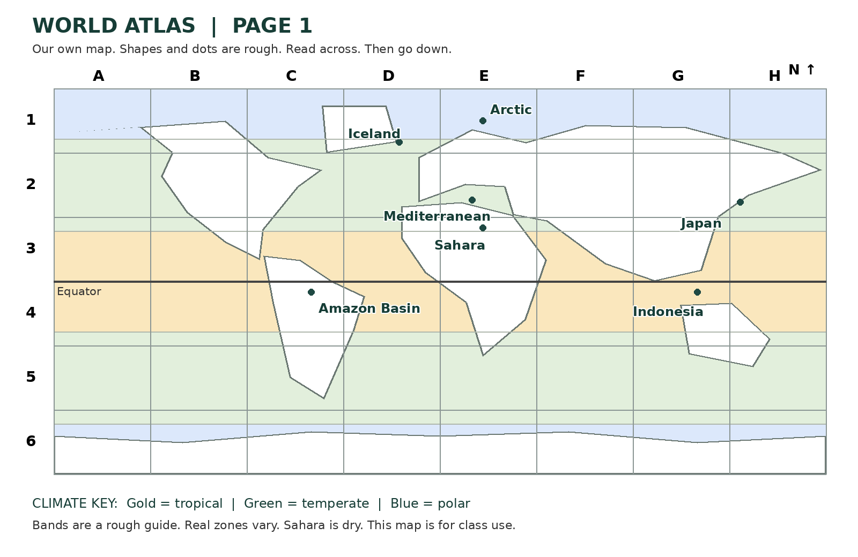
A map grid
Starter · 3 minutes
Find north. Find a letter across. Find a number down.
Made by Matt
2

Slide 3
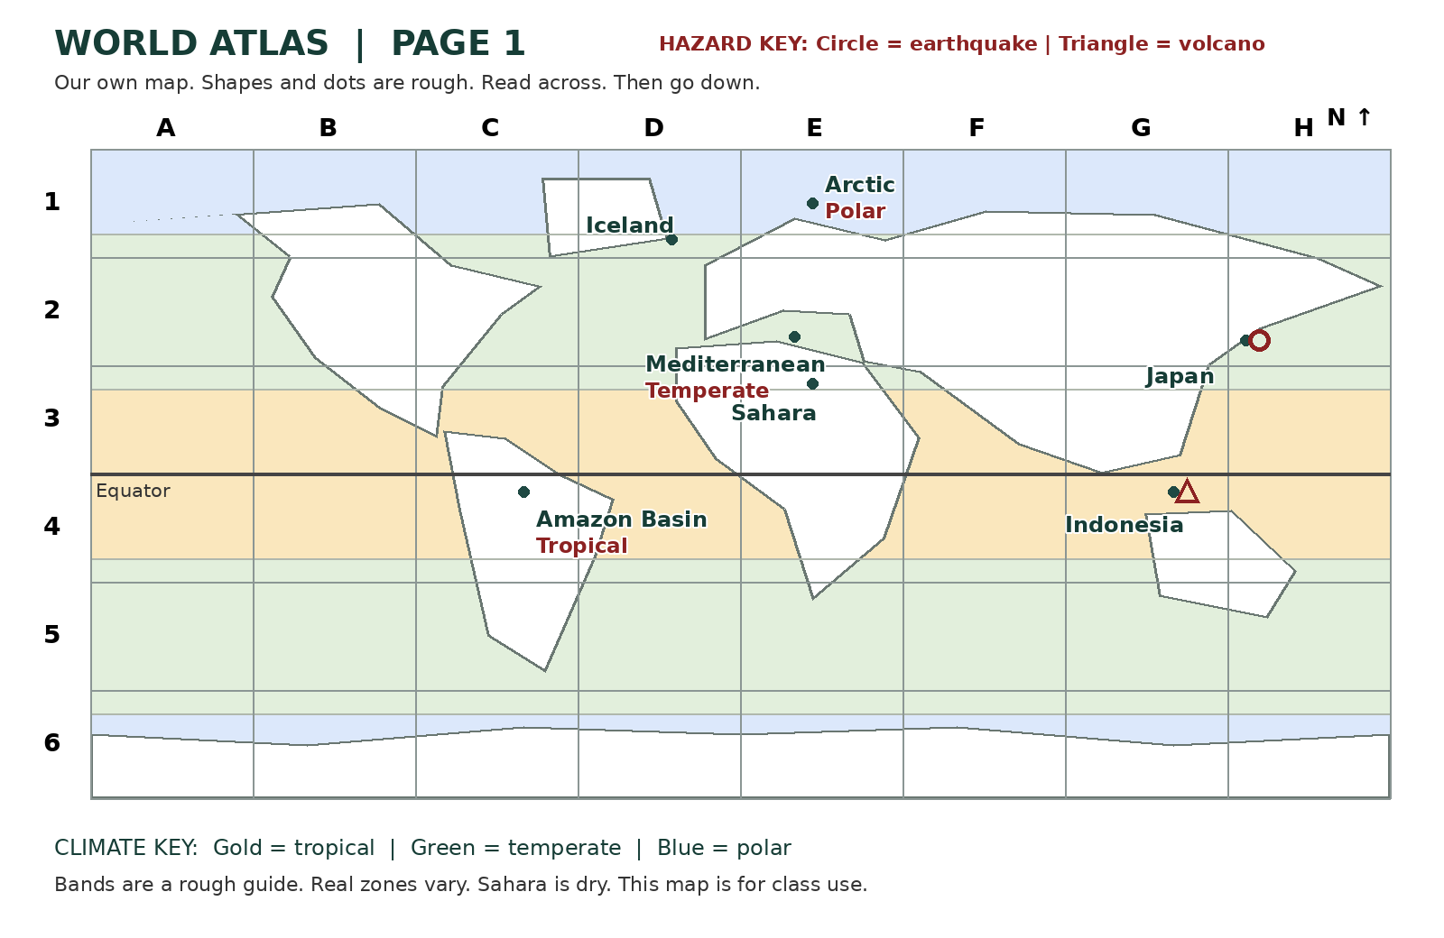
Japan in H2
I do · 5 minutes
Read Japan in the index.
Find H across.
Find row 2 down.
Circle means earthquake hazard.
Made by Matt
3
Notes:
Optional original captioned model: assets/Captioned_Model.mp4. Read the transcript if video is not available. Check E2 privately after the model. No public answer required.

Slide 4
Climate and hazard keys
We do · 7 minutes
Tropical: hot through the year.
Temperate: between tropical and polar.
Polar: very cold for much of the year.
Dry: very little rain.
Circle = earthquake hazard.
Triangle = volcano hazard.
Climate describes usual weather over many years.
Made by Matt
4
Notes:
Fact basis: Met Office Climate zones, checked 30 October 2026. Original wording. The three latitude belts are only a broad learning guide, not complete climate classification. Dry climates are a separate example. No website addresses or reproduced maps.

Slide 5
The atlas index
We do · 7 minutes
Place | Box | Clue
Amazon Basin | C4 | Tropical
Mediterranean | E2 | Temperate
Arctic | E1 | Polar
Japan | H2 | Earthquake
Indonesia | G4 | Volcano
Map Finder reads the place and box. Key Checker checks the clue. Swap each turn.
Made by Matt
5

Slide 6
Climate and earthquake cause
We do 2 · 5 minutes
Does a hot climate cause an earthquake?
A Yes
B No
Choose and give a reason in private or by pointing.
Made by Matt
6
Notes:
Correct B. Climate describes usual weather; plate movement causes earthquakes. If any learner conflates them, reteach then use parallel question: can cold Iceland have earthquakes? Yes, it is at a spreading plate boundary. US Geological Survey What is the Ring of Fire and This Dynamic Earth Understanding plate motions; checked 30 October 2026.

Slide 7
Your route
Independent work · 8 minutes
Supported
Use one card at a time. An adult may read. You choose each place.
Independent
Use the index and key to make and check your own map.
Aspire
Add Sahara dry climate E3 and both hazards for Iceland D1.
Made by Matt
7

Slide 8
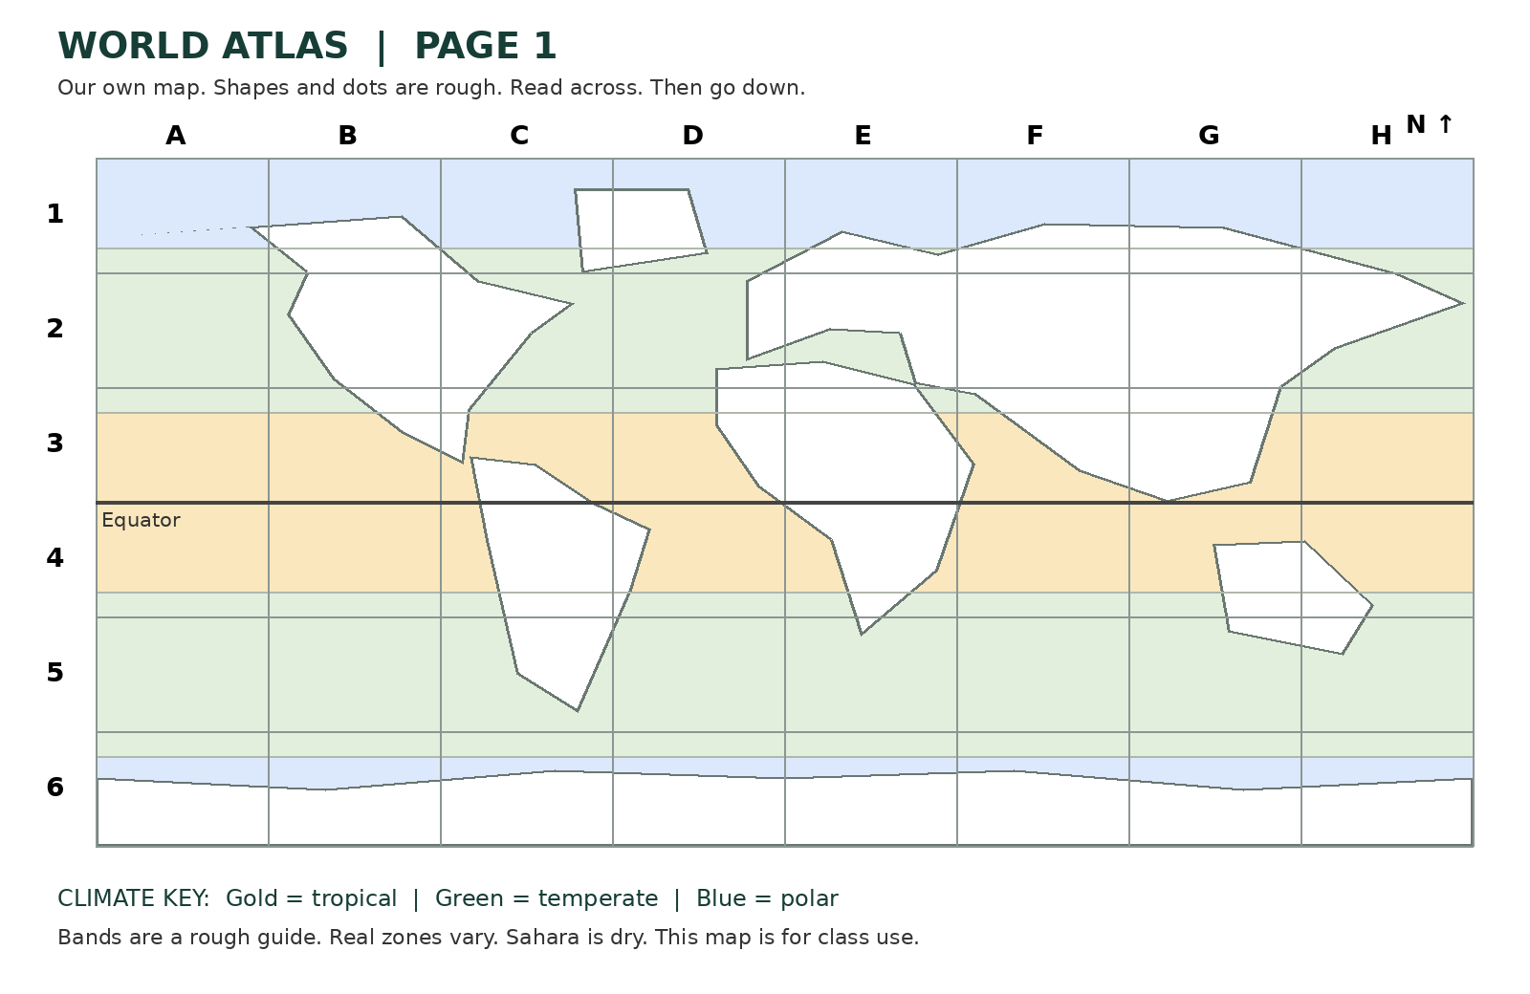
Your own map in your book
Independent work · 8 minutes
Add three climate labels.
Add a circle in Japan.
Add a triangle in Indonesia.
Make a key.
Check the index and grid.
Made by Matt
8

Slide 9
A grid and key explanation
Review · 4 minutes
I found ____ in box ____.
The key shows ____.
This place has ____.
Your audience gives one next step.
Respond in the same colour, on the same page or usual mode.
Made by Matt
9

Slide 10
One final map check
Exit · 3 minutes
Use the index to find Japan.
Check the key.
Show your own map in your book.
Ask for a quiet pause with the agreed signal.
Rejoin with one map check.
Made by Matt
10

Slide 11
Map check answers
Use after your own choices
Amazon C4 tropical · Mediterranean E2 temperate · Arctic E1 polar
Japan H2 circle · Indonesia G4 triangle
Made by Matt
11

Slide 12
Adult brief
Hidden staff slide
40 minutes: 5 + 3 + 5 + 7 + 5 + 8 + 4 + 3.
Private responses, pointing and exact directed scribing.
Model index, letter across, number down, then key.
Hinge B; parallel check cold Iceland can have earthquakes.
Record each pupil’s actual choices and help.
R after voice, audience reply, one NS and own response.
E after actual banking. Offer to the Communication portfolio.
Made by Matt
12
Notes:
Read Teacher_and_Cover_Plan and TA_Brief. Three brief resets sit within arrival, pair task and own task timings. No personal disaster accounts, graphic images, compulsory public reading or cold calling. The atlas is original and schematic with approximate points/outlines and correct indexed boxes for marked points; broad climate belts are not complete classification. Current owner order corroborated by GROW Weekly Spring row 46. Theme Resilience & Change. No later weeks built.

