Slide 1
Kit
This activity kit uses paper packs, card packs and fastener packs.
We compare the points needed for each item.
Notes:
Practice task with deliberate issues. The title is vague. Body text is size 22 and pale on white. Replace the title and use larger dark text. Facts: paper 12 points, card 10, fasteners 8. Keep the facts unchanged. No live talk is required.

Slide 2
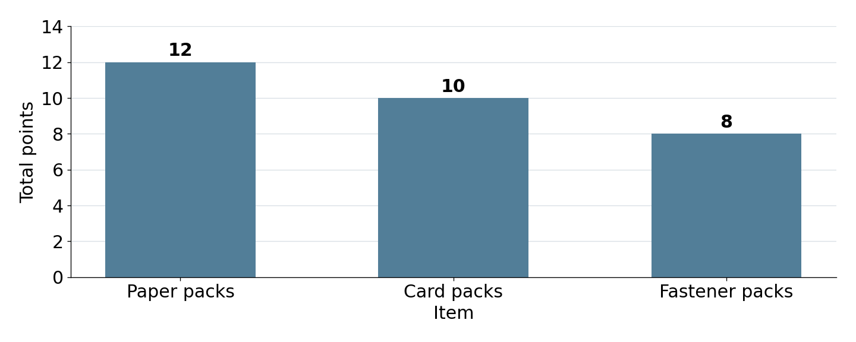
Points
Paper uses 2 more points than card.
Notes:
Practice task with deliberate issues. The title is vague. The chart image has no alternative text and precedes the title in object order. Give it a meaningful description and put the title first. Facts: paper 12 points, card 10, fasteners 8. Keep the facts unchanged. No live talk is required.

Slide 3
Checks
Easy to read.
Labels and words.
Check the file.
Notes:
Practice task with deliberate issues. The title and statements are too vague. Replace them with a clear title and a specific change with its reason. Facts: paper 12 points, card 10, fasteners 8. Keep the facts unchanged. No live talk is required.

