Slide 1

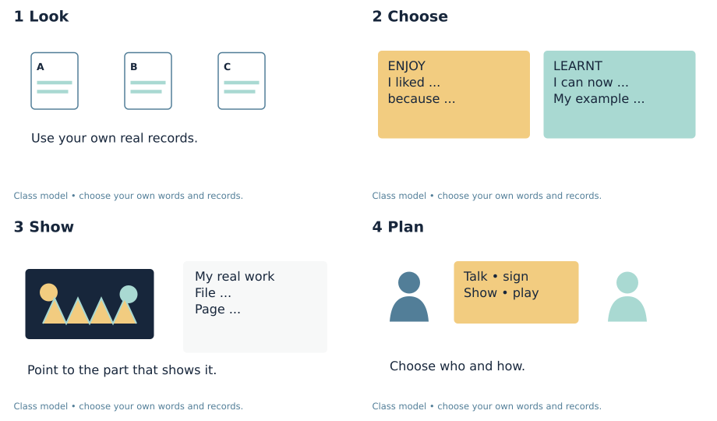
CREATIVE ARTS • BUILD / GROW • WEEK 7 LESSON 1
OPENING • PART D
Choose what you will share
I can choose what I enjoyed and what I learnt to do.
I can look back at my own art and records.
I can show one thing I liked and say why.
I can show one thing I learnt to do.
Choose your own enjoyment and one thing you learnt.
ART-BUILD-A2-W07-P1 • Public • 1/14
Original diagrams © Made by Matt 2026 • CC BY 4.0
Notes:
ART_BUILD_A2_W07_P1 • Public • Opening • 0 minutes (route detail slides use the same task time).
Part D is a personal account of enjoyment and achievement chosen by looking back at A–C. Keep both elements, pupil authorship, the example/file/page and intended audience/mode on D page 1. It is preparation, not proof of the actual December share. Mark absent B or C evidence as a gap in the Evidence Index; do not invent it. The actual sharing record belongs at D page 3 when it happens.
Use one route, with Independent as the GROW default. Offer Supported when useful and Aspire as optional stretch. All pupil text uses the BUILD band. The routes change support and depth, not the part requirements. For five learners, use a pair and a trio, with a separate piece and record for each learner. In the trio, rotate maker, observer and materials roles; every learner retains their own choices. Offer private responses, silent directing and a pause. Do not cold call or seek personal or family disclosure. Scribe exact words or confirmed choices, read them back and allow correction. Do not compose pupils’ plans or reviews. Mark I, S or C beside the task in staff records and note the actual prompt. Give one specific success and one useful next step. Use VF / WS / I / NS+ / // / ? / R / E as appropriate. Record R only after Voice, Audience, an NS+ prompt and the pupil’s response in their own colour; capture alone is not closure. Upload the selected individual evidence to the evidence app on the same day.
Evidence: D_Share.pdf • page 1
Sources: CREATIVE_ARTS_A2_W06_BUNDLE.zip @ fd164cc6f64b784eb570bf3c0180aa6911ff7a0b10db87b03301f88201196f05; tools/artsaward/SPEC.json @ 72f1a9914f877b7aa14fd9ed91b6103799bf7b16; tools/artsaward/SLOTS.json @ 72f1a9914f877b7aa14fd9ed91b6103799bf7b16

Slide 2
CREATIVE ARTS • BUILD / GROW • WEEK 7 LESSON 1
ARRIVAL • PART D • 5 MIN
What we bring from last time
Find your own art and records.
Show one thing you made or tried.
Which part did you like doing?
What can you do now that was hard before?
Choose your own enjoyment and one thing you learnt.
In your book: Four short answers or marks.
ART-BUILD-A2-W07-P1 • Public • 2/14
Original diagrams © Made by Matt 2026 • CC BY 4.0
Notes:
ART_BUILD_A2_W07_P1 • Public • Arrival • 5 minutes (route detail slides use the same task time).
Use the learner’s actual records; do not substitute class examples.
Any genuine activity or work. Keep A and C distinct.
Accept the learner’s own choice, including mixed feelings. No forced praise.
A real skill, choice or achievement. Supported participation is valid; ask for a specific example.
Part D is a personal account of enjoyment and achievement chosen by looking back at A–C. Keep both elements, pupil authorship, the example/file/page and intended audience/mode on D page 1. It is preparation, not proof of the actual December share. Mark absent B or C evidence as a gap in the Evidence Index; do not invent it. The actual sharing record belongs at D page 3 when it happens.
Use one route, with Independent as the GROW default. Offer Supported when useful and Aspire as optional stretch. All pupil text uses the BUILD band. The routes change support and depth, not the part requirements. For five learners, use a pair and a trio, with a separate piece and record for each learner. In the trio, rotate maker, observer and materials roles; every learner retains their own choices. Offer private responses, silent directing and a pause. Do not cold call or seek personal or family disclosure. Scribe exact words or confirmed choices, read them back and allow correction. Do not compose pupils’ plans or reviews. Mark I, S or C beside the task in staff records and note the actual prompt. Give one specific success and one useful next step. Use VF / WS / I / NS+ / // / ? / R / E as appropriate. Record R only after Voice, Audience, an NS+ prompt and the pupil’s response in their own colour; capture alone is not closure. Upload the selected individual evidence to the evidence app on the same day.
Evidence: D_Share.pdf • page 1
Sources: CREATIVE_ARTS_A2_W06_BUNDLE.zip @ fd164cc6f64b784eb570bf3c0180aa6911ff7a0b10db87b03301f88201196f05; tools/artsaward/SPEC.json @ 72f1a9914f877b7aa14fd9ed91b6103799bf7b16; tools/artsaward/SLOTS.json @ 72f1a9914f877b7aa14fd9ed91b6103799bf7b16

Slide 3
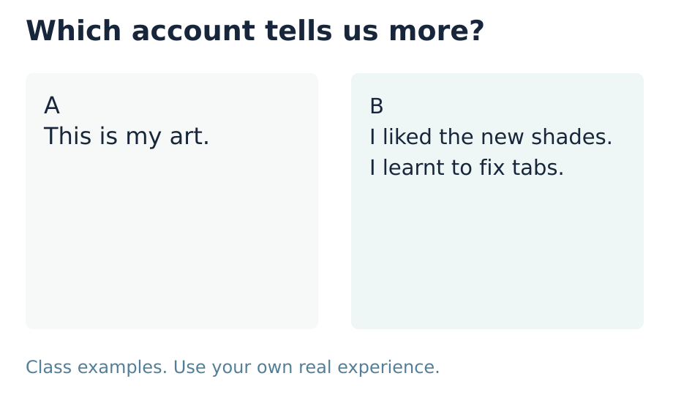
CREATIVE ARTS • BUILD / GROW • WEEK 7 LESSON 1
STARTER • PART D • 3 MIN
Look and choose
Which card tells us what the maker enjoyed and learnt? Choose A or B.
Choose your own enjoyment and one thing you learnt.
In your book: A or B, with the words that helped you choose.
ART-BUILD-A2-W07-P1 • Public • 3/14
Original diagrams © Made by Matt 2026 • CC BY 4.0
Notes:
ART_BUILD_A2_W07_P1 • Public • Starter • 3 minutes (route detail slides use the same task time).
B gives a personal reason for enjoyment and a specific learnt skill. A only names an object. B is a class example; each learner must choose their own account.
Part D is a personal account of enjoyment and achievement chosen by looking back at A–C. Keep both elements, pupil authorship, the example/file/page and intended audience/mode on D page 1. It is preparation, not proof of the actual December share. Mark absent B or C evidence as a gap in the Evidence Index; do not invent it. The actual sharing record belongs at D page 3 when it happens.
Use one route, with Independent as the GROW default. Offer Supported when useful and Aspire as optional stretch. All pupil text uses the BUILD band. The routes change support and depth, not the part requirements. For five learners, use a pair and a trio, with a separate piece and record for each learner. In the trio, rotate maker, observer and materials roles; every learner retains their own choices. Offer private responses, silent directing and a pause. Do not cold call or seek personal or family disclosure. Scribe exact words or confirmed choices, read them back and allow correction. Do not compose pupils’ plans or reviews. Mark I, S or C beside the task in staff records and note the actual prompt. Give one specific success and one useful next step. Use VF / WS / I / NS+ / // / ? / R / E as appropriate. Record R only after Voice, Audience, an NS+ prompt and the pupil’s response in their own colour; capture alone is not closure. Upload the selected individual evidence to the evidence app on the same day.
Evidence: D_Share.pdf • page 1
Sources: CREATIVE_ARTS_A2_W06_BUNDLE.zip @ fd164cc6f64b784eb570bf3c0180aa6911ff7a0b10db87b03301f88201196f05; tools/artsaward/SPEC.json @ 72f1a9914f877b7aa14fd9ed91b6103799bf7b16; tools/artsaward/SLOTS.json @ 72f1a9914f877b7aa14fd9ed91b6103799bf7b16

Slide 4
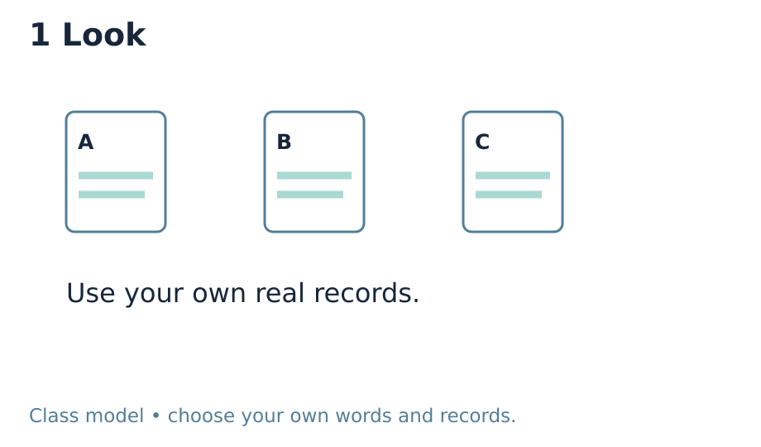
CREATIVE ARTS • BUILD / GROW • WEEK 7 LESSON 1
I DO • PART D • 2 MIN
Look and Choose
Look back at your own work and records.
Choose one thing you liked and one thing you learnt to do.
Choose your own enjoyment and one thing you learnt.
In your book: One real piece or record you chose.
ART-BUILD-A2-W07-P1 • Public • 4/14
Original diagrams © Made by Matt 2026 • CC BY 4.0
Notes:
ART_BUILD_A2_W07_P1 • Public • I do • 2 minutes (route detail slides use the same task time).
0–15 seconds Point to the labelled class model and three example records. Say: “I look back. I use what is here. A gap stays a gap.” This is a made-up teaching example, not learner evidence. 15–30 seconds Point to the colour sample. Say: “I enjoyed the colour test because I liked the new shades.” Place the ENJOY card beside it. 30–45 seconds Point to the folded paper sample. Say: “I learnt to fix the tabs so the folds stand up.” Place the LEARNT card beside the join. 45–60 seconds Point to the audience and response-mode cards. Say: “I could show my work and use these words with one trusted adult.” Leave the event date unfilled until confirmed.
Part D is a personal account of enjoyment and achievement chosen by looking back at A–C. Keep both elements, pupil authorship, the example/file/page and intended audience/mode on D page 1. It is preparation, not proof of the actual December share. Mark absent B or C evidence as a gap in the Evidence Index; do not invent it. The actual sharing record belongs at D page 3 when it happens.
Use one route, with Independent as the GROW default. Offer Supported when useful and Aspire as optional stretch. All pupil text uses the BUILD band. The routes change support and depth, not the part requirements. For five learners, use a pair and a trio, with a separate piece and record for each learner. In the trio, rotate maker, observer and materials roles; every learner retains their own choices. Offer private responses, silent directing and a pause. Do not cold call or seek personal or family disclosure. Scribe exact words or confirmed choices, read them back and allow correction. Do not compose pupils’ plans or reviews. Mark I, S or C beside the task in staff records and note the actual prompt. Give one specific success and one useful next step. Use VF / WS / I / NS+ / // / ? / R / E as appropriate. Record R only after Voice, Audience, an NS+ prompt and the pupil’s response in their own colour; capture alone is not closure. Upload the selected individual evidence to the evidence app on the same day.
Evidence: D_Share.pdf • page 1
Sources: CREATIVE_ARTS_A2_W06_BUNDLE.zip @ fd164cc6f64b784eb570bf3c0180aa6911ff7a0b10db87b03301f88201196f05; tools/artsaward/SPEC.json @ 72f1a9914f877b7aa14fd9ed91b6103799bf7b16; tools/artsaward/SLOTS.json @ 72f1a9914f877b7aa14fd9ed91b6103799bf7b16

Slide 5
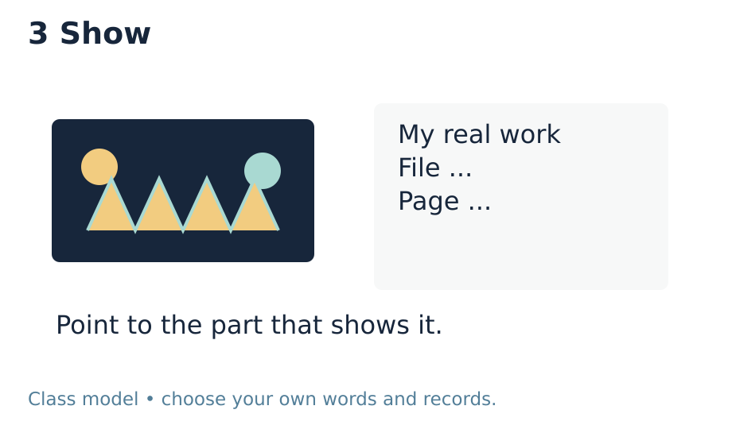
CREATIVE ARTS • BUILD / GROW • WEEK 7 LESSON 1
I DO • PART D • 2 MIN
Show and Plan
Find a real example to show each choice.
Choose who to share with and how to share.
Choose your own enjoyment and one thing you learnt.
In your book: One thing you liked and one thing you learnt.
ART-BUILD-A2-W07-P1 • Public • 5/14
Original diagrams © Made by Matt 2026 • CC BY 4.0
Notes:
ART_BUILD_A2_W07_P1 • Public • I do • 2 minutes (route detail slides use the same task time).
Part D is a personal account of enjoyment and achievement chosen by looking back at A–C. Keep both elements, pupil authorship, the example/file/page and intended audience/mode on D page 1. It is preparation, not proof of the actual December share. Mark absent B or C evidence as a gap in the Evidence Index; do not invent it. The actual sharing record belongs at D page 3 when it happens.
Use one route, with Independent as the GROW default. Offer Supported when useful and Aspire as optional stretch. All pupil text uses the BUILD band. The routes change support and depth, not the part requirements. For five learners, use a pair and a trio, with a separate piece and record for each learner. In the trio, rotate maker, observer and materials roles; every learner retains their own choices. Offer private responses, silent directing and a pause. Do not cold call or seek personal or family disclosure. Scribe exact words or confirmed choices, read them back and allow correction. Do not compose pupils’ plans or reviews. Mark I, S or C beside the task in staff records and note the actual prompt. Give one specific success and one useful next step. Use VF / WS / I / NS+ / // / ? / R / E as appropriate. Record R only after Voice, Audience, an NS+ prompt and the pupil’s response in their own colour; capture alone is not closure. Upload the selected individual evidence to the evidence app on the same day.
Evidence: D_Share.pdf • page 1
Sources: CREATIVE_ARTS_A2_W06_BUNDLE.zip @ fd164cc6f64b784eb570bf3c0180aa6911ff7a0b10db87b03301f88201196f05; tools/artsaward/SPEC.json @ 72f1a9914f877b7aa14fd9ed91b6103799bf7b16; tools/artsaward/SLOTS.json @ 72f1a9914f877b7aa14fd9ed91b6103799bf7b16

Slide 6
CREATIVE ARTS • BUILD / GROW • WEEK 7 LESSON 1
I DO • PART D • 2 MIN
Words to use
enjoy — To like what you do.
achieve — To learn or do a new thing through your own work.
audience — The people who see or hear your share.
evidence — A record of what you did or learnt.
Choose your own enjoyment and one thing you learnt.
In your book: One word with a sketch or example.
ART-BUILD-A2-W07-P1 • Public • 6/14
Original diagrams © Made by Matt 2026 • CC BY 4.0
Notes:
ART_BUILD_A2_W07_P1 • Public • I do • 2 minutes (route detail slides use the same task time).
Part D is a personal account of enjoyment and achievement chosen by looking back at A–C. Keep both elements, pupil authorship, the example/file/page and intended audience/mode on D page 1. It is preparation, not proof of the actual December share. Mark absent B or C evidence as a gap in the Evidence Index; do not invent it. The actual sharing record belongs at D page 3 when it happens.
Use one route, with Independent as the GROW default. Offer Supported when useful and Aspire as optional stretch. All pupil text uses the BUILD band. The routes change support and depth, not the part requirements. For five learners, use a pair and a trio, with a separate piece and record for each learner. In the trio, rotate maker, observer and materials roles; every learner retains their own choices. Offer private responses, silent directing and a pause. Do not cold call or seek personal or family disclosure. Scribe exact words or confirmed choices, read them back and allow correction. Do not compose pupils’ plans or reviews. Mark I, S or C beside the task in staff records and note the actual prompt. Give one specific success and one useful next step. Use VF / WS / I / NS+ / // / ? / R / E as appropriate. Record R only after Voice, Audience, an NS+ prompt and the pupil’s response in their own colour; capture alone is not closure. Upload the selected individual evidence to the evidence app on the same day.
Evidence: D_Share.pdf • page 1
Sources: CREATIVE_ARTS_A2_W06_BUNDLE.zip @ fd164cc6f64b784eb570bf3c0180aa6911ff7a0b10db87b03301f88201196f05; tools/artsaward/SPEC.json @ 72f1a9914f877b7aa14fd9ed91b6103799bf7b16; tools/artsaward/SLOTS.json @ 72f1a9914f877b7aa14fd9ed91b6103799bf7b16

Slide 7
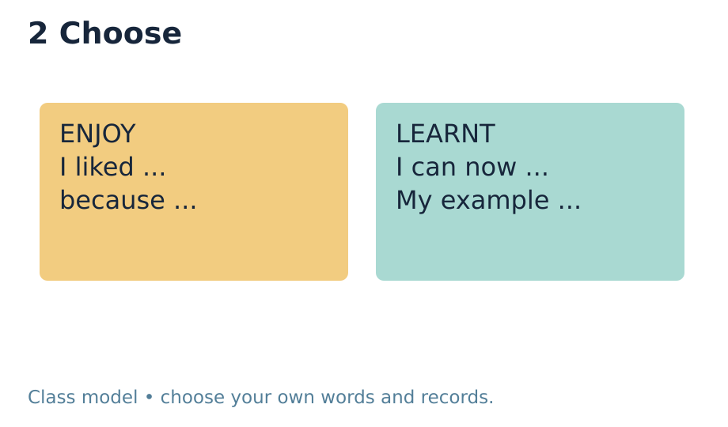
CREATIVE ARTS • BUILD / GROW • WEEK 7 LESSON 1
WE DO • PART D • 4 MIN
Try it together
We point to what the model maker liked.
We find the reason in the model’s words.
Choose your own enjoyment and one thing you learnt.
In your book: The model’s own reason.
ART-BUILD-A2-W07-P1 • Public • 7/14
Original diagrams © Made by Matt 2026 • CC BY 4.0
Notes:
ART_BUILD_A2_W07_P1 • Public • We do • 4 minutes (route detail slides use the same task time).
Part D is a personal account of enjoyment and achievement chosen by looking back at A–C. Keep both elements, pupil authorship, the example/file/page and intended audience/mode on D page 1. It is preparation, not proof of the actual December share. Mark absent B or C evidence as a gap in the Evidence Index; do not invent it. The actual sharing record belongs at D page 3 when it happens.
Use one route, with Independent as the GROW default. Offer Supported when useful and Aspire as optional stretch. All pupil text uses the BUILD band. The routes change support and depth, not the part requirements. For five learners, use a pair and a trio, with a separate piece and record for each learner. In the trio, rotate maker, observer and materials roles; every learner retains their own choices. Offer private responses, silent directing and a pause. Do not cold call or seek personal or family disclosure. Scribe exact words or confirmed choices, read them back and allow correction. Do not compose pupils’ plans or reviews. Mark I, S or C beside the task in staff records and note the actual prompt. Give one specific success and one useful next step. Use VF / WS / I / NS+ / // / ? / R / E as appropriate. Record R only after Voice, Audience, an NS+ prompt and the pupil’s response in their own colour; capture alone is not closure. Upload the selected individual evidence to the evidence app on the same day.
Evidence: D_Share.pdf • page 1
Sources: CREATIVE_ARTS_A2_W06_BUNDLE.zip @ fd164cc6f64b784eb570bf3c0180aa6911ff7a0b10db87b03301f88201196f05; tools/artsaward/SPEC.json @ 72f1a9914f877b7aa14fd9ed91b6103799bf7b16; tools/artsaward/SLOTS.json @ 72f1a9914f877b7aa14fd9ed91b6103799bf7b16

Slide 8
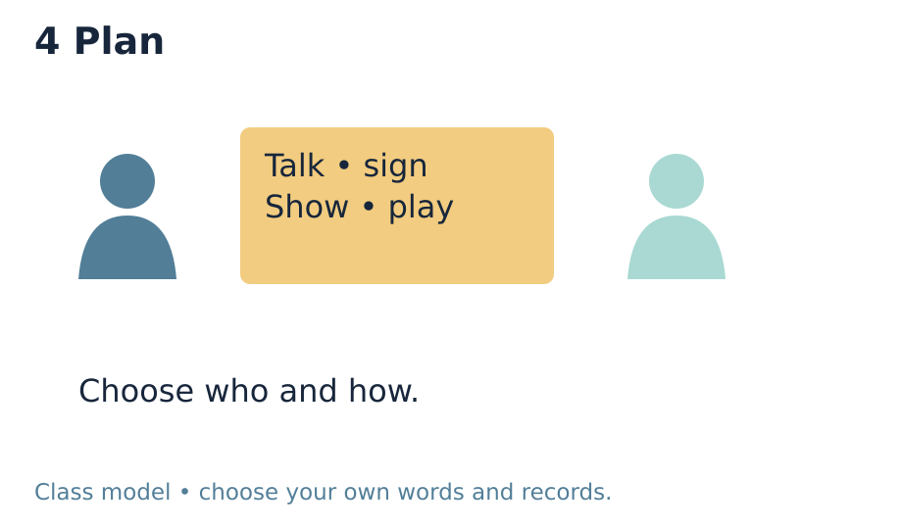
CREATIVE ARTS • BUILD / GROW • WEEK 7 LESSON 1
WE DO • PART D • 4 MIN
One check and one choice
We point to a skill the model maker learnt.
We find the work that shows it.
Choose your own enjoyment and one thing you learnt.
In your book: A real example to match the claim.
ART-BUILD-A2-W07-P1 • Public • 8/14
Original diagrams © Made by Matt 2026 • CC BY 4.0
Notes:
ART_BUILD_A2_W07_P1 • Public • We do • 4 minutes (route detail slides use the same task time).
The class model liked mixing shades and learnt to fix the tabs. Link each statement to the labelled sample. Pupils can prefer other aspects of their own work.
Part D is a personal account of enjoyment and achievement chosen by looking back at A–C. Keep both elements, pupil authorship, the example/file/page and intended audience/mode on D page 1. It is preparation, not proof of the actual December share. Mark absent B or C evidence as a gap in the Evidence Index; do not invent it. The actual sharing record belongs at D page 3 when it happens.
Use one route, with Independent as the GROW default. Offer Supported when useful and Aspire as optional stretch. All pupil text uses the BUILD band. The routes change support and depth, not the part requirements. For five learners, use a pair and a trio, with a separate piece and record for each learner. In the trio, rotate maker, observer and materials roles; every learner retains their own choices. Offer private responses, silent directing and a pause. Do not cold call or seek personal or family disclosure. Scribe exact words or confirmed choices, read them back and allow correction. Do not compose pupils’ plans or reviews. Mark I, S or C beside the task in staff records and note the actual prompt. Give one specific success and one useful next step. Use VF / WS / I / NS+ / // / ? / R / E as appropriate. Record R only after Voice, Audience, an NS+ prompt and the pupil’s response in their own colour; capture alone is not closure. Upload the selected individual evidence to the evidence app on the same day.
Evidence: D_Share.pdf • page 1
Sources: CREATIVE_ARTS_A2_W06_BUNDLE.zip @ fd164cc6f64b784eb570bf3c0180aa6911ff7a0b10db87b03301f88201196f05; tools/artsaward/SPEC.json @ 72f1a9914f877b7aa14fd9ed91b6103799bf7b16; tools/artsaward/SLOTS.json @ 72f1a9914f877b7aa14fd9ed91b6103799bf7b16

Slide 9
CREATIVE ARTS • BUILD / GROW • WEEK 7 LESSON 1
YOU DO • PART D • 15 MIN
Choose one route
Supported: use the steps with help.
Independent: make your own choices.
Aspire: add depth to your review or plan.
Use one route. Keep your own record.
Choose your own enjoyment and one thing you learnt.
In your book: Your own choices and plan for the share.
ART-BUILD-A2-W07-P1 • Public • 9/14
Original diagrams © Made by Matt 2026 • CC BY 4.0
Notes:
ART_BUILD_A2_W07_P1 • Public • You do • 15 minutes (route detail slides use the same task time).
Part D is a personal account of enjoyment and achievement chosen by looking back at A–C. Keep both elements, pupil authorship, the example/file/page and intended audience/mode on D page 1. It is preparation, not proof of the actual December share. Mark absent B or C evidence as a gap in the Evidence Index; do not invent it. The actual sharing record belongs at D page 3 when it happens.
Use one route, with Independent as the GROW default. Offer Supported when useful and Aspire as optional stretch. All pupil text uses the BUILD band. The routes change support and depth, not the part requirements. For five learners, use a pair and a trio, with a separate piece and record for each learner. In the trio, rotate maker, observer and materials roles; every learner retains their own choices. Offer private responses, silent directing and a pause. Do not cold call or seek personal or family disclosure. Scribe exact words or confirmed choices, read them back and allow correction. Do not compose pupils’ plans or reviews. Mark I, S or C beside the task in staff records and note the actual prompt. Give one specific success and one useful next step. Use VF / WS / I / NS+ / // / ? / R / E as appropriate. Record R only after Voice, Audience, an NS+ prompt and the pupil’s response in their own colour; capture alone is not closure. Upload the selected individual evidence to the evidence app on the same day.
Evidence: D_Share.pdf • page 1
Sources: CREATIVE_ARTS_A2_W06_BUNDLE.zip @ fd164cc6f64b784eb570bf3c0180aa6911ff7a0b10db87b03301f88201196f05; tools/artsaward/SPEC.json @ 72f1a9914f877b7aa14fd9ed91b6103799bf7b16; tools/artsaward/SLOTS.json @ 72f1a9914f877b7aa14fd9ed91b6103799bf7b16

Slide 10
CREATIVE ARTS • BUILD / GROW • WEEK 7 LESSON 1
YOU DO • PART D
Supported
Look at two real pieces with help.
Point to one thing you liked. Say or show why.
Point to one thing you learnt to do.
Use a prompt card to show your own choice.
Choose a way to share with someone you trust.
Choose your own enjoyment and one thing you learnt.
In your book: Your own choices and plan for the share.
ART-BUILD-A2-W07-P1 • Public • 10/14
Original diagrams © Made by Matt 2026 • CC BY 4.0
Notes:
ART_BUILD_A2_W07_P1 • Public • You do • 0 minutes (route detail slides use the same task time).
Part D is a personal account of enjoyment and achievement chosen by looking back at A–C. Keep both elements, pupil authorship, the example/file/page and intended audience/mode on D page 1. It is preparation, not proof of the actual December share. Mark absent B or C evidence as a gap in the Evidence Index; do not invent it. The actual sharing record belongs at D page 3 when it happens.
Use one route, with Independent as the GROW default. Offer Supported when useful and Aspire as optional stretch. All pupil text uses the BUILD band. The routes change support and depth, not the part requirements. For five learners, use a pair and a trio, with a separate piece and record for each learner. In the trio, rotate maker, observer and materials roles; every learner retains their own choices. Offer private responses, silent directing and a pause. Do not cold call or seek personal or family disclosure. Scribe exact words or confirmed choices, read them back and allow correction. Do not compose pupils’ plans or reviews. Mark I, S or C beside the task in staff records and note the actual prompt. Give one specific success and one useful next step. Use VF / WS / I / NS+ / // / ? / R / E as appropriate. Record R only after Voice, Audience, an NS+ prompt and the pupil’s response in their own colour; capture alone is not closure. Upload the selected individual evidence to the evidence app on the same day.
Evidence: D_Share.pdf • page 1
Sources: CREATIVE_ARTS_A2_W06_BUNDLE.zip @ fd164cc6f64b784eb570bf3c0180aa6911ff7a0b10db87b03301f88201196f05; tools/artsaward/SPEC.json @ 72f1a9914f877b7aa14fd9ed91b6103799bf7b16; tools/artsaward/SLOTS.json @ 72f1a9914f877b7aa14fd9ed91b6103799bf7b16

Slide 11
CREATIVE ARTS • BUILD / GROW • WEEK 7 LESSON 1
YOU DO • PART D
Independent
Look back at your own A, B and C records.
Choose one thing you enjoyed and say why.
Choose one thing you learnt or did well.
Link both choices to work you can show.
Plan who to share with and how.
Choose your own enjoyment and one thing you learnt.
In your book: Your own choices and plan for the share.
ART-BUILD-A2-W07-P1 • Public • 11/14
Original diagrams © Made by Matt 2026 • CC BY 4.0
Notes:
ART_BUILD_A2_W07_P1 • Public • You do • 0 minutes (route detail slides use the same task time).
Part D is a personal account of enjoyment and achievement chosen by looking back at A–C. Keep both elements, pupil authorship, the example/file/page and intended audience/mode on D page 1. It is preparation, not proof of the actual December share. Mark absent B or C evidence as a gap in the Evidence Index; do not invent it. The actual sharing record belongs at D page 3 when it happens.
Use one route, with Independent as the GROW default. Offer Supported when useful and Aspire as optional stretch. All pupil text uses the BUILD band. The routes change support and depth, not the part requirements. For five learners, use a pair and a trio, with a separate piece and record for each learner. In the trio, rotate maker, observer and materials roles; every learner retains their own choices. Offer private responses, silent directing and a pause. Do not cold call or seek personal or family disclosure. Scribe exact words or confirmed choices, read them back and allow correction. Do not compose pupils’ plans or reviews. Mark I, S or C beside the task in staff records and note the actual prompt. Give one specific success and one useful next step. Use VF / WS / I / NS+ / // / ? / R / E as appropriate. Record R only after Voice, Audience, an NS+ prompt and the pupil’s response in their own colour; capture alone is not closure. Upload the selected individual evidence to the evidence app on the same day.
Evidence: D_Share.pdf • page 1
Sources: CREATIVE_ARTS_A2_W06_BUNDLE.zip @ fd164cc6f64b784eb570bf3c0180aa6911ff7a0b10db87b03301f88201196f05; tools/artsaward/SPEC.json @ 72f1a9914f877b7aa14fd9ed91b6103799bf7b16; tools/artsaward/SLOTS.json @ 72f1a9914f877b7aa14fd9ed91b6103799bf7b16

Slide 12
CREATIVE ARTS • BUILD / GROW • WEEK 7 LESSON 1
YOU DO • PART D
Aspire
Look back at two choices in your art.
Explain what you enjoyed and what you learnt.
Use real details to show how your work changed.
If two real artists are known, compare an idea.
Set one next aim and say how you will check it.
Choose your own enjoyment and one thing you learnt.
In your book: Your own choices and plan for the share.
ART-BUILD-A2-W07-P1 • Public • 12/14
Original diagrams © Made by Matt 2026 • CC BY 4.0
Notes:
ART_BUILD_A2_W07_P1 • Public • You do • 0 minutes (route detail slides use the same task time).
Part D is a personal account of enjoyment and achievement chosen by looking back at A–C. Keep both elements, pupil authorship, the example/file/page and intended audience/mode on D page 1. It is preparation, not proof of the actual December share. Mark absent B or C evidence as a gap in the Evidence Index; do not invent it. The actual sharing record belongs at D page 3 when it happens.
Use one route, with Independent as the GROW default. Offer Supported when useful and Aspire as optional stretch. All pupil text uses the BUILD band. The routes change support and depth, not the part requirements. For five learners, use a pair and a trio, with a separate piece and record for each learner. In the trio, rotate maker, observer and materials roles; every learner retains their own choices. Offer private responses, silent directing and a pause. Do not cold call or seek personal or family disclosure. Scribe exact words or confirmed choices, read them back and allow correction. Do not compose pupils’ plans or reviews. Mark I, S or C beside the task in staff records and note the actual prompt. Give one specific success and one useful next step. Use VF / WS / I / NS+ / // / ? / R / E as appropriate. Record R only after Voice, Audience, an NS+ prompt and the pupil’s response in their own colour; capture alone is not closure. Upload the selected individual evidence to the evidence app on the same day.
Evidence: D_Share.pdf • page 1
Sources: CREATIVE_ARTS_A2_W06_BUNDLE.zip @ fd164cc6f64b784eb570bf3c0180aa6911ff7a0b10db87b03301f88201196f05; tools/artsaward/SPEC.json @ 72f1a9914f877b7aa14fd9ed91b6103799bf7b16; tools/artsaward/SLOTS.json @ 72f1a9914f877b7aa14fd9ed91b6103799bf7b16

Slide 13
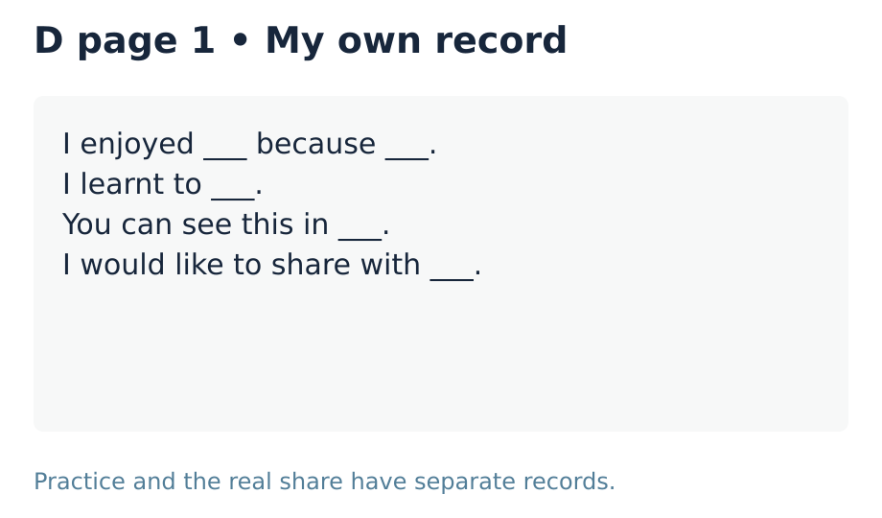
CREATIVE ARTS • BUILD / GROW • WEEK 7 LESSON 1
YOU DO • PART D
My evidence record
I enjoyed ___ because ___.
I learnt to ___.
You can see this in ___.
I would like to share with ___.
Keep my choices in D_Share.pdf on page 1.
Choose your own enjoyment and one thing you learnt.
In your book: Your checked choices at D page 1.
ART-BUILD-A2-W07-P1 • Public • 13/14
Original diagrams © Made by Matt 2026 • CC BY 4.0
Notes:
ART_BUILD_A2_W07_P1 • Public • You do • 0 minutes (route detail slides use the same task time).
Part D is a personal account of enjoyment and achievement chosen by looking back at A–C. Keep both elements, pupil authorship, the example/file/page and intended audience/mode on D page 1. It is preparation, not proof of the actual December share. Mark absent B or C evidence as a gap in the Evidence Index; do not invent it. The actual sharing record belongs at D page 3 when it happens.
Use one route, with Independent as the GROW default. Offer Supported when useful and Aspire as optional stretch. All pupil text uses the BUILD band. The routes change support and depth, not the part requirements. For five learners, use a pair and a trio, with a separate piece and record for each learner. In the trio, rotate maker, observer and materials roles; every learner retains their own choices. Offer private responses, silent directing and a pause. Do not cold call or seek personal or family disclosure. Scribe exact words or confirmed choices, read them back and allow correction. Do not compose pupils’ plans or reviews. Mark I, S or C beside the task in staff records and note the actual prompt. Give one specific success and one useful next step. Use VF / WS / I / NS+ / // / ? / R / E as appropriate. Record R only after Voice, Audience, an NS+ prompt and the pupil’s response in their own colour; capture alone is not closure. Upload the selected individual evidence to the evidence app on the same day.
Evidence: D_Share.pdf • page 1
Sources: CREATIVE_ARTS_A2_W06_BUNDLE.zip @ fd164cc6f64b784eb570bf3c0180aa6911ff7a0b10db87b03301f88201196f05; tools/artsaward/SPEC.json @ 72f1a9914f877b7aa14fd9ed91b6103799bf7b16; tools/artsaward/SLOTS.json @ 72f1a9914f877b7aa14fd9ed91b6103799bf7b16

Slide 14
CREATIVE ARTS • BUILD / GROW • WEEK 7 LESSON 1
EXIT • PART D • 3 MIN
What I learnt and what comes next
What did you enjoy, and why?
What did you learn to do? Show one example.
Who might you share with, and how?
Choose your own enjoyment and one thing you learnt.
In your book: Your enjoyment, learning and next step.
ART-BUILD-A2-W07-P1 • Public • 14/14
Original diagrams © Made by Matt 2026 • CC BY 4.0
Notes:
ART_BUILD_A2_W07_P1 • Public • Exit • 3 minutes (route detail slides use the same task time).
Own enjoyment and reason, linked to an actual activity.
Own achievement with a clear real example.
A feasible preferred audience and method. The owner confirms event arrangements; do not promise a booking.
Part D is a personal account of enjoyment and achievement chosen by looking back at A–C. Keep both elements, pupil authorship, the example/file/page and intended audience/mode on D page 1. It is preparation, not proof of the actual December share. Mark absent B or C evidence as a gap in the Evidence Index; do not invent it. The actual sharing record belongs at D page 3 when it happens.
Use one route, with Independent as the GROW default. Offer Supported when useful and Aspire as optional stretch. All pupil text uses the BUILD band. The routes change support and depth, not the part requirements. For five learners, use a pair and a trio, with a separate piece and record for each learner. In the trio, rotate maker, observer and materials roles; every learner retains their own choices. Offer private responses, silent directing and a pause. Do not cold call or seek personal or family disclosure. Scribe exact words or confirmed choices, read them back and allow correction. Do not compose pupils’ plans or reviews. Mark I, S or C beside the task in staff records and note the actual prompt. Give one specific success and one useful next step. Use VF / WS / I / NS+ / // / ? / R / E as appropriate. Record R only after Voice, Audience, an NS+ prompt and the pupil’s response in their own colour; capture alone is not closure. Upload the selected individual evidence to the evidence app on the same day.
Evidence: D_Share.pdf • page 1
Sources: CREATIVE_ARTS_A2_W06_BUNDLE.zip @ fd164cc6f64b784eb570bf3c0180aa6911ff7a0b10db87b03301f88201196f05; tools/artsaward/SPEC.json @ 72f1a9914f877b7aa14fd9ed91b6103799bf7b16; tools/artsaward/SLOTS.json @ 72f1a9914f877b7aa14fd9ed91b6103799bf7b16

